Slide 1
Data Storytelling & Statistical Validation
ApexPlanet Data Analytics Internship – Task 4
Objective: To transform analytical findings into meaningful business insights and validate them using statistical methods.
Presented by: G Akshitha

Slide 2
Business Objective
The objective of this project is to analyse the sales dataset and identify meaningful business insights. The analysis focuses on understanding sales performance, customer behaviour, product performance, and city-wise revenue to support better business decisions.
Goals
Analyze overall sales performance.
Identify the highest-selling product category.
Find the top-performing cities.
Understand customer purchasing patterns.
Validate findings using statistical testing.

Slide 3
Dataset Overview
Dataset Information
Source: Apex Planet Software Pvt. Ltd.
Records: 992 Sales Transactions
Categories: Electronics, Fashion, Grocery, Education & Furniture
Key Attributes
Order Details
Product & Category
Quantity & Total Sales
Customer Demographics (Age, Gender)
City
Data Preparation
Missing values and duplicates removed
Date format standardized
Dataset prepared for analysis

Slide 4
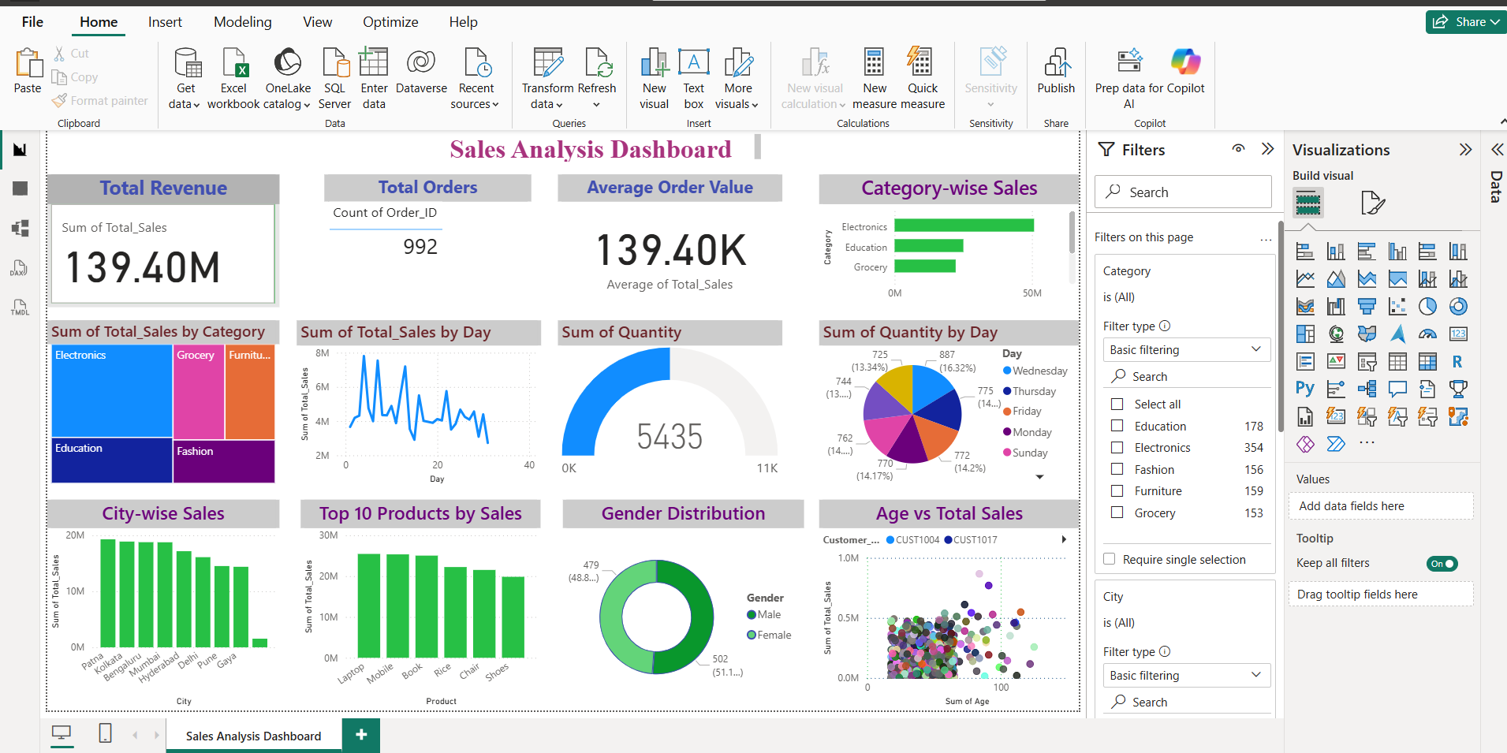
Dashboard Summary
Total Revenue: ₹139,399,439.65
Total Orders: 992
Average Order Value: ₹139,399.44
Top Category: Electronics
Top City: Patna

Slide 5
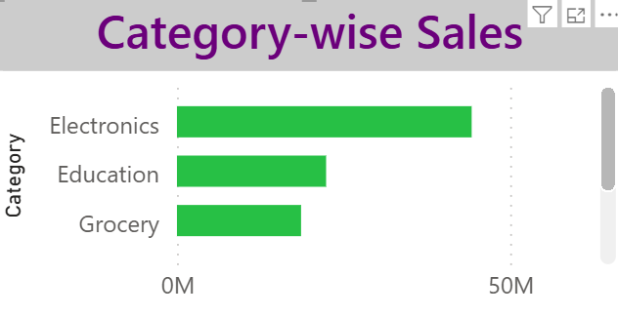
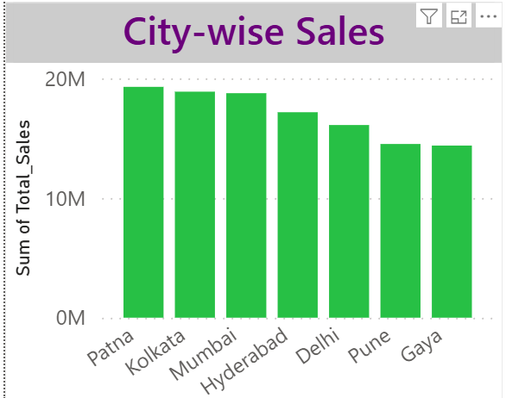
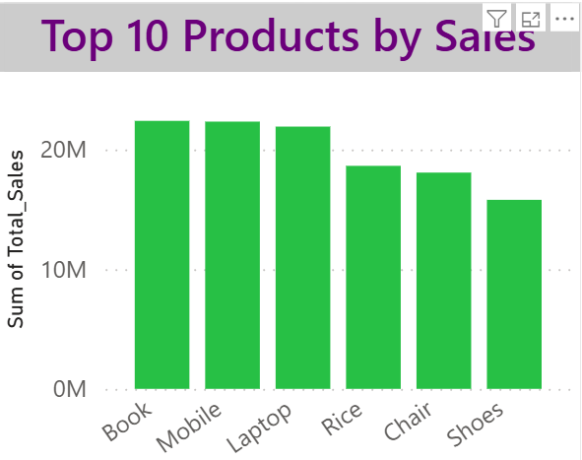
Key Business Insights
Key Findings
Electronics generated the highest revenue among all categories.
Patna recorded the highest sales revenue.
Fashion contributed the lowest revenue.
Sales are concentrated among a few high-performing products.
Revenue varies across different cities.

Slide 6
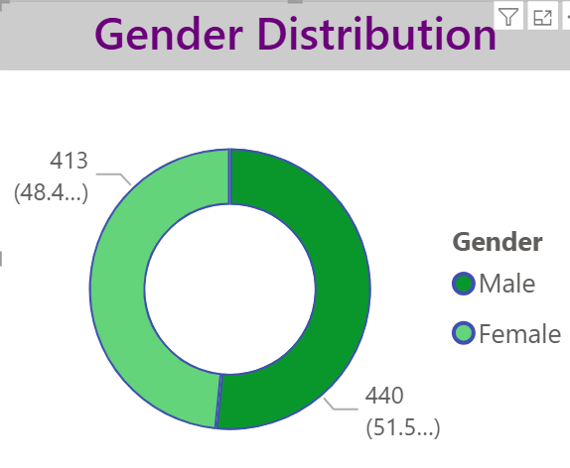
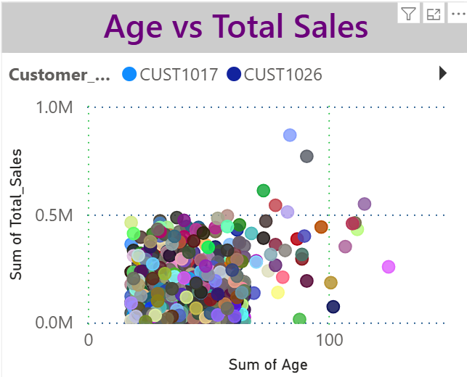
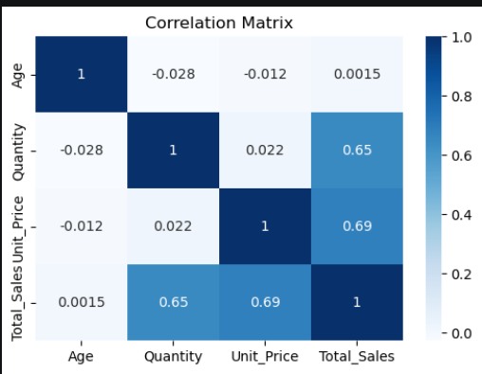
Customer Analysis
Observations
Sales are distributed across both male and female customers.
Customer age shows only a weak relationship with sales.
Quantity sold and Total Sales have a positive correlation.
Most purchasing behaviour is influenced by product demand rather than customer age.

Slide 7
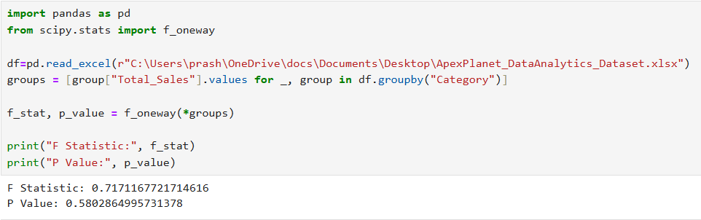
Hypothesis Testing
Null Hypothesis (H₀): There is no significant difference in average sales across product categories.
Alternative Hypothesis (H₁): There is a significant difference in average sales across product categories.
Test Used : One-Way ANOVA
Result
F Statistic: 0.7171
P Value: 0.5803

Slide 8
Conclusion
Summary
Successfully analysed the sales dataset using Python, SQL, and Power BI.
Identified key performance indicators (KPIs) and business trends.
Electronics emerged as the highest-performing product category.
Patna generated the highest revenue among all cities.
Statistical testing confirmed that category-wise sales differences are not statistically significant.
Business Impact
The insights obtained from this analysis can help businesses improve inventory planning, sales strategies, and decision-making through data-driven approaches.

