Slide 1

Predict Future Sales: A Time-Series Analysis
Welcome to our presentation on predicting future sales using time-series analysis. We'll explore how to leverage daily sales data to forecast future trends and make informed business decisions.
By
Akshitha Bavisetti , D Leena Reddy, Sanjna Allada, Bhuvanika Atla

Slide 2
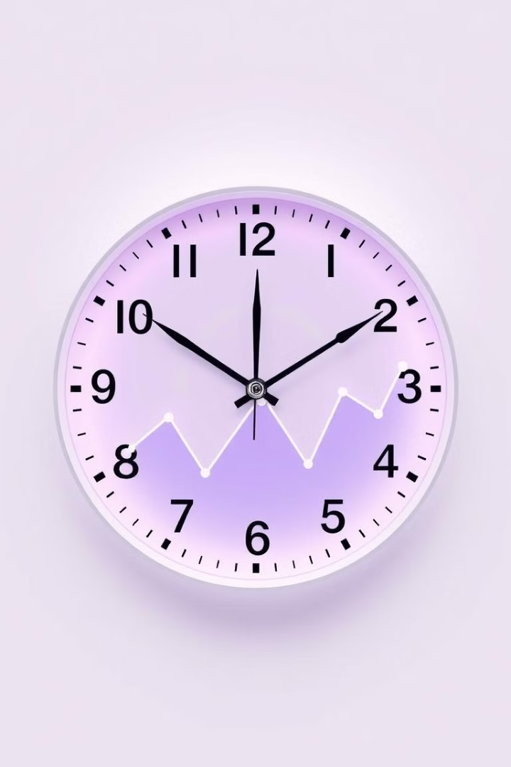
Introduction to Time-Series Forecasting
1
Time-Series Data
Daily sales records forming a chronological sequence
2
Forecasting Goals
Predict future sales based on historical patterns
3
Business Impact
Inform inventory, staffing, and strategic planning decisions
4
Challenges
Handling seasonality, trends, and irregular fluctuations

Slide 3

Exploratory Data Analysis
Data Cleaning
Remove outliers and handle missing values
Visualization
Plot time series data to identify patterns
Statistical Tests
Check for stationarity and autocorrelation
Decomposition
Separate trend, seasonality, and residual components

Slide 4

Feature Engineering for Time-Series Data
Time-Based Features
Lag Features
External Features
Day of week
Previous day's sales
Promotions
Month of year
Rolling averages
Economic indicators
Holidays
Seasonal lags
Competitor actions

Slide 5





Model Selection and Training
ARIMA
Prophet
LSTM
Random Forest
For stationary time series with clear trends
Handles multiple seasonalities and holiday effects
Deep learning for complex, non-linear patterns
Ensemble method for capturing non-linear relationships

Slide 6





Model Evaluation and Optimization
Cross-Validation
2
Select Metrics
1
Hyperparameter Tuning
3
5
Model Comparison
4
Ensemble Methods
Key metrics: RMSE, MAE, MAPE. Use time series cross-validation for robust evaluation.

Slide 7





Making Predictions and Forecasts
Input Data
Generate Forecast
Confidence Intervals
Visualize Results
Prepare latest sales data and features
Apply trained model to make predictions
Create clear, actionable reports
Calculate uncertainty in forecasts

Slide 8

Conclusion and Next Steps
Implement
Integrate forecasting model into business processes
Monitor
Continuously track model performance and adjust as needed
Expand
Apply similar techniques to other business forecasting needs
Innovate
Explore advanced techniques like deep learning for even better predictions

