Slide 1

CAPSTONE PROJECT SMART PROMPT OPTIMIZER
Presented by:
Student Name: Akshitha Darji
College Name: GITAM university
Department: CSE
Email: darjiakshitha@gmail.com
AICTE Student ID: STU681362e57e8e31746100965

Slide 2
OUTLINE
1. Problem Statement
2. Proposed System/Solution
3. System Development Approach
4. Algorithm & Deployment
5. Result (Output Image)
6. Conclusion
7. Future Scope
8. References

Slide 3
Problem Statement
Many users of generative AI struggle to obtain high-quality outputs due to poorly constructed prompts. As a result, the responses are often vague, generic, or misaligned with the intended task. This significantly limits the effectiveness of AI tools in practical applications such as content writing, resume generation, email drafting, and more—where clarity, tone, and relevance are crucial. Without proper prompting, the full potential of generative AI remains underutilized.

Slide 4
Proposed Solution
This project explores the practical application of Prompt Engineering techniques—specifically Role-based prompting, Contextual and Constraint-driven prompting, and Chain-of-Thought reasoning—to enhance the precision, clarity, and task alignment of outputs generated by large language models. Using ChatGPT as the testing environment, multiple prompt variations were crafted and evaluated for the same task (e.g., writing a product description). This comparison between unstructured and structured prompts demonstrates how effective prompt design can significantly improve the quality and relevance of AI-generated content.

Slide 5
System Approach
Technology Used: ChatGPT (powered by GPT-3.5)
Development Platform: No-code interface (ChatGPT web UI) for prompt-response testing
Process:
Select a real-world NLP task (e.g., writing a product description)
Create an unstructured prompt (weak example)
Create a structured prompt using prompt engineering techniques (role-based, contextual, and constraint-driven)
Use ChatGPT to test both prompts and generate outputs
Record and compare results based on clarity, relevance, and alignment with the task
Analyze improvements, extract insights, and document the impact of effective prompt design

Slide 6
Algorithm & Deployment
Algorithm Selection:
This project uses a pre-trained generative AI model (GPT-3.5) available via ChatGPT. No model training or custom ML pipeline was required.
Data Input:
The input is the user-provided text prompt. One is unstructured, and the other uses prompt engineering techniques (role-based + context + constraints).
Training Process:
The model (GPT) was pre-trained by OpenAI using large-scale datasets. No additional training was done in this project.
Prediction Process:
The model generates a product description based on the given prompt. The output is then evaluated by comparing clarity, engagement, and detail.

Slide 7
Prompt Engineering Techniques Used
Technique | Description
Role - based prompting | Assign the AI a persona or the role(eg. tech writer, career coach...)
Contextual Prompting | Adds specific background or situation information
Constraint-based prompting | Uses limits like words count, tone, or target audience
Chain-of-Thought (CoT | Guides AI throught reasoning or step-by-step ouptput

Slide 8
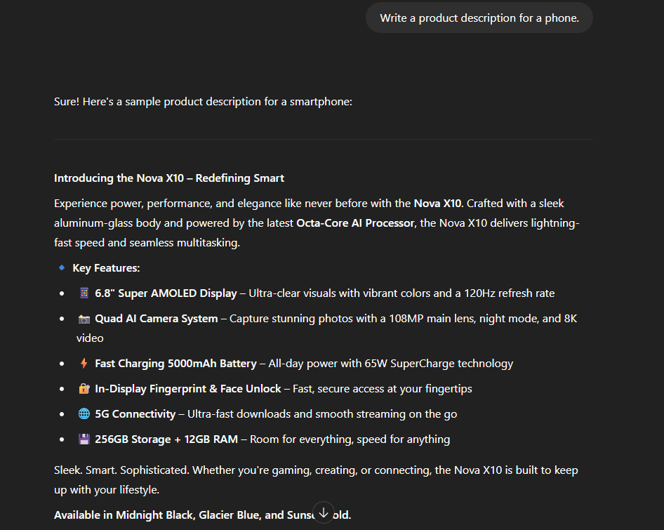
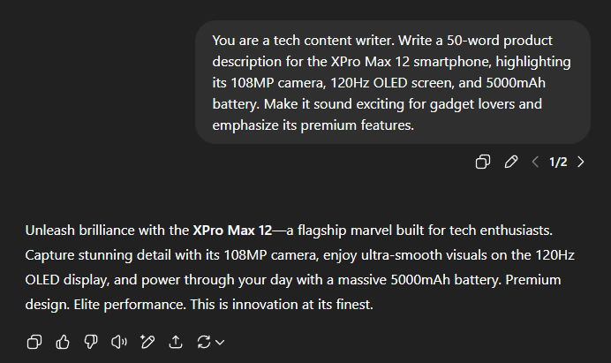
Result
Unstructured Prompt Output
Optimized Prompt Output

Slide 9
Evalutation Table
Prompt Type | Clarity | Detail | Tone | Overall Score
Unstructured Prompt | ⭐⭐ | ⭐ | ⭐ | 2.0/5
Optimized Prompt | ⭐⭐⭐⭐ | ⭐⭐⭐⭐ | ⭐⭐⭐⭐ | 4.5/5

Slide 10
How Prompt Engineering improves the AI Ouput
The results clearly demonstrate the impact of prompt quality on AI-generated content.
The unstructured prompt led to a vague, generic response that lacked specificity, tone, and user relevance. In contrast, the optimized prompt—crafted using prompt engineering techniques such as role assignment, contextual information, and constraints—produced a response that was more detailed, engaging, and aligned with the intended task.
This experiment highlights how well-designed prompts can guide generative AI models like ChatGPT to deliver significantly better results, especially in NLP tasks such as content writing and product descriptions.

Slide 11
Conclusion
The results demonstrate that structured prompts—incorporating role, context, and constraints—lead to significantly more relevant and effective AI responses. Prompt engineering proves to be a simple yet powerful technique to enhance the performance of generative AI systems, particularly in NLP tasks such as content creation, resume writing, and product descriptions.

Slide 12
Future scope
This project can be expanded into an intelligent prompt recommender tool, helping users craft optimized prompts in real time.
It could be adapted to support a variety of domains such as education, marketing, and job applications.
The solution may be further developed as a browser extension or plugin integrated with platforms like ChatGPT, Copilot, or Bing AI.
Future enhancements could include multilingual support, voice-based prompt input, and dynamic prompt feedback for improved user interaction.

Slide 13
References
Brown, T. et al. (2020). Language Models are Few-Shot Learners. OpenAI’s GPT-3 research paper introducing generative pre-trained transformers. https://arxiv.org/abs/2005.14165
OpenAI – GPT-4 Technical Report Describes GPT-4’s capabilities and limitations. https://openai.com/research/gpt-4
Zamfirescu-Pereira, M. (2023). Prompt Engineering Guide Practical techniques and patterns for writing effective prompts for LLMs. https://www.promptingguide.ai/
OpenAI Platform Documentation API reference and usage guidelines for GPT-based models. https://platform.openai.com/docs
Azure OpenAI Documentation How to use OpenAI models through Azure’s hosted interface. https://learn.microsoft.com/en-us/azure/cognitive-services/openai/overview
ChatGPT (OpenAI) Tool used to perform prompt testing and evaluation. https://chat.openai.com

Slide 14
Thank you

