Slide 1
ConnectIn
Bridging careers and culture in one app
TEAM MEMBERS: PROJECT WORK SUPERVISOR
M. Akshitha Devi(20021A0524) Dr . A . Krishna Mohan
P. Rupa Anusha(20021A0552) Professor Of CSE & Director of
G. Venkata Naga Sandeep(20021A0539) School Of Management Studies
M. Yaswanth(20021A0540)

Slide 2
Table of Contents :
Problem Statement
Abstract
Existing System
Proposed System
Workflow
List of Modules/Technologies
System Requirements
Results
Conclusion
References

Slide 3
Problem Statement:
Create a React Native app for UCEK students, enabling job alerts, career resources, and seamless job applications with updates on college activities. Challenges include user engagement, data security, scalability, and personalized content delivery.
Objective: Develop a user-centric platform empowering students in their career paths, effectively addressing these challenges.

Slide 4
ABSTRACT
ConnectIn – Bridging careers and cultures in one app.
This project aims to develop a React Native mobile application for University College of Engineering, Kakinada (UCEK) students, offering job alerts, career resources, and seamless job applications, alongside updates on college activities.
Acknowledging the challenges inherent in such a venture, including user engagement, data security, scalability, and personalized content delivery, this project adopts a strategic approach.
Ultimately, the aim is to empower students in their career paths by providing them with a robust and intuitive toolset..

Slide 5
Existing System
Prior to the introduction of ConnectIn, University College of Engineering, Kakinada (UCEK) students lacked a centralized platform that effectively addressed their needs for staying updated on college activities, accessing job opportunities, and building professional resumes.

Slide 6
Proposed System
The proposed system, ConnectIn, is a centralized platform designed to address the challenges faced by UCEK students in managing their career development effectively.
It offers robust job search capabilities, including personalized recommendations, a resume builder, and profile sharing options.
With a user-friendly interface and emphasis on security and privacy, ConnectIn aims to empower students to navigate their career paths confidently and achieve their professional goals.

Slide 7
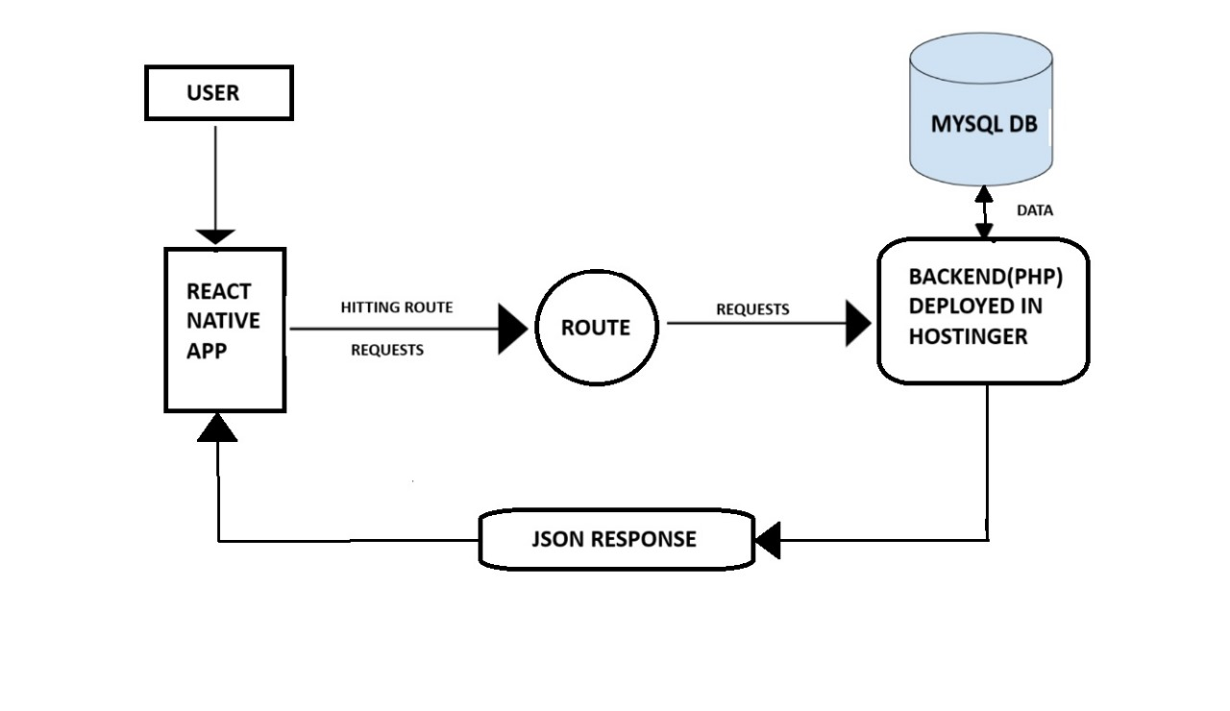
Workflow of ConnectIn

Slide 8
MODULES PRESENT IN PROPOSED SYSTEM
In the proposed system, several modules are proposed to create a comprehensive and efficient application. Here are the key modules used in the proposed system:
User Authentication Module:
This module manages user authentication, ensuring secure access to the application. It leverages Firebase for robust authentication protocols.
User Profile Module:
The User Profile module manages and displays user information. It allows students to update their profiles, ensuring that their user details and skills can be shared via link or Qrcode.
Job Information Module:
The Job Information module is responsible for sourcing and presenting real-time job catalogue. It facilitates the seamless integration of job listings, ensuring that students are promptly informed about upcoming opportunities.

Slide 9
COCE Event Updates Module:
This module focuses on delivering updates related to COCE events, workshops, and activities. It keeps students engaged with the academic community and provides information about upcoming events.
Notification Module:
This module handles the delivery of notifications to users. Whether it's job updates, COCE events, or application-related alerts, the Notification module ensures timely and relevant communication.
Resume Generator Module:
The Resume Generator module enables users to create professional resumes within the app. It incorporates features for formatting, content creation, and customization to streamline the job application process.
Resume Score Calculator Module:
As an additional feature, the Resume Score Calculator module evaluates resumes based on predefined criteria, providing users with instant feedback and actionable insights for improvement.
Resources Module:
This module consolidates comprehensive resources for career development. It offers valuable information, guides, and tools to assist students in making informed decisions about their academic and professional paths.

Slide 10
REQUIREMENTS
Hardware requirements:
Smartphones
Personal Computer
Software Requirements:
Operating System(iOS, Android, Windows, macOS, Linux)
Integrated development environment(Visual Studio Code, Xcode, Android Studio)
Programming Language:
Front – end : React Native, Expo (for accelerated development)
Back – end : PHP
Database : MySQL

Slide 11
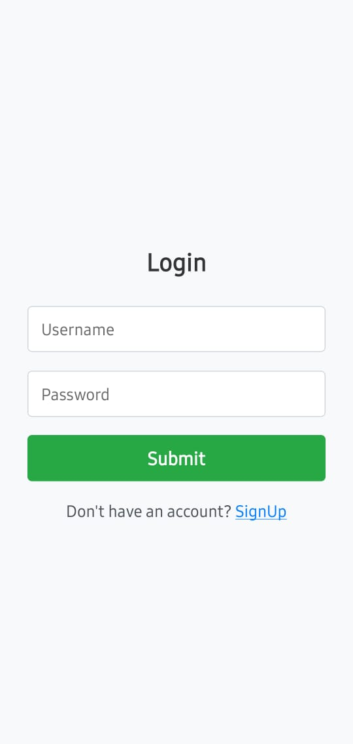
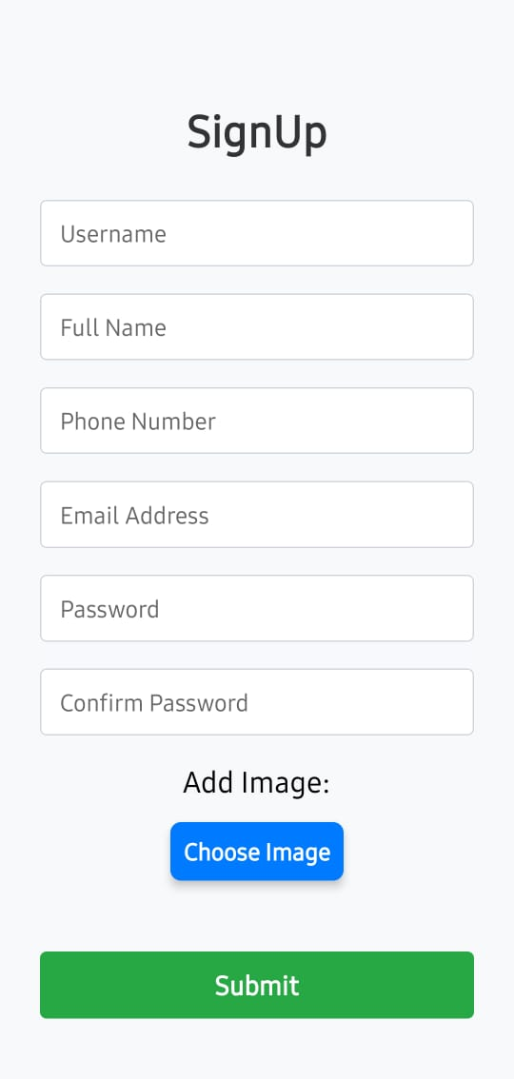
Results :

Slide 12
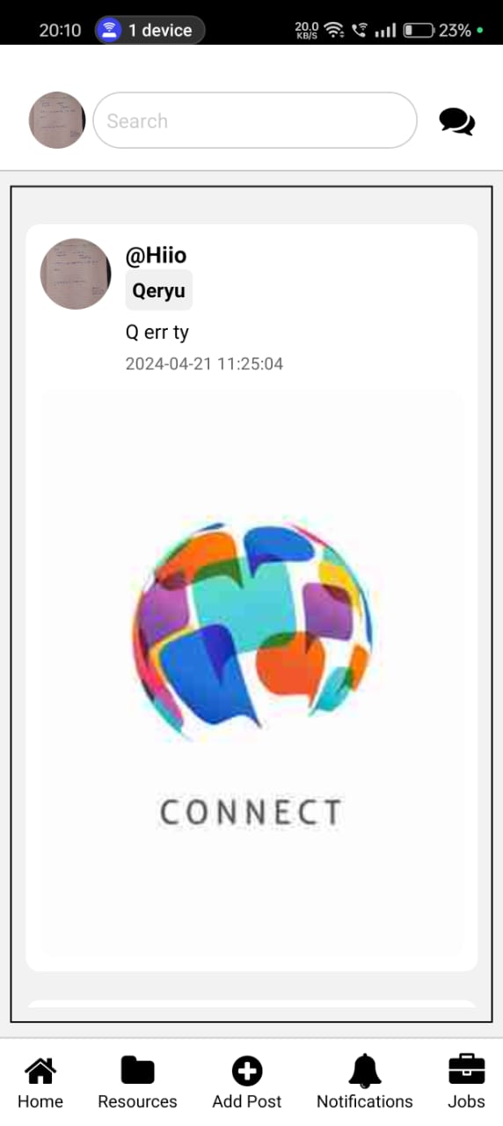
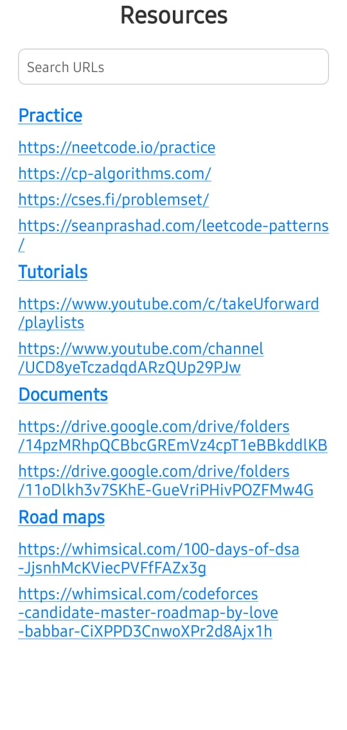
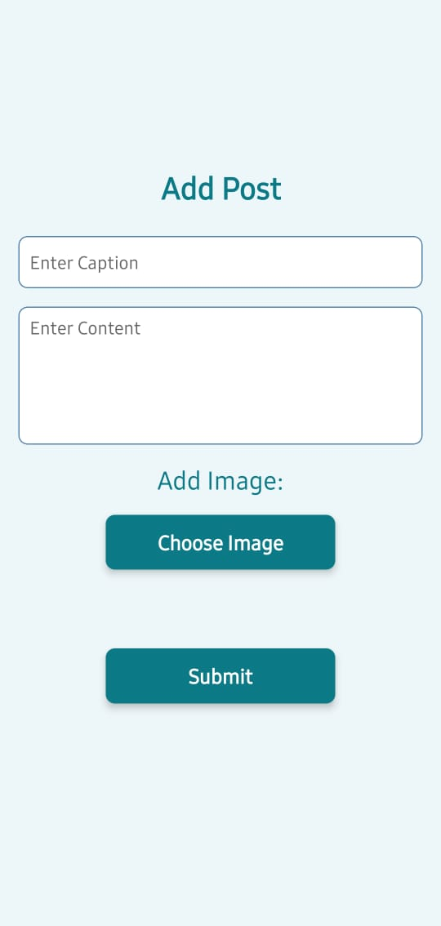

Slide 13
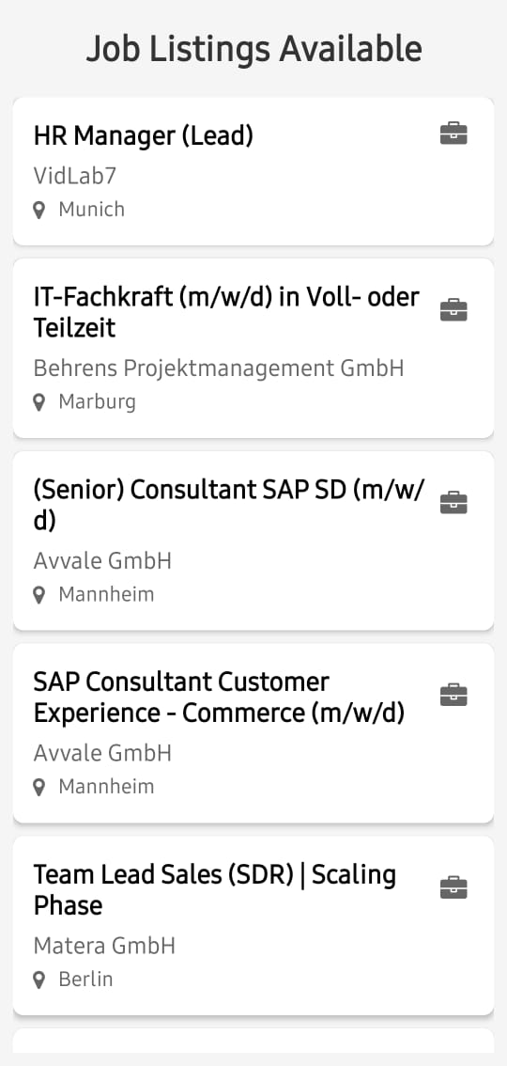
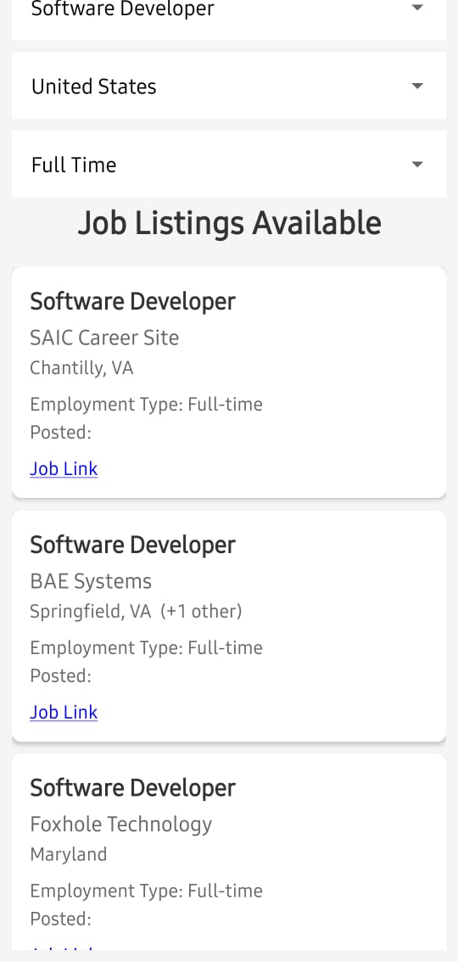
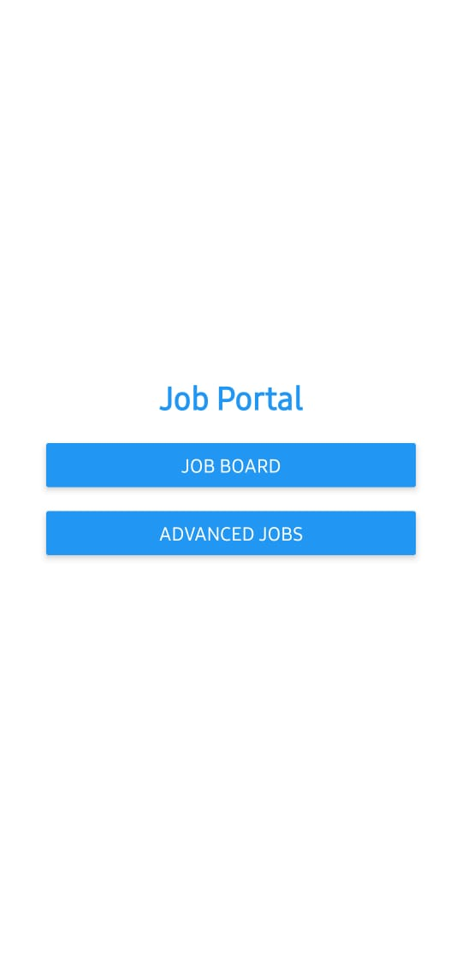

Slide 14
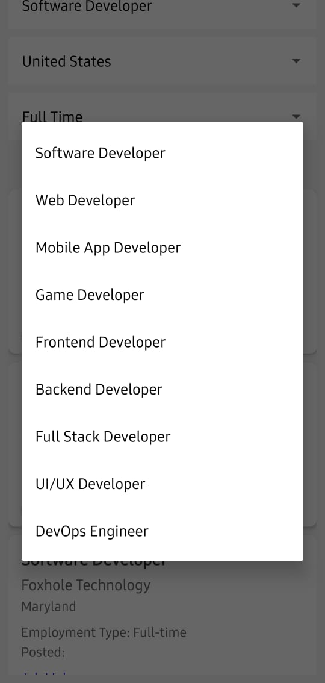
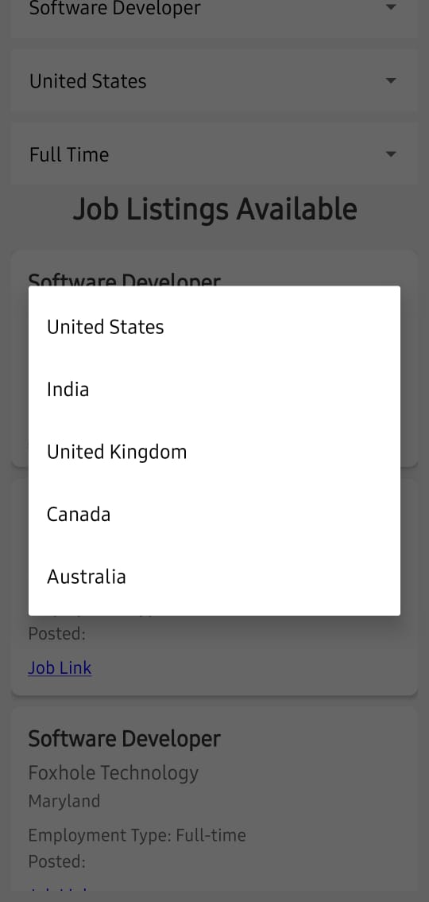
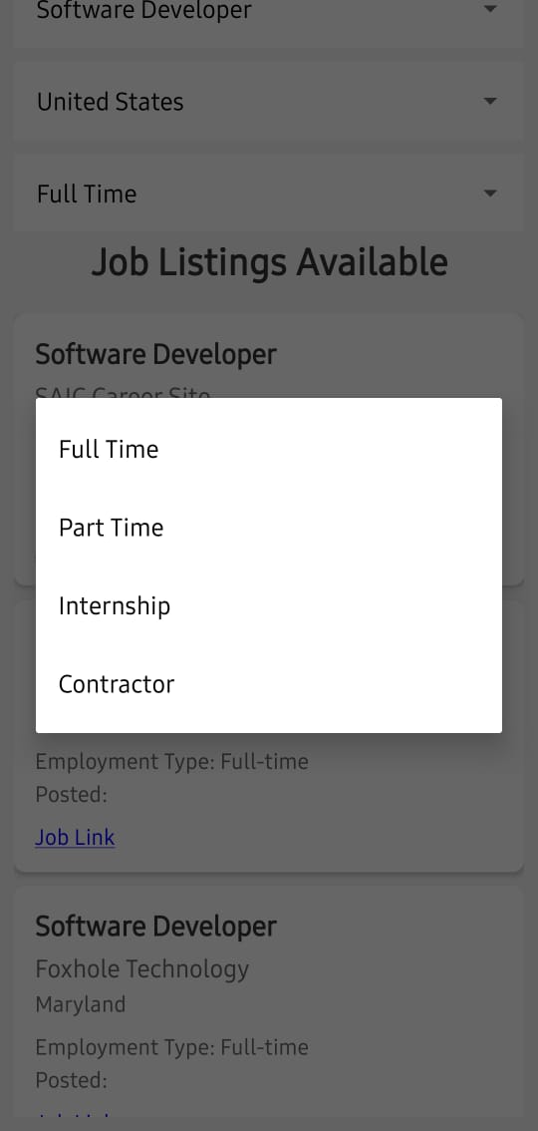

Slide 15
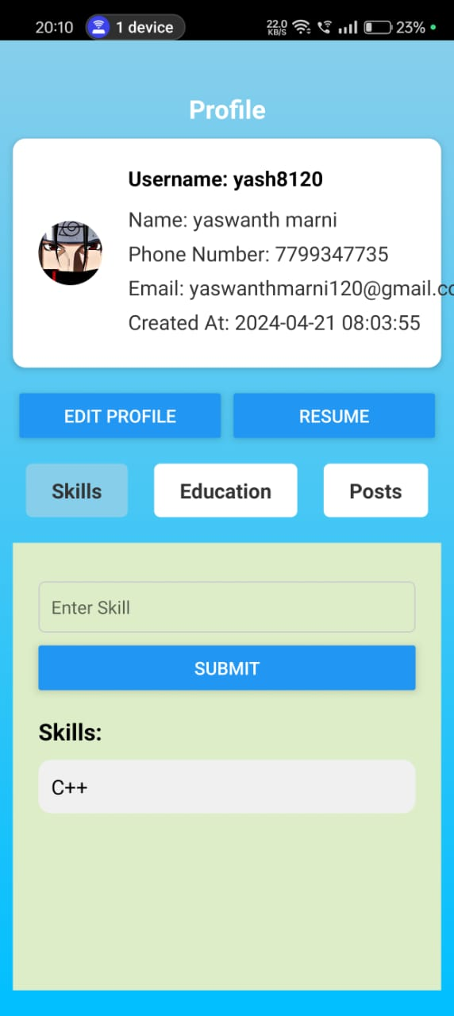
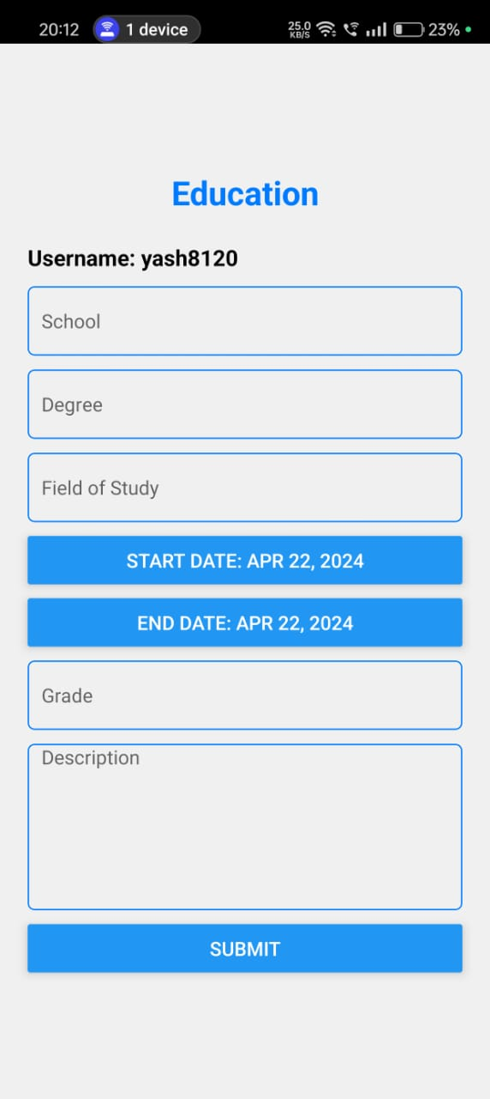
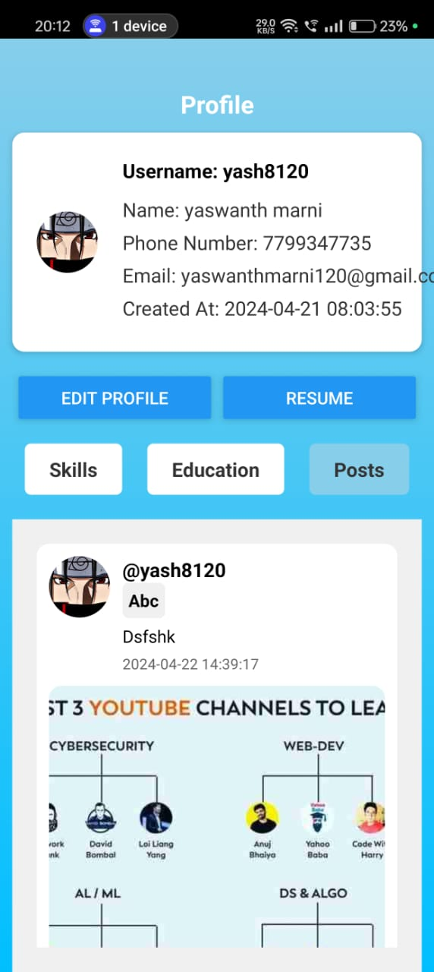

Slide 16
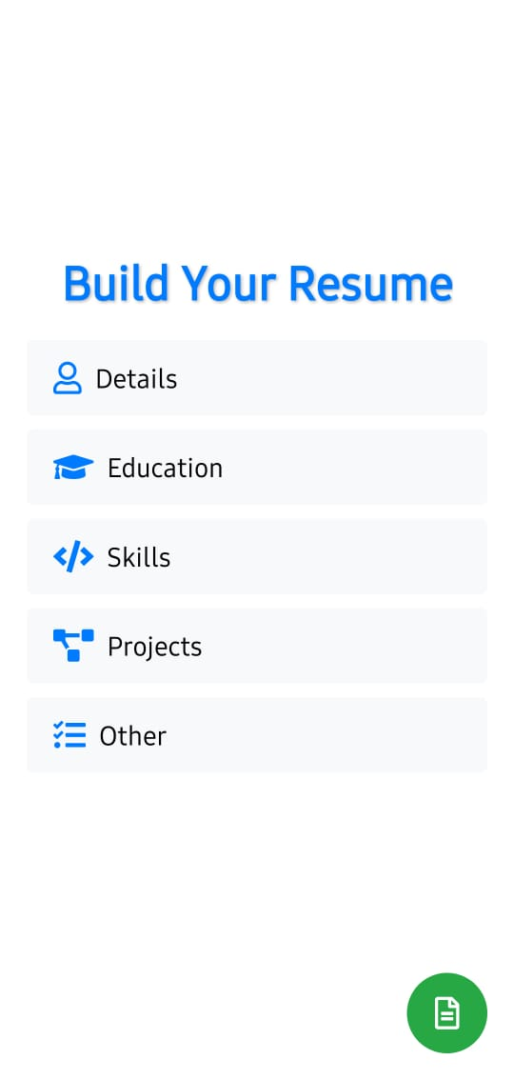
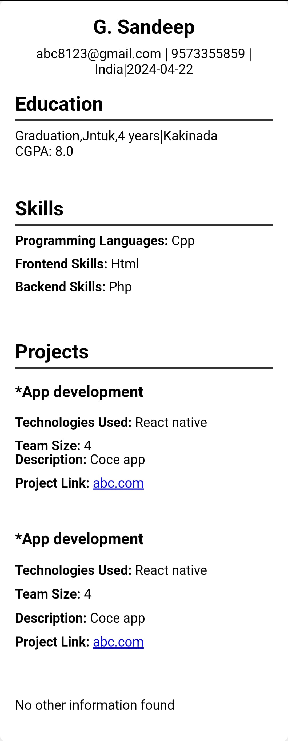

Slide 17
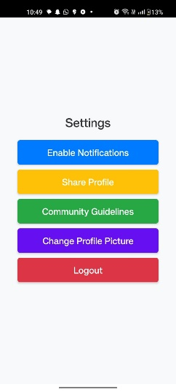
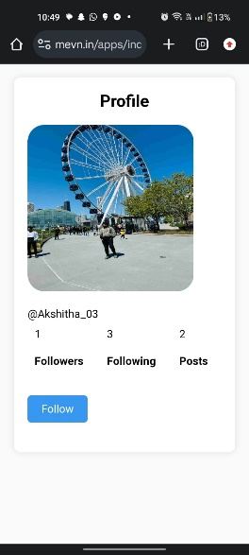
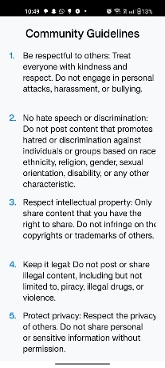

Slide 18
Conclusion
In conclusion, our project has successfully devised, implemented, and evaluated a robust and scalable system architecture for our mobile application.
Leveraging cutting-edge technologies like React Native for the front end, PHP for the back end, and MySQL for database management, we've ensured high performance, responsiveness, and data integrity.
Through thorough testing and evaluation, we've made sure it's reliable and efficient.
Overall, our goal is to provide a user-friendly and reliable app that meets the needs of our users now and in the future

Slide 19
References :
React Native for Front-End Development:
React Native Documentation: https://reactnative.dev/docs/getting-started
React Native Tutorial: https://www.tutorialspoint.com/react_native/index.htm/
PHP for Back-End Development:
PHP Documentation: https://www.php.net/manual/en/
PHP Tutorial: https://www.w3schools.com/php/
MySQL for Database Management:
MySQL Documentation: https://dev.mysql.com/doc/
MySQL Tutorial: https://www.mysqltutorial.org/
Hostinger for Server Deployment:
Hostinger Documentation: https://www.hostinger.com/tutorials/
Hostinger Support: https://www.hostinger.com/tutorials/

Slide 20
THANK YOU

