Slide 1
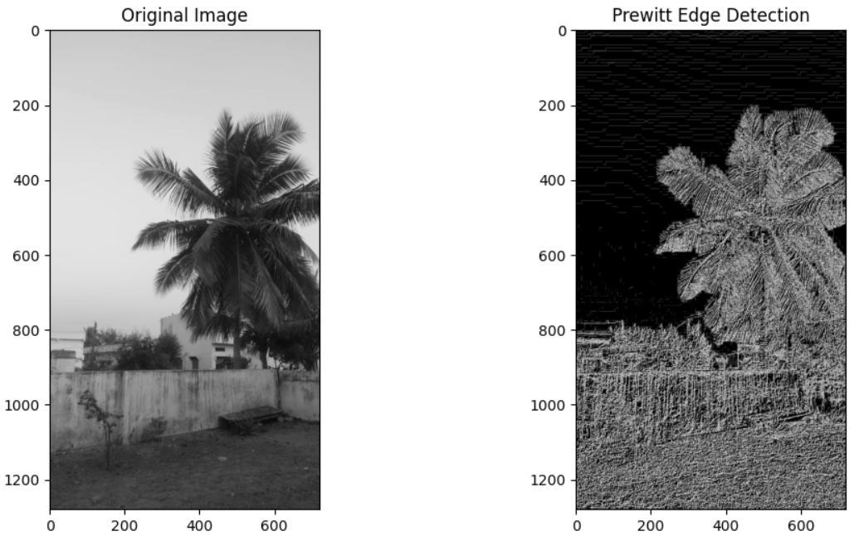
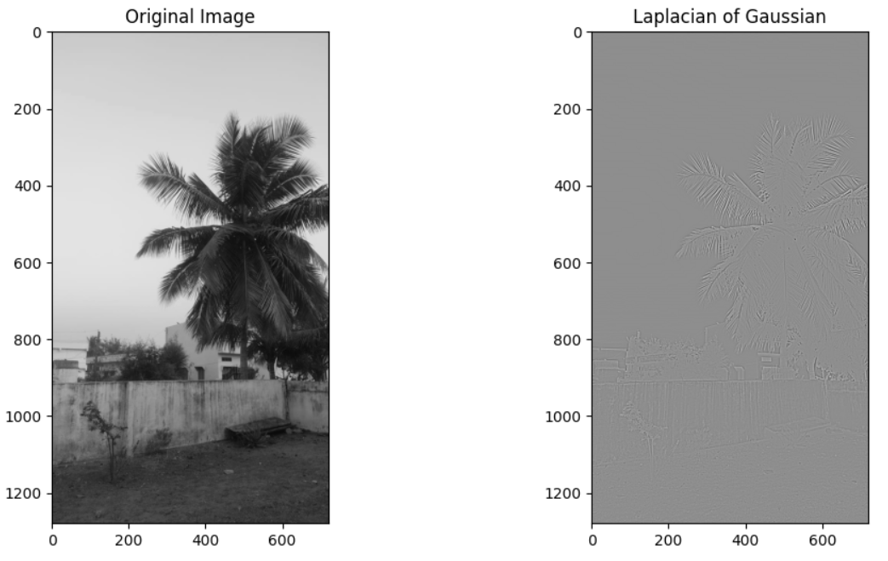
CV ASSIGNMENT 1 Faculty : Dr Tilottama Goswami
Section : A
Group Number : 1
Roll Numbers : 1602-20-737-004, 022
Names : Akshitha Nampally, Lithin Sairam Jinukala
Image Processing Task : Edge Detection
Algorithms Used : Prewitt, Laplacian of Gaussian
Input and Output Images :

