Slide 1

Music Store DataAnalysis
Presented by-
Akshitha Yasala
Batch No. 493

Slide 2

AGENDA
Business Problem
Problem Statement
DataBase Schema & Entity Relationship Diagram
Data Exploration & SQL Techniques
Business Questions & Analysis
Key Insights & Findings
Conclusion & Business Recommendations

Slide 3
Business Problem
The Music Store operates across multiple countries and serves a diverse customer base with varying music preferences. However, the business lacks clear insights into customer purchasing behavior, top-performing artists, popular music genres, and key revenue-generating markets. Without these insights, management faces challenges in designing effective marketing campaigns, improving customer retention, and maximizing sales opportunities. Therefore, the company requires a data-driven analysis to uncover actionable insights and support strategic business decision-making.

Slide 4
Problem Statement
The Music Store generates large volumes of sales and customer transaction data, but the business lacks a systematic approach to analyze this information and derive meaningful insights. There is a need to identify high-value customers, top-performing artists, popular music genres, and revenue-driving markets to better understand customer preferences and purchasing behavior. By leveraging SQL-based data analysis, the organization aims to transform raw transactional data into actionable insights that support targeted marketing, customer retention, and revenue growth strategies.

Slide 5
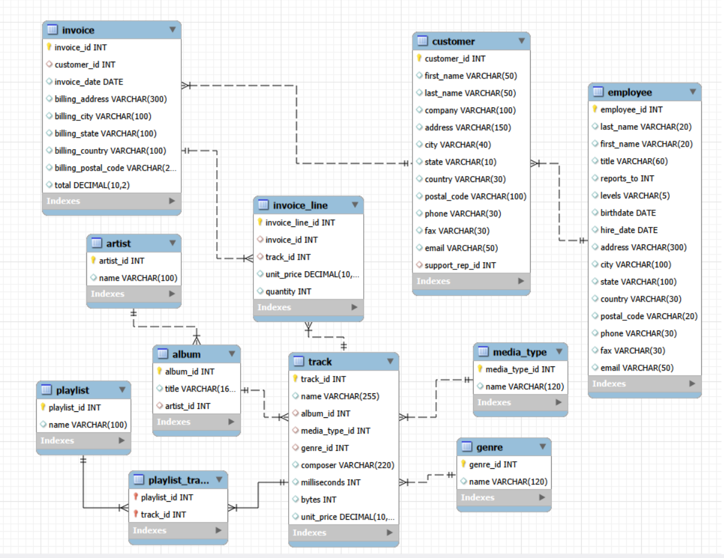
Database Schema & ER Diagram

Slide 6
Data Exploration & SQL Techniques
Data Exploration and Data Validation
SQL Joins for Multi-Table Analysis
Aggregate Functions (SUM, COUNT, AVG)
Subqueries and CTEs
Window Functions (RANK, DENSE_RANK)
Grouping, Filtering, and Sorting for Business Insights

Slide 7
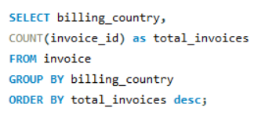
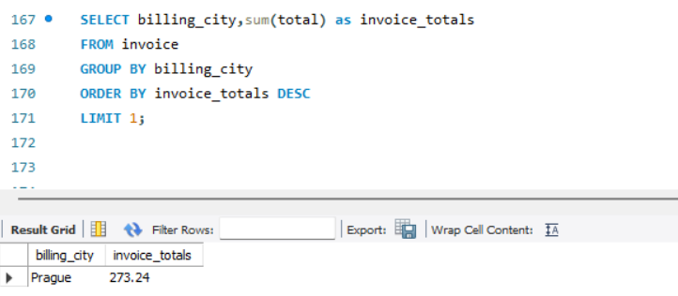
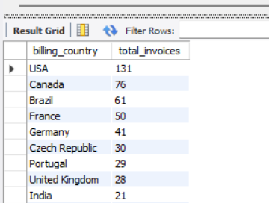
Business Questions and Analysis
Which city has the best customers? We would like to throw a promotional Music Festival in the city we made the most money. Write a query that returns one city that has the highest sum of invoice totals. Return both the city name & sum of all invoice totals
Which countries have the most Invoices?

Slide 8
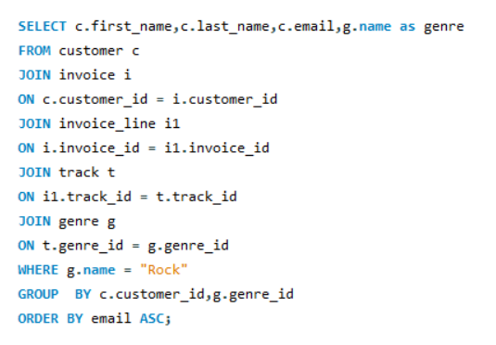
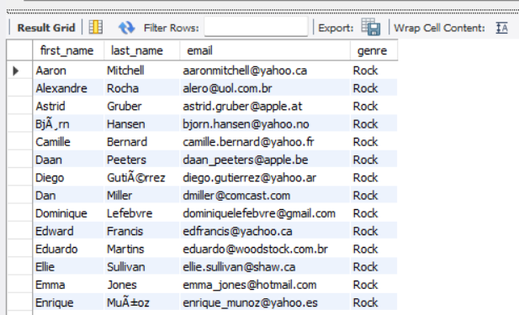
Write a query to return the email, first name, last name, & Genre of all Rock Music listeners. Return your list ordered alphabetically by email starting with A

Slide 9
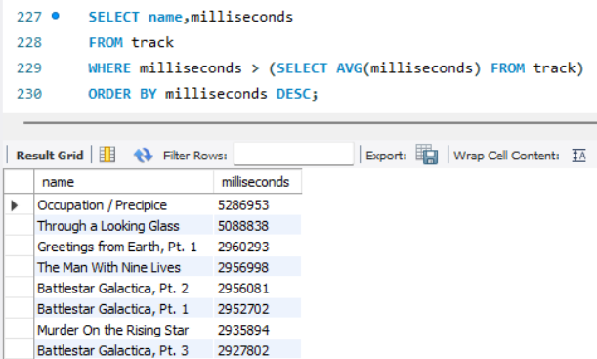
Return all the track names that have a song length longer than the average song length.Return the Name and Milliseconds for each track. Order by the song length, with the longest songs listed first

Slide 10
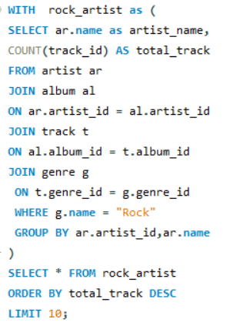
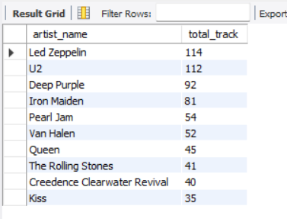
Let's invite the artists who have written the most rock music in our dataset. Write a query that returns the Artist name and total track count of the top 10 rock bands

Slide 11
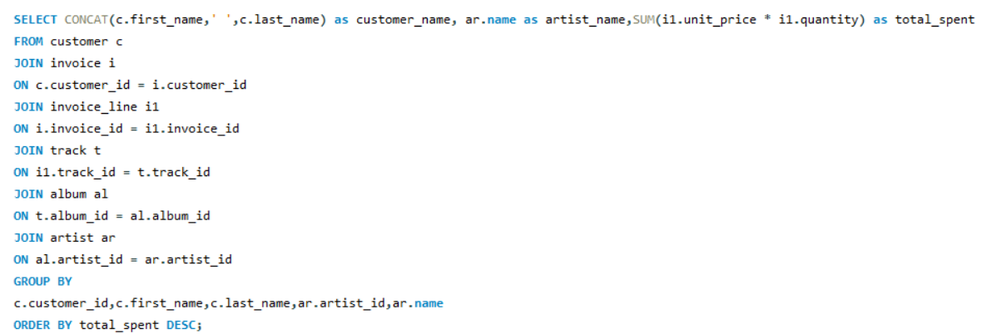
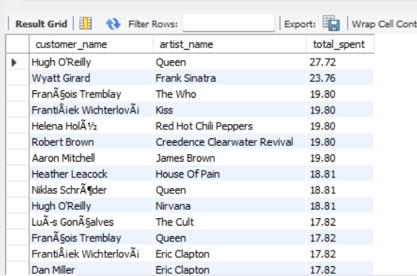
Find how much amount is spent by each customer on artists? Write a query to return customer name, artist name and total spent

Slide 12
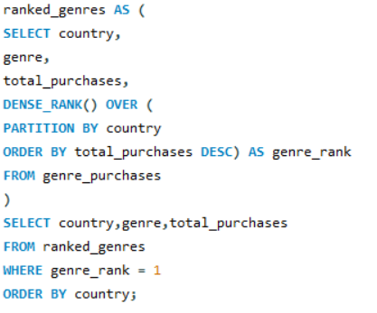
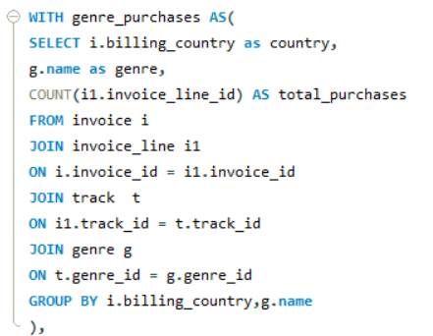
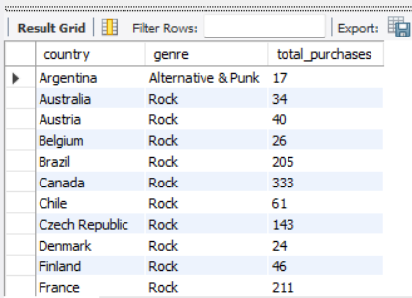
We want to find out the most popular music Genre for each country. We determine the most popular genre as the genre with the highest amount of purchases. Write a query that returns each country along with the top Genre. For countries where the maximum number of purchases is shared, return all Genres

Slide 13
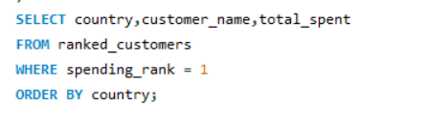
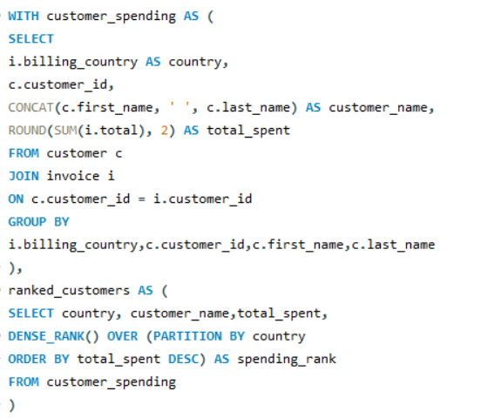
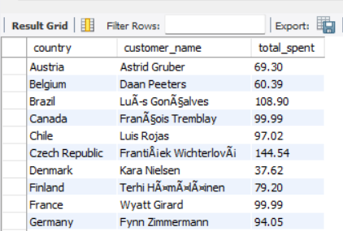
Write a query that determines the customer that has spent the most on music for each country. Write a query that returns the country along with the top customer and how much they spent. For countries where the top amount spent is shared, provide all customers who spent this amount

Slide 14
Key Insights & Findings
Identified the highest-spending customers, enabling the business to target premium customers with personalized offers and loyalty programs.
Determined the top-performing music genres across different countries, revealing regional music preferences and market trends.
Analyzed sales data to identify the cities and countries generating the highest revenue, helping prioritize future marketing and promotional activities.
Discovered the most popular artists and rock bands based on track purchases, providing insights for artist collaborations and promotional campaigns.
Found significant variations in customer spending behavior across markets, highlighting opportunities for targeted customer engagement strategies.
Identified tracks and albums contributing the most to sales, enabling the business to optimize recommendations and improve revenue generation

Slide 15
Business Recommendations
Identified key revenue drivers, customer segments, and music preferences.
Focus on retaining high-value customers through targeted promotions.
Promote top genres and artists to maximize sales.
Prioritize high-performing markets while expanding growth opportunities.
Use data-driven insights to improve profitability and business growth.

Slide 16
Conclusion
Identified key customer spending and purchasing patterns.
Analyzed top-performing artists, genres, and tracks.
Determined the highest revenue-generating cities and countries.
Uncovered valuable insights to support marketing and sales strategies.
Enabled data-driven decision-making for business growth and profitability.

Slide 17


Slide 18


