Slide 1

PROJECT PRESENTATION
Student Performance & Dropout-Risk
Prediction System
Data Engineering and MLOps | Individual Project (Part 2: MLOps Integration)
Student Name : Akshitha
USN :
______________________
CMR Institute of Technology, Bengaluru

Slide 2
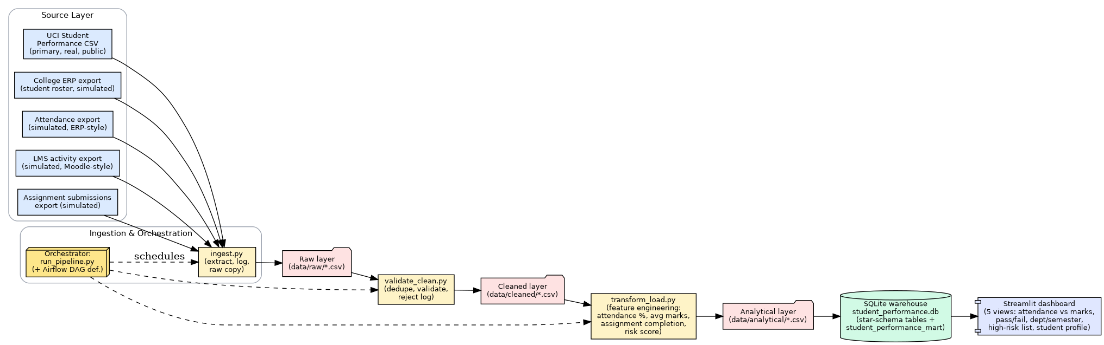
CMR INSTITUTE OF TECHNOLOGY | DATA ENGINEERING AND MLOps
PROJECT PRESENTATION
1. Recap: Part 1 Data Pipeline
Done in Part 1: 5 sources, ingest, validate/clean, SQLite star schema, dashboard (1,034 records, 35 rejected, 15 flagged). Part 2 builds on that pipeline.
Orchestration: Airflow DAG, now run in Docker (6 tasks, all green).
Student Name: Akshitha | USN: ______________
CMRIT 2

Slide 3
CMR INSTITUTE OF TECHNOLOGY | DATA ENGINEERING AND MLOps
PROJECT PRESENTATION
2. Problem & Prediction Target
What we predict
Which students are on course to fail a subject, at mid-semester, early enough for a mentor to step in.
Target: at_risk = 1 if the final score G3 is below 10 (the dataset's own pass mark). About 22% of students are positive.
The data has no real 'dropped out' column, so this is a proxy for dropout risk. I say that on the slides and in the report.
When the prediction is made
After the second assessment (G2), before the final result (G3). Only things known at that point are allowed as inputs.
Part 1's risk_score is built from the final score, so using it would leak the answer. It is not a feature.
Student Name: Akshitha | USN: ______________
CMRIT 3

Slide 4
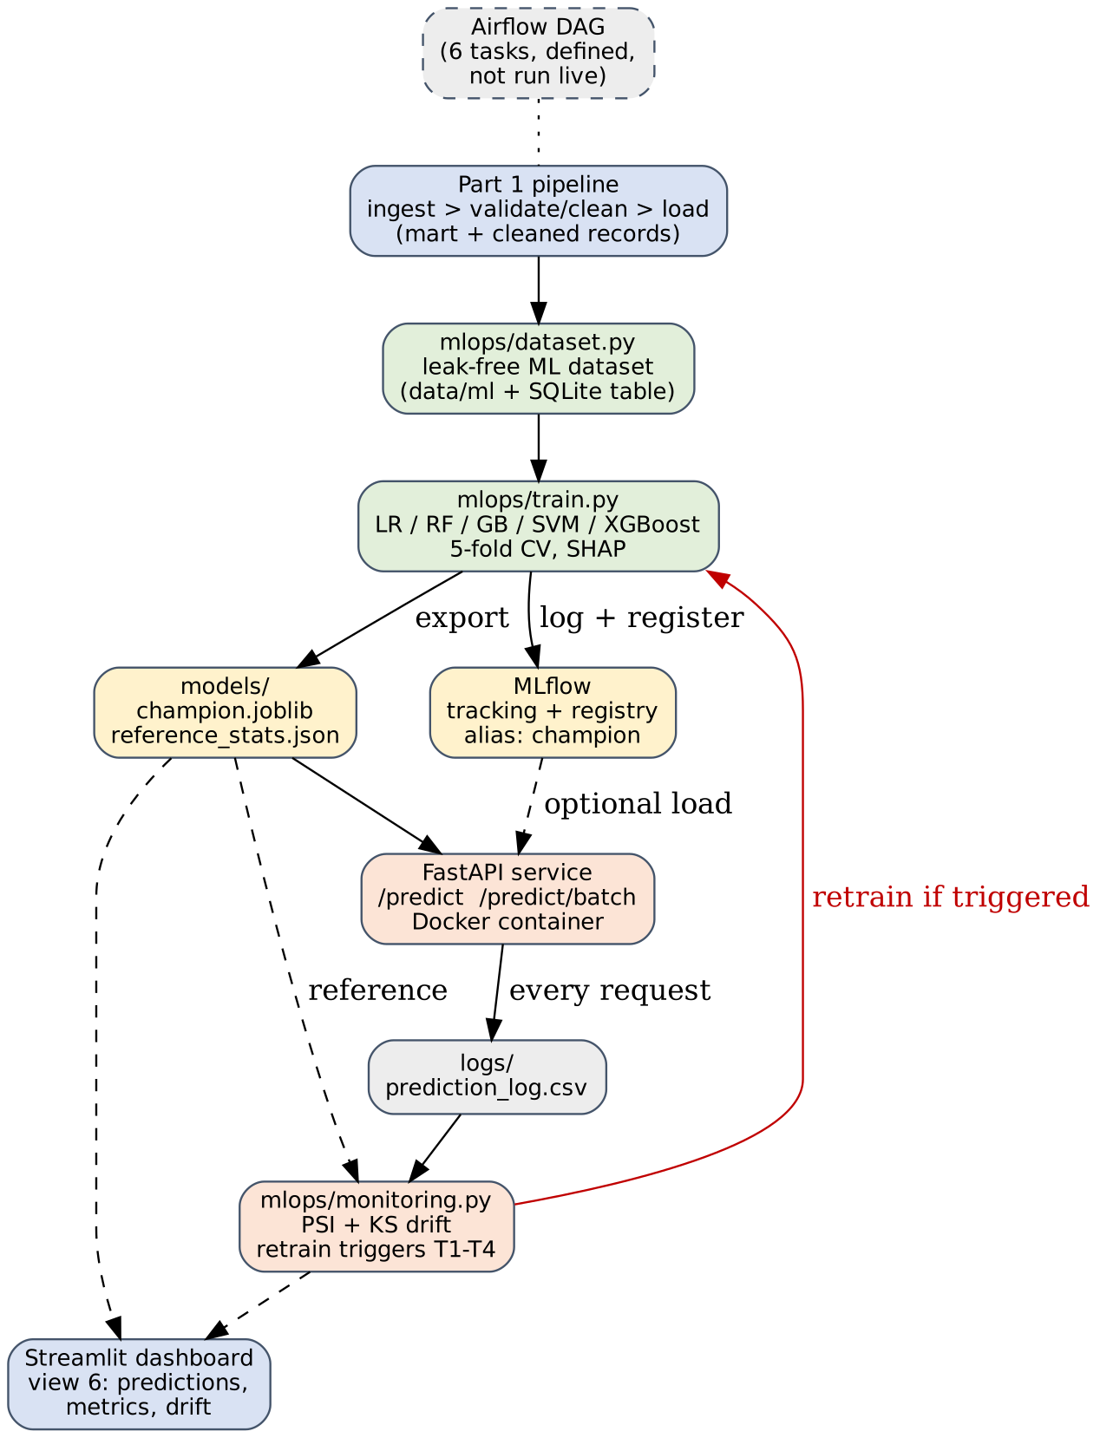
CMR INSTITUTE OF TECHNOLOGY | DATA ENGINEERING AND MLOps
PROJECT PRESENTATION
3. Part 2 Architecture
Part 1 pipeline feeds a leak-free ML dataset.
Training logs every run to MLflow and registers the winner as 'champion'.
A FastAPI service serves the champion and logs each prediction.
The monitor compares those logs with the training data (PSI, KS) and says when to retrain.
Everything hangs off the same Airflow DAG and dashboard as Part 1.
Student Name: Akshitha | USN: ______________
CMRIT 4

Slide 5
CMR INSTITUTE OF TECHNOLOGY | DATA ENGINEERING AND MLOps
PROJECT PRESENTATION
4. Features & Leakage Control
Group | What's in it | Count
Multi-source (Part 1 mart) | attendance, internal marks, G2 score, assignment completion, LMS engagement | 5
Academic record (real UCI) | study time, failures, absences, going out, alcohol, health, family, age, ... | 13
Yes/No fields | internet, wants higher ed, extra support, paid classes, romantic, is_male, is_math, ... | 9
Availability flags (Part 1) | was attendance / LMS / assignment data present? | 3
Left out on purpose
G3, current_score, pass_flag: they are the answer. risk_score / risk_category: computed from G3.
department, semester: assigned randomly in Part 1, so they carry no real signal.
A test checks none of these can slip into the feature list. Missing values at serving time get the training median plus the flag set to 0.
Student Name: Akshitha | USN: ______________
CMRIT 5

Slide 6
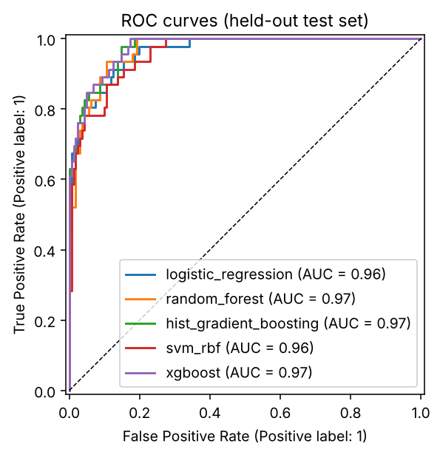
CMR INSTITUTE OF TECHNOLOGY | DATA ENGINEERING AND MLOps
PROJECT PRESENTATION
5. Models & Evaluation
Model | CV ROC-AUC | Test ROC-AUC | Test PR-AUC | Recall | Precision
Logistic Regression | 0.969 | 0.964 | 0.907 | 0.91 | 0.66
Random Forest (champion) | 0.971 | 0.968 | 0.903 | 0.89 | 0.71
Gradient Boosting | 0.959 | 0.972 | 0.923 | 0.87 | 0.68
SVM (RBF) | 0.954 | 0.957 | 0.881 | 0.78 | 0.80
XGBoost | 0.963 | 0.974 | 0.927 | 0.89 | 0.71
Rule: G2 below 10 | - | 0.971 | 0.894 | 1.00 | 0.53
Majority class | - | 0.500 | 0.222 | 0.00 | 0.00
80/20 stratified split, 5-fold CV on the train part. Winner picked by CV only, test scored once.
At threshold 0.64: caught 38 of 46 at-risk students, 11 false alarms (recall 0.83, precision 0.78).
Recall/precision in the table use the default 0.5 threshold.
ROC curves, held-out test set
Student Name: Akshitha | USN: ______________
CMRIT 6

Slide 7
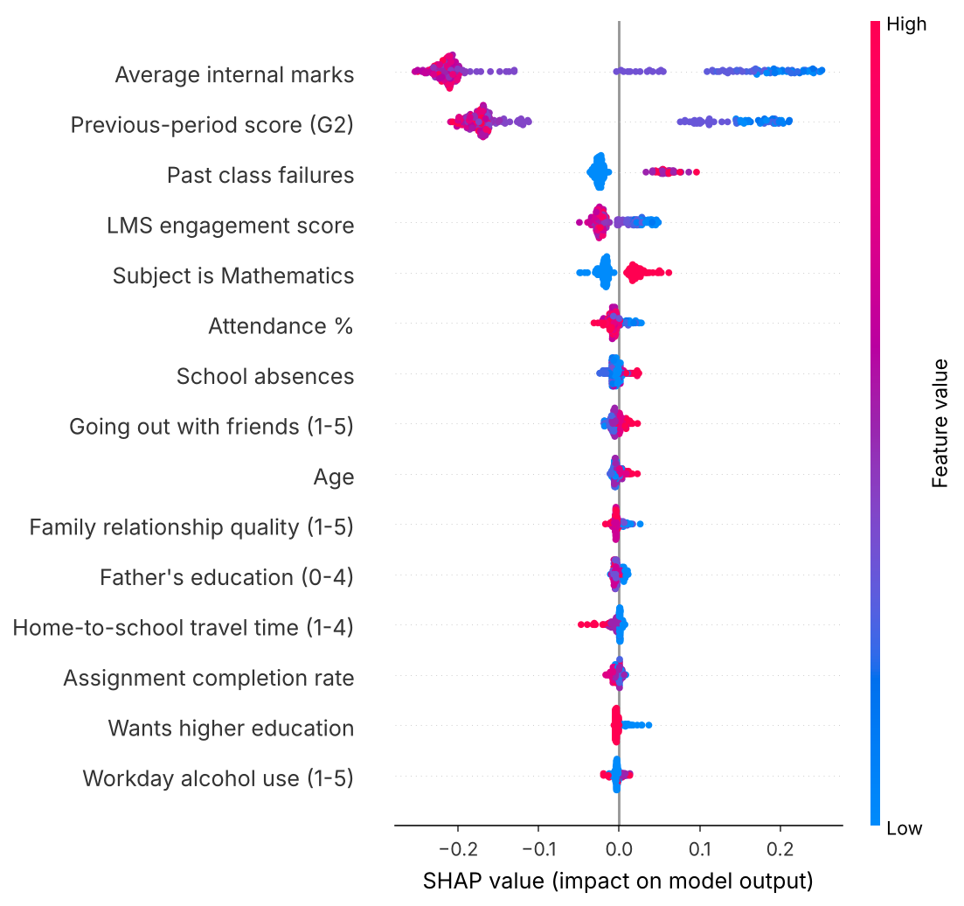
CMR INSTITUTE OF TECHNOLOGY | DATA ENGINEERING AND MLOps
PROJECT PRESENTATION
6. What the Results Actually Say
The five models are about equal. 207 test rows, only 46 at-risk, so the differences are noise.
The simple rule 'G2 below 10' already gets ROC-AUC 0.971. G2 is just a very strong predictor of G3.
What the models really add: fewer false alarms. At 0.5 they wrongly flag 17 students vs 40 for the rule, but miss 5 at-risk ones vs 0.
SHAP: marks and G2 dominate, then past failures. The synthetic attendance / LMS columns barely matter because I generated them independently of G3.
So it's an early-warning aid, not a decision-maker.
SHAP summary, champion model
Student Name: Akshitha | USN: ______________
CMRIT 7

Slide 8
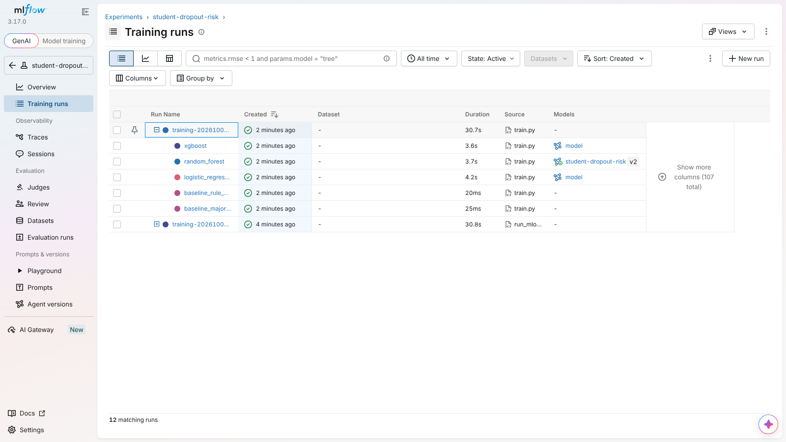
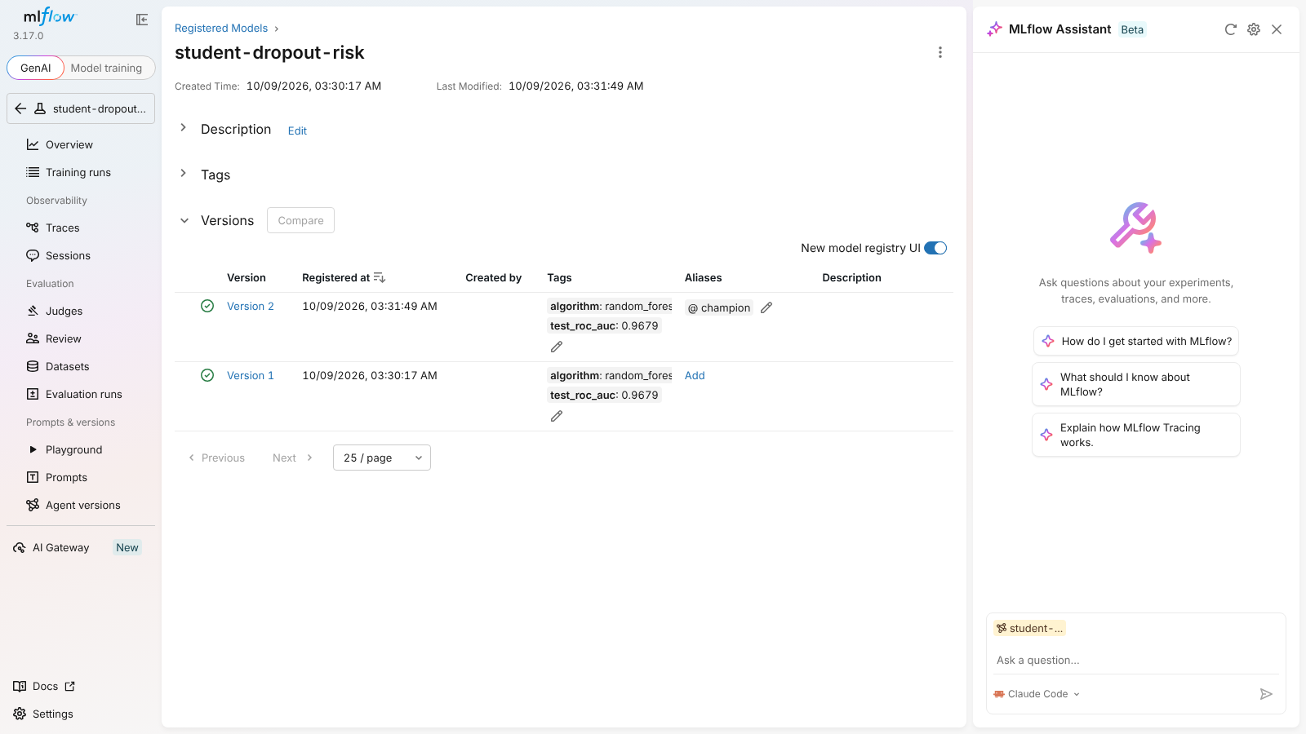
CMR INSTITUTE OF TECHNOLOGY | DATA ENGINEERING AND MLOps
PROJECT PRESENTATION
7. Experiment Tracking & Model Registry (MLflow)
One parent run per training, a child run per model
Registered model: versions + 'champion' alias
Each run logs params, CV + test metrics, plots, model signature. Winner is registered as student-dropout-risk.
A new version becomes champion only if its test AUC is within 0.005 of the current one. Retrained several times in Docker; v3 (5 models) is the current champion.
Student Name: Akshitha | USN: ______________
CMRIT 8

Slide 9
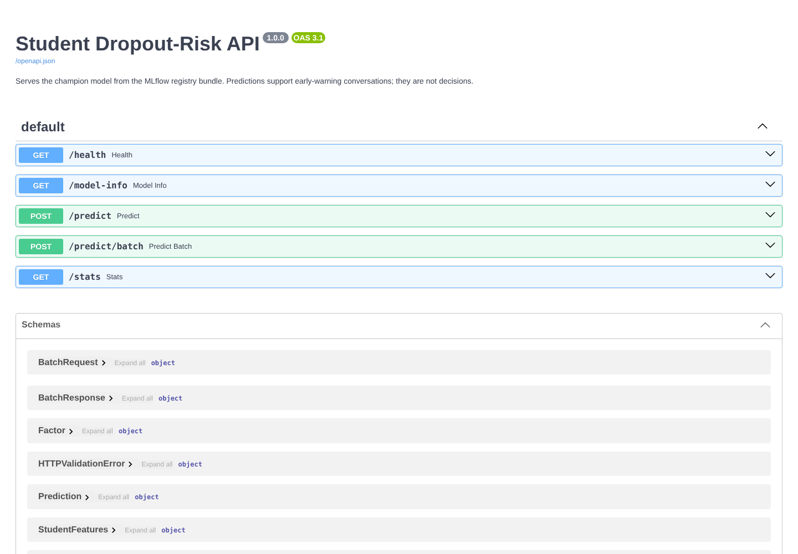
CMR INSTITUTE OF TECHNOLOGY | DATA ENGINEERING AND MLOps
PROJECT PRESENTATION
8. Model Serving with FastAPI
POST /predict
{"student_id":"DEMO1","previous_semester_score":8,
"avg_internal_marks":8.5,"attendance_pct":62,"failures":1}
-> {"at_risk_probability":0.8693,"at_risk":true,"risk_band":"High",
"top_factors":[avg_internal_marks, previous_semester_score, failures]}
Only G2 is required; missing fields are imputed and flagged. Bad input gets a 422.
Reasons per student come from swapping one feature at a time for the average, so no SHAP in the container.
Endpoints: /health, /model-info, /predict, /predict/batch, /stats.
Every prediction is appended to a log, which feeds the monitor.
Swagger docs at /docs
Student Name: Akshitha | USN: ______________
CMRIT 9

Slide 10
CMR INSTITUTE OF TECHNOLOGY | DATA ENGINEERING AND MLOps
PROJECT PRESENTATION
9. Docker & Orchestration
Docker (API, trainer, MLflow, monitor, Airflow)
Airflow DAG (now 6 tasks)
docker compose --profile train run --rm trainer
docker compose up --build api
docker compose up mlflow
docker compose --profile monitor run --rm monitor
docker compose --profile airflow up --build airflow
# | Task
1 | ingest_source_to_raw
2 | validate_and_clean_raw_to_cleaned
3 | transform_and_load_to_analytical_db
4 | build_ml_dataset (new)
5 | train_and_register_model (new)
6 | monitor_drift (new)
Non-root user, health check, code in the image, data/models/logs as volumes.
Trainer runs inside the same image so the pickled model matches the library versions.
Built and run on Docker Desktop: trainer, API (healthy), MLflow UI and Airflow all ran.
Runs in its own container (Airflow 2.10, UI on :8080). All 6 tasks passed.
A first run crashed: MLflow logging looped inside the task process. Training now runs in a child process.
python scripts/run_mlops.py runs tasks 4 to 6 without Airflow.
Student Name: Akshitha | USN: ______________
CMRIT 10

Slide 11
CMR INSTITUTE OF TECHNOLOGY | DATA ENGINEERING AND MLOps
PROJECT PRESENTATION
10. Monitoring & Retraining Criteria
Trigger | Fires when
T1 data drift | 2+ features PSI > 0.20, or any > 0.25
T2 prediction drift | share flagged moves > 10 points
T3 performance | recall < 0.70 or AUC drops > 0.05 (needs real outcomes)
T4 age | model older than 180 days (a semester)
Simulated bad semester (demo)
Feature | PSI | Mean: train -> sim
attendance_pct | 4.22 | 88.8 -> 73.8
lms_engagement_score | 3.12 | 55.2 -> 37.8
absences | 2.04 | 4.4 -> 10.4
avg_internal_marks | 0.68 | 11.2 -> 9.1
previous_semester_score | 0.55 | 11.3 -> 9.1
Drift = PSI per feature (+ KS test). Needs 30+ logged predictions, otherwise it says 'not enough data'.
A trigger means 'retrain recommended'. A person checks the new version in MLflow before it serves.
No real traffic yet, so real drift has not been seen. The demo is simulated, and labelled that way.
Result: RETRAIN_RECOMMENDED
Flagged share 49% vs 24% in training; both T1 and T2 fired.
Student Name: Akshitha | USN: ______________
CMRIT 11

Slide 12
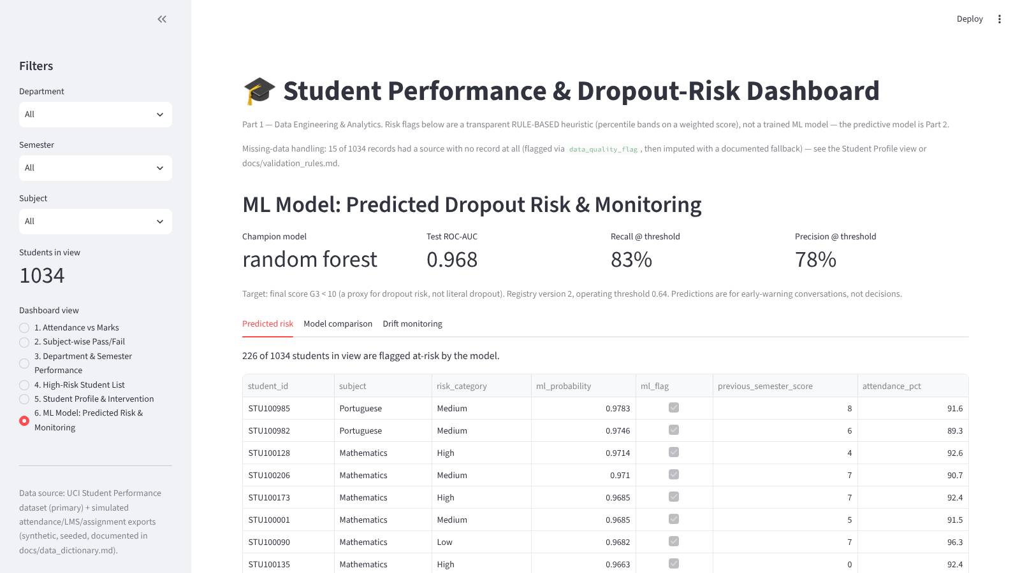
CMR INSTITUTE OF TECHNOLOGY | DATA ENGINEERING AND MLOps
PROJECT PRESENTATION
11. Dashboard: ML View
New 6th view next to the Part 1 ones.
Champion metrics, predicted risk next to the old rule-based category.
Tabs for model comparison and drift reports.
Scores in the table are in-sample, so use the test metrics above for honest accuracy.
Student Name: Akshitha | USN: ______________
CMRIT 12

Slide 13
CMR INSTITUTE OF TECHNOLOGY | DATA ENGINEERING AND MLOps
PROJECT PRESENTATION
12. Testing & Evidence
pytest: 16 tests, all pass in a clean environment with matching library versions. API (validation, ordering, missing fields, batch + logging), dataset/leakage, target definition, reproducibility, PSI + drift logic.
python scripts/run_mlops.py: dataset, 5 models, registration and export in about a minute. Same numbers on every run (seed 42).
API, MLflow server and dashboard were started and used live; all 6 dashboard views load without errors.
Found and fixed along the way: MLflow rejected the default model format, and the drift report had invalid JSON (NaN). Both fixed and re-tested.
Also found: a 350 MB GPU library made the Docker build time out (switched to xgboost-cpu), and Airflow's logging crashed MLflow (fixed with a child process).
Docker and Airflow were built and run on Docker Desktop: trainer, API, MLflow UI, and the 6-task DAG all succeeded.
Student Name: Akshitha | USN: ______________
CMRIT 13

Slide 14
CMR INSTITUTE OF TECHNOLOGY | DATA ENGINEERING AND MLOps
PROJECT PRESENTATION
13. Limitations & Future Work
Limitations
Next
Label is a proxy (fail the subject), not actual dropout.
About 1,000 rows, 46 positives in test.
A plain G2 rule is nearly as good on AUC.
Attendance / LMS / assignments are synthetic.
No tuning, calibration or fairness check yet (sex is a feature).
Collect real outcomes so performance drift can be measured.
Hyperparameter search with nested CV, calibration, subgroup metrics.
CI to run the tests, scheduled monitor with alerts.
Deploy the container somewhere managed.
Student Name: Akshitha | USN: ______________
CMRIT 14

Slide 15
CMR INSTITUTE OF TECHNOLOGY | DATA ENGINEERING AND MLOps
PROJECT PRESENTATION
14. Conclusion
Part 1's pipeline now feeds a full MLOps loop: dataset, tracked experiments, registry, API, Docker, monitoring, retraining rules.
Honest result: on this data a simple rule is already strong. The model adds fewer false alarms and a reason per student.
The real test for the monitoring is real traffic and real outcomes, which don't exist yet.
Everything runs from the same repo: pip install, run_pipeline, run_mlops, pytest.
Student Name: Akshitha | USN: ______________
CMRIT 15

Slide 16
Thank You
Questions & Discussion
Student Name: Akshitha | USN: ______________
CMR Institute of Technology, Bengaluru

