Slide 1

PROJECT PRESENTATION
Student Performance & Dropout-Risk
Prediction System
Data Engineering and MLOps | Individual Project (Part 1)
Student Name : Akshitha
USN :
______________________
CMR Institute of Technology, Bengaluru

Slide 2
CMR INSTITUTE OF TECHNOLOGY | DATA ENGINEERING AND MLOps
PROJECT PRESENTATION
1. Project Overview
The problem
Attendance, LMS activity, assignments and grades all sit in different places right now.
There's no single view that catches a student slipping until it's too late to actually help.
What Part 1 does
Pulls data from 5 sources into one pipeline.
Cleans and validates it, then loads it into a proper database.
Puts a dashboard on top so the risk data is actually usable.
Note: the risk scoring here is a simple rule, not a trained model yet - that's Part 2.
Student Name: Akshitha | USN: ______________
CMRIT 2

Slide 3
CMR INSTITUTE OF TECHNOLOGY | DATA ENGINEERING AND MLOps
PROJECT PRESENTATION
2. Dataset & Data Sources
UCI Student Performance dataset (real data, Math + Portuguese) - 1,054 records.
Attendance logs - synthetic, but seeded and tied to each student's real absence count - ~4,000 records.
LMS activity export - synthetic, correlated with study time - ~12,500 records.
Assignment submissions - synthetic - ~6,300 records.
A note on the synthetic data
Everything is read in as plain CSV files with pandas.
The synthetic parts are seeded (same random seed every run) and built off real attributes, not just random noise.
Student Name: Akshitha | USN: ______________
CMRIT 3

Slide 4
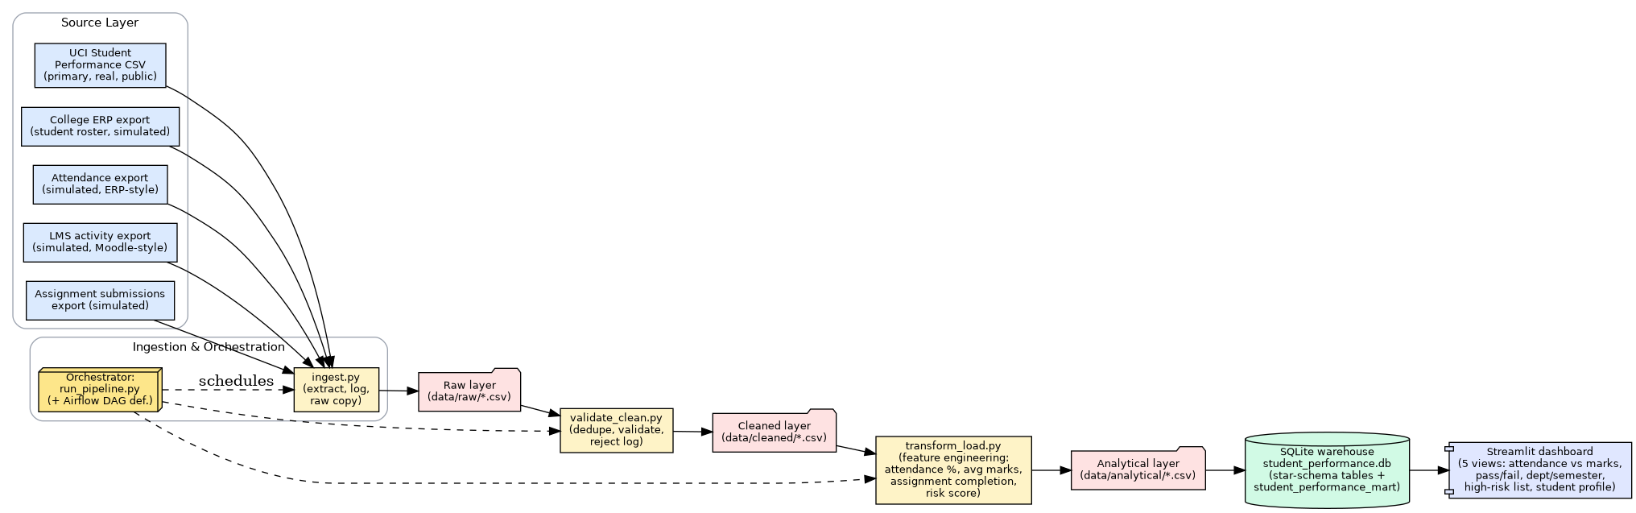
CMR INSTITUTE OF TECHNOLOGY | DATA ENGINEERING AND MLOps
PROJECT PRESENTATION
3. Data Architecture
Source files -> ingestion -> validation/cleaning -> transform & load -> SQLite -> dashboard.
Orchestration is a real Airflow DAG (ingest -> validate -> transform_load).
Student Name: Akshitha | USN: ______________
CMRIT 4

Slide 5
CMR INSTITUTE OF TECHNOLOGY | DATA ENGINEERING AND MLOps
PROJECT PRESENTATION
4. Data Ingestion Pipeline
ingest.py pulls all 5 sources into a raw layer, one source at a time, with error handling so one bad file doesn't kill the run.
Every extraction gets logged - timestamp, row count, success or failure - in logs/extraction_log.csv.
Orchestrated as an Airflow DAG: ingest_task >> validate_task >> transform_load_task.
Why the raw data isn't perfectly clean
I deliberately added a small amount of seeded noise while copying to raw (a few duplicate rows, some out-of-range grades, some attendance gaps) so the validation step has real errors to catch instead of a spotless toy file.
Student Name: Akshitha | USN: ______________
CMRIT 5

Slide 6
CMR INSTITUTE OF TECHNOLOGY | DATA ENGINEERING AND MLOps
PROJECT PRESENTATION
5. ETL & Data Quality
Standardized every student_id (trim + uppercase) so records actually join across all 5 sources.
Removed duplicates, checked grades/attendance are in valid ranges, checked every record points to a real student.
Every rejected row is logged with a reason - logs/rejected_records.csv.
Handling missing data
I don't just fill missing values with 0. First I flag that a value is actually missing (vs. genuinely zero), then apply a documented fallback.
15 of 1,034 records are flagged this way right now - a real, checkable example, not a hypothetical.
Student Name: Akshitha | USN: ______________
CMRIT 6

Slide 7
CMR INSTITUTE OF TECHNOLOGY | DATA ENGINEERING AND MLOps
PROJECT PRESENTATION
6. Database / Star Schema
A light star schema in SQLite: one student roster table, four fact tables (academic records, attendance, LMS, assignments), and a few aggregate tables.
student_performance_mart is the main table the dashboard reads from - one row per student per subject, 1,034 rows total.
department_semester_performance is a smaller rollup table for the department/semester view.
Full schema with column comments: docs/schema.sql
Student Name: Akshitha | USN: ______________
CMRIT 7

Slide 8
CMR INSTITUTE OF TECHNOLOGY | DATA ENGINEERING AND MLOps
PROJECT PRESENTATION
7. Feature Engineering
attendance %, average internal marks, previous-semester score, assignment completion rate.
an LMS engagement score, blended from logins, quiz averages and forum activity.
risk_score - a simple weighted formula on top of the above. Not a trained model.
risk_category (Low / Medium / High) - based on where a student falls in the cohort, not a fixed cutoff.
Part 2 will swap risk_score for an actual trained classifier using these same features.
Student Name: Akshitha | USN: ______________
CMRIT 8

Slide 9
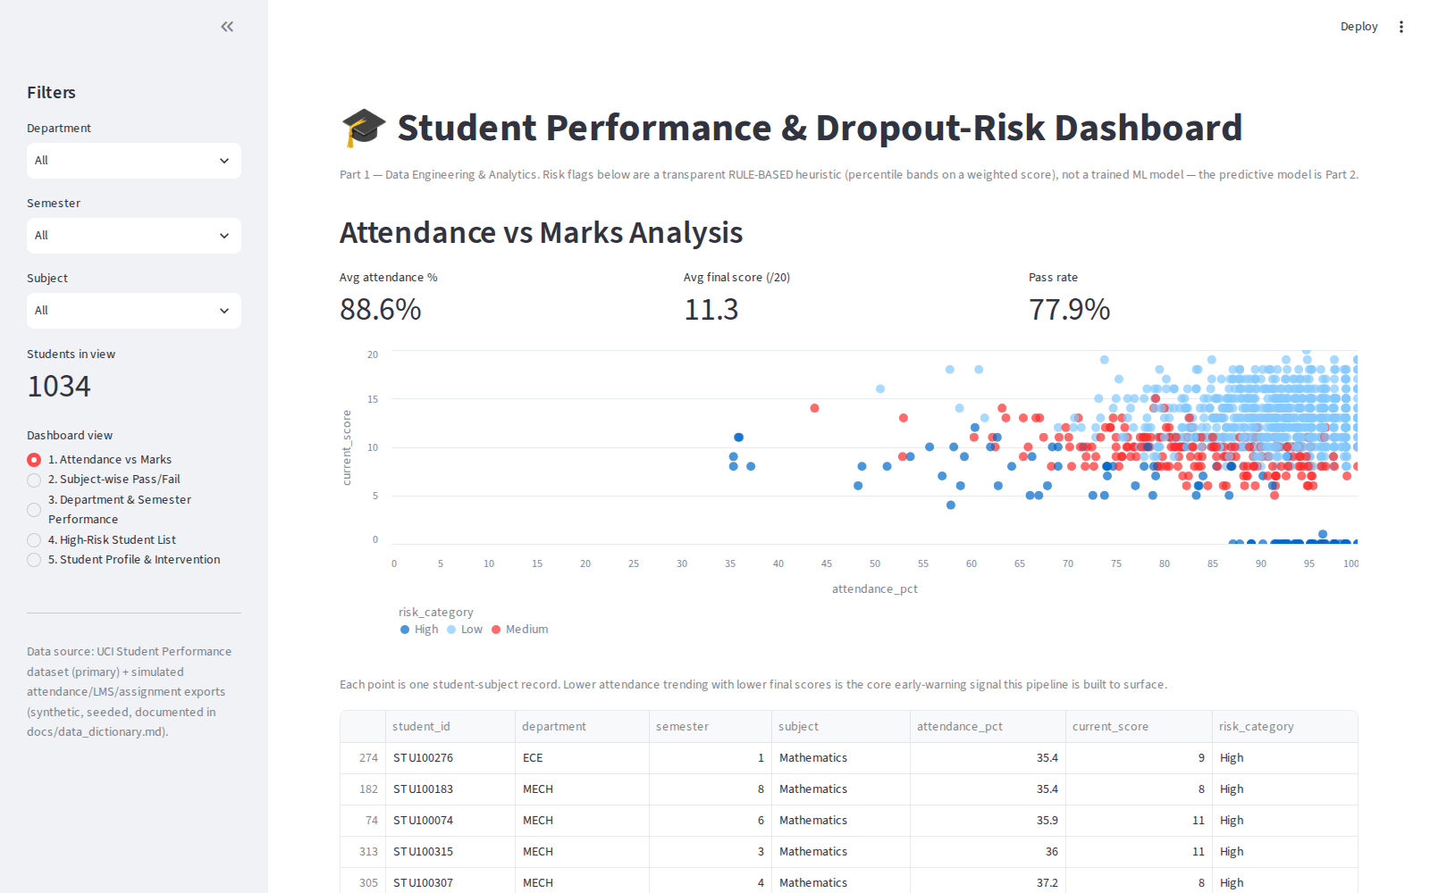
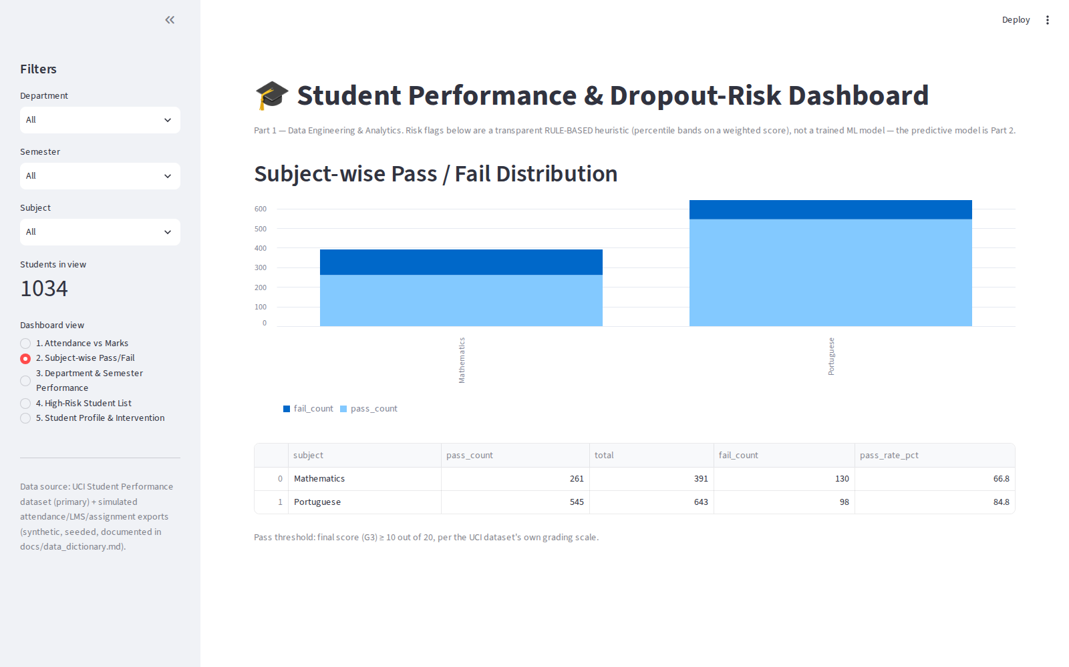
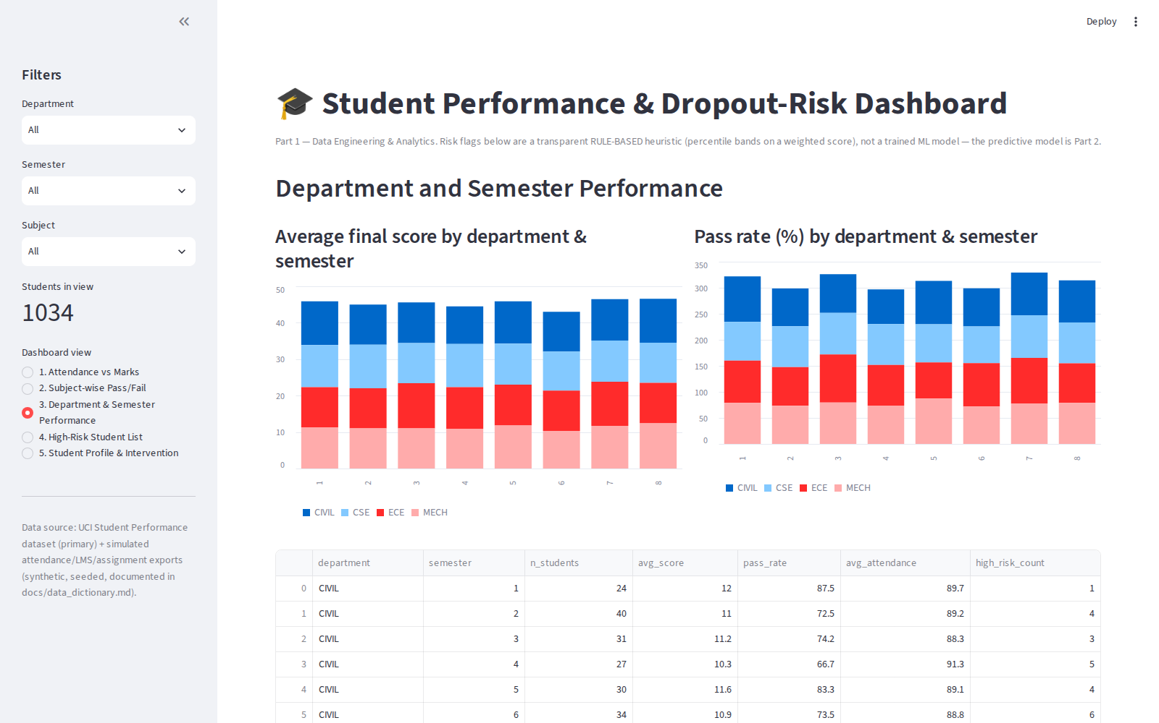
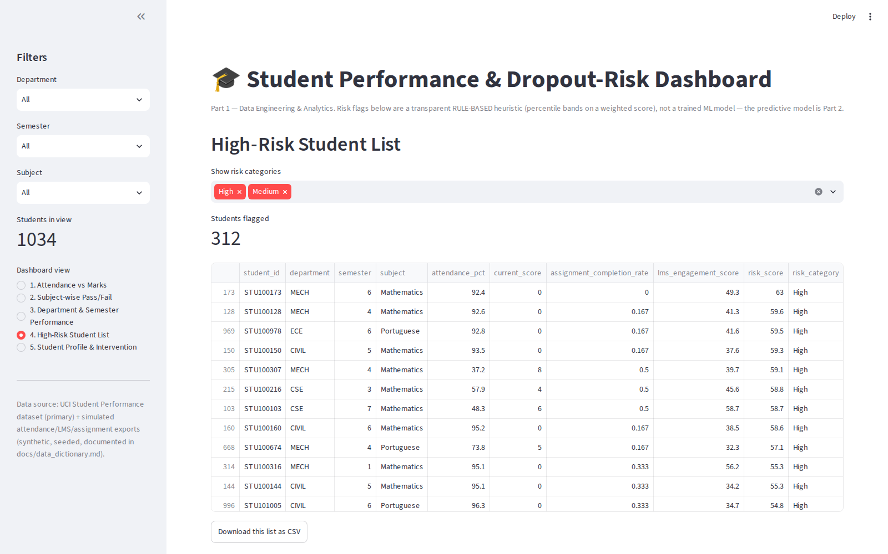
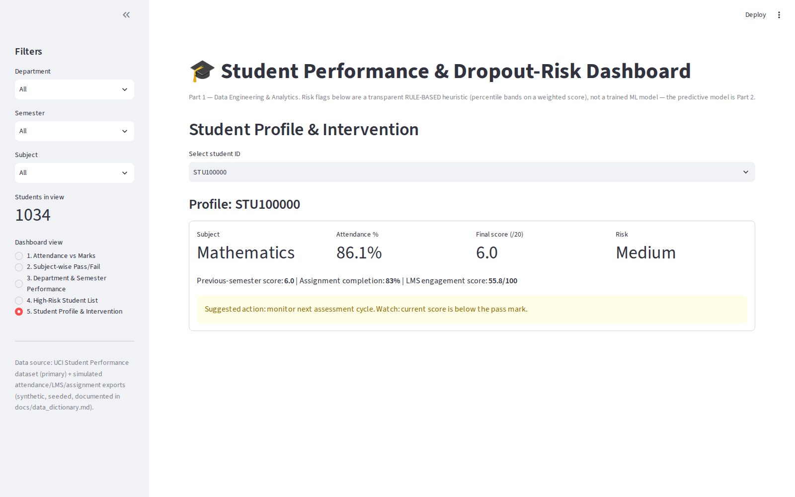
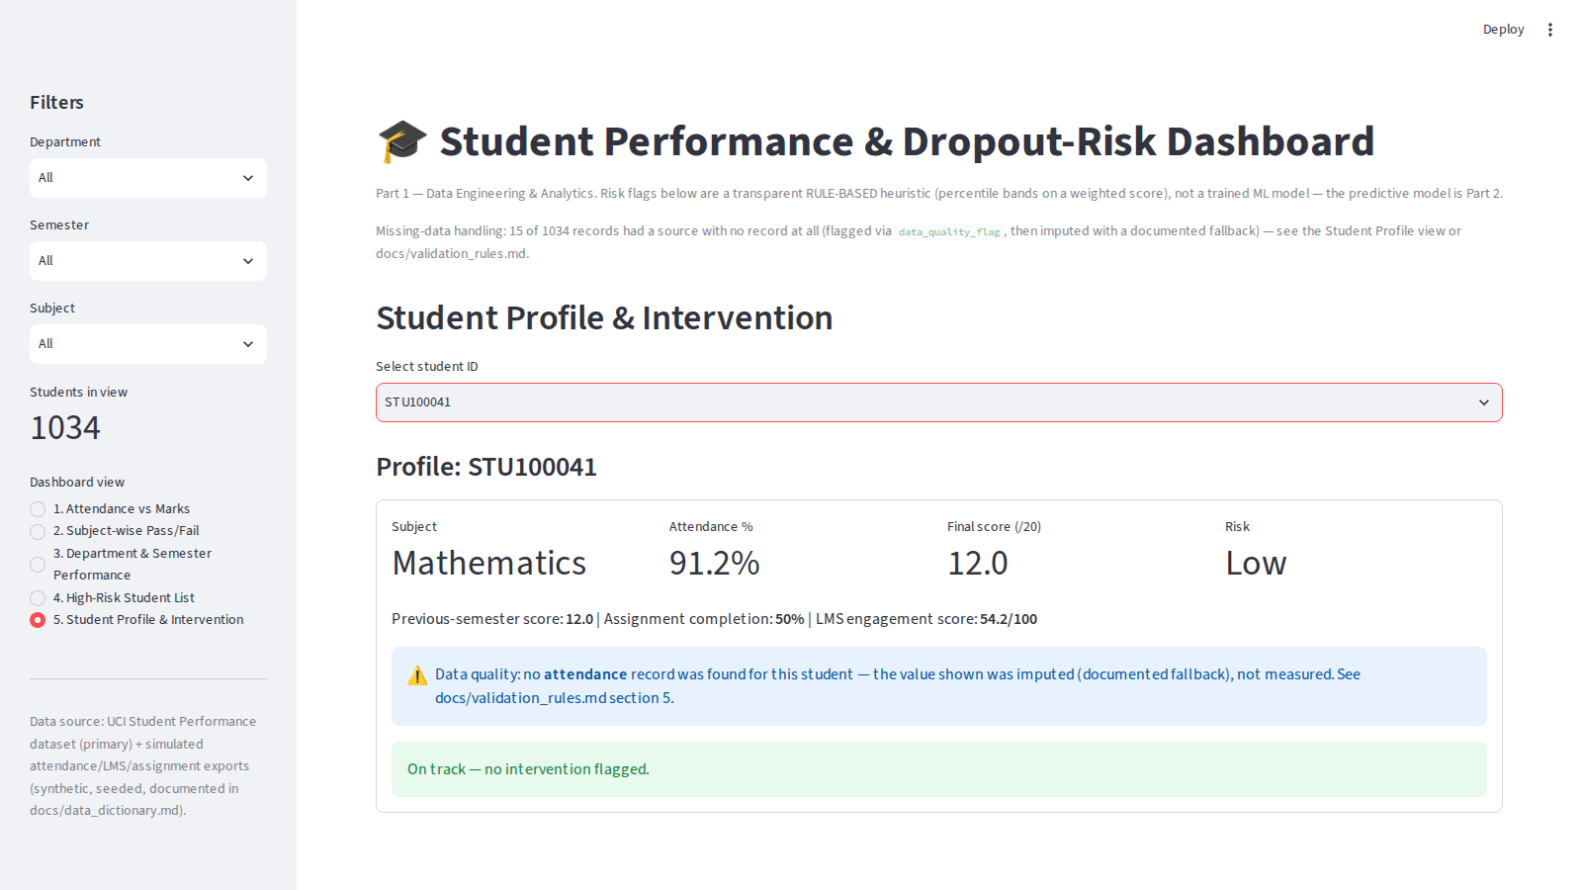
CMR INSTITUTE OF TECHNOLOGY | DATA ENGINEERING AND MLOps
PROJECT PRESENTATION
8. Dashboard & Analytics
Attendance vs marks
Subject-wise pass/fail
Department & semester view
High-risk student list
Student profile
Missing-data flag, in action
Student Name: Akshitha | USN: ______________
CMRIT 9

Slide 10
CMR INSTITUTE OF TECHNOLOGY | DATA ENGINEERING AND MLOps
PROJECT PRESENTATION
9. Pipeline Execution Evidence
A full run: python scripts/run_pipeline.py
[16:43:48] PIPELINE RUN START
[16:43:48] ingest (source -> raw) ... OK (0.15s)
[16:43:49] validate_clean (raw -> cleaned) ... OK (0.16s)
[16:43:49] transform_load (cleaned -> SQLite) ... OK (0.23s)
[16:43:49] PIPELINE RUN COMPLETE
What that one run produced
Read in about 24,000 rows total across the 5 sources (logged per source).
35 rows rejected during cleaning, 78 attendance gaps logged separately.
1,034 final records loaded into SQLite, which the dashboard reloads on every run.
Student Name: Akshitha | USN: ______________
CMRIT 10

Slide 11
CMR INSTITUTE OF TECHNOLOGY | DATA ENGINEERING AND MLOps
PROJECT PRESENTATION
10. Roadmap: MLOps Extension (Part 2)
(Not built yet - just what's planned next. Everything else in this deck is done and working.)
Define the dropout label properly from the mart's existing scores.
Train and compare a couple of model candidates on the features already built in Part 1.
Track experiments with MLflow, serve the model with FastAPI, package it with Docker.
Figure out monitoring - when should the model get retrained.
Student Name: Akshitha | USN: ______________
CMRIT 11

Slide 12
CMR INSTITUTE OF TECHNOLOGY | DATA ENGINEERING AND MLOps
PROJECT PRESENTATION
11. Results & Key Insights (Part 1)
1,034 student-subject records made it into the final mart.
35 rows rejected during cleaning, 78 attendance gaps logged.
15 records had missing data that got flagged and filled in, fully traceable.
104 students (about 10%) came out High risk under the current rule-based score.
What stood out
Attendance and final scores clearly move together - visible right in the scatter plot.
Fixed risk thresholds barely flagged anyone (1 out of 1,034); switching to percentile bands fixed that.
Student Name: Akshitha | USN: ______________
CMRIT 12

Slide 13
CMR INSTITUTE OF TECHNOLOGY | DATA ENGINEERING AND MLOps
PROJECT PRESENTATION
12. Challenges & Learning Outcomes
Challenges
SQLite kept throwing disk I/O errors - turned out to be a file-locking issue with the synced folder. Fixed it by reading/writing through a local copy of the DB.
My first risk thresholds were way too strict (only 1 student flagged High) - switched to percentile-based bands instead.
Couldn't reach the UCI source directly because of network restrictions, so I used a mirror and checked it matched the real schema first.
What I learned
How to build synthetic data that's actually useful instead of just random noise.
Why you shouldn't just fillna(0) - detect missing data first, then decide.
Student Name: Akshitha | USN: ______________
CMRIT 13

Slide 14
CMR INSTITUTE OF TECHNOLOGY | DATA ENGINEERING AND MLOps
PROJECT PRESENTATION
13. Conclusion & Future Scope
Done so far
A full working pipeline: ingest -> validate -> transform -> SQLite -> dashboard.
Documented it properly - schema, data dictionary, validation rules, a written report.
Next up (Part 2)
Train an actual model to replace the rule-based risk score.
Add MLflow, FastAPI, Docker, and some kind of monitoring/retraining setup.
Student Name: Akshitha | USN: ______________
CMRIT 14

Slide 15
CMR INSTITUTE OF TECHNOLOGY | DATA ENGINEERING AND MLOps
PROJECT PRESENTATION
14. References
UCI Student Performance dataset - Cortez & Silva.
Python, pandas, SQLite, Streamlit, Apache Airflow.
Course guideline document on data sources & missing-data handling.
Full docs in the project repo - data dictionary, validation rules, schema, report.
Student Name: Akshitha | USN: ______________
CMRIT 15

Slide 16
Thank You
Questions & Discussion
Student Name: Akshitha | USN: ______________
CMR Institute of Technology, Bengaluru

