Slide 1
REVIEW 4 / VALIDATION OF PROJECT
AI-Based Ground Vibration
Detection
Human / Vehicle Activity Classification
Validation of the sensing, signal-processing and
machine-learning pipeline
TEAM MEMBERS
G. Akshith • K. Ahladh • P. Cyril Raj
K. Sravya • B. Gowri
Guides: A. Bhuvaneshwari (AECD) | Ashwini Kumar Varma (Signal Processing)
Gangamohan Paidi (Machine Learning)

Slide 2
System Under Validation
Integrated path from ground vibration to activity classification
SENSING + ANALOG FRONT END
SIGNAL PROCESSING
CLASSIFICATION + ALERT
• Piezoelectric vibration transducer
• Protection, AC coupling and 1.65 V bias
• Non-inverting amplifier (design gain ≈ 22)
• Analog low-pass design cutoff ≈ 408 Hz
• Sampling target: 2 kHz
• 1-second windows (2,000 samples)
• 101-tap Hamming FIR band-pass: 5–400 Hz
• RMS, peak, FFT frequency and band energies
• Decision Tree and Random Forest
• Four activity classes
• OLED class display
• LED / buzzer response planned for activity
FOUR TARGET CLASSES
01
No activity
02
Human footsteps
03
Light vehicle
04
Other vibration
Validation status must be reported separately for software tests, circuit simulation and physical hardware.
02 / 07

Slide 3
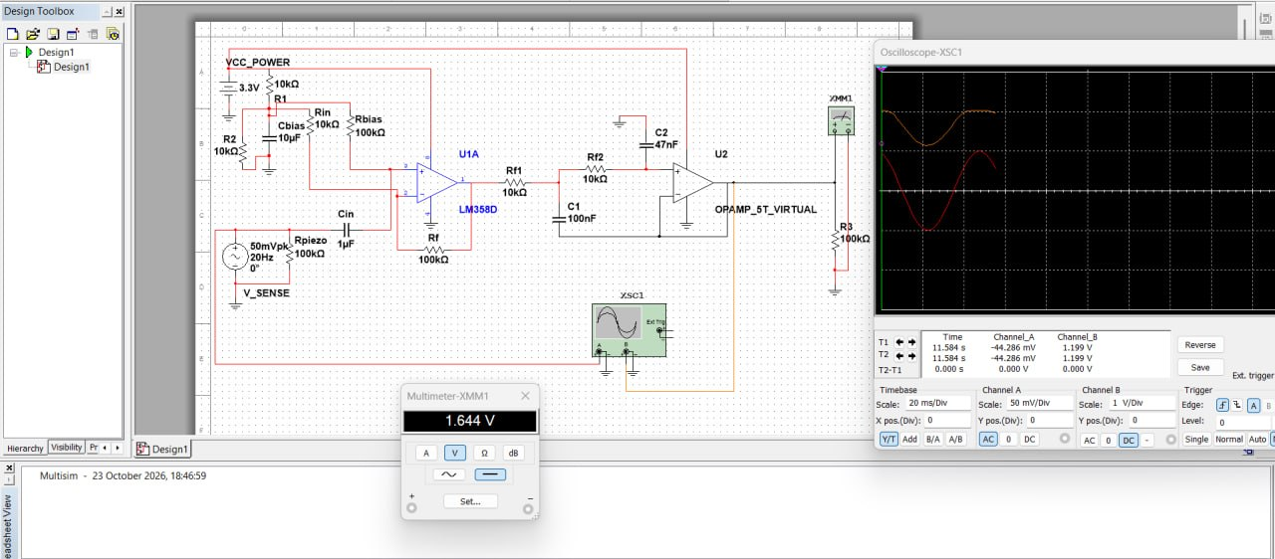
Hardware & Circuit Validation
Multisim output from the project documentation
MULTISIM SIMULATION OUTPUT
DESIGN CHECKS
• Bias target: ≈ 1.65 V
• Amplifier gain target: ≈ 22
• Low-pass cutoff target: ≈ 408 Hz
• ADC signal must stay within 0–3.3 V
The documentation includes a Multisim simulation screenshot. Confirm exact readings and mark each hardware test as PASS / FAIL / NOT YET TESTED.
Calculated targets are not presented as physical measurements.
03 / 07

Slide 4
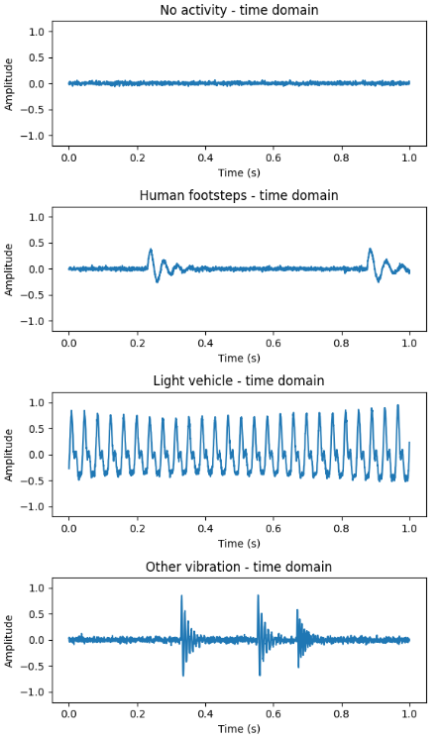
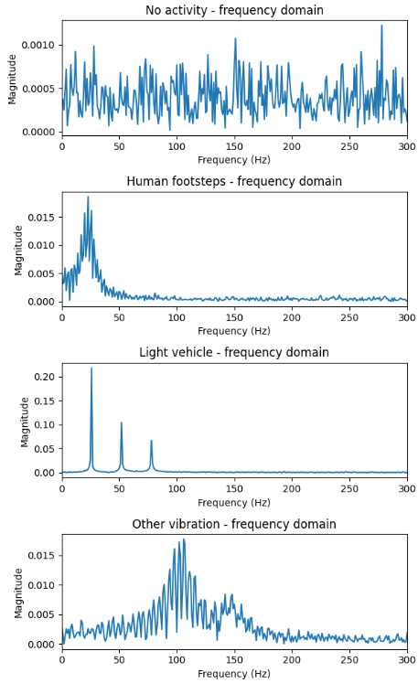
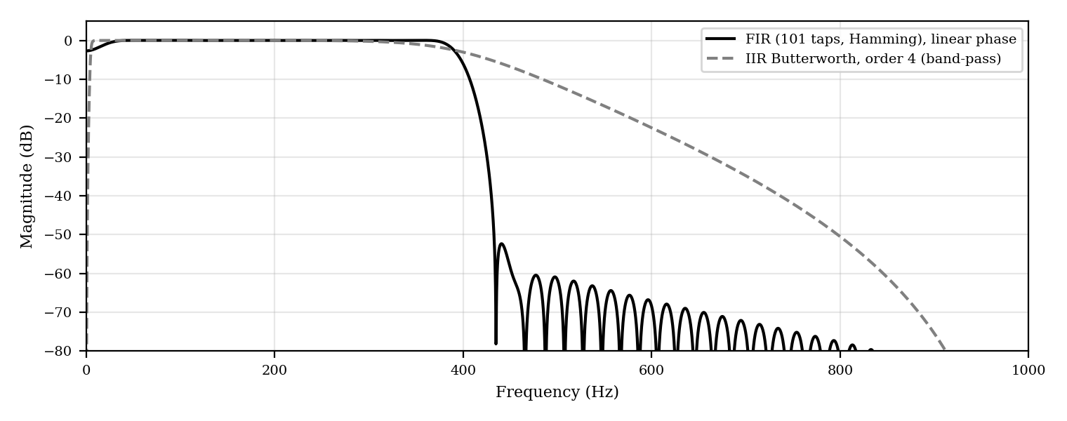
Signal-Processing Output
Figures from the documentation: time-domain and frequency-domain responses
EXAMPLE 1-SECOND SIGNAL WINDOWS
FFT MAGNITUDE SPECTRA
FIR / IIR FILTER RESPONSE
Pipeline parameters
2 kHz sampling • 101-tap Hamming FIR
5–400 Hz band-pass • 1 s windows
Six extracted features
These plots illustrate synthetic example signals and designed filter responses; real sensor recordings are still required for field validation.
04 / 07

Slide 5
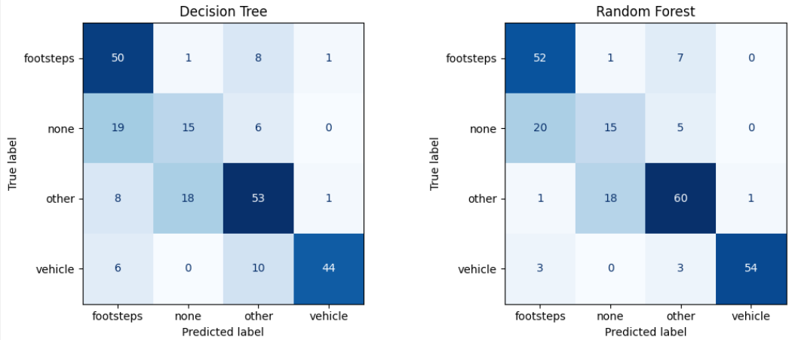
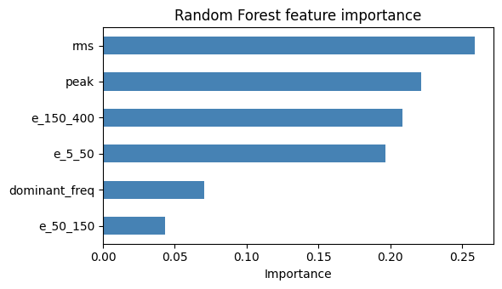
Machine-Learning Validation
Classification outputs reproduced from the project documentation
CONFUSION MATRICES
RANDOM FOREST FEATURE IMPORTANCE
HELD-OUT TEST ACCURACY
5-FOLD CROSS-VALIDATION
Decision Tree: 67.5% Random Forest: 75.4%
Decision Tree: 80.9% ± 5.2%
Random Forest: 86.4% ± 6.5%
All reported ML metrics are from synthetic data, not real-world hardware recordings.
05 / 07

Slide 6
Integrated Testing & Test Cases
Record actual predictions and output behaviour during validation
TEST INPUT
EXPECTED CLASS
ACTUAL OUTPUT
STATUS
Quiet ground
No activity
Fill from test
Not tested / Pass / Fail
Person walking
Human footsteps
Fill from test
Not tested / Pass / Fail
Bicycle / car passing
Light vehicle
Fill from test
Not tested / Pass / Fail
Tap / knock / burst
Other vibration
Fill from test
Not tested / Pass / Fail
Attach real screenshots/photos: sensor readings, OLED class display and LED/buzzer response—only for features actually integrated.
A test-case template is provided here; fill in the observed output after testing the physical system.
06 / 07

Slide 7
Conclusion & Remaining Validation Work
What is established now—and what is still needed before claiming field performance
CURRENTLY ESTABLISHED
NEXT VALIDATION STEPS
• Python signal-processing and ML pipeline tested on synthetic data
• Random Forest outperformed Decision Tree on the held-out synthetic test set
• Preliminary test accuracy: 75.4% Random Forest
• Design targets and hardware test criteria are documented
• Verify analog front end in simulation and on breadboard
• Record real labelled vibration data across surfaces and distances
• Retrain and evaluate on real recordings
• Integrate OLED / LED / buzzer and test live classifications
• Report limitations and false alarms
FINAL MESSAGE: the software pipeline has a synthetic-data baseline; physical and real-world validation are essential next steps.
Thank you • Questions
07 / 07

