Slide 1
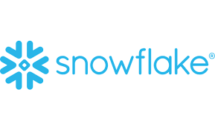
Introduction
Snowflake enables data storage, processing, and analytic solutions that are faster, easier to use, and far more flexible than traditional offerings.
Snowflake is a SaaS (Software – as – a- service) solution, a cloud-based data warehouse that holds no physical space and takes care of maintenance itself.
Snowflake is also used for data science where running python is an effortless process using Snowpark for python.

Slide 2
Data warehouse and cloud computing
Data warehouse is used to store data for analytical purpose.
Cloud Computing is the delivery of computing services like servers, databases, networking, analytics, etc.
Snowflake provides the management of data storage, virtual warehouses, etc.
RAW data (Staging)
Data Integration (Transformation)
Access Layer

Slide 3
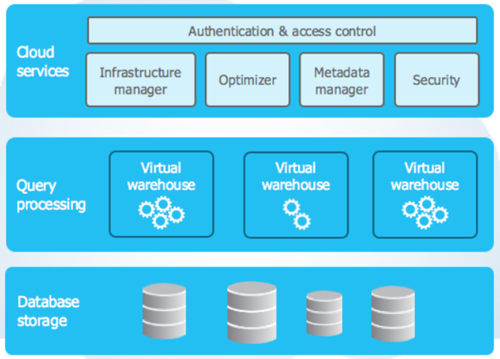
Architecture

Slide 4
Snow pipe
Serverless feature which enables loading once a file appears in a bucket.
Structure:
File
S3 Bucket
COPY
S3 Notification
Serverless Load
Snowflake DB

Slide 5
Thank you!

