Slide 1
DOM
Document Object Model
A standard for how to get, change, add, or delete HTML elements.

Slide 2
What to expect?
Quick introduction to DOM
How the DOM represents an HTML document in memory?
How to use APIs to create web content and applications

Slide 3



JavaScript makes the HTML page active and dynamic via the DOM.
Notes:
to make an HTML document more interactive and dynamic, the script‌‌ needs to be able to access the contents of the document and it also needs to know when the user is interacting with it.‌‌

Slide 4
You want a button to change colours when it gets clicked or an image to appear when the mouse hovers over text.
First, you need to reference those elements from your JavaScript.

Slide 5
What is DOM?
A programming interface for web documents.
DOM is not a programming language.
Represents the page so that programs can change the document structure, style, and content.
The DOM is a tree-like representation of the web page that gets loaded into the browser.
The DOM represents the document as nodes and objects.
Without it, the JavaScript language wouldn't have any model or notion of web pages, HTML documents, SVG documents, and their component parts.
Web API used to build websites

Slide 6
Accessing the DOM
When you create a script, whether inline in a <script> element or included in the web page, you can immediately begin using the API for the document or window objects to manipulate the document itself.
The DOM was designed to be independent of any particular programming language, making the structural representation of the document available from a single, consistent API
Let’s look at an example:

Slide 7
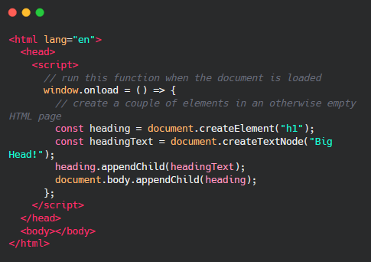
Notes:
the following function creates a new h1 element, adds text to that element, and then adds it to the tree for the document:

Slide 8
DOM contd
It represents the web page using a‌‌ series of objects. The main object is the document object, which in turn houses other objects which also house their own objects, and so on.

Slide 9
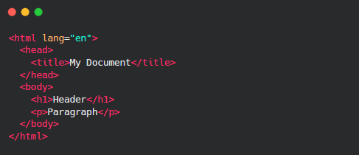

Slide 10
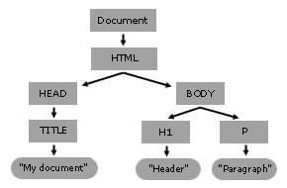
DOM Tree
The DOM is a tree-like representation of the web page that gets loaded into the browser.

Slide 11
When a web browser parses an HTML document, it builds a DOM tree and then uses it to display the document.
Let’s look at the different objects

Slide 12
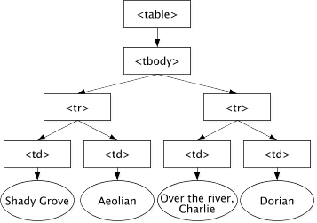
The Document Object
This is the top most object in the DOM. It has properties and methods which you can use to get information about the document using a rule known as dot notation.

Slide 13
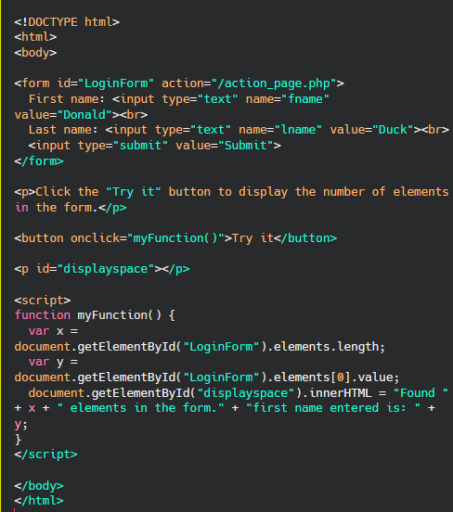
Example

Slide 14

The createElement() method
Create a specified element and insert it into the DOM:

Slide 15
Finding HTML Elements
If you want to manipulate HTML elements.
But we need to find the elements first. Multiple ways to do this:
Finding HTML elements by id
Finding HTML elements by tag name
Finding HTML elements by class name
Finding HTML elements by CSS selectors
Finding HTML elements by HTML object collections

Slide 16
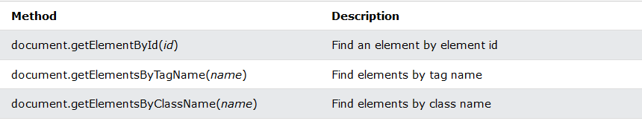
Finding HTML Elements

Slide 17
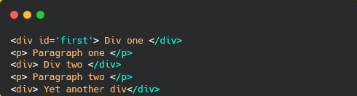
getElementById()
Method to get an element from the document by its unique id attribute.

Slide 18
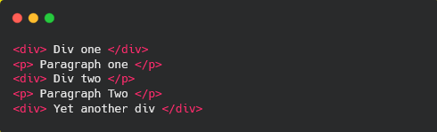
getElementsByTagname()
Method to access one or more elements by their HTML tag name

Slide 19
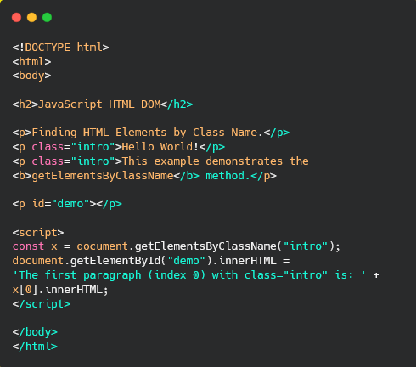
getElementByClassName()

Slide 20

Finding HTML Elements by CSS Selectors : querySelectorAll)
Access one or more elements from the DOM that matches one or more CSS selectors.
Finds all HTML elements that match a specified
CSS selector (id, class names, types, attributes,
values of attributes, etc), use the querySelectorAll() method.

Slide 21
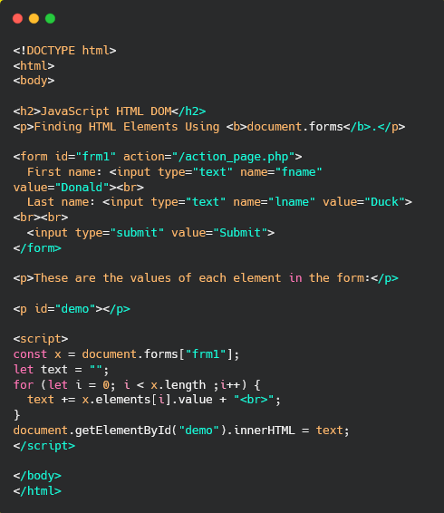
Finding HTML Elements by HTML Object Collections

Slide 22
Difference Between an HTMLCollection and a NodeList
HTML collection | NodeList
getElementsByClassName() and getElementsByTagName() methods return a live HTMLCollection. | querySelectorAll() method returns a static NodeList.
A collection of document elements. | A collection of document nodes (element nodes, attribute nodes, and text nodes).
Items can be accessed by their name, id, or index number. | Items can only be accessed by their index number.
It is always a live collection. Example: If you add a <li> element to a list in the DOM, the list in the HTMLCollection will also change. | Most often a static collection. Example: If you add a <li> element to a list in the DOM, the list in NodeList will not change.

Slide 23
Let’s look at all the other elements you can see as well
document.anchors
document.body
document.documentElement
document.embeds
document.forms
Document.head
Document.images
Document.links
Document.scripts
document.title

Slide 24
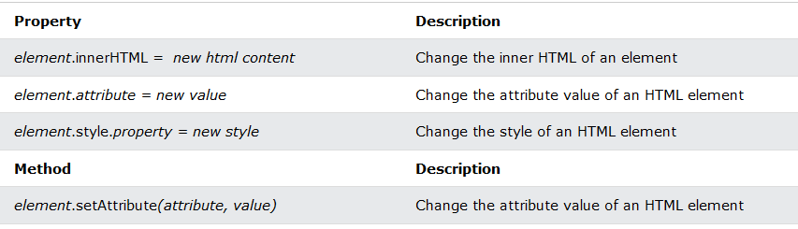
Changing HTML Elements

Slide 25
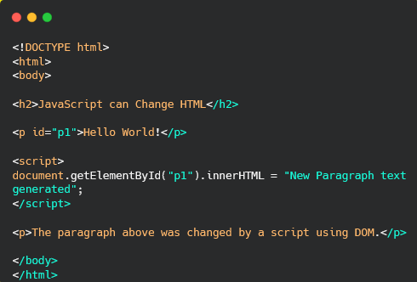
Changing HTML Content
innerHTML property
document.getElementById(id).innerHTML = new HTML

Slide 26
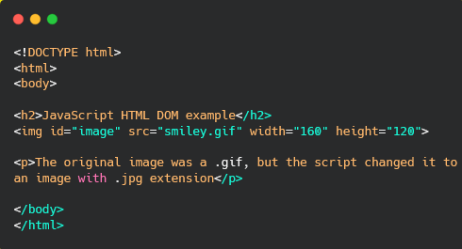
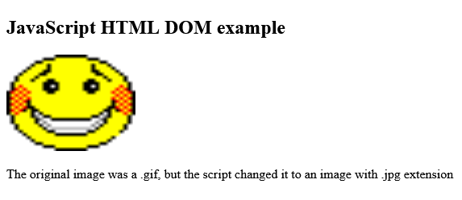
Changing the Value of an Attribute

Slide 27
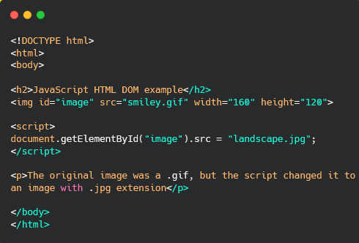
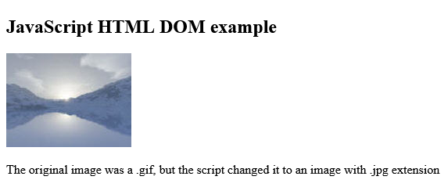

Slide 28
Dynamic HTML content
document.write(): write directly to the HTML output stream
Never use document.write() after the document is loaded. It will overwrite the document.
The setAttribute() method sets a new value to an attribute.
If the attribute does not exist, it is created first.
element.setAttribute("style", "background-color:red;"); vs
element.style.backgroundColor = "red";

Slide 29
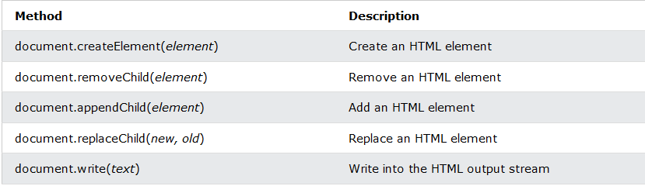
Adding and Deleting Elements

Slide 30
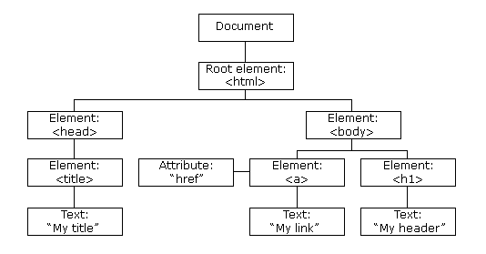
DOM Nodes
The entire document is a document node
Every HTML element is an element node
The text inside HTML elements are text nodes
Every HTML attribute is an attribute node (deprecated)
All comments are comment nodes

Slide 31
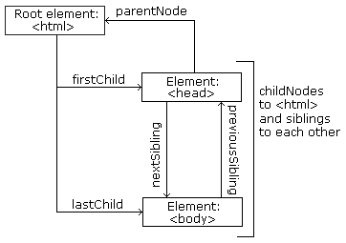
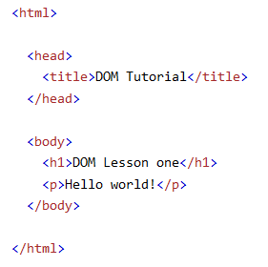

Slide 32
The node method
You can access any element by using the following properties with the node object:
node.childNodes – accesses the child nodes of a selected parent‌‌
node.firstChild – accesses the first child of a selected parent‌‌
node.lastChild – accesses the last child of a selected parent.‌‌
node.parentNode – accesses the parent of a selected child node.‌‌
node.nextSibling – accesses the next consecutive element (sibling) of a selected element.‌‌
node.previousSibling – accesses the previous element (sibling) of a selected element

Slide 33
A common error in DOM processing is to expect an element node to contain text.

Slide 34
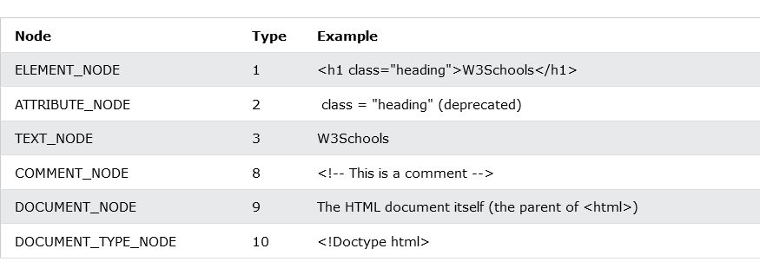
Types of Nodes

Slide 35
DOM Events
HTML DOM allows JavaScript to react to HTML events:

Slide 36
A JavaScript can be executed when an event occurs, like when a user clicks on an HTML element.
To execute code when a user clicks on an element, add JavaScript code to an HTML event attribute:
onclick=JavaScript

Slide 37
Onload and Onunload functions
The onload and onunload events are triggered when the user enters or leaves the page.
The onload event can be used to check the visitor's browser type and browser version, and load the proper version of the web page based on the information.
The onload and onunload events can be used to deal with cookies.

Slide 38
DOM EventListener
Attaches an event handler to the specified element (without overwriting existing event handlers).
You can add many event handlers(even of the same type) to one element.
You can add event listeners to any DOM object not only HTML elements. i.e the window object.
The addEventListener() method makes it easier to control how the event reacts to bubbling.
When using the addEventListener() method, the JavaScript is separated from the HTML markup, for better readability and allows you to add event listeners even when you do not control the HTML markup.
You can easily remove an event listener by using the removeEventListener() method.

Slide 39
Event Bubbling or Event Capturing?
Two ways of event propagation in the HTML DOM - bubbling and capturing.
Event propagation is a way of defining the element order when an event occurs. If you have a <p> element inside a <div> element, and the user clicks on the <p> element, which element's "click" event should be handled first?
In bubbling the inner most element's event is handled first and then the outer: the <p> element's click event is handled first, then the <div> element's click event.
In capturing the outer most element's event is handled first and then the inner: the <div> element's click event will be handled first, then the <p> element's click event.

