Slide 1
Project 3:Customer Satisfaction Prediction
Data Analyst Internship Project
Tools: Python (Pandas, Matplotlib, Seaborn) & EDA

Slide 2
Project Overview
Project Objective:
1.Analyze customer support data to understand factors affecting satisfaction
2.Domain: Data Science & Analytics
3.Dataset: Customer Support Tickets (8,469 records)
4.Focus on business insights & predictive readiness

Slide 3
Dataset Summary
Total Records: 8,469 | Total Features: 18
  Key Features: Ticket Type, Priority, Channel, Resolution Time
  Target Variable: Customer Satisfaction Rating (1–5)
  ~67% ratings missing as feedback is given post ticket resolution

Slide 4
Data Preprocessing & Feature Engineering
Converted date & time columns to date time format
Handled missing values logically (open vs closed tickets)
Created Resolution_Hours feature from response & resolution times
Filtered resolved tickets for satisfaction analysis

Slide 5
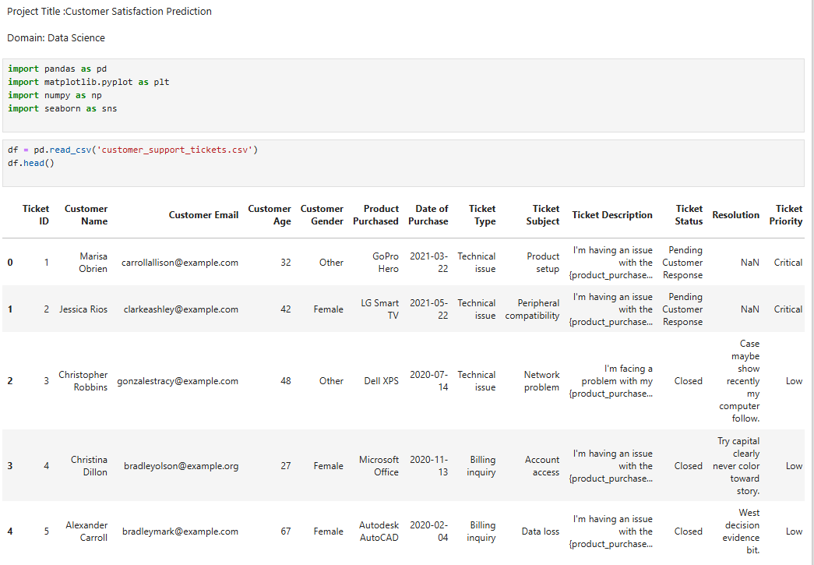
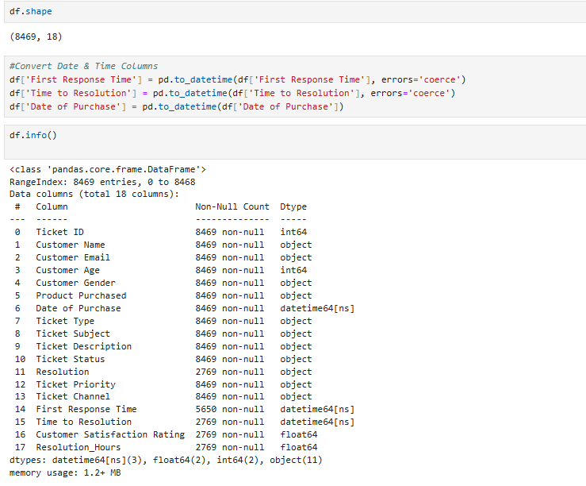
Data Structure

Slide 6
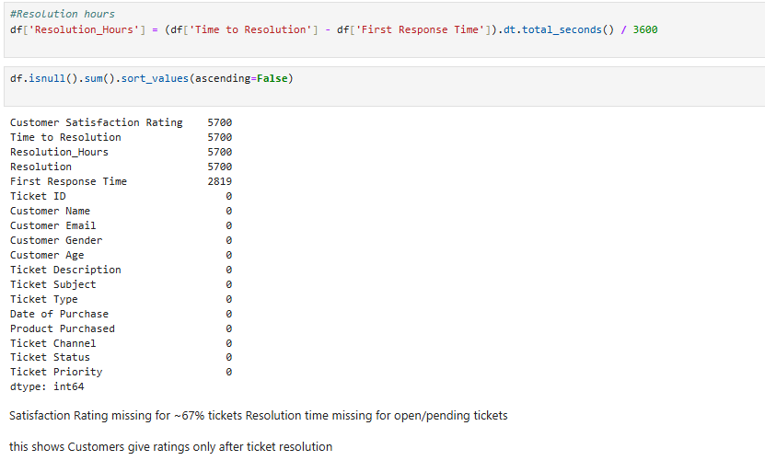
Data Structure

Slide 7
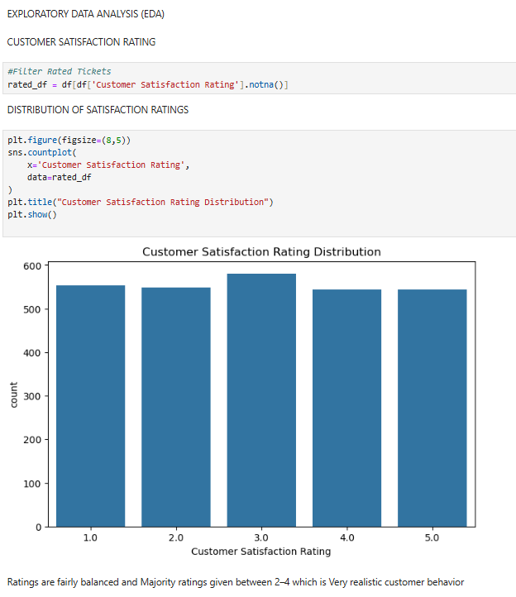
Satisfaction Rating Distribution

Slide 8
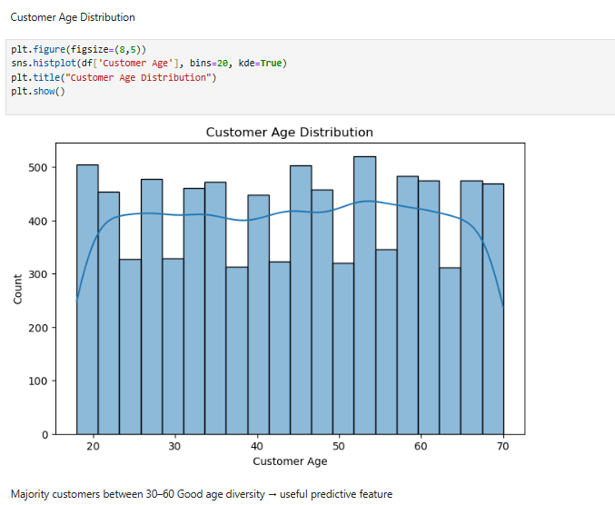
Customer Age Distribution

Slide 9
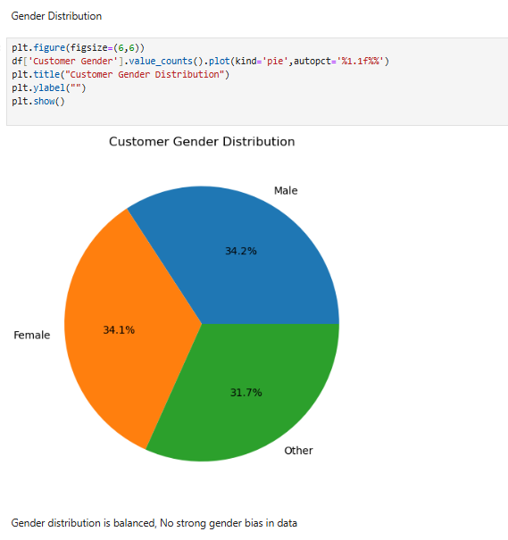
Gender Distribution

Slide 10
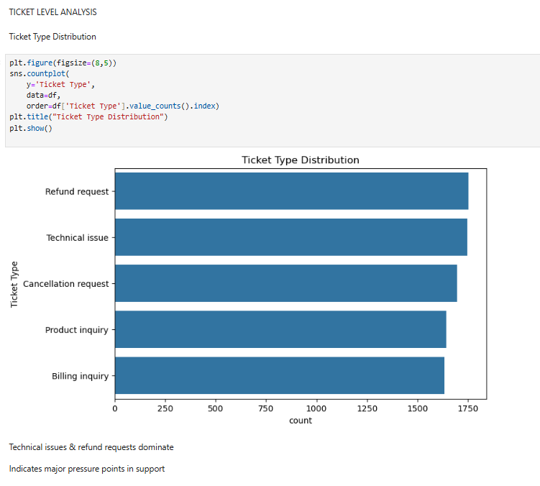
Ticket Type Distribution

Slide 11
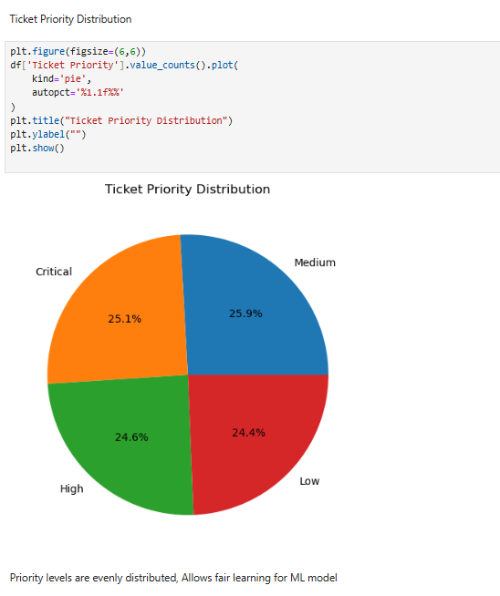
Ticket Priority Distribution

Slide 12
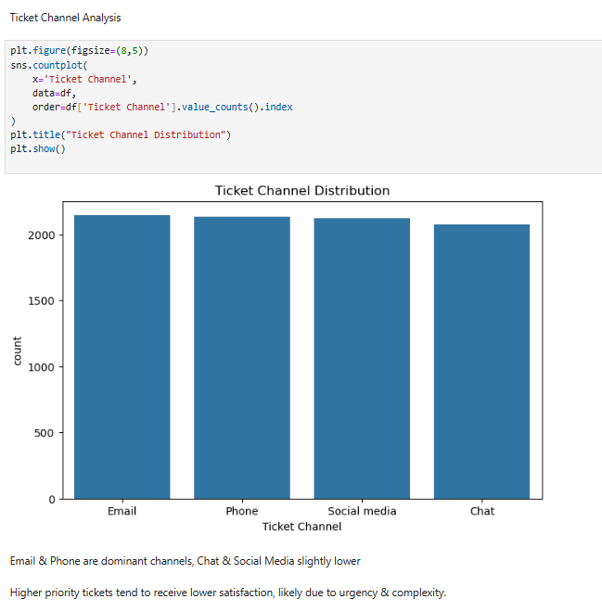
Ticket Channel Distribution

Slide 13
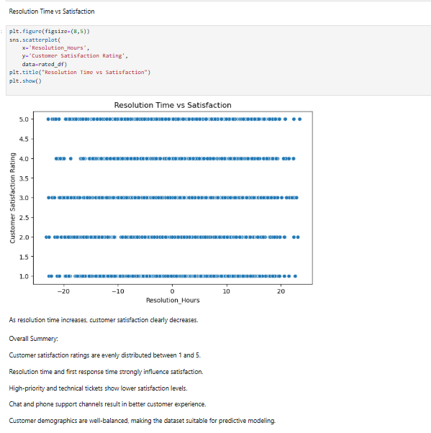
Resolution Time vs Satisfaction

Slide 14
Key Business Insights
Customer satisfaction decreases as resolution time increases
  High-priority & technical tickets show lower satisfaction
  Email & Phone are dominant support channels
  Balanced demographics improve model fairness
  Conclusion
Resolution speed is the strongest driver of customer satisfaction
  Insights can help optimize support operations
  Data is suitable for predictive modeling
  Can be extended to ML-based satisfaction prediction

