Slide 1
Introduction
Team name: Planet Tag
Team member: Akshobha Aravind, Class 8, Bangalore, India
Challenge selected: A World Away: Hunting for Exoplanets with AI

Slide 2
Problem statement
I addressed the following problem statement:
Datapoints recorded by satellites are classified as Exoplanets or other astronomical bodies by a team of experts who manually inspect each datapoint.
The process is slow and there can be disputes over classifications due to the interpretation of what a datapoint means can be different for different experts and hence there can be errors in classification.

Slide 3
Solution - Model Architecture
I decided to use the capability of Machine learning algorithms for this task as they are good at interpreting data and they also are fast at processing while at the same time they provide accurate classifications for large datasets. In this project I have used an FNN model for processing and classifying a users dataset.
I choose FNN model because it outperformed commonly used models such as Random Forest, Adaboost and logistic regressor. I tested each of these models using the dataset: TESS Objects of Interest (TOI). Hence, I decided to use FNN model for Exoplanet classifications.
Weights and biases are the definitions that an FNN model learns when training on a dataset. I saved weights and biases as a .pt file in Github. This file will be loaded into my model every time it has to process a file from a user. I decided to make this model run locally on a user's system as FNN models are not computationally heavy.

Slide 4
Solution - Model architecture & GUI
My FNN model was custom built by me using a Python library called Pytorch. This model has a total of 3 hidden layers and total neuron count of 843.
It has several components that aids at improving its prediction accuracy. The major components that I custom built into this model are: An activation function called ReLU, a batch size of 32 a shuffled train loader to increase generalization, a Scheduler called Exponential LR for stable learning and other such components.
In order for a user to leverage my models capability of classification, they would need an interface to interact with this model. I decided to leverage a library in Python called tkinter to build an interface.
The tkinter is a default library that use syntax for generating simple GUI.
Using this library, I was able to design an interface where a user can input file path that my pretrained model can analyse and then classify the datapoints.

Slide 5
How to use the model
Go through the Readme file. It is available in the Github repo. If you clone the repo to your local system, the file is available in the NASAProject folder. Read the guidelines and ensure to comply the requirements.
Run my program in a Python IDE.
Answer yes/no to the first question: "Are you gonna input a dataset for a model to train on?"
If Yes,
input file path that can be used for training the model. Click submit.
In the What’s your target parameter, input the parameter that contains classifications. Click submit.
Now, input your parameter values. Ensure they are the same as the parameters described in the Readme file. Click submit and wait for my model to complete training. The training is complete when you will see it’s accuracy and other parameter values are displayed. Then input the file path that my model will classify. Click submit.
Navigate to NASAProject > NASA-Spaceapps-challenge folder, and you’ll see a csv file called classifications that contains the models classifications based on the data that you provided.
If No,
Input the file path that needs to be classified. Click submit.
Navigate to NASAProject > NASA-Spaceapps-challenge folder, and you’ll see a csv file called classifications that contains the models classifications based on the data that you provided.

Slide 6
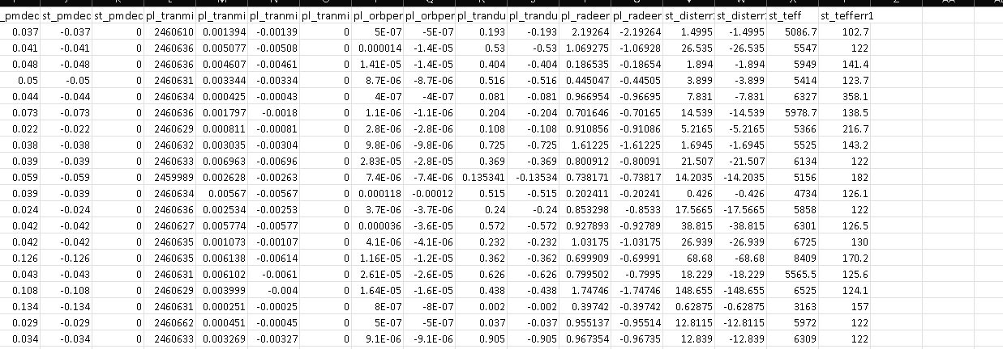
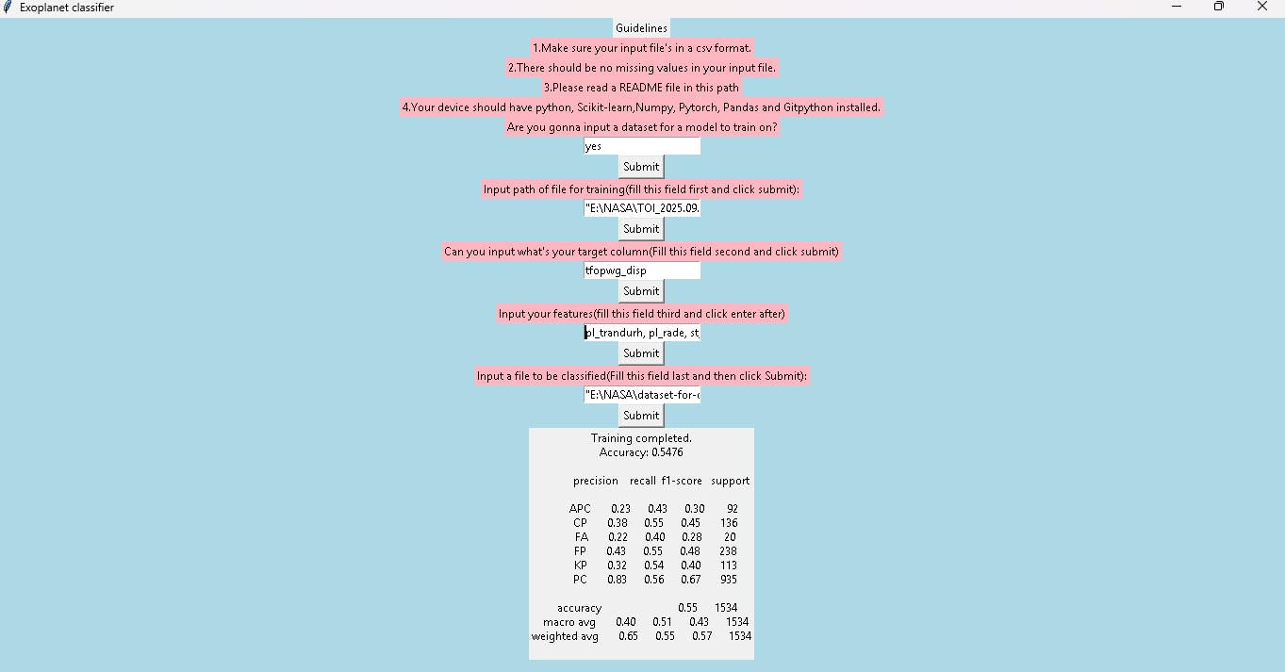
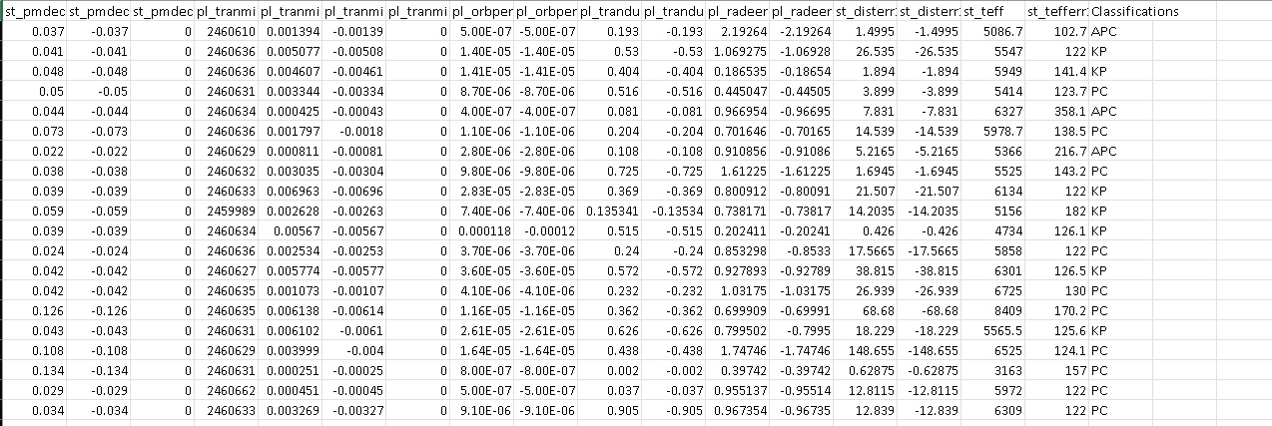
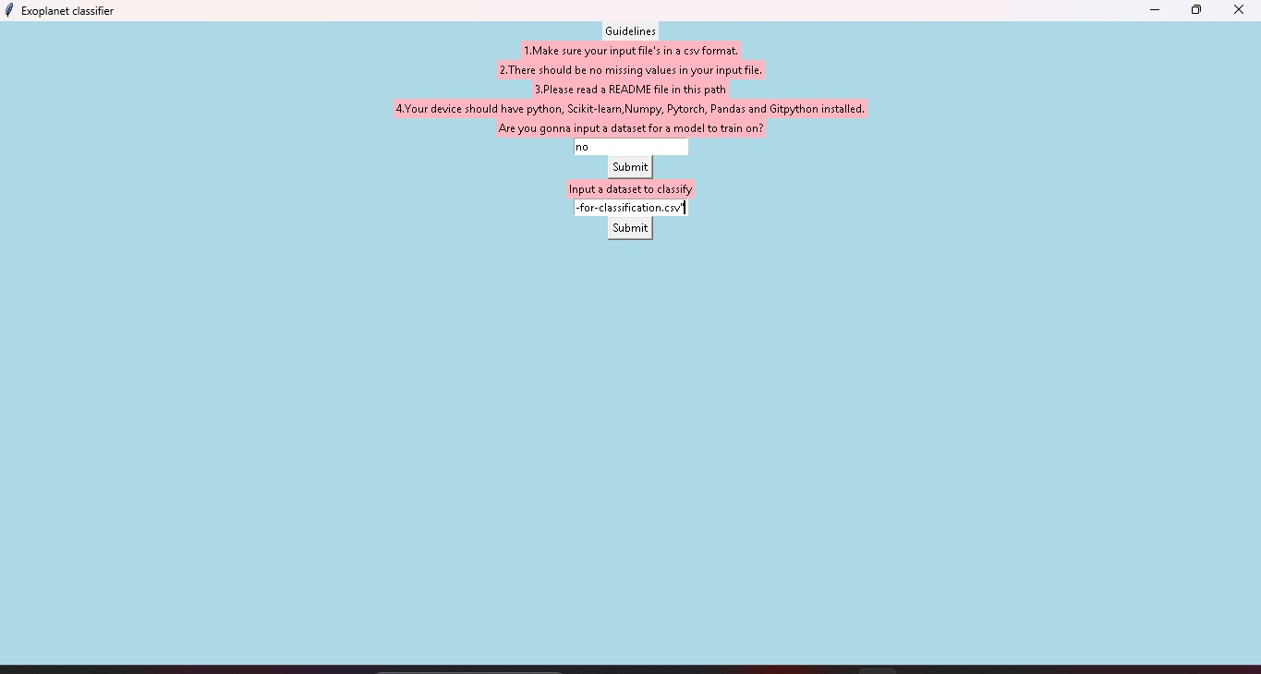
GUI and Datasets sample view
App UI
Datasets before processing
Classification added post processing
Datasets After processing

Slide 7
THANK YOU FOR THE OPPORTUNITY
NASA SPACEAPP CHALLENGE IS A GREAT OPPORTUNITY FOR STUDENTS LIKE ME TO EXPLORE THE EXISITING WORLD OF DATASET PROCESSING FOR REAL WORLD RESEARCH.
By Akshobha Aravind, Class 8, Bengaluru, India

