Slide 1

Sri Kumaran Public School – ICSE, Mallasandra
Solution name: Arogya Setu
Team name: Positrons
Team members:
Advaiy Vasishta
Adyant Anbarasan
Akshobha Aravind
Chirantan R. D. Poojary

Slide 2




Problem Statement & SDG Alignment
Healthcare: Rural Healthcare, SDG 3
Problem Statement: Rural people have challenges in accessing quality health care. Diseases like, diarrhea, tuberculosis, malaria, are prevalent in rural Karnataka. This requires people to have access to health care within a reasonable distance and time of their locality. The rural hospitals in Karnataka have specialized departments that provide medications to patient suffering from diseases. However, rural people face issues in terms of average commute time to a hospital, the waiting time in the hospital, and availability of the prescribed medication at the hospital pharmacy. Thus, these problems have to be solved in order to provide good healthcare to rural people.
The problem statement was arrived at using the Design Thinking principles. In order to make sure that the problems highlighted in it are legitimate problems for our user, we read a user transcript interview that was conducted in rural areas near Bangalore (Hosahalli, DJ Halli and Chandenahalli) and the users highlighted the problems mentioned.
User base: People in Rural areas.
Application of the project: To improve accessibility of healthcare in rural Karnataka and minimize time for receiving healthcare.
In rural India, the nearest doctor is often hours away. Small illnesses go unchecked until they become serious, and district hospitals tend to stay overcrowded with multiple cases.
Too few doctors
~1 doctor for every 1,500+ people in rural areas — far below WHO's recommendation.
Long travel & waiting
Villagers lose a full day's wages travelling to a hospital and waiting in OPD queues.
Crowded OPDs
Hospitals handle minor coughs and colds while serious patients wait longer.
Late detection
BP, sugar and fever issues are caught late because routine check-ups are hard to access.

Slide 3











Proposed Solution / Design & Technology used
Arogya Setu. A Doctor-Connected AI Health Kiosk
A self-service/community-assisted kiosk placed in villages or clusters of approximately 50 households.
Patient Interaction. A conversational interface communicates with the patient in a local/vernacular language, collecting basic symptoms and health information.
Non-Invasive Health Screening. Sensors capture basic parameters such as: body temperature, blood pressure, heart rate.
AI-Assisted Preliminary Report. Software combines sensor readings with patient-provided information and generates a simple preliminary health summary. Additionally, this summary will contain the AI’s diagnosis of the disease and possible medications the user can receive.
Doctor Validation. The report is electronically sent to a qualified doctor. The doctor—not the AI—makes the final medical decision.
Closure at the Kiosk
After doctor approval: Approved prescription → authorised medicines is dispensed or referral is printed.
Further examination required → hospital appointment is booked.
What technologies are used?
What happens in kiosk?
Measures non-invasive vitals — temperature, pulse, SpO₂, blood pressure.
IoT sensors
Vernacular LLM
Digital BP monitor, pulse oximeter, IR thermometer on Raspberry Pi.
Speech-to-text + LLM chatbot fine-tuned for local languages to capture symptoms.
Talks to the patient in their own language (Kannada, Hindi, etc.) using a voice-based LLM to record symptoms.
generate an easy health report with readings and AI analysis.
AI analysis model
Cloud + telemedicine
ML model compares vitals + symptoms against normal ranges to draft the report and diagnose the disease.
Secure cloud stores records; doctor reviews via web dashboard or video call.
Sends the report to an online doctor for approval before anything is dispensed.
Dispenses doctor-approved basic medicines like a 'pharmacy ATM', or auto-books a hospital appointment.
Printer
Medicine dispenser
ATM-style slip printer for the patient's drugstore referral.
Vending-machine unit unlocked only after the doctor's digital approval.

Slide 4
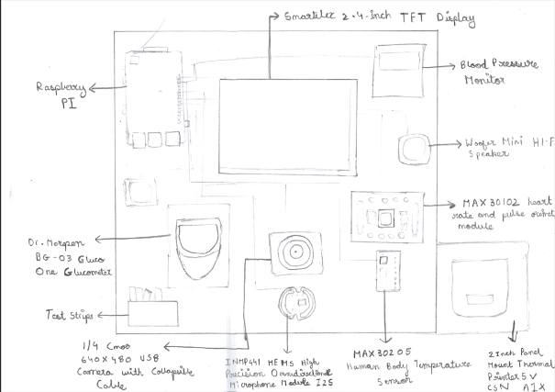
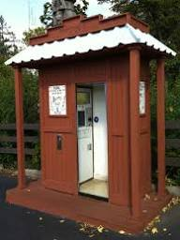
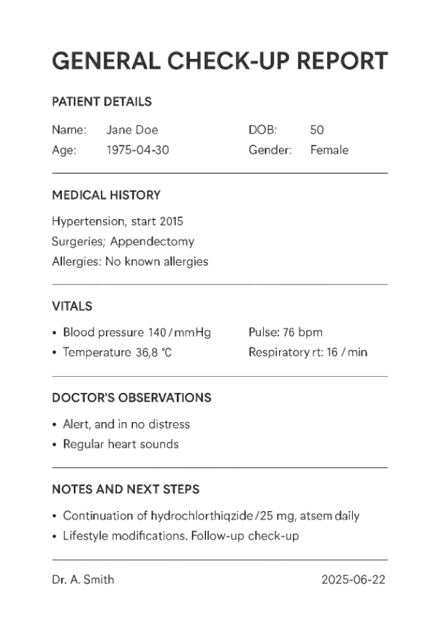
Proof of Concept — How One Visit Works
Prototype plan: a tabletop model using a Raspberry Pi, off-the-shelf BP monitor & pulse oximeter, a speech-to-text API with an LLM chatbot in the native language in the region, a slip printer.
Subbamma Gowda
26 Jan 1976
50 y

Slide 5
Workflow
Booth Entry
Identify User
Capture Health Data
Q&A
Booth Exit
Dispense Medicine
Review by Doctor
Diagnosis & Advice

Slide 6
DEMO

Slide 7
Workflow - Breakup
Booth Entry
Identify User
Capture Health Data
Q&A
Diagnosis & Advice
Review by Doctor
Dispense Medicine
Booth Exit
In PoC
Technology Used – Identify User
QR Code Scanner: OpenCV library is used to extract details, such as name and DoB.
Fingerprint scanner: Adafruit library is used to capture fingerprint data. The information collected from the QR code and biometric info will be sent to a server for validation.
JSON: After the user info is validated, the user detail is stored as a JSON file in a cloud DB.
Technology Used – Capture Health Data
Camera: OpenCV is used to capture a photograph. EasyOCR library is used to identify text and extract it.
smbus: smbus python library is used to capture sensor information.
JSON: The captured details are added to the patient’s report.
Scan Govt Issued ID
Reports (Scan)
Validate User
Health Parameters
Capture Details
Capture Details
In PoC
Not In PoC

Slide 8
Workflow - Breakup
Booth Entry
Identify User
Capture Health Data
Q&A
Diagnosis & Advice
Review by Doctor
Dispense Medicine
Booth Exit
In PoC
Language Model
In PoC
Technology Used-Q&A
Gtts: Gtts library is used to convert the questions into speech.
Sounddevice: Sounddevice library is used to capture answers through a microphone.
Genai: Genai library is used to transcribe audio files into English text.
JSON: JSON library is used to store details.
AI LLM Model
Technology Used – Diagnosis & Advice
Medi-phi & Ollama: Medi-phi is used to process user data; Ollama is used to run that model locally.
Request: Request library is used to send health data to the model.
JSON: The model-generated diagnosis and medication is stored in the patient’s report.
Dynamic Q
Diagnostic runs
Transcribe to Text
Diagnosis medication
Capture Details
In PoC
Not In PoC

Slide 9
Workflow - Breakup
Booth Entry
Identify User
Capture Health Data
Q&A
Diagnosis & Advice
Review by Doctor
Dispense Medicine
Booth Exit
In PoC
Technology Used- Review by doctor
Push.js: Push.js library is used to send a push request to a doctor.
WebRTC: WebRTC is a protocol used for setting up an online meeting for the doctor. It allows video and audio interaction.
HTML: HTML is used for rendering the website.
JSON: JSON is used to append and store the doctor’s recommendations in a patient’s diagnosis and medication to the patient’s report.
Push review requests
Robotic dispensing
Accept or Modify
Reject
Print report
Technology Used- Dispense medicine
YOLO: YOLO model can be used to recognize which medicine bottle has to be picked up.
Adafruit: adafruit-circuitpython-pca9685 library allows the robot to pick up the required medicine.
Update medication
Online meet
Share Diagnosis & medication
In PoC
Not In PoC

Slide 10




Impact & Future Scope
Faster healthcare
Decongested OPDs
Specialists freed up
Less waiting & travel
First-level check-up in minutes, right inside the village.
Minor cases handled at the kiosk, so hospitals see fewer crowds.
Doctors spend time on serious cases instead of routine ones.
No lost wages or long queues for a simple consultation.
Future scope
Faster referrals
Add more tests: blood sugar strips, ECG patch, basic eye & hearing screening.
Link every report to the patient's ABHA digital health record for lifelong history.
Use anonymised village data to alert officials about disease outbreaks early.
Solar power + offline mode so kiosks work even with weak electricity or internet.
Scale from one village to a district-wide network run with local health workers (ASHAs)
External link:
https://docs.google.com/document/d/1ZCZfzZupEzLPW2j9h5pHD_JS4Qk-SkGE9nn89oN3pU8/edit?tab=t.0
Patients requiring examination can be directed to appropriate facilities.
AI assists. Doctor decides.

Slide 11
Closing statements
The uniqueness lies in AI diagnosis and recommendations. The recommendation themselves are subject to doctor’s expert review and opinion before it can be shared with the patient.
Using AI to perform the preliminary diagnosis can potentially –
Ease the pressure on the OPD in hospitals
Improve accessibility for health consultation
It is not restricted to rural areas alone, but can be used in urban areas as well–a lab reports can have an AI analysis included along with the standard health report.
The AI model itself can be improved, which is an area for further development and research.

Slide 12
Thank You

