Slide 1
Introduction to Java Swing
From basics to advanced GUI
By:
L.Anritha Nievtha(23BCS064)
B.Ashika Fathima(23BCS065)
25.09.2024
1

Slide 2
Table of contents
1.Introduction to Java Swing
2.Core Concepts
3.Containers
4.Components
5.Layout Managers
6.Event Handling
25.09.2024
2

Slide 3

01
Introduction
Key Concepts and Components to Get You Started with Java Swing
25.09.2024
3

Slide 4
Introduction
What is Java Swing?
Java Swing is a GUI (Graphical User Interface) toolkit for Java applications. It's a part of the Java Foundation Classes (JFC) and provides a set of components for building rich and interactive desktop applications.
Why Java Swing?
Swing is Entirely written in Java. Java Swing Components are Platform-independent, and The Swing Components are lightweight.

Slide 5
02
Core Concepts
Understanding the Building Blocks of Java Swing

Slide 6
Core Concepts
Containers:
Containers are an integral part of SWING GUI components. A container provides a space where a component can be located . There are several types of containers , some of the important containers are
1.JFrame
2.JPannel
3. JDialouge
4. JScrollPane
5.JTabbedPane.

Slide 7
03
CONTAINERS
A concept to create basic containers

Slide 8
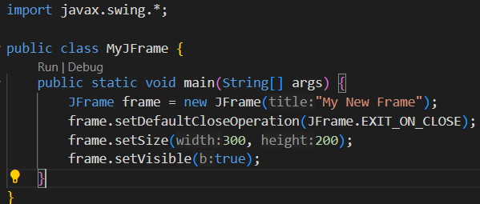
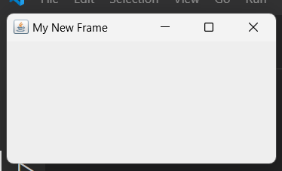
JFrame
Code:
Output:

Slide 9
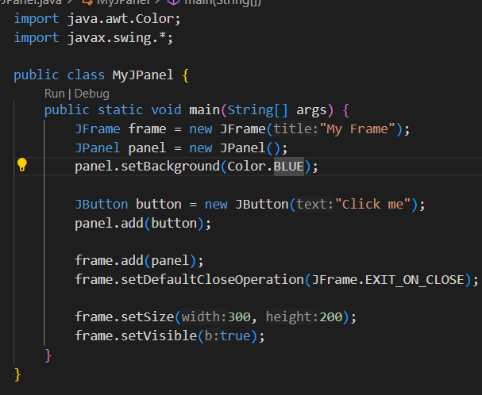
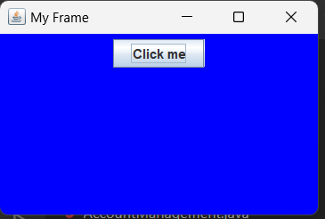
JPannel
Code:
Output:

Slide 10
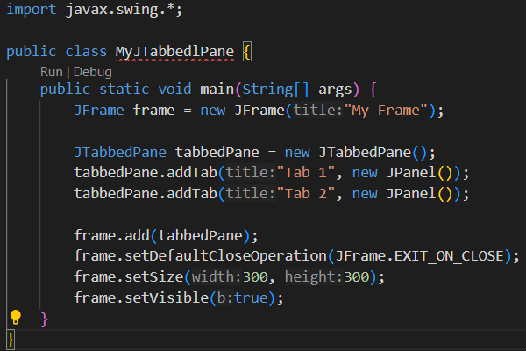
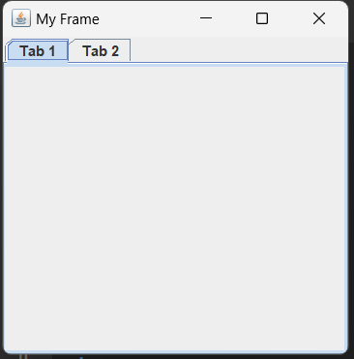
JTabbedPane
Code
Output

Slide 11
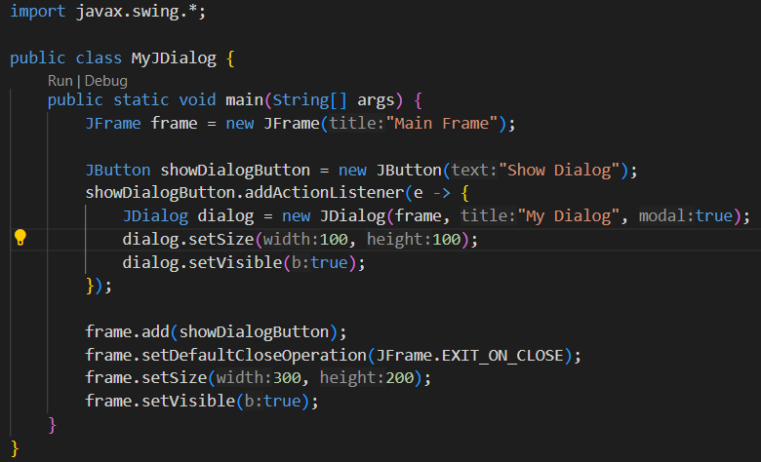
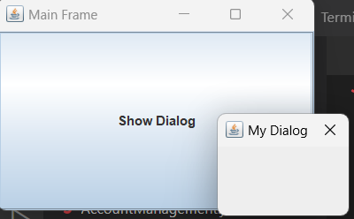
JDialog
Code
Output

Slide 12
04
COMPONENTS

Slide 13
COMPONENTS
In Java Swing, components are the building blocks of graphical user interfaces (GUIs). A component is an object that represents a part of the user interface (UI) that can be seen and interacted with by the user. These include buttons, labels, text fields, sliders, menus, panels, and more.
Common Components in Java Swing:
JButton: A button that users can click to perform an action.
JLabel: A non-interactive text or image display.
JTextField: A single-line text input field.
JTextArea: A multi-line text area for input or display.
JCheckBox: A checkbox that can be selected or deselected.
JRadioButton: A radio button, used to select one option from a group.
JComboBox: A drop-down menu for selecting one option from a list.
JMenuBar: A menu bar at the top of a window.
JSlider: A slider component that allows selecting a value from a range.

Slide 14
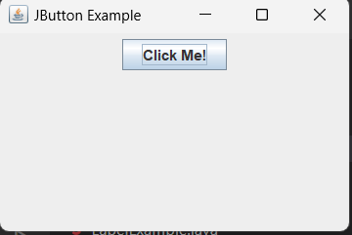
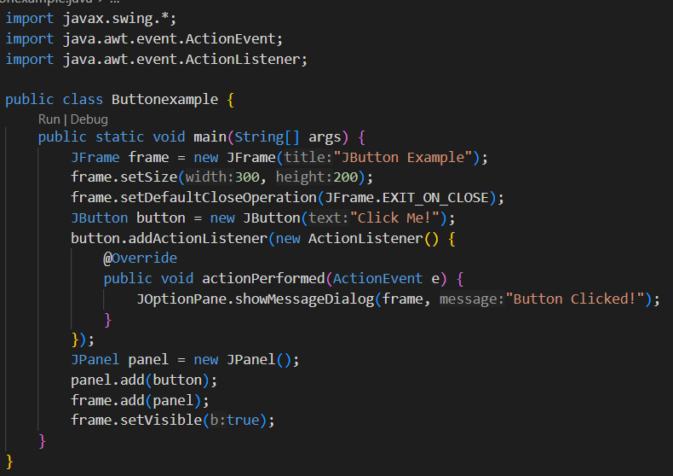
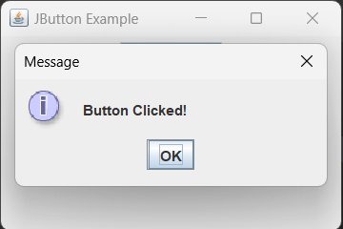
JButton
Code:
Output:

Slide 15
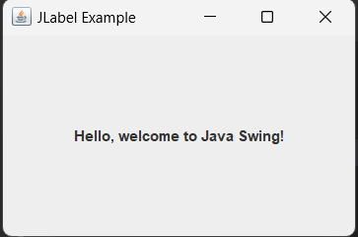
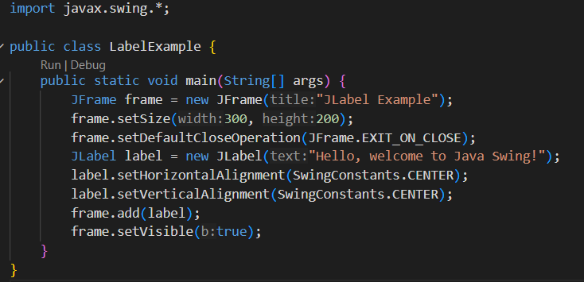
JLabel
Code:
Output:

Slide 16
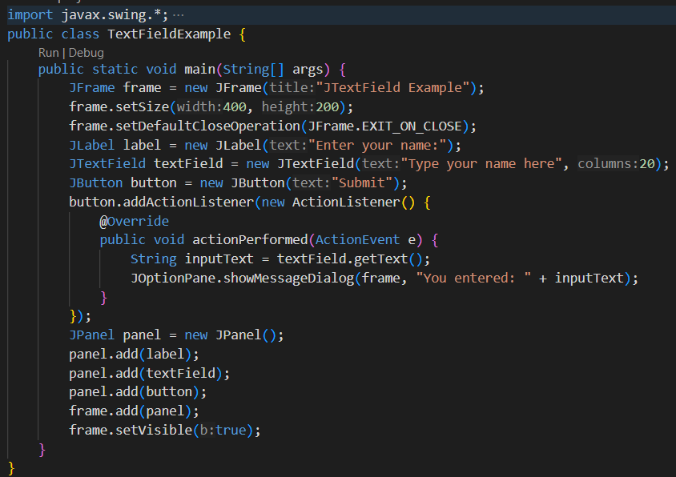
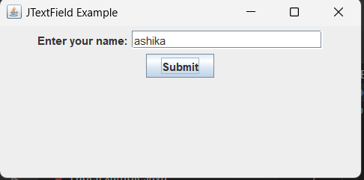
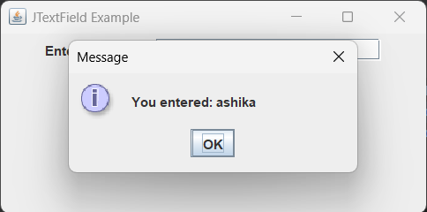
JTextfield
Code:
Output:

Slide 17
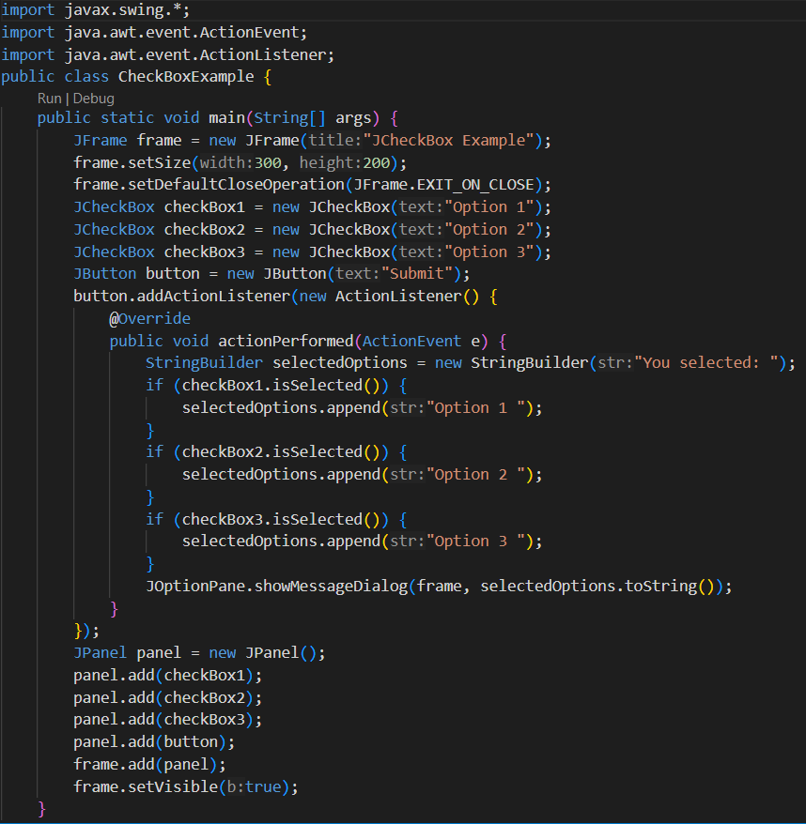
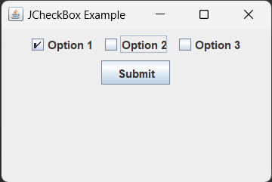
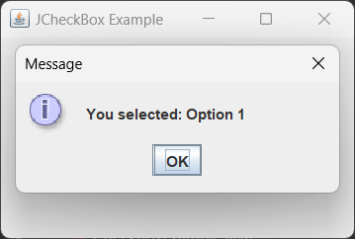
JCheckBox
Code:
Output:

Slide 18
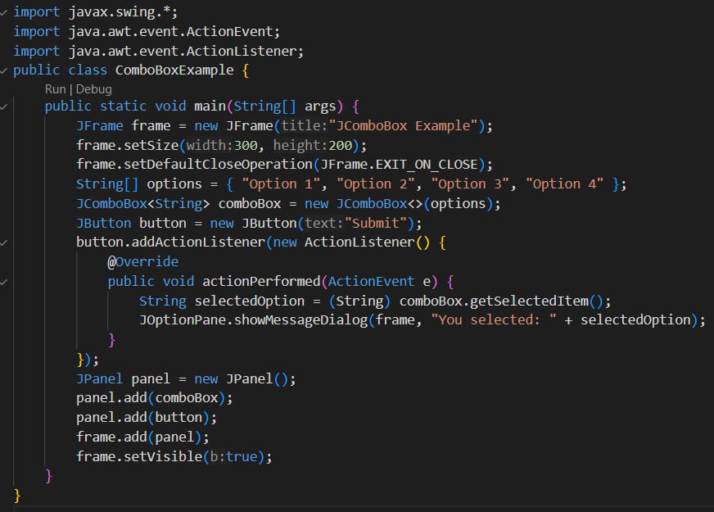
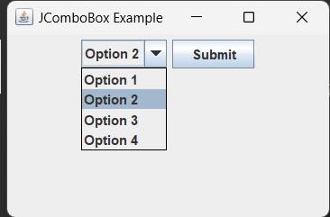
JComboBox
Code:
Output:

Slide 19
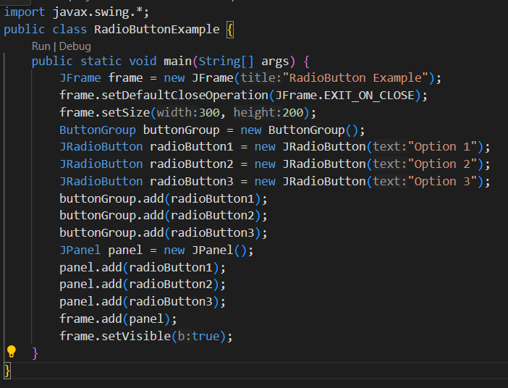
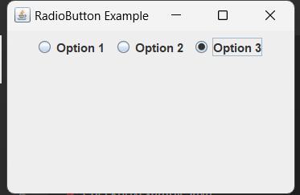
JRadioButton
Code:
Output:

Slide 20
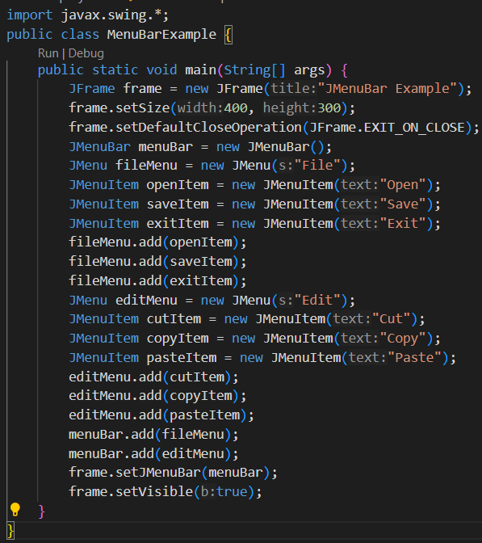
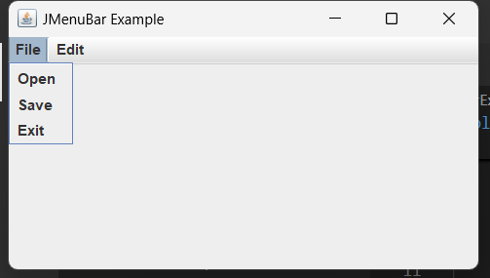
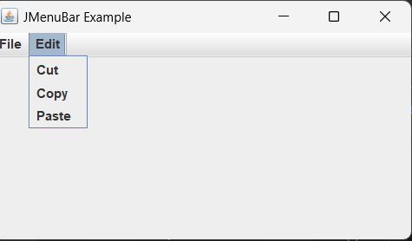
JMenuBar
Code:
Output:

Slide 21
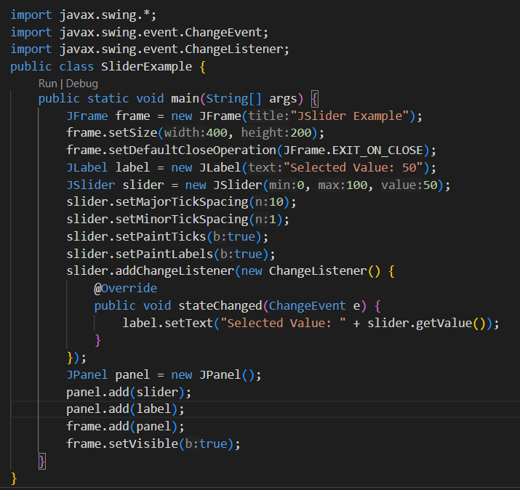
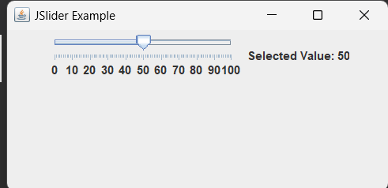
JSlider
Code:
Output:

Slide 22
5
LayoutManager

Slide 23
LayoutManager
In Java Swing, Layout Managers are responsible for controlling the size and
position of components within a container . They provide a flexible way to arrange GUI components automatically without having to specify exact coordinates.
Here’s a list of the most commonly used layout managers in Java Swing:
FlowLayout: Components flow in a row.
BorderLayout: Divides into five regions (North, South, East, West, Center).
CardLayout: Stack of components, one visible at a time.
GridLayout: Grid of equal-sized cells.
GridBagLayout: Complex grid with precise control over component placement.
BoxLayout: Arranges components vertically or horizontally.
GroupLayout: Complex layout, useful for forms.
SpringLayout: Defines flexible relationships between components.

Slide 24
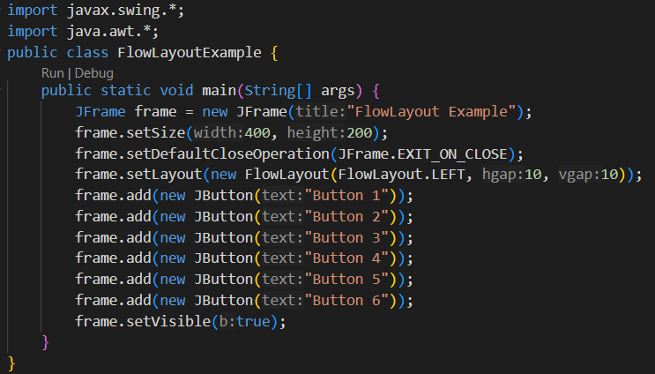
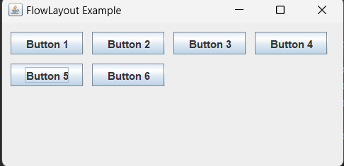
Flowlayout
Code:
Output:

Slide 25
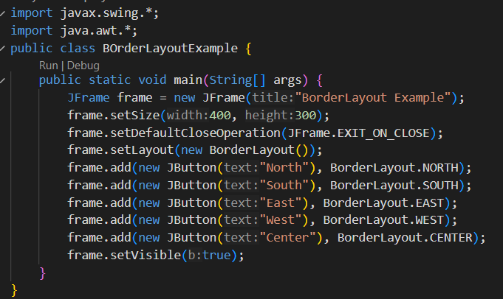
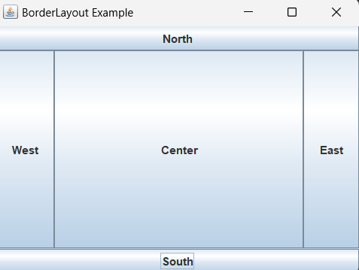
BorderLayout
Code:
Output:

Slide 26
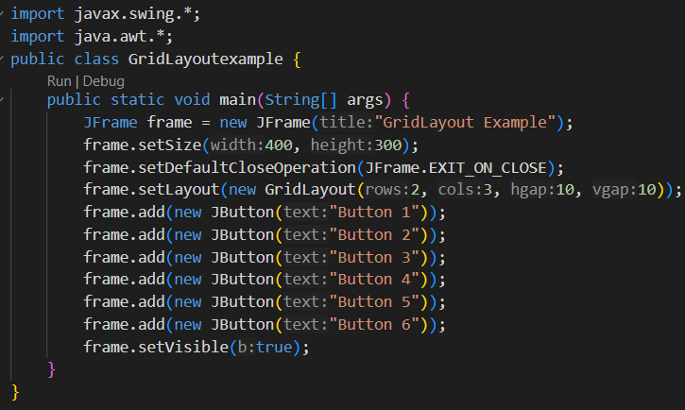
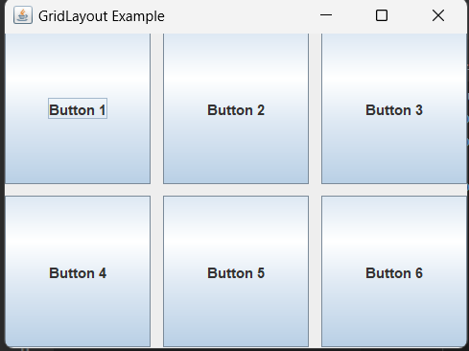
GridLayout
Code:
Output:

Slide 27
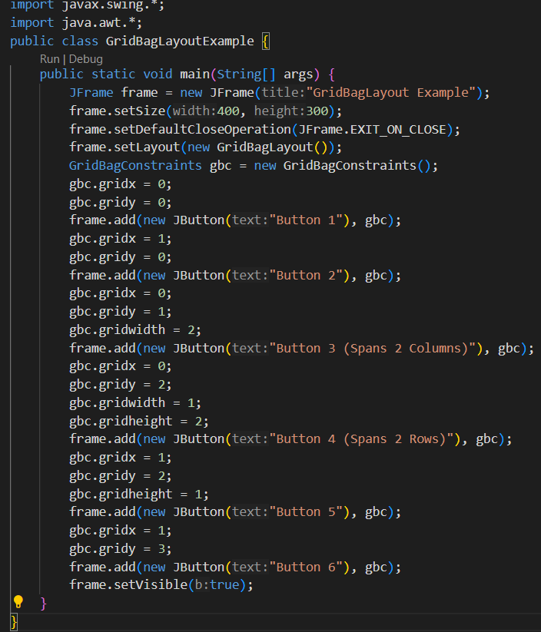
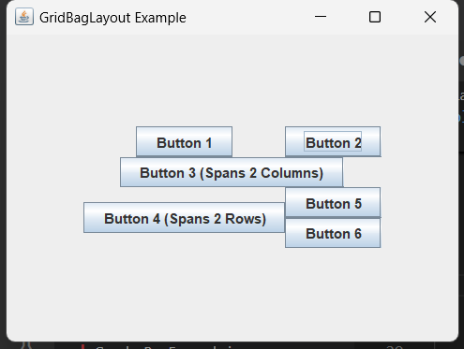
GridBagLayouot
Code:
Output:

Slide 28
6
Event Handling

Slide 29

Event Handling
In Java Swing, event handling refers to the process of managing events such as button clicks, key presses, mouse movements, etc. The Java Swing framework provides a rich set of event-handling mechanisms to handle different user interactions with graphical components.
Some of the event handling are,
ActionListener: For button clicks and menu actions.
MouseListener: For mouse interactions (clicks, enter, exit).
KeyListener: For keyboard input (key press/release).
WindowListener: For window actions (closing, opening).
ItemListener: For items in checkboxes, combo boxes, etc.
ChangeListener: For changes in components like sliders or spinners.

Slide 30
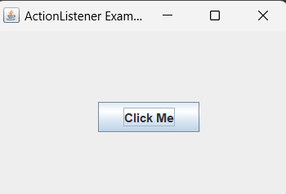
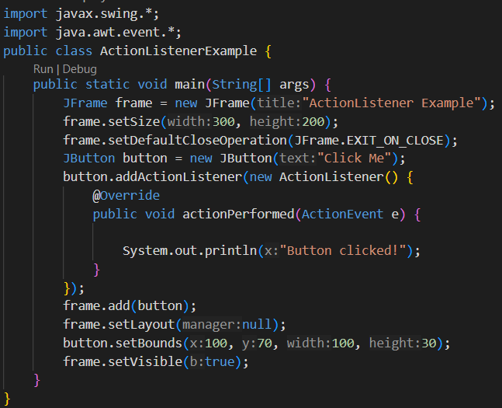

ActionListener
Code:
Output:

Slide 31
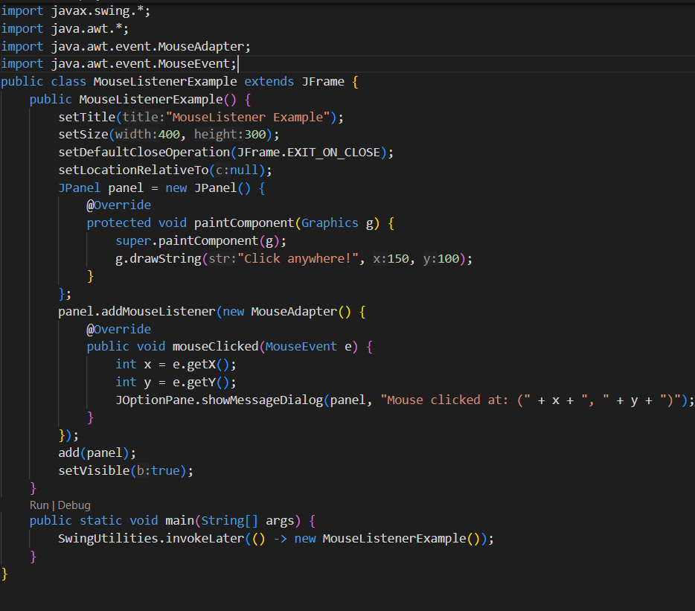
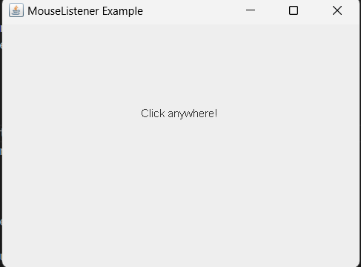
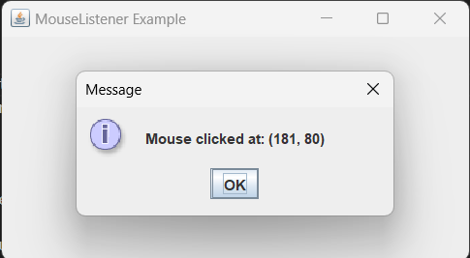
MouseListener
Code:
Output:

Slide 32
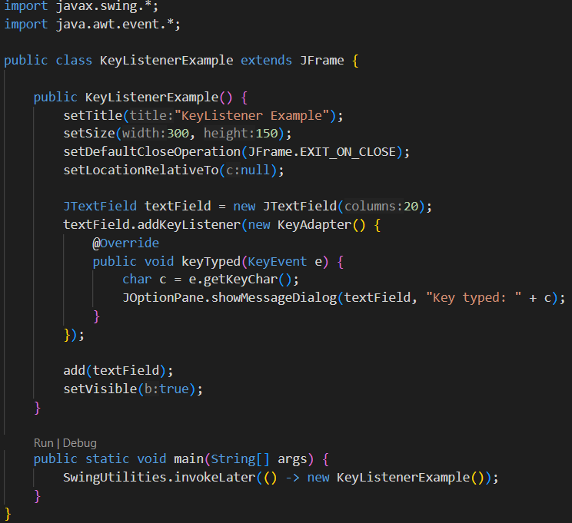
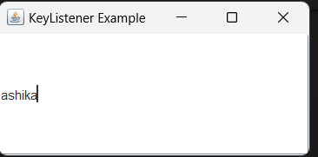
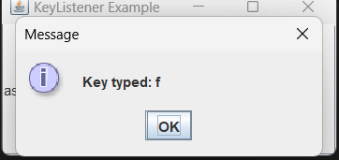
KeyListener
Code:
Output:

Slide 33
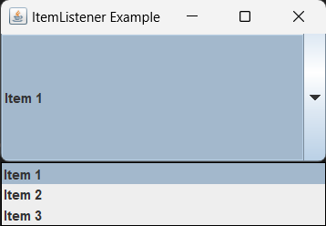
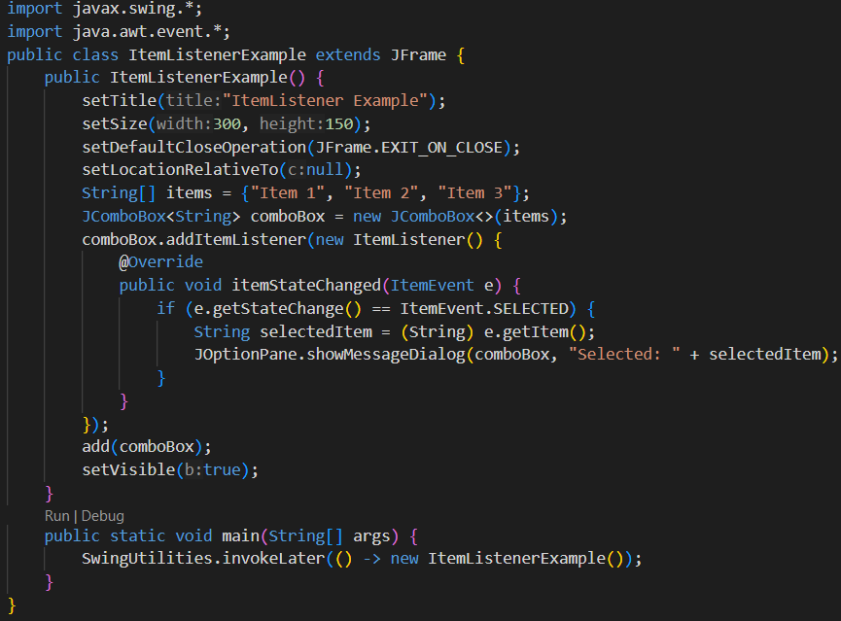
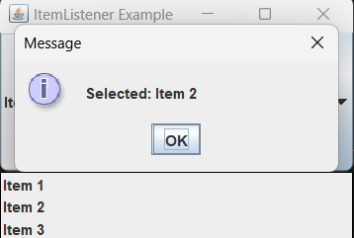
ItemListener
Code:
Output:

Slide 34
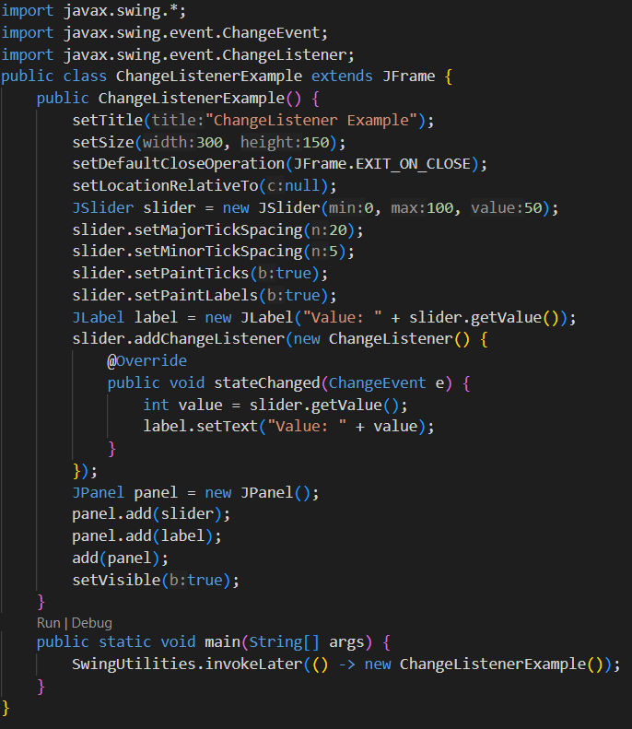
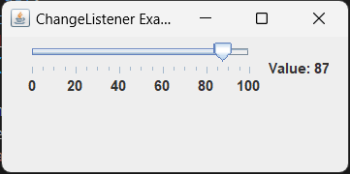
ChangeListener
Code:
Output:

Slide 35
THANK YOU
REFERENCES:
Java Swing Tutorial
Java KeyListener
Java ItemListener
Java ChangeListener
Creating a GUI With Swing
Handling Event

