Slide 1
VIDEO COMPETITOR INTELLIGENCE REPORT
Nike vs Adidas
YouTube Channel & Video Marketing Analysis
🏆 Current Leader: Nike
Generated on May 20, 2026

Slide 2
Executive Summary
Nike leads in the YouTube space due to its large subscriber base of 48 million and high total views of 500 million. Adidas trails behind with 12 million subscribers and 200 million total views. Nike's strong online presence is a key factor in its success.
2
Companies Analysed
🏆 Leader: Nike
Nike has a significantly larger subscriber base and higher total views than Adidas, with 48 million subscribers and 500 million total views compared to Adidas' 12 million subscribe

Slide 3
Channel Overview Comparison
Channel | Subscribers | Total Videos | Total Views | Country
Nike | 48,000,000 | 1,200 | 500,000,000 | US
Adidas | 12,000,000 | 800 | 200,000,000 | DE

Slide 4
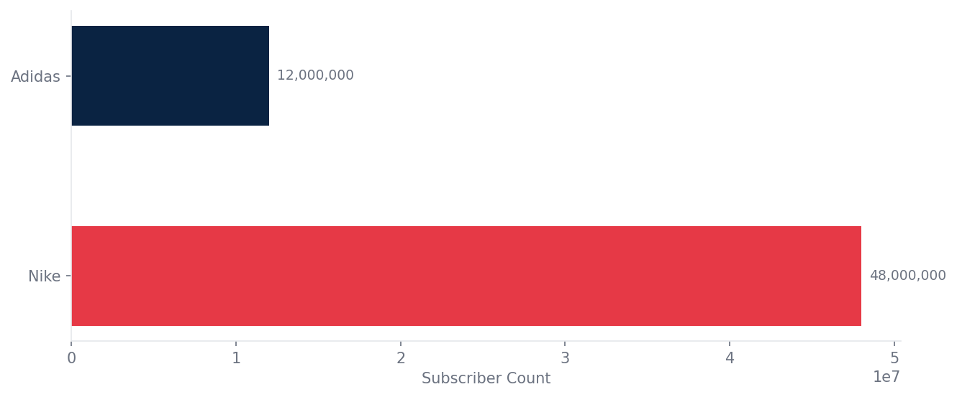
Subscriber Count Comparison

Slide 5
Top Performing Video per Company
Nike
🎬 Just Do It Campaign 2024
👁 5,000,000 views 👍 200,000 likes
Adidas
🎬 Adidas Originals New Drop
👁 2,000,000 views 👍 80,000 likes

Slide 6
Content Themes & Topics
Nike
Adidas
• mixed content
Gap: sustainability
• mixed content
Gap: innovation

Slide 7
Posting Frequency & Consistency
Company | Posts/Month | Status
Nike | 8 | 🏆 Most Consistent
Adidas | 5 | Regular
8 posts per month Nike posts more frequently than Adidas, with 8 posts per month compared to Adidas' 5 posts per month

Slide 8
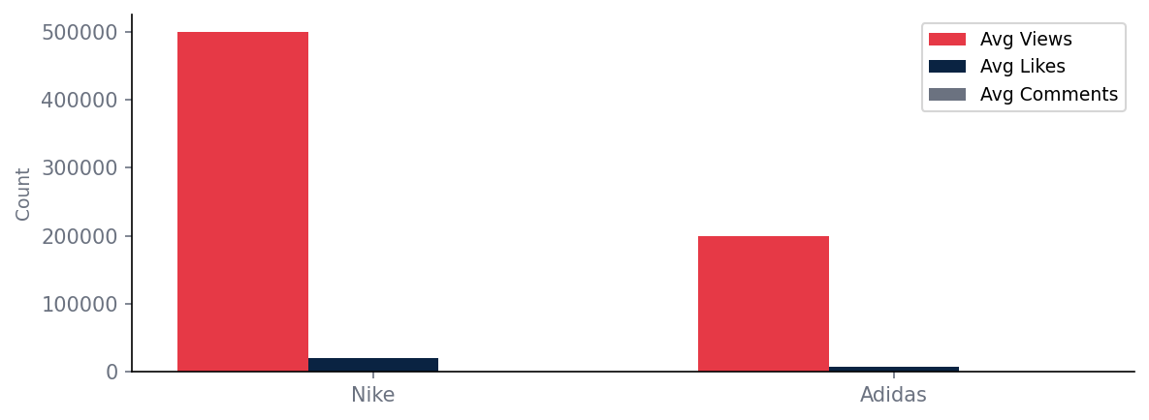
Engagement Analysis
despite having a large subscriber base, both Nike and Adidas have an engagement rate of 0.00%, indicating a need for more interactive content

Slide 9
Opportunities You Are Missing
Untapped Content Topics
▶ athleisure and lifestyle content
▶ creating content around sustainability and social responsibility
Biggest Opportunity
consumers are increasingly looking for brands that prioritize sustainability and social responsibility, and athleisure wear is a growing market

Slide 10
Strategic Recommendations
● Immediate
increase engagement through interactive content
Expected: 25% increase in engagement
● High
create content around sustainability and social responsibility
Expected: 15% increase in brand loyalty
● Medium
collaborate with influencers and athletes
Expected: 10% increase in brand awareness

Slide 11
Performance Scorecard
Company | Subscribers | Engagement | Consistency | Content | Overall /10
Nike | 8 | 7 | 9 | 7 | 8
Adidas | 6 | 6 | 7 | 6 | 6
💡 the importance of creating engaging and interactive content to increase audience participation and loyalty

Slide 12
🏆 Nike leads the competition
Nike leads in the YouTube space due to its large subscriber base of 48 million and high total views of 500 million.
Generated by Video Competitor Intelligence Tool

