Slide 1
Image Super-Resolution Using
Convolutional Neural Network
BY: Akanksh Rai (PES1UG23AM031)
Aniruddha K S (PES1UG23AM0905)

Slide 2
Contents
1️⃣ Problem Statement 2️⃣ Dataset + Pipeline 3️⃣ Training and Results 4️⃣ Conclusion and Next Steps 5️⃣ References
OVERVIEW Image Super-Resolution enhances low-resolution images into high-resolution ones by reconstructing fine details and edges using CNNs.This work builds on the pioneering SRCNN model proposed by Chao Dong et al. (2014), the first to learn an end-to-end LR–HR mapping.Our implementation improves image clarity and sharpness, achieving higher PSNR than traditional interpolation methods

Slide 3
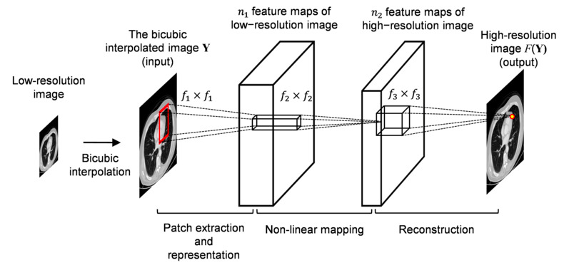
Problem Statement
Enhance low-resolution (LR) images to high-resolution (HR) using CNN that reconstructs fine details and edges. Libraries/Tools: Python, PyTorch, NumPy, OpenCV, Matplotlib, PIL.

Slide 4
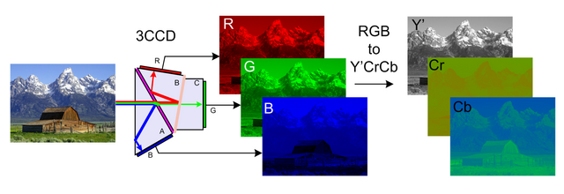
Dataset & Pipeline
Images converted from RGB to YCbCr. Super-resolution applied to Y (luminance) channel; Cb, Cr upscaled directly. Model Overview: - Feature extraction from LR input - Non-linear mapping to HR feature space - Reconstruction of final HR image

Slide 5
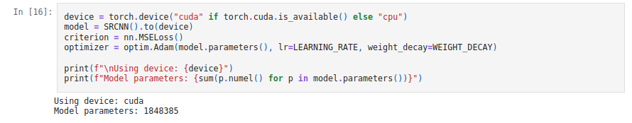
Training & Results
Training Setup: LR=1e-4 | Batch=8 | Epochs=10 | Optimizer=Adam | Loss=MSE + (L2 REGULARIZATION ) Loss Function: Mean Squared Error (MSE) Metric: Peak Signal-to-Noise Ratio (PSNR) Validation: Tracked PSNR after each epoch with visual inspection to prevent overfitting.

Slide 6


Conclusion & Next Steps
✅ Limited data slowed convergence. ✅ Y-channel focus improved fine detail reconstruction. ✅ Model achieved sharper images and higher PSNR than bicubic interpolation. Next Steps: - Train on larger datasets for better clarity. - Use deeper architectures for enhanced edge recovery.

Slide 7
References
1. Dong et al., ‘Learning a Deep Convolutional Network for Image Super-Resolution’, ECCV 2014. 2. PyTorch Documentation: https://pytorch.org 3. OpenCV Library: https://opencv.org 4 . https://www.kaggle.com/datasets/adityachandrasekhar/image-super-resolution

