Slide 1

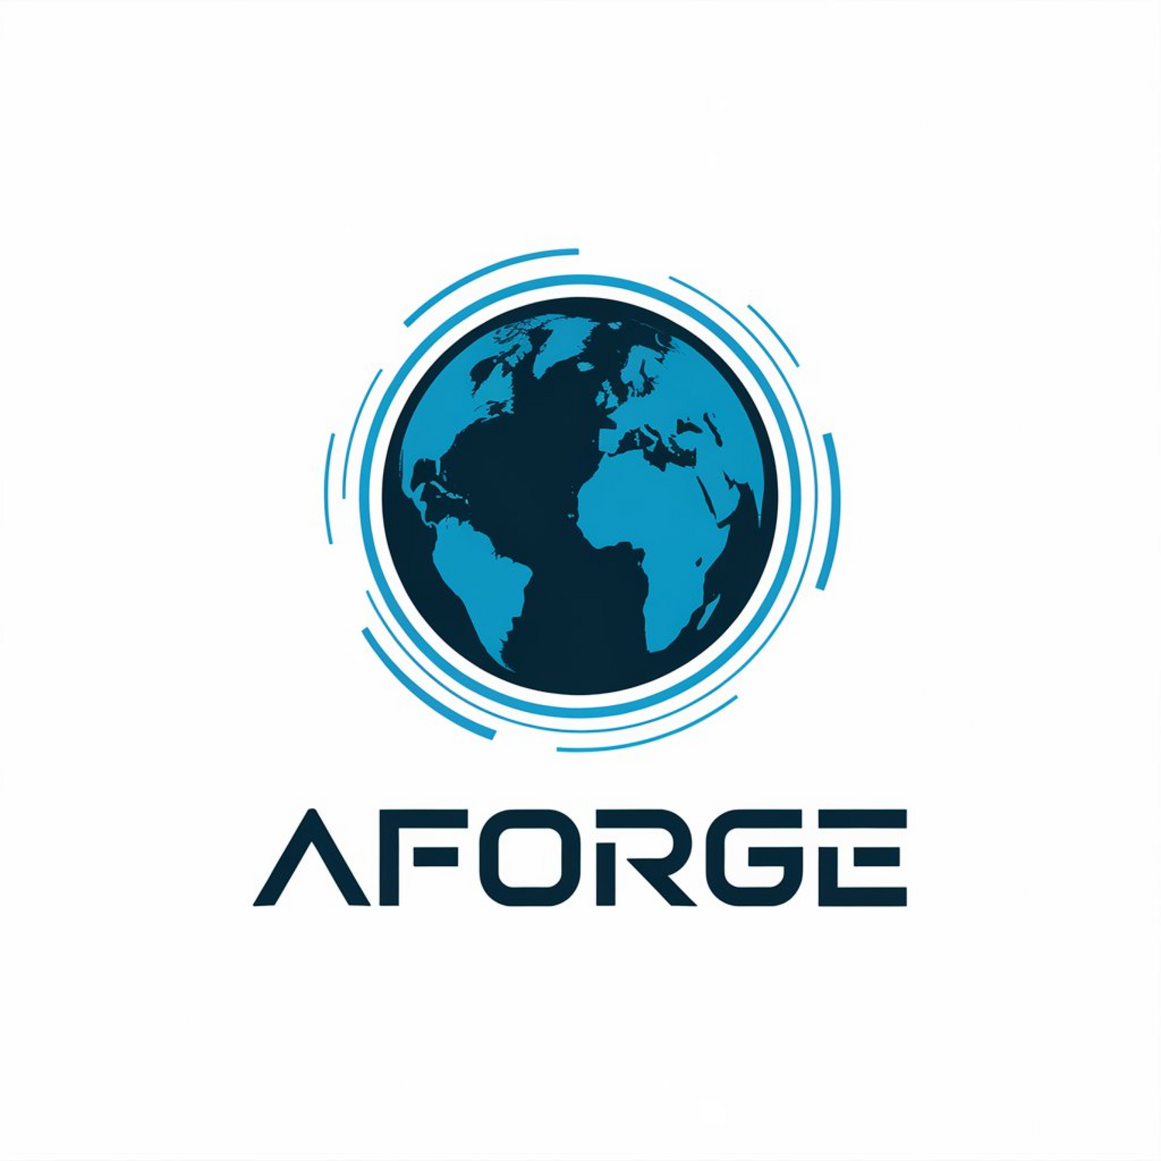
DEVOPS TRANSFORMATION STRATEGY
FOR AFORGE
Presented by: Manjinder, Veerajdeep, Akshveer, Jobanjit and Puneet

Slide 2
ABOUT
AFORGE
WHAT WE DO?
Alchemy Forge, better known as AForge, a large-scale e-commerce retailer operates as an online marketplace which offers a diverse range of products, from everyday necessities to luxurious goods.
Our Mission
Our Vision
Core Values
To deliver exceptional products and services that simplify lives, empower innovation, and drive sustainable growth.
To be a global leader in our industry, setting the standard for innovation, customer satisfaction, and sustainable practices.
Innovation, Customer Focus, Integrity, Sustainability, Colloboration, Excellence and Empowerment

Slide 3


01
02
03
Assessment & Challenges
Gap Analysis
Proposed DevOps Strategy
PROJECT
OVERVIEW
04
05
06
Toolchain Selection:
CI/CD Strategy
Security & Compliance Considerations
07
08
09
Monitoring and Metrics
Training and Culture Change
Conclusion

Slide 4



CURRENT
STATE
ASSESSMENT

Slide 5







UNDERSTANDING THE PRESENT
01
Technology & Infrastructure
02
Processes & Operations
03
Collaboration & Culture
04
Skills & Expertise
05
Monitoring & Metrics

Slide 6

Established Legacy Systems:
  The company operates on systems that have supported business growth over the years.
  These systems are reliable and support track record of stability to some extent.
01
Technology & Infrastructure
Maintenance-Focused Approach:
  A significant focus is placed on maintaining and optimizing existing infrastructure.
  This ensures continuity in operations while minimizing disruptions.
Expanding Business Needs:
  AForge’s growth and market demands highlight areas where scalability and flexibility could play a greater role.
  Teams are exploring new approaches to meet these evolving needs.

Slide 7


Communication and Collaboration
  Internal communication tools like Slack and Teams are used for departmental coordination.
  Collaboration is well-supported within teams, but face issues with opportunities for cross-departmental improvement.
02
Processes & Operations
Process Efficiency
  Processes are focused on reliability, with efforts directed toward minimizing disruptions.
  Manual workflows are in place and adapted for operational continuity.
Operational Workflow
  Established workflows ensure smooth daily operations.
  Processes are tailored to meet current business needs effectively.

Slide 8

Team Dynamics
  Teams work well within their departments, fostering a supportive environment.
  Cross-department collaboration could be improved for better alignment.
Leadership Engagement
  Leaders provide guidance and ensure stability.
  Opportunities exist to encourage more innovation and idea-sharing across teams.
03
Collaboration & Culture

Slide 9

Technical Proficiency
  Teams demonstrate strong expertise in maintaining existing systems and ensuring operational stability.
  Foundational knowledge in tools like MySQL, MongoDB, and Apache Kafka is well-established.
Specialized Expertise
  Certain team members excel in niche areas like data management and system monitoring.
  This specialization ensures a reliable backbone for ongoing operations.
Emerging Skills
  Initial exploration of cloud platforms and automation tools, such as AWS and Jenkins, indicates adaptability.
  Teams are open to learning advanced tools like Kubernetes and Infrastructure as Code (IaC).
04
Skills & Expertise

Slide 10

Established Monitoring Frameworks
  AForge employs tools like Nagios, ensuring basic infrastructure monitoring, such as server uptime and resource utilization.
  Application-level performance is partially tracked using Grafana, with visual dashboards aiding in decision-making.
Focus on System Health
  Monitoring efforts are primarily centered on system stability and identifying critical bottlenecks in real-time.
  Alerts and notifications are in place for key performance thresholds, helping teams respond quickly to disruptions.
Gaps in Metrics Integration
  Business and operational metrics, such as customer satisfaction or deployment frequency, are not fully integrated into monitoring dashboards.
  Limited visibility into cross-functional metrics (e.g., deployment lead times or failure rates) reduces insights into pipeline efficiency.
05
Monitoring & Metrics

Slide 11
GAP
ANALYSIS

Slide 12
LEGACY SYSTEMS & INFRASTRUCTURE
S
G
A
Current State
Gap
Proposed Action
The company relies on established legacy systems and a maintenance-focused approach.
Limited scalability and flexibility to meet new business demands.
Transition towards more scalable, cloud-based solutions to enable growth and adaptability.

Slide 13
LACK OF AUTOMATION
S
Current State
  Manual processes in development, testing, and deployment.
G
Gap
  Reduced speed, higher error rates, and inefficiencies.
  Implement continuous integration and deployment (CI/CD) pipelines to automate processes.
A
Porposed Action

Slide 14
LIMITED COLLABORATION
S
Current State
Teams work in silos, with minimal cross-functional collaboration.
G
Gap
Slower decision-making and reduced knowledge sharing.
A
Proposed Action
Foster a culture of collaboration through team-building exercises and role-specific training.

Slide 15

SKILL GAPS IN DEVOPS
Current State
Gap
Proposed Action
S
G
A
  Limited familiarity with modern tools (e.g., Jenkins, Docker, Kubernetes).
  Reduced ability to leverage modern DevOps tools effectively.
  Provide foundational and role-specific training and certifications to build skills.

Slide 16
MONITORING AND METRICS
S Current State | G Gap | A Proposed Action
Limited monitoring capabilities with reactive issue management. | Inability to proactively identify bottlenecks or predict potential failures. | Implement real-time monitoring and metrics dashboards using tools like Prometheus and Grafana to drive continuous improvement.
By addressing these gaps, AForge can enhance its DevOps practices, improve collaboration, and scale its operations more effectively.

Slide 17

PROPOSED
DEVOPS
STRATEGIES

Slide 18
Processes
  Establish CI/CD pipelines to accelerate software delivery.
  Adopt Agile methodologies to improve responsiveness.
  Standardize workflows for consistency across teams.
People and Culture
Technology
  Promote cross-functional collaboration.
  Conduct training on DevOps principles and tools.
  Encourage a feedback-driven, blameless environment.
  Implement cloud-based infrastructure for scalability.
  Integrate containerization tools like Docker and Kubernetes.
  Adopt monitoring tools like Prometheus and Grafana for system health.

Slide 19

ROADMAP
IMPLEMENTATION

Slide 20



01
Assessment and Training
  Conduct DevOps workshops for foundational understanding.
  Perform a gap analysis to identify focus areas

Slide 21

02
CI/CD Pipeline Integration
  Implement version control and automated builds.
  Set up automated testing and deployment workflows.

Slide 22
03
Monitoring and Feedback
  Deploy monitoring dashboards with actionable alerts.
  Analyze metrics like deployment frequency and MTTR for continuous improvement

Slide 23
04
Scaling and Optimization
  Migrate to scalable infrastructure (e.g., cloud platforms).
  Optimize resource allocation and response to peak demands.

Slide 24

TOOLCHAIN
SELECTION
GitHub
Jenkins
Docker
Terraform
Prometheus & Grafana
Slack & Jira

Slide 25

TOOLCHAIN
SELECTION
GitHub
AFORGE uses GitHub as the primary platform for code versioning and collaboration.
  Features like pull requests, branch management, and code reviews foster seamless teamwork.
  GitHub Actions: Automates workflows such as CI/CD, testing, and deployments.

Slide 26
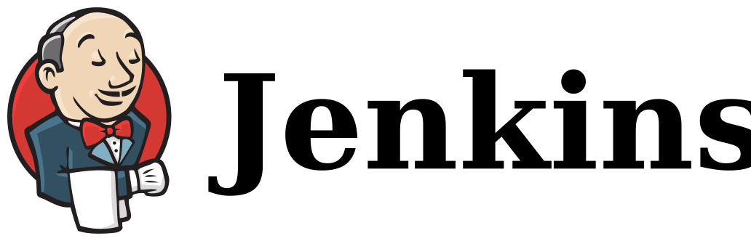
TOOLCHAIN
SELECTION
Currently used for building pipelines, testing, and deploying code.
  Can integrate with GitHub to trigger automated workflows on code pushes or pull requests.
  Offers flexibility in creating custom pipelines.
Jenkins

Slide 27
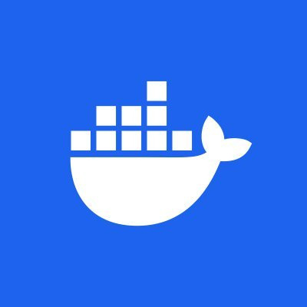
TOOLCHAIN
SELECTION
Docker is an essential part of the modern DevOps toolchain due to its ability to:
  Ensures consistency between development, testing, and production environments.
  Speeds up deployments with lightweight, portable containers.
  Facilitates the deployment and management of individual services in isolated containers.
  Integrates seamlessly with CI/CD tools for automated testing, building, and deployment.
Docker

Slide 28


TOOLCHAIN
SELECTION
Terraform is an ideal IaC tool for AFORGE due to its:
  Automates the provisioning and management of infrastructure resources, reducing manual intervention.
  Allows teams to define infrastructure in code, ensuring consistency and traceability.
  Supports a wide range of providers (e.g., AWS, Azure, Google Cloud, VMware).
  Facilitates scaling resources up or down as needed with minimal effort.
  Tracks infrastructure state, enabling updates and rollbacks.
Terraform

Slide 29



TOOLCHAIN
SELECTION
Real-Time Monitoring (Prometheus)
  Prometheus is an open-source monitoring and alerting toolkit designed for reliability and scalability.
  It collects metrics from applications and infrastructure in real-time, offering visibility into system performance.
Data Visualization (Grafana)
  Grafana is an open-source data visualization platform used to create interactive dashboards.
  It allows teams to visualize Prometheus data in rich, customizable charts, aiding in decision-making and proactive monitoring.
Prometheus & Grafana

Slide 30


TOOLCHAIN
SELECTION
Slack - Streamlined Communication and Collaboration
  Slack is a cloud-based communication tool that facilitates instant messaging, channels for team discussions, and integrations with other tools.
  It helps teams communicate in real time, share updates, and collaborate effectively on projects.
Jira - Project Management and Issue Tracking
  Jira is a comprehensive project management tool, primarily used for issue tracking, bug reporting, and managing agile workflows.
  It integrates with Slack to provide seamless communication and updates on task progress and project milestones.
Slack & Jira

Slide 31



CI/CD STRATEGY
Developers push the code to the repository.
Trigger automated build processes and run tests to validate functionality and performance.
Conduct peer reviews for quality assurance.
Deploy validated code to a staging environment for final checks.
  Automate deployment to production after staging approval.

Slide 32


SECURITY AND COMPLIANCE CONSIDERATIONS

Slide 33

SECURITY IN DEVOPS
Transition from traditional security to DevSecOps for proactive integration throughout the pipeline.
Foster a shared responsibility model where all teams (Development, Operations, and Security) contribute to system security.
02

Slide 34

SECURITY MEASURES
Identity and Access Management (IAM)
Implement role-based access control (RBAC) to limit system access.
Use tools like AWS IAM or Azure AD to manage user roles securely.
Data Protection:
Encrypt sensitive data in transit (TLS) and at rest (AES).
Regular backups with tested recovery procedures.
Vulnerability Management:
Encrypt sensitive data in transit (TLS) and at rest (AES).
Regular backups with tested recovery procedures.
Automate vulnerability scanning for code, dependencies, and containers using tools like Snyk or Nessus.
03

Slide 35
Secure Code Practices:
Perform static and dynamic code analysis for early detection of security flaws.
Monitor open-source dependencies to address vulnerabilities.
Infrastructure Security:
Automate deployment securely using IaC tools like Terraform or Ansible.
Conduct regular audits for IaC misconfigurations.
Incident Response Planning:
Establish and document response protocols for quick detection and containment of incidents.
Use real-time monitoring and logging tools like Prometheus and ELK Stack for alerts.
03

Slide 36


COMPLIANCE MEASURES
  Regulatory Adherence:
Align with GDPR, HIPAA, PCI-DSS, or other relevant standards.
  Audit Trails:
Maintain logs of system access and operational changes for transparency and accountability.
  Automated Policy Enforcement:
Use tools like Chef InSpec or Open Policy Agent (OPA) to automate compliance checks.
06

Slide 37



CONTINUOUS SECURITY PRACTICES
Penetration Testing:
Regularly simulate attacks to identify vulnerabilities.
Threat Modeling:
Evaluate potential risks during the design phase.
Continuous Monitoring:
Use tools like Grafana or AWS CloudWatch to track anomalies.
Secure Code Review:
Conduct peer reviews with a focus on security.

Slide 38

BENEFITS OF SECURITY-FIRST DEVOPS
Resilience
Trust
Cost Efficiency
It reduces risks of breaches and ensures business continuity.
Builds customer and stakeholder confidence.
Avoids expenses related to security incidents or non-compliance fines.

Slide 39






MONITORING AND METRICS
Critical Role
Monitoring and metrics play a critical role in the DevOps transformation by providing real-time visibility into system performance, deployment pipelines, and overall workflow efficiency.
Identification
They help teams identify bottlenecks, pinpoint areas for improvement, and ensure issues are detected early, allowing for quicker resolution and smoother operations.
Optimization
By tracking key metrics, organizations can continually optimize their processes, improve product quality, and deliver better customer experiences.

Slide 40



KEY PERFORMANCE INDICATORS (KPIS)
Deployment Frequency
Measures how often code is deployed to production.
Lead Time for Changes
Tracks the time from code commit to deployment.
Change Failure
Rate
Monitors the percentage of deployments that fail in production.
Mean Time to Recovery (MTTR)
Measures the time taken to restore services after a failure.

Slide 41





TRAINING AND CULTURAL CHANGE

Slide 42



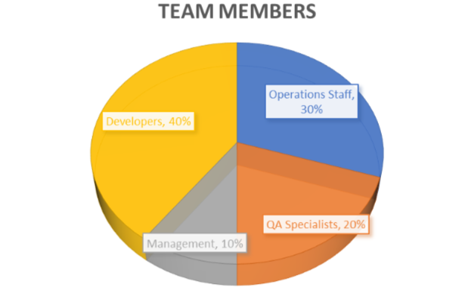


SURVEY:
We conducted a survey with AForge team consisted of 20 questions which were divided into four major categories of DevOps Concepts, familarity with the tools, process knowledge and collaboration. The following were the demographics of this:

Slide 43
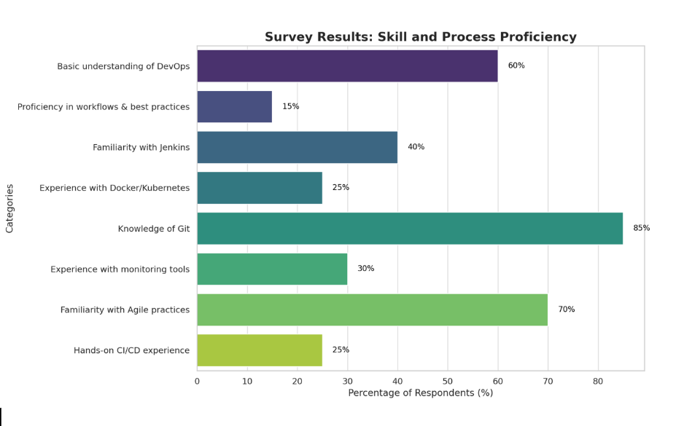

Slide 44


THYNK UNLIMITED
Key Findings & Solutions:
Foundational Training Programs:
Role-Specific In-Depth Training:
Cross-Functional Team Initiatives:
Customized Learning Paths:
Certifications:
  Workshops on DevOps principles for all teams.
  Beginner tutorials on tools like Jenkins and Docker.
  For Developers: Advanced sessions on CI/CD pipeline and Infrastructure as Code (IaC).
  For Operations: Hands-on practice with tools like Kubernetes and Grafana.
  For Management: Focused sessions on Agile-DevOps and metrics.
Organize DevOps Hackathons, Innovation Sprints, and scenario-based challenges to foster team collaboration.
Tailor individual training plans based on survey results to meet employees' current skill levels.
Support certifications like AWS Certified DevOps Engineer or Kubernetes Administrator.

Slide 45

CULTURAL TRANSFORMATION:
LEADERSHIP COMMITMENT:
Encourage leadership to model DevOps principles and values such as collaboration and transparency.
Train internal advocates to drive DevOps adoption.
BLAMELESS ENVIRONMENT:
Promote a culture where incidents are reviewed to focus on learning and growth instead of blame.
FEEDBACK LOOPS:
Foster real-time feedback through tools like Slack or Microsoft Teams to improve communication.
RECOGNITION
Celebrate team successes to boost morale and motivation.

Slide 46
CONCLUSION
By following the proposed actions and plans, the company will be able to achieve greater agility, reliability, and success in its DevOps transformation journey.

Slide 47



OUR TEAM
Manjinder
Singh
Akshveer
Kaur
Veerajdeep
Singh
Jobanjit
Singh
Puneet
Kumar

Slide 48

THANK
YOU

