Slide 1
Slide Presentation
CSC 4195 Research Methodology
10
5
Fall 2022-2023
Dr. Afroza Nahar, Associate Professor
Department of Computer Science, Faculty of Science & Technology.
afroza@aiub.edu

Slide 2
Purpose of a research talk
Is not to
Impress the audience
Tell them all you know about a subject
Present every little detail of your work
Is to
Give the audience a sense of what your idea/work is
Make them want to read your paper
Get feedback on your work

Slide 3
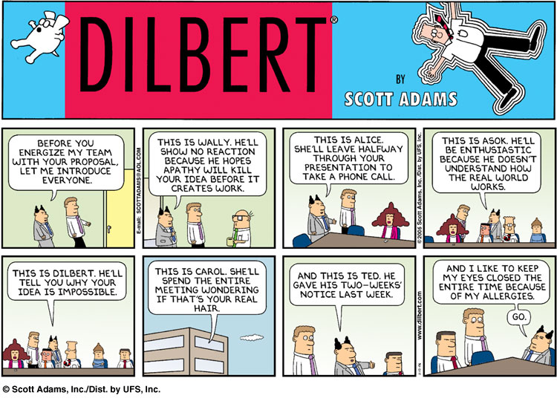
Know your audience

Slide 4
Know your audience
Who would be there?
Scientists expert in your field
Scientists not expert in your field
Students
Non experts
Who knows?
Most likely a mix so have something for all

Slide 5
Know your audience…
Keep in mind
They might be tired
They can read ☺
They are thinking “Why should I listen?”
Non-experts will tune off within 2 minutes
Experts after 5 minutes
What can you do?

Slide 6
What can you do?
Early motivation - at the beginning of your talk motivate your research with easy to understand examples
Spoil the punch line - State your results early and in simple terms
Visuals – Illustrate your idea with images and diagrams

Slide 7
Leave them with these thoughts
I understood what the problem was and why it was important
I have an idea of what her solution was and how it was different/better than others
She knows the literature (i.e. quoted my work ☺) and we might collaborate on this aspect of her research

Slide 8
Use examples
Examples are your weapon to
Motivate your work
Illustrate the basic intuition
Show your solution in action (baby problem)
Highlight extreme cases or shortcomings
If you are running out of time cut the general case not the example

Slide 9
Where were you?
People will get lost during your talk, even those who are listening
have a running outline of the main steps of your idea (more than the talk itself)
use visual clue to highlight where you are in the process
present it at the beginning of each step
Preprocessing
Filtering
Texture Extraction
Decision Trees
Classification

Slide 10
Related work
Be familiar with all related work
Don’t list each paper you read
Mainly talk about results that are immediately related to what you did
References at the end of the talk or better in the paper itself
Acknowledge co-authors (title slide)

Slide 11
Technical details: in or out?
A fine line
Present specific aspect that show the “meat” of your work
Leave the rest out. If you were convincing they will read your paper
Don’t fill up your slides with lots of equations
Prepare back-up slides to answer questions. Leave them at the end of the presentation

Slide 12
The skeleton
What is the problem
Motivation and goals
Relevant state of the art
What is your key idea/contribution
Why is your approach good/better
What I just said and what I want to do next

Slide 13
Preparing the presentation
Less is more. Fill in with narration not words
Use animation sparingly
Use color to emphasize some points but limit to 2 or 3
Be consistent! In the choice and use of color font size/type etc
Use slide real estate appropriately

Slide 14
Slide layout - Bad
This page contains too many words for a presentation slide. It is not written in point form, making it difficult both for your audience to read and for you to present each point. Although there are exactly the same number of points on this slide as the previous slide, it looks much more complicated. In short, your audience will spend too much time trying to read this paragraph instead of listening to you.

Slide 15
Slide layout - GOOD
Show one point at a time:
Will help audience concentrate on what you are saying
Will prevent audience from reading ahead
Will help you keep your presentation focused

Slide 16
Fonts - Good
Use a decent font size
Use different size fonts for main points and secondary points
this font is 24-point, the main point font is 32-point, and the title font is 44-point
Use a standard font like Times New Roman or Arial

Slide 17
Fonts - BAD
If you use a small font, your audience won’t be able to read what you have written
CAPITALIZE ONLY WHEN NECESSARY. IT IS DIFFICULT TO READ
Don’t use a complicated font

Slide 18
Color - Good
Use font color that contrasts sharply with the background
Blue font on white background
Use color to reinforce the logic of your structure
Ex: light blue title and dark blue text
Use color to emphasize a point
But only use this occasionally

Slide 19
Color - bad
Using a font color that does not contrast with the background color is hard to read
Using color for decoration is distracting and annoying.
Using a different color for each point is unnecessary
Same for secondary points
Trying to be creative can also be bad

Slide 20
Background - Good
Use backgrounds such as this one that are attractive but simple
Use backgrounds which are light
Use the same background consistently throughout your presentation

Slide 21
Background – Bad
Avoid backgrounds that are distracting or difficult to read from
Always be consistent with the background that you use

Slide 22
Graphs - Good
Use graphs rather than just charts and words
Data in graphs is easier to comprehend & retain than is raw data
Trends are easier to visualize in graph form
Always title your graphs

Slide 23
Graphs - Good

Slide 24
Graphs - Bad

Slide 25
Graphs - Bad
Minor gridlines are unnecessary
Font is too small
Colors are illogical
Title is missing
Shading is distracting

Slide 26
Graphs - Bad

Slide 27
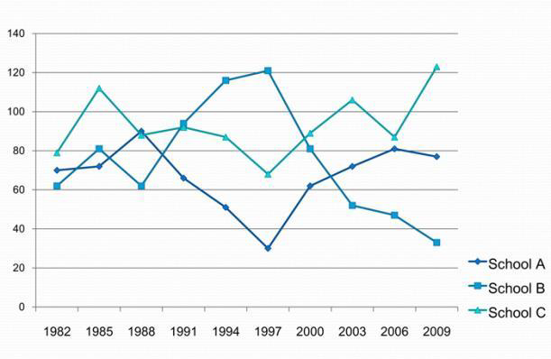
Presenting with Charts
•Simplify charts
Changing the chart format
How do you know when to use which chart?
That depends on how well you’ve stated the message.
Your heading should always tell people what you want them to look for on a chart.
•Choosing the chart
Use an action statement as a heading,
look at the verbs in the statement to get an idea of the best chart to use to present your data.
•Look for a key word
Grow
Decline
–Trends
Line Charts
•Line charts are best when a variable has more than four or five data point.
•The slope of the line quickly tells the audience the direction of the trends.

Slide 28
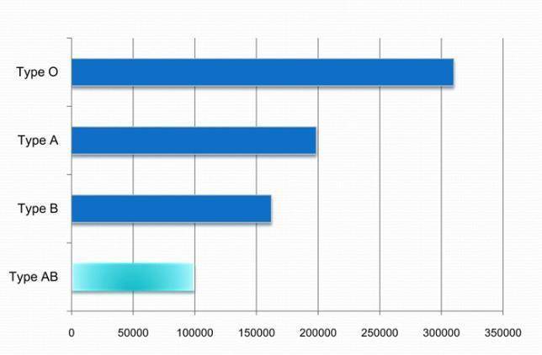
Charts ...
Comparing items at one point in time
•Look for a key word
–Ranks
–Compares
–Highest profit
–The lowest interest rate
–The most products sold
–Rank variables from largest to smallest
Bar Charts
•Bar charts are often the best way to compare a set of individual items or several sets of related items.
•The bar’s length corresponds to its ranking; the bar’s label identifies the item.

Slide 29
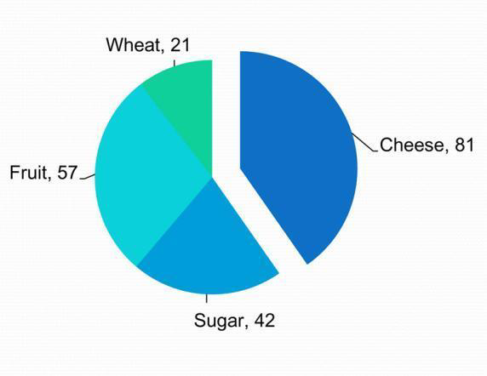
Charts ...
Comparing parts of a whole
•Look for a key word
Percentage
Portion
Share
Pie Charts

Slide 30
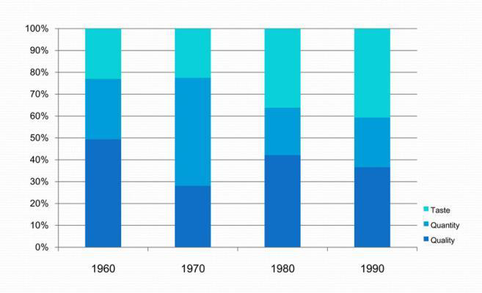
Charts ...
Comparing data by geographic location
•Look for a key word
Country
Area
Segmented Bar Charts
Distinguish among regions by using different colours, shadings, or symbols.

Slide 31
Charts ...
Additional Tips for Graphs & Charts
Show one message per chart.
Make the chart easy to read.
Be accurate.
Always start a numerical axis at zero.
Eliminate all unnecessary details.
To focus attention, use colour, shading, arrows to highlight

Slide 32
Preparing the presentation
Prepare the slides in advance
Show them to friends
When you think you are done read them again
Check all animations with the sound on ☺

Slide 33
Preparing the presentation
Practice, practice, practice
Give a practice talk to a general audience
Give a practice talk to an audience of expert
Time your presentation (allow for speed up effect caused by nervousness)
Always assume technology will fail you. Have backups.

Slide 34
Some resources
http://research.microsoft.com/~simonpj/papers/giving-a-talk/writing-a-paper-slides.pdf
http://wit.tuwien.ac.at/research/tips/good_research_talk_slides.pdf
http://research.microsoft.com/~simonpj/papers/giving-a-talk/giving-a-talk-html.html
http://www.cse.buffalo.edu/~rapaport/howtowrite.html
http://www.iasted.org/conferences/formatting/Presentations-Tips.ppt

