Slide 1
METHODOLOGY: Scientific Research Method
CSC 4195 Research Methodology
6-8
4
Fall 2022 -2023
Dr. Afroza Nahar, Associate Professor,
Department of Computer Science, Faculty of Science & Technology.
afroza@aiub.edu

Slide 2
Introduction
Research is a creative process
Research is knowledge acquisition gained
Through reasoning
Through intuition
But most importantly through the use of appropriate methods: Scientific Method!

Slide 3
Introduction
Research methods describes how the objectives will be achieved
They address:
How will data be generated or collected
Analytic techniques to be used
Sequence of procedures

Slide 4
Scientific Method
Scientific Method comprises a series of four cyclic steps:
Observing a phenomenon
Formulating tentative explanations or statements of cause and effect
Further observing or experimenting or both to rule out alternative explanations
Refining and retesting the explanations

Slide 5
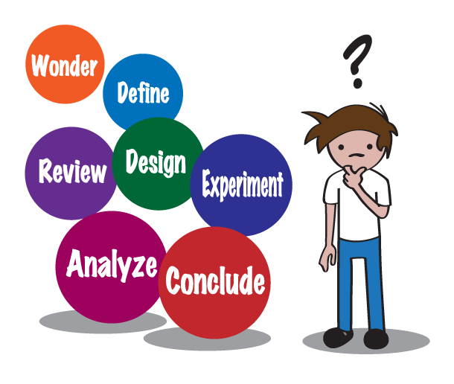

Slide 6
Basic Elements of Scientific Method
Empiricism: The notion that enquiry is conducted through observation and knowledge verified through evidence
Determinism: The notion that events occur according to regular laws and causes. The goal of research is to discover these
Skepticism: The notion that any proposition is open to analysis and critique

Slide 7
Observing a Phenomenon
To observe the behaviour of interest and of potential causes for that behaviour
To formulate hypotheses about the factors affecting the behaviour observed
To identify variables that appear to have an impact on the behaviour
[A variable is any characteristic or quantity that can take on two or more values]

Slide 8
Formulating Tentative Explanations
To develop one or more tentative explanations that deem consistent with the observations
Formulate a statement on the nature of the relationship between variables that you expect to uncover with your research: hypothesis
Any hypothesis developed should be testable with empirical research

Slide 9
Further Observing & Experimenting
Further observations to be carried out to test the validity of any hypotheses that has been developed.
Design a research study to test the proposed relationship, such as:
A correlational study in which you measure two or more variables and look for a relationship between them
A quasi-experimental study in which you take advantage of some naturally occurring event or pre-existing conditions, or
An experiment in which you systematically manipulate a variable and look for changes in the value of another that occur as a result

Slide 10
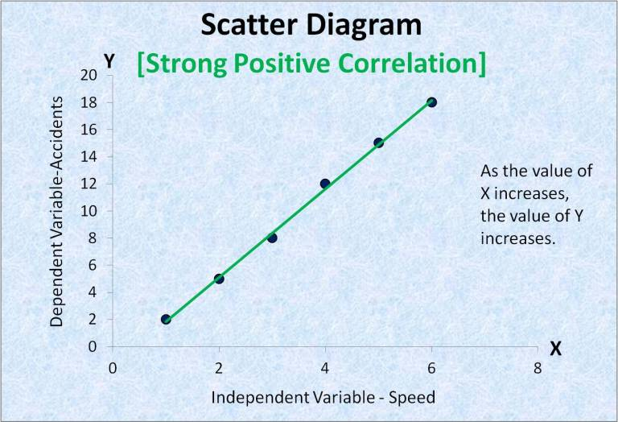

Slide 11
Refining & Retesting Explanations
Confirming a hypothesis with a research study leads to other hypotheses that expand on the relationships discovered, explore the limits of the phenomenon under study, or examine the causes for the relationship observed.
Refinement process: A process of generating new, more specific hypotheses in the light of previous results.
Not all research studies confirm your hypothesis. Next step is to:
Discard your original hypothesis, or
Do retesting, i.e. revise and retest your hypothesis. (Must be tested as rigorously as was the original hypothesis.)
SEC L

Slide 12
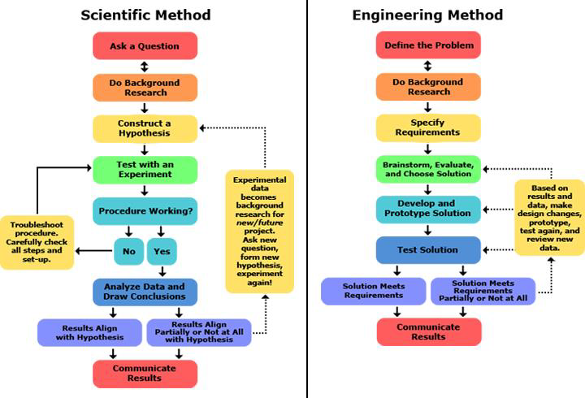

Slide 13
^{The} SCIENTIFIC METHOD
Modified Hypothesis
Observe natural Phenomena
Formulate Hypothesis
Test hypothesis via rigorous Experiment
Establish theory based on repeated validation of results
^{The} ACTUAL METHOD
Modify Theory to fit data
Make up Theory base on what Funding Agency Manager wants to be true
Design minimum experiments that will prove / show suggested Theory is true
Publish a paper: Rename Theory a “Hypothesis” and pretend you used the Scientific Method
Defend Theory despite all evidence to the Contrary

Slide 14
Research Variables
Research is the study of the relationship among variables
Variable: Any characteristic that can take on more than one value
e.g. speed, accuracy of feedback, reaction time
There must be, at least, two variables in a research study

Slide 15
Types of Variables
Independent variables are those that (probably) cause, influence, or affect outcomes.
Dependent variables are those that depend on the independent variables;
They are the outcomes or results of the influence of the independent variables.
Other names for dependent variables are criterion, outcome, effect, and response variables

Slide 16
Measuring the Variables
Measurement: Assigning numbers to indicate the level of a variable
Sometimes the number assignment is intuitive (e.g., time measured in seconds)
Sometimes it is more arbitrary (e.g., 1 for male and 2 for female)

Slide 17
Hypothesis
An hypothesis is a specific statement of prediction that describes in concrete (rather than theoretical) terms what is expected to happen.
Not all studies have hypotheses. Sometimes a study is designed to be exploratory
Hypotheses bring clarity, specificity and focus to a research problem, but are not essential for a study.

Slide 18
Hypothesis…
A hypothesis serves the following functions:
It tells you what specific aspects of a research problem to investigate.
A hypothesis tells you what data to collect and what not to collect, thereby providing focus to the study.
Enhances objectivity in a study.
May enable you to add to the formulation of theory. It enables you to conclude specifically what is true or what is false.

Slide 19
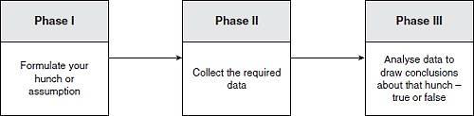
Testing a Hypothesis
A hypothesis must be testable and falsifiable
Observations and experiments must be repeatable
Easy to test:
The maximum efficiency of a solar cell is 28%
Difficult to test:
Suicide rates vary inversely with social cohesion

Slide 20
Limitations of Scientific Methods
Scientific method is a powerful tool, but it does have its limitations
Science cannot prove or refute the existence of God or any other supernatural entity.
Science is also incapable of making value judgments. It can study the causes and effects of global warming and report on those results, but It cannot say global warming is bad

Slide 21
Limitations …
Occasionally, certain organizations use scientific data to advance their causes. This blurs the line between science and morality and encourages the creation of "pseudo-science," which tries to legitimize a product or idea with a claim that has not been subjected to rigorous testing.
The major ethical issues in conducting research are:
Informed consent
Beneficence- Do not harm
Respect for anonymity and confidentiality
Respect for privacy.

Slide 22
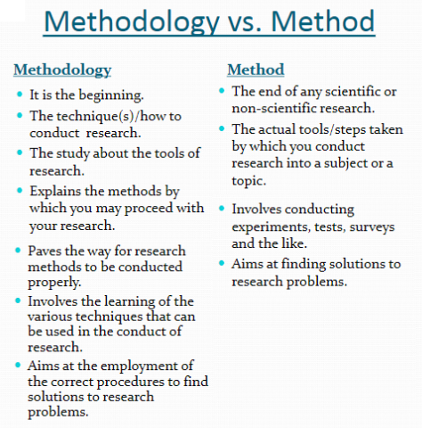

Slide 23
