Slide 1
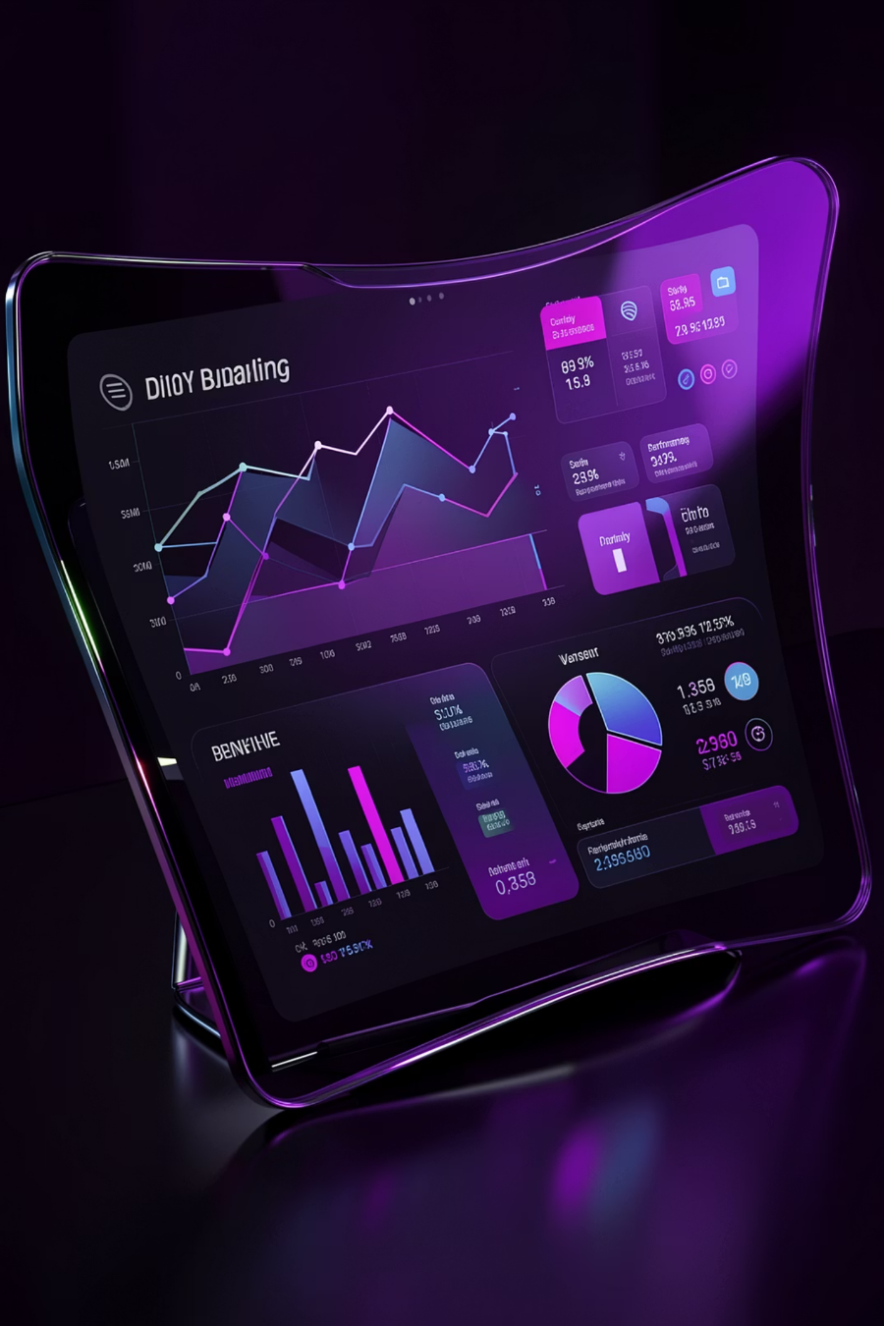

Customer Churn Analysis Dashboard
A comprehensive data-driven investigation into customer retention patterns across 10,000 banking customers

Slide 2

Executive Summary: The Churn Challenge
10K
Total Customers
Base population analyzed
51%
Active Members
Current engagement level
20.37%
Churn Rate
Customers leaving annually
650
Avg Credit Score
Mid-credit segment focus
The bank is experiencing high churn, especially among long-tenure customers, mid-credit segments, and multi-product users, indicating gaps in retention, engagement, and value delivery.

Slide 3
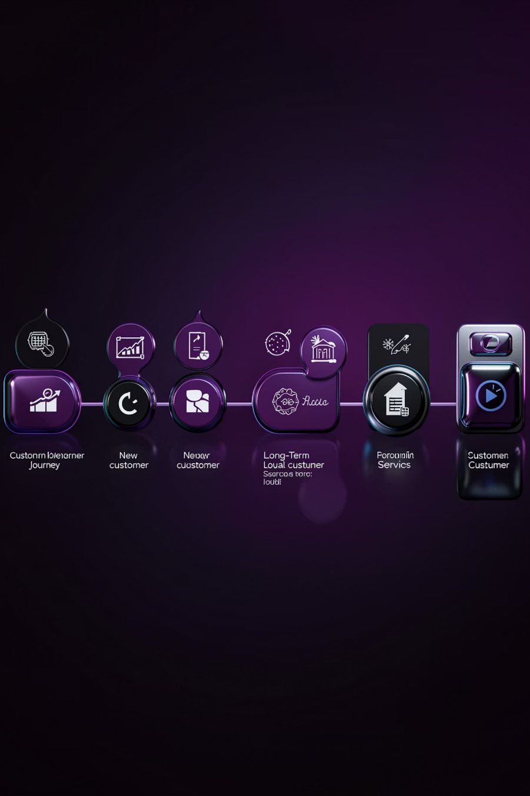
Tenure Analysis: The Long-Term Disengagement
1
0-3 Years
Low churn - initial engagement phase
2
3-7 Years
Gradual increase - growing dissatisfaction
3
7-10 Years
Peak churn - critical retention window
4
Year 9
Significant spike - highest risk point
Long-term customers are disengaging over time due to lack of loyalty rewards, competitive market offerings, and reduced perceived value. The 9th year represents a critical intervention point.

Slide 4

Geography Analysis: Regional Risk Profile
France 🇫🇷
Germany 🇩🇪
Spain 🇪🇸
~16% churn
~32% churn
~16-17% churn
Highest customer base with stable market performance
Highest and critical - major retention issue requiring immediate action
Moderate churn levels - manageable risk
Germany is the primary risk region while France shows strongest retention performance. Geographic targeting strategies must prioritize German market interventions.

Slide 5

Demographic Insights: Who's Leaving
Gender Analysis
Age Group Analysis
Male customers: ~55-57% of churn
Highest churn: 40-50 age group
Female customers: ~43-45% of churn
Moderate: 29-39
Lowest: 18-28 & 70+
Male customers show slightly higher churn behavior, indicating possible differences in expectations or engagement strategies needed.
Middle-aged customers are financially active, more likely to compare competitors, representing high-value but high-risk segments.

Slide 6

Credit Score Impact: The Underserved Middle
550-750 Range
Majority of customers fall within this mid-credit segment
Highest Churn Zone
This same segment shows the highest churn rates
Value Gap
Do not receive premium benefits and are not treated as high-risk
Mid-credit customers feel underserved, leading to churn. They receive neither the perks of premium customers nor the special attention given to high-risk segments, creating a perception gap in value delivery.

Slide 7




Product Strategy Paradox: More Products, More Problems
1 Product
2 Products
~5,084 customers
~4,590 customers
~1,409 churns (highest volume)
~348 churns (lowest churn)
3 Products
4 Products
~266 customers
~60 customers
~220 churns (highest rate)
~60 churns (highest rate)
Key insight: Increasing number of products does not guarantee retention. Customers with 3+ products are most likely to churn due to over-selling, poor bundling, complex experiences, or lack of perceived value.

Slide 8
Strategic Recommendations: Action Plan
01
02
03
Retention Strategy
Customer Segmentation
Geography Focus
Introduce loyalty rewards after 5+ years and target 9-year tenure customers with retention campaigns
Personalized offers for age 40-50, male customers, and credit score 550-750 segments
Localized offers, competitor benchmarking, and customer feedback programs for Germany
04
05
Product Strategy
Engagement
Focus on value-driven bundling, improve cross-sell quality, simplify product usage, move toward 2-product optimal zone
Increase active members beyond 51% through improved digital experience and usability

Slide 9

Dashboard Design System
Color & Typography
Visuals & Layout
Primary: Soft Pink (#A95B95) for churn highlights
Secondary: Grey for comparison values
Background: Light neutral tones
Accent: Beige/Gold for headers
Typography: Clean sans-serif (Segoe UI/Poppins)
Donut Charts: Churn proportion analysis
Bar Charts: Product distribution & churn
KPI Cards: Summary metrics display
Structure: Title + filters at top, key visuals middle, insights bottom

Slide 10

Key Business Problems & Final Insights
Germany Crisis
32% churn rate requires immediate geographic intervention
Long-Term Loss
Customers leaving after 9 years indicate weak loyalty programs
Mid-Credit Gap
Underserved segment feels neither premium nor high-risk
Product Paradox
More products increase churn rather than retention
Biggest Opportunity
Strengthening customer retention strategies, improving product value and bundling, and targeting high-risk segments effectively will drive measurable churn reduction. The 2-product segment represents the optimal balance between engagement and satisfaction.

