Slide 1
Transactions

Slide 2
PostgreSQL Transaction
A database transaction is a single unit of work that consists of one or more operations.
A database transaction is a collection of SQL queries that are treated as one unit of work. Basically, you begin a transaction and then do some queries, and then end the transaction, this is one unit of work.
PostgreSQL transactions adhere to the ACID principles (Atomicity, Consistency, Isolation, and Durability) to manage concurrent access and prevent data corruption.

Slide 3
When to Use Transactions
Transactions are most beneficial in scenarios requiring data:
Financial applications (banking, e-commerce)
Inventory management systems
Reservation systems (airlines, hotels)
Applications with multi-user access to shared data

Slide 4
ACID
Atomicity guarantees that the transaction completes in an all- or-nothing manner.
Consistency ensures the change to data written to the database must be valid and follow predefined rules.
Isolation determines how transaction integrity is visible to other transactions.
Durability makes sure that transactions that have been committed will be stored in the database permanently.

Slide 5
Atomicity
Atomicity ensures that all the operations within a transaction are treated as a single, indivisible unit of work. This means that if any operation within the transaction fails, the entire transaction will be rolled back and none of the changes will be committed to the database.

Slide 6
Consistency
Consistency ensures that the transaction brings the database from one valid state to another. This means that the transaction must follow all the rules and constraints defined in the database schema, such as unique keys, foreign keys, and check constraints.

Slide 7
Consistency in data
This represented the state that actually persisted in the data. This mainly involves enforcing.
foreign keys referential integrity between two tables or documents an example can be seen when creating a user-like system, when a user(s) like an image or blog, the blog or image should persist the actual number of likes it has got from the user table.
atomicity – data should persist across the database.
Isolation – based on the isolation level which we will talk about later should return correct reads from two concurrent parallel tables.

Slide 8
Isolation
Isolation ensures that concurrent transactions do not interfere with each other. Each transaction is executed as if it is the only transaction in the system, even though other transactions may be executing simultaneously. It is the result of having transactions as a separate entity (isolation) from other concurrent transactions which may lead to reads phenomena and Isolation levels.

Slide 9
Durability
Durability ensures that the changes made by a committed transaction are permanent and will survive any subsequent failures. This is typically achieved by writing or persisting the changes to disk or other non-volatile storage. This involves a system that can recover all writes and see all changes after committed even when the system crashes or loss of power.

Slide 10
Transaction Lifecycle
Begin: Starts the transaction.
Execute: Performs database operations like reads, writes, or updates.
Commit: Confirms and saves changes if all operations succeed.
Rollback: Reverts changes if an error occurs, maintaining data integrity.

Slide 11
Commit a transaction
COMMIT WORK;
or
COMMIT TRANSACTION;
or simply: COMMIT;

Slide 12
Begin a transaction
BEGIN TRANSACTION;
or
BEGIN WORK;
or just: BEGIN;

Slide 13
Rolling back a transaction
To roll back or undo the change of the current transaction, you use any of the following statement:
ROLLBACK WORK;
or
ROLLBACK TRANSACTION;
or in short: ROLLBACK;

Slide 14
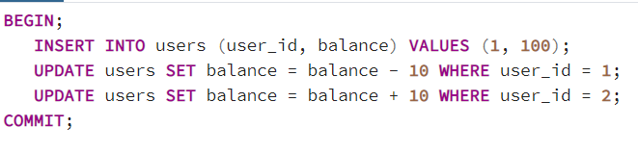
Basic Transaction Control Statements
BEGIN: Starts a transaction.
COMMIT: Saves changes made in the transaction to the database.
ROLLBACK: Undoes all changes made within the transaction.
If an error occurs at any point, you can call ROLLBACK instead of COMMIT

Slide 15
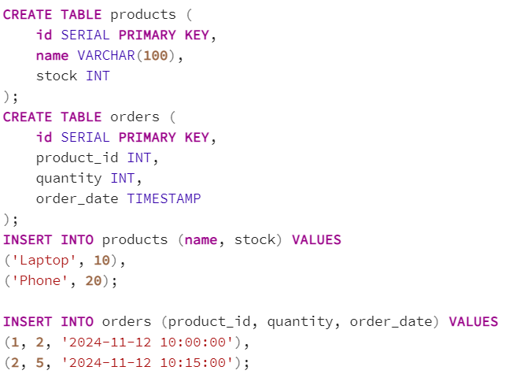
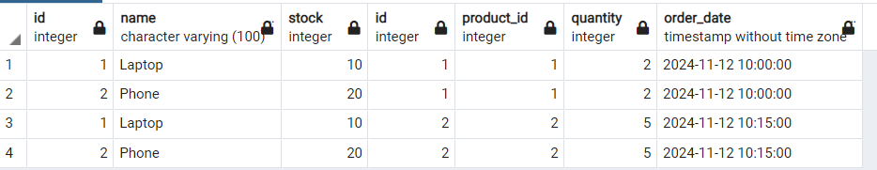
Examples

Slide 16
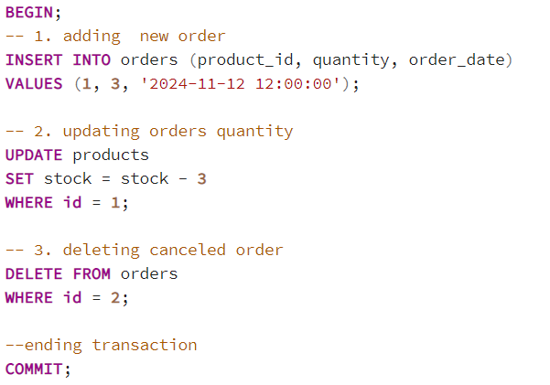
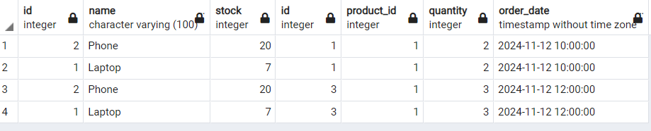
Examples

Slide 17
Isolation levels
Read Uncommitted: Allows transactions to read uncommitted changes.
Read Committed (Default): Only reads committed data.
Repeatable Read: Guarantees consistent data for the duration of a transaction, even if other transactions modify it.
Serializable: The strictest level, ensuring transactions behave as if executed sequentially.

Slide 18
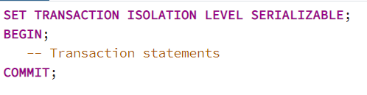
Set an isolation level:

Slide 19
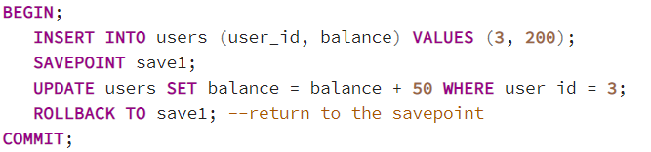
Savepoints
Savepoints: Savepoints allow you to create a checkpoint within a transaction, which can be rolled back to without affecting the entire transaction.

Slide 20
Benefits of Savepoints
Flexibility in Transactions: Savepoints allow you to manage complex transactions that may require only partial rollbacks rather than full transaction rollbacks.
Improved Error Management: By using savepoints, you can isolate and handle errors within sections of a transaction, retry specific steps, or skip them if needed.
Enhanced Modularity: Savepoints break a large transaction into parts, making it easier to understand, test, and debug, particularly useful in complex applications like financial processing or booking systems.

Slide 21
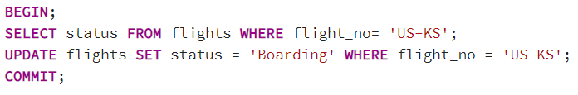
Examples
Update Flight Status to ‘Boarding’:

Slide 22
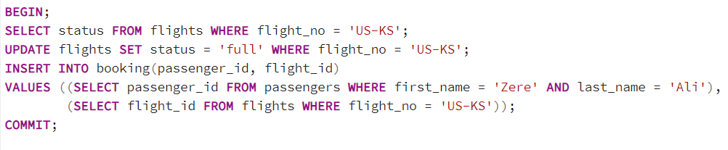
Examples
The transaction starts with BEGIN.
The status of flight UK-KS is checked. Since the flight is initially available, it will return 'available'.
Once Zere’s books her ticket, the flight’s status is updated to 'full', indicating no more seats are available.
A record is inserted for Zere in the booking table.
The transaction is committed, which saves the changes to the database.

Slide 23
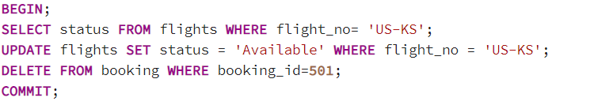
Examples
Cancel a booking for Zere

Slide 24
Advantages of Using Transactions
ACID
Error Handling and Rollback Capability: Transactions allow error handling through rollbacks. If an error or failure occurs, changes are reverted to the initial state, protecting the database from corrupt or partial data entries.
Improved Concurrency Control: By isolating transactions, databases can manage multiple users and operations concurrently without compromising data consistency. This is particularly beneficial for multi-user environments where several transactions are processed simultaneously.

Slide 25
Disadvantages of Using Transactions
Increased Complexity and Overhead:
Managing transactions and implementing isolation levels adds complexity to application design and introduces computational overhead.
Reduced Concurrency Due to Locking:
Depending on the isolation level, transactions may require extensive locking, reducing the level of concurrency by blocking access to certain data until the transaction is complete.
Resource Consumption:
Transactions often consume significant resources, especially in long or complex transactions
Difficulty in Debugging and Troubleshooting:
Errors in transactions can be challenging to diagnose and troubleshoot due to the potential for complex dependencies between operations within the transaction.

