Slide 1
Data manipulation Language foundation, basic SQL overview, principles of data manipulation

Slide 2
This Lecture
SQL SELECT
  WHERE Clauses
  SELECT from multiple tables

Slide 3
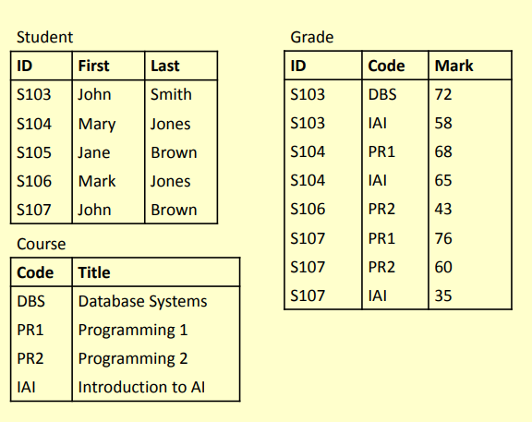
Example Tables

Slide 4
SQL SELECT
SELECT is the type of query you will use most
often.
  Queries one or more tables and returns the result as a table
  Lots of options, which will be covered over the
next few lectures
  Usually queries can be achieved in a number of ways

Slide 5
Simple SELECT
columns can be
A single column
A comma-separated list
of columns
* for ‘all columns’
SELECT
FROM
columns
table-name;

Slide 6
Sample SELECTs
SELECT
* FROM
Student;
Student
sID | sName | sAddress | sYear
1 | Smith | 5 Arnold Close | 2
2 | Brooks | 7 Holly Avenue | 2
3 | Anderson | 15 Main Street | 3
4 | Evans | Flat 1a, High Street | 2
5 | Harrison | Newark Hall | 1
6 | Jones | Southwell Hall | 1

Slide 7
Sample SELECTs
SELECT
sName
FROM
Student;

Slide 8
Sample SELECTs
SELECT
sName
FROM
Student;
sName
Smith
Brooks
Anderson
Evans
Harrison
Jones

Slide 9
Sample SELECTs
SELECT
FROM
sName, sAddress
Student;

Slide 10
Sample SELECTs
SELECT
FROM
sName, sAddress
Student;
sName | sAddress
Smith | 5 Arnold Close
Brooks | 7 Holly Avenue
Anderson | 15 Main Street
Evans | Flat 1a, High Street
Harrison | Newark Hall
Jones | Southwell Hall

Slide 11
SQL SELECT Overview
SELECT
[DISTINCT | ALL] column-list
FROM table-names
[WHERE condition]
([] optional, | or)

Slide 12
Example Tables
Student
Grade
ID | First | Last
S103 | John | Smith
S104 | Mary | Jones
S105 | Jane | Brown
S106 | Mark | Jones
S107 | John | Brown
ID | Code | Mark
S103 | DBS | 72
S103 | IAI | 58
S104 | PR1 | 68
S104 | IAI | 65
S106 | PR2 | 43
S107 | PR1 | 76
S107 | PR2 | 60
S107 | IAI | 35
Course
Code | Title
DBS | Database Systems
PR1 | Programming 1
PR2 | Programming 2
IAI | Introduction to AI

Slide 13
DISTINCT
Sometimes you end up with duplicate entries
Using DISTINCT removes duplicates
SELECT
FROM
DISTINCT
Student;
Last
Last
Smith
Jones
Brown

Slide 14
WHERE Clauses
In most cases returning all the rows is not necessary
  A WHERE clause restricts
rows that are returned
  It takes the form of a condition – only rows that satisfy the condition are returned
Example conditions:
  Mark < 40
  First = ‘John’
• First <> ‘John’
First
(First =
= Last
‘John’)
=
AND (Last
‘Smith’)
(Mark
(Mark
< 40) OR
> 70)

Slide 15
WHERE Examples
SELECT
WHERE
* FROM
Grade
SELECT
FROM WHERE
DISTINCT ID
Mark
>= 60;
Grade Mark
>= 60;

Slide 16
WHERE Examples
SELECT
WHERE
* FROM
Grade
SELECT
FROM WHERE
DISTINCT ID
Mark
>= 60;
Grade Mark
>= 60;
ID | Code | Mark
S103 | DBS | 72
S104 | PR1 | 68
S104 | IAI | 65
S107 | PR1 | 76
S107 | PR2 | 60
ID
S103
S104
S107

Slide 17
WHERE Examples
Given the table:
Grade
Write an SQL query to find a list of the ID numbers and Marks for students who have passed (scored 50% or more) in IAI
ID | Code | Mark
S103 | DBS | 72
S103 | IAI | 58
S104 | PR1 | 68
S104 | IAI | 65
S106 | PR2 | 43
S107 | PR1 | 76
S107 | PR2 | 60
S107 | IAI | 35
ID | Mark
S103 | 58
S104 | 65

Slide 18
Solution
SELECT ID, Mark WHERE (Code
FROM Grade
= ‘IAI’)
AND (Mark >=
50);

Slide 19
WHERE Examples
Given the table:
Grade
Write an SQL query to find a list of the ID numbers and Marks for students who have passed with Marks (Marks in [60, 69])
ID | Code | Mark
S103 | DBS | 72
S103 | IAI | 58
S104 | PR1 | 68
S104 | IAI | 65
S106 | PR2 | 43
S107 | PR1 | 76
S107 | PR2 | 60
S107 | IAI | 35
ID | Mark
S104 | 68
S104 | 65
S107 | 60

Slide 20
Solution
SELECT
ID, Mark
FROM
>=60
Grade
WHERE (Mark
AND Mark < 70);

Slide 21
BETWEEN AND
SELECT
ID, Mark
FROM
Grade
WHERE
Mark BETWEEN
60 AND 69;

Slide 22
WHERE Examples
Given the table:
Grade
Write an SQL query to find a list of the students IDs for both the IAI and PR2 modules
ID | Code | Mark
S103 | DBS | 72
S103 | IAI | 58
S104 | PR1 | 68
S104 | IAI | 65
S106 | PR2 | 43
S107 | PR1 | 76
S107 | PR2 | 60
S107 | IAI | 35
ID
S103
S104
S106
S107
S107

Slide 23
WHERE Examples
Given the table:
Grade
Write an SQL query to find a list of the students IDs for both the IAI and PR2 modules
ID | Code | Mark
S103 | DBS | 72
S103 | IAI | 58
S104 | PR1 | 68
S104 | IAI | 65
S106 | PR2 | 43
S107 | PR1 | 76
S107 | PR2 | 60
S107 | IAI | 35
ID
S103
S104
S106
S107
S107

Slide 24
Solution
SELECT
ID FROM
(Code
Grade
WHERE
= ‘IAI’
OR Code
= ‘PR2’);

Slide 25
SELECT from Multiple Tables
Often you need to combine information from two or more tables
You can produce the effect of a Cartesian product using:
SELECT * FROM Table1,
Table2
If the tables have columns with the same name, ambiguity will result
This can be resolved by referencing columns with the table name:
TableName.ColumnName

Slide 26
SELECT from Multiple Tables
Student
SELECT
First, FROM
ID
First
Last
S103
S104 Mar
ID
S105 Jane
S103
S106 Mar
S107
Last,
Mark
John
Smith
Grade
y Jones
Code
Mark
Brow
n
Student, WHERE
DBS IAI PR1 IAI PR2 PR1 PR2 IAI
72
58
68
65
43
76
60
35
Grade
k Jones
S103 S104 S104 S106 S107 S107 S107
John
Brow
n
(Student.ID
= Grade.ID)
AND (Mark
>= 40);

Slide 27

SELECT from Multiple Tables
SELECT ... FROM Student, Grade WHERE ...
ID | First | Last | ID | Code | Mark
S103 | John | Smith | S103 | DBS | 72
S103 | John | Smith | S103 | IAI | 58
S103 | John | Smith | S104 | PR1 | 68
S103 | John | Smith | S104 | IAI | 65
S103 | John | Smith | S106 | PR2 | 43
S103 | John | Smith | S107 | PR1 | 76
S103 | John | Smith | S107 | PR2 | 60
S103 | John | Smith | S107 | IAI | 35
S104 | Mary | Jones | S103 | DBS | 72
S104 | Mary | Jones | S103 | IAI | 58
S104 | Mary | Jones | S104 | PR1 | 68
S104 | Mary | Jones | S104 | IAI | 65

Slide 28
SELECT from Multiple Tables
SELECT ... FROM Student, Grade
WHERE (Student.ID = Grade.ID) AND ...
ID | First | Last | ID | Code | Mark
S103 | John | Smith | S103 | DBS | 72
S103 | John | Smith | S103 | IAI | 58
S104 | Mary | Jones | S104 | PR1 | 68
S104 | Mary | Jones | S104 | IAI | 65
S106 | Mark | Jones | S106 | PR2 | 43
S107 | John | Brown | S107 | PR1 | 76
S107 | John | Brown | S107 | PR2 | 60
S107 | John | Brown | S107 | IAI | 35

Slide 29
SELECT from Multiple Tables
SELECT ... FROM Student, Grade
WHERE (Student.ID = Grade.ID) AND (Mark >= 40)
ID | First | Last | ID | Code | Mark
S103 | John | Smith | S103 | DBS | 72
S103 | John | Smith | S103 | IAI | 58
S104 | Mary | Jones | S104 | PR1 | 68
S104 | Mary | Jones | S104 | IAI | 65
S106 | Mark | Jones | S106 | PR2 | 43
S107 | John | Brown | S107 | PR1 | 76
S107 | John | Brown | S107 | PR2 | 60

Slide 30
SELECT from Multiple Tables
SELECT First, Last, Mark FROM Student, Grade WHERE (Student.ID = Grade.ID) AND (Mark >= 40)
First | Last | Mark
John | Smith | 72
John | Smith | 58
Mary | Jones | 68
Mary | Jones | 65
Mark | Jones | 43
John | Brown | 76
John | Brown | 60

Slide 31
SELECT from Multiple Tables
When selecting from multiple tables, it is almost always best to use a WHERE clause to find common values
SELECT *
From
Student,
Course
WHERE
Grade,
Student.ID = Grade.ID
AND
Course.Code = Grade.Code

Slide 32
SELECT from Multiple Tables
Student
Grade
Course
ID | First | Last | ID | Code | Mark | Code | Title
S103 | John | Smith | S103 | DBS | 72 | DBS | Database Systems
S103 | John | Smith | S103 | IAI | 58 | IAI | Introduction to AI
S104 | Mary | Jones | S104 | PR1 | 68 | PR1 | Programming 1
S104 | Mary | Jones | S104 | IAI | 65 | IAI | Introduction to AI
S106 | Mark | Jones | S106 | PR2 | 43 | PR2 | Programming 2
S107 | John | Brown | S107 | PR1 | 76 | PR1 | Programming 1
S107 | John | Brown | S107 | PR2 | 60 | PR2 | Programming 2
Student.ID = Grade.ID
Grade.Code = Course.Code

Slide 33
Data table selection, data filtering, ordering of output data

Slide 34
This Lecture
Aliases and ‘Self-joins’
More WHERE Clauses
Subqueries
IN, EXISTS, ANY, ALL
LIKE
ORDER BY

Slide 35
Aliases
Aliases rename columns or tables
  Can make names more meaningful
  Can shorten names, making them easier to use
  Can resolve ambigious names
Two forms:
  Column alias
SELECT column [AS] new- col-name
  Table alias
SELECT * FROM table new- table-name
([] optional)

Slide 36
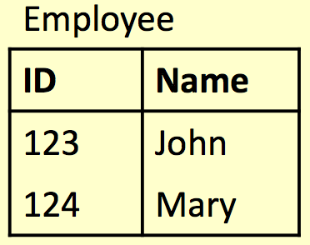
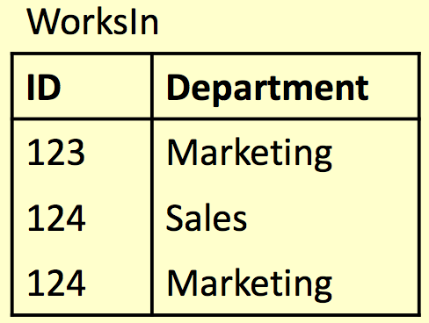
Alias Example
SELECT
E.ID AS empID,
E.Name, W.Department FROM
Employee E,
WorksIn W WHERE
E.ID = W.ID;

Slide 37
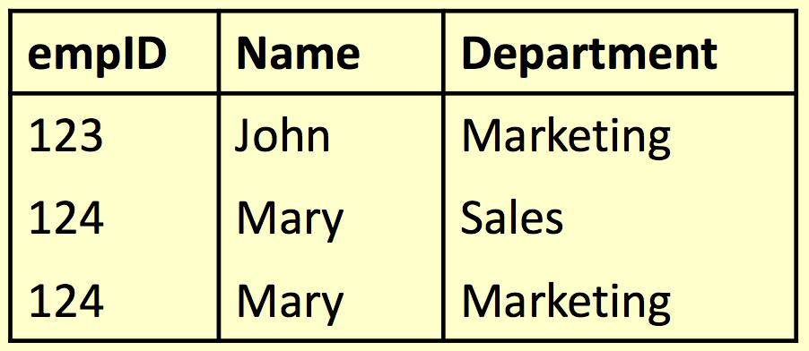
Alias Example
SELECT
E.ID AS empID,
E.Name, W.Department FROM
Employee E, WorksIn W
WHERE
E.ID = W.ID;

Slide 38
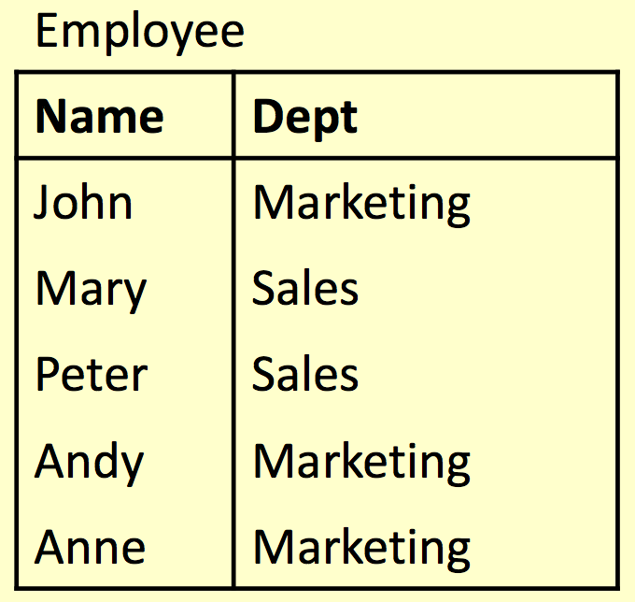
Aliases and ‘Self-Joins’
Aliases can be used to copy a table, so that it can be combined with itself
Example: Find the names of all employees who work in the same department as Andy

Slide 39
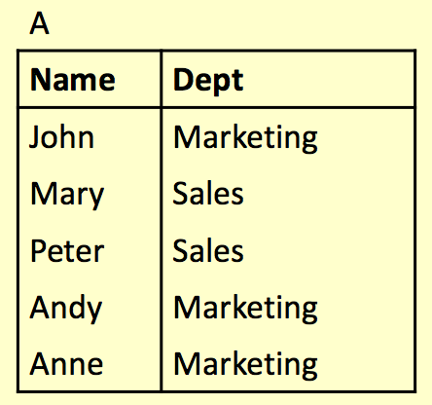
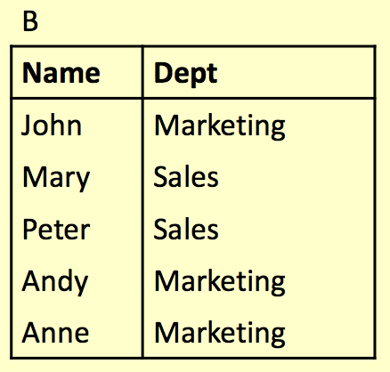
Aliases and ‘Self-Joins’
Employee A Employee B

Slide 40
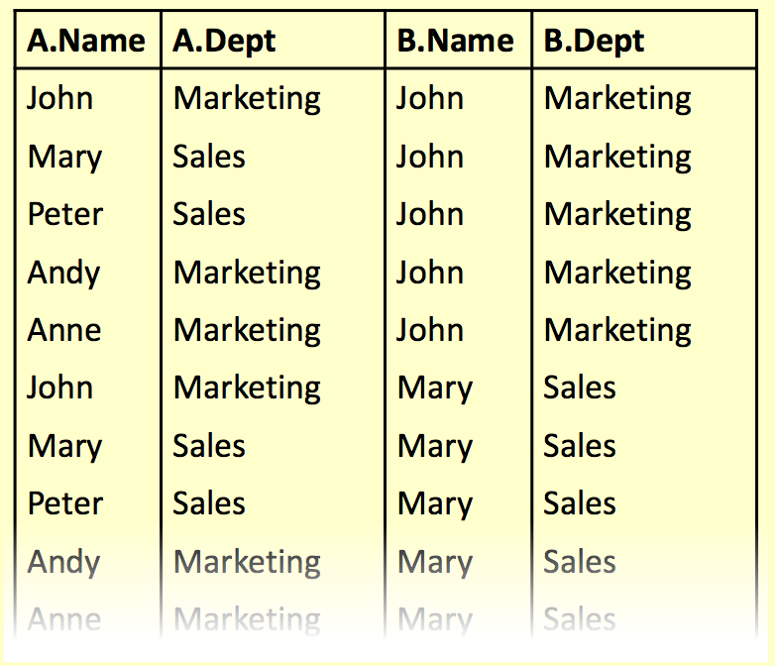
Aliases and ‘Self-Joins’
SELECT ... FROM Employee A, Employee B ...

Slide 41
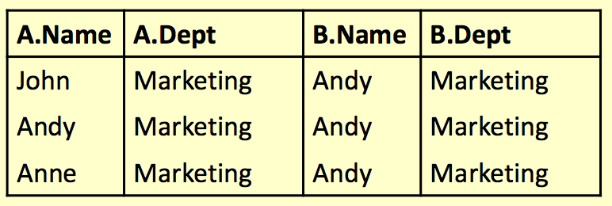
Aliases and ‘Self-Joins’
SELECT ... FROM Employee A, Employee B
WHERE A.Dept = B.Dept AND B.Name = ‘Andy’;

Slide 42
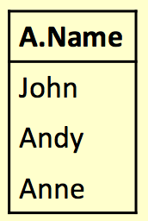
Aliases and ‘Self-Joins’
SELECT A.Name FROM Employee A, Employee B WHERE A.Dept = B.Dept AND B.Name = ‘Andy’;
Names of all employees who work in the same department as Andy

Slide 43
The SQL WHERE Clause
The WHERE clause is used to extract only those records that fulﬁll a speciﬁed criterion
WHERE Syntax
SELECT column_name, column_name
FROM table_name
WHERE column_name operator value;

Slide 44
Operators in The WHERE Clause
= | Equal
<> | Not equal. Note: In some versions of SQL this operator may be written as !=
> | Greater than
< | Less than
>= | Greater than or equal
<= | Less than or equal
BETWEEN | Between an inclusive range
IN | To specify multiple possible values for a column
LIKE | Search for a pattern

Slide 45
Subqueries
A SELECT statement can be nested inside another query to form a subquery
The results of the subquery are passed back to the containing query
For example, retrieve a list of names of people who are in Andy’s department:
SELECT Name FROM Employee
WHERE Dept = (SELECT Dept
FROM Employee WHERE Name=‘Andy’);

Slide 46
Subqueries
SELECT Name FROM Employee WHERE Dept = (SELECT Dept
FROM Employee WHERE
Name=‘Andy’);
First the subquery is evaluated returning ‘Marketing’
This value is passed to the main query:
SELECT Name FROM Employee WHERE Dept = ‘Marketing’);

Slide 47
Subqueries
Onen a subquery will return a set of values rather than a single value
We cannot directly compare a single value to a set. Doing so will result in an error
Options for handling sets:
  IN – checks to see if a value in a set
  EXISTS – checks to see if a set is empty
  ALL/ANY – checks to see if a relationship holds for every/one member of a set
  NOT can be used with any of the above

Slide 48
IN
Using IN we can see if a given value is in a set of values
NOT IN checks to see if a given a value is not in the set
The set can be given explicitly or can be produced in a subquery
SELECT columns FROM tables WHERE value
IN set;
SELECT columns FROM tables WHERE value
NOT IN set;

Slide 49
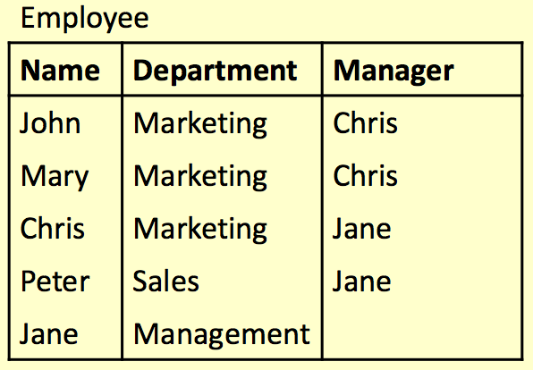
IN
SELECT *
FROM Employee WHERE Department
IN
(‘Marketing’, ‘Sales’);

Slide 50
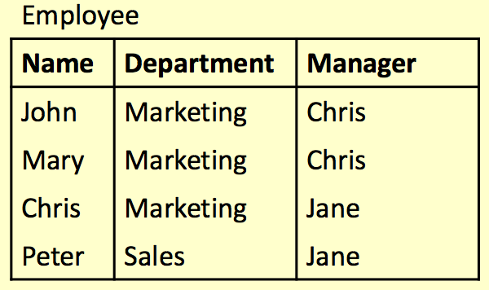
IN
SELECT *
FROM Employee WHERE Department
IN
(‘Marketing’, ‘Sales’);

Slide 51
NOT IN
SELECT *
FROM Employee WHERE Name
NOT IN
(‘Chris’, ‘Jane’);

Slide 52
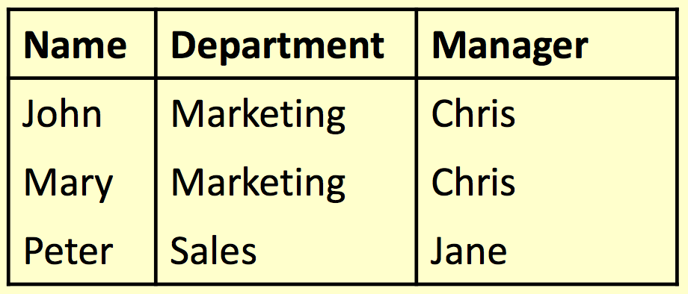
NOT IN
SELECT *
FROM Employee WHERE Name
NOT IN
(‘Chris’, ‘Jane’);

Slide 53
EXISTS
Using EXISTS we can see whether there is at least one element in a given set
NOT EXISTS is true if the set is empty
The set is always given by a subquery
SELECT columns FROM tables WHERE EXISTS set;
SELECT columns FROM tables WHERE
NOT EXISTS set;

Slide 54
EXISTS
SELECT *
FROM Employee AS E1 WHERE EXISTS (
SELECT * FROM
Employee AS E2
WHERE E1.Name =
E2.Manager);
Retrieve all the info for those employees who are also managers.

Slide 55
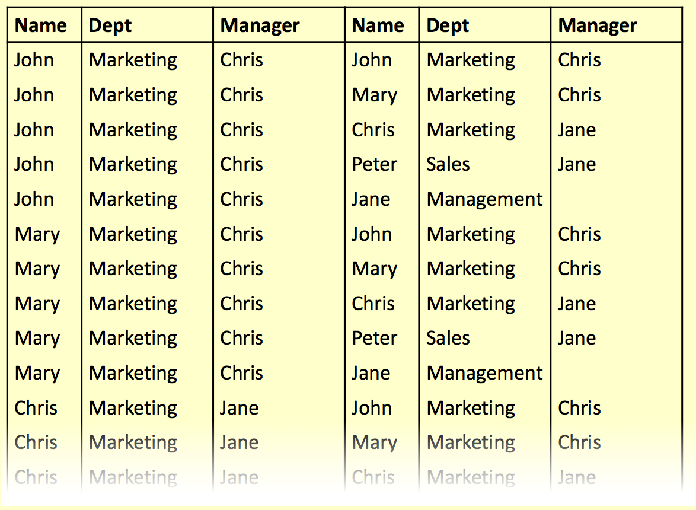
EXISTS

Slide 56
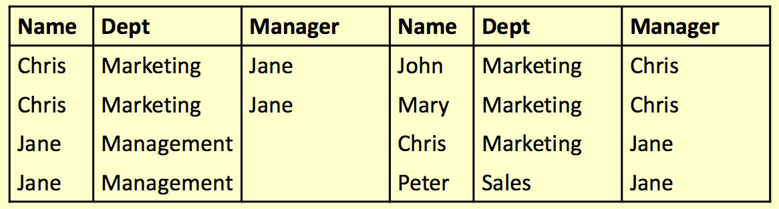
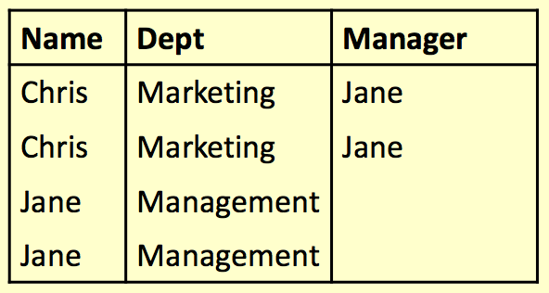
EXISTS
SELECT * FROM Employee AS E1 WHERE EXISTS
(SELECT * FROM Employee AS E2 WHERE E1.Name = E2.Manager);

Slide 57
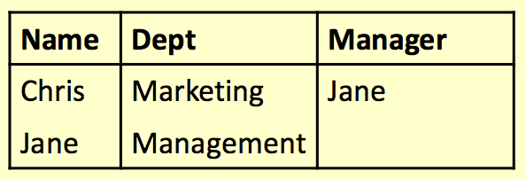
EXISTS
SELECT *
FROM Employee AS E1 WHERE EXISTS (
SELECT * FROM
Employee AS E2
WHERE E1.Name =
E2.Manager);

Slide 58
ANY and ALL
ANY and ALL compare • val = ANY(set) is true
a single value to a set of values
if there is at least one member of the set equal to value
They are used with
comparison operators• val = ALL(set) is true if
like =, >, <, <>, >=, <=
all members of the set are equal to the value

Slide 59
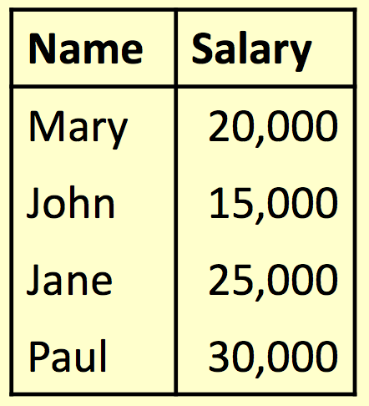
ALL
Find the name(s) of the employee(s) who earn the highest salary

Slide 60

ALL
Find the name(s) of the employee(s) who earn the highest salary
SELECT Name
FROM Employee
WHERE Salary >= ALL (
SELECT Salary FROM Employee);

Slide 61
ANY
Find the name(s) of the employee(s) who earn more than someone else

Slide 62
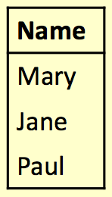
ANY
Find the name(s) of the employee(s) who earn more than someone else
SELECT Name
FROM Employee
WHERE Salary > ANY(
SELECT Salary
FROM Employee);

Slide 63
Word Search
Commonly used for searching product catalogues etc.
Need to search by keywords
Might need to used partial keywords
For example, Given a database of books, search for “crypt” might return
  “Cryptonomicon” by Neil Stephenson
  “Applied Cryptographer” by Bruce Schneier

Slide 64
LIKE
We can use the LIKE keyword to perform string comparisons in queries
Like is not the as ‘=’ because it allows wildcard characters
It is NOT normally case sensitive
SELECT * FROM books
WHERE bookName LIKE “%crypt%”

Slide 65
LIKE
The ‘%’ character can represent any number of characters, including none
bookName LIKE “crypt%”
The ‘_’ character represents exactly one character
bookName LIKE “cloud_”
Will return “Clouds” but not “Cloud” or “cloud computing”
Will return “Cryptography Engineering” and “Cryptonomicon” but not “Applied Cryptography”

Slide 66
SQL ORDER BY
The ORDER BY keyword is used to sort the result-set by one or more columns.
The ORDER BY keyword sorts the records in ascending order by default. To sort the records in a descending order, you can use the DESC keyword.
  SELECT column_name, column_name
FROM table_name
ORDER BY column_name ASC|DESC,
column_name ASC|DESC;

Slide 67
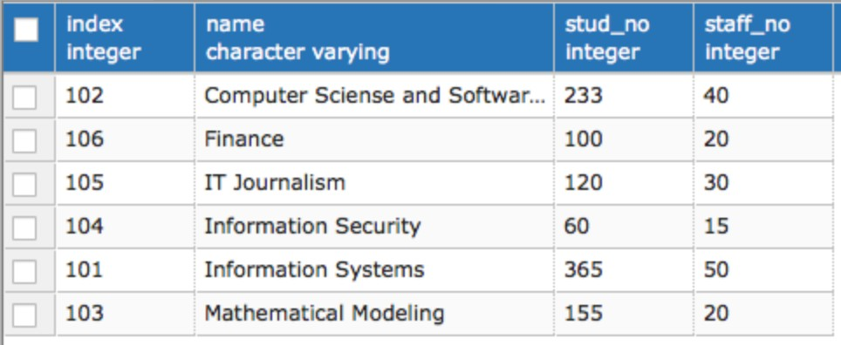
SELECT * FROM DEPARTMENT ORDER BY NAME;

Slide 68
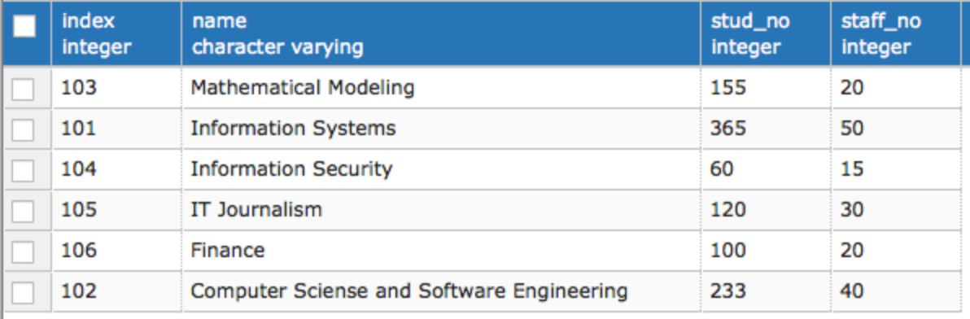
SELECT * FROM DEPARTMENT ORDER BY NAME DESC;

Slide 69
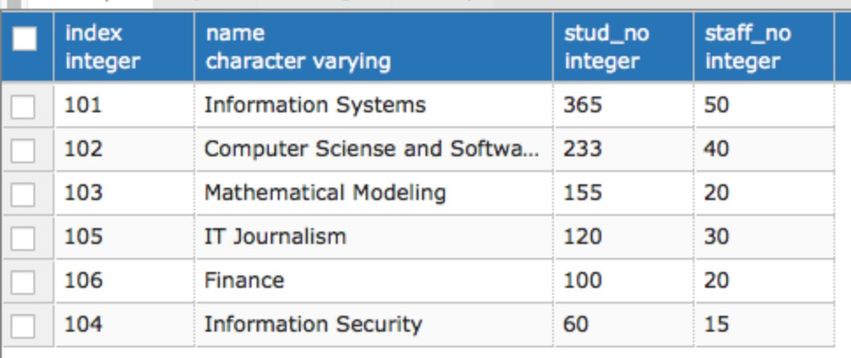
SELECT * FROM DEPARTMENT ORDER BY STUD_NO DESC, NAME;

Slide 70
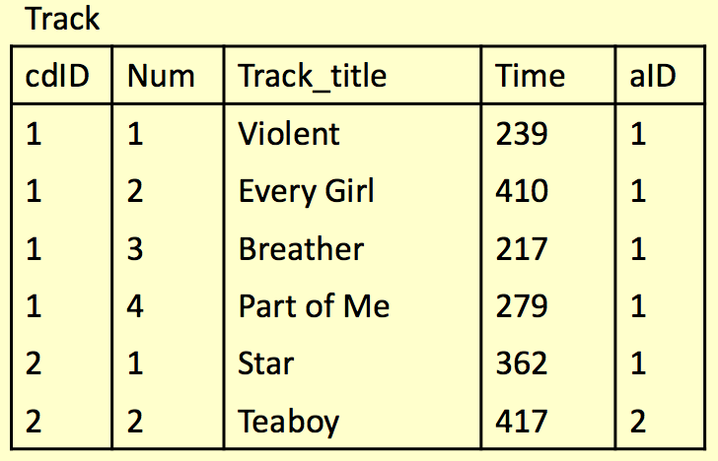
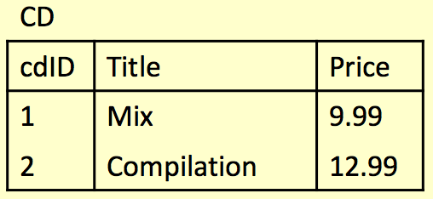
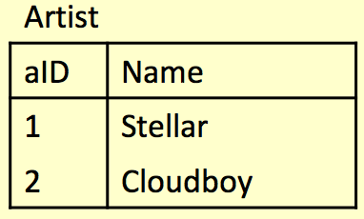
Example
Write a query to ﬁnd any track title containing either the string ‘boy’ or ‘girl’

Slide 71
Example
SELECT Track_title FROM Track WHERE Track_title LIKE “%boy%”
OR Track_title LIKE “%girl%”;

Slide 72
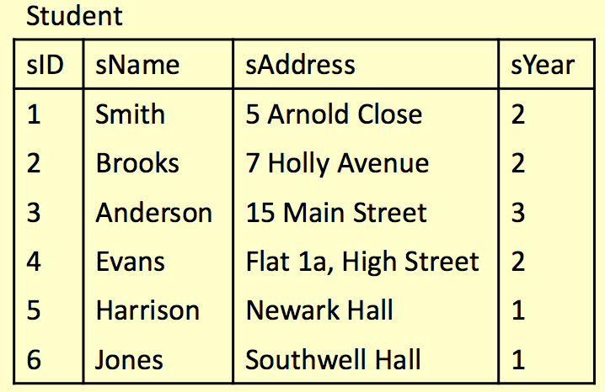
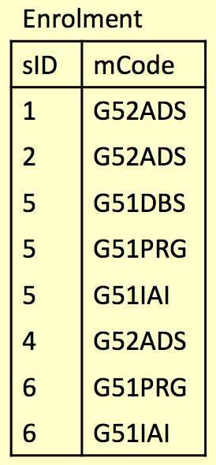
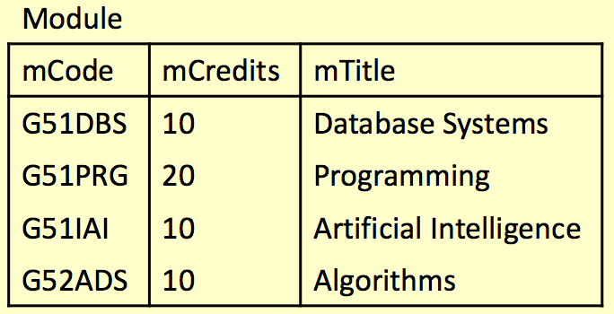
Example
Find a list of names of any students who are enrolled on at least one module alongside ‘Evans’

Slide 73
Example
SELECT sName FROM Student WHERE sID IN
(SELECT sID FROM Enrolment WHERE mCode =
(SELECT mCode FROM Enrolment
WHERE sID =
(SELECT sID FROM Student WHERE sName = “Evans”)));

