Slide 1
Reference options

Slide 2
Foreign Key Options
Comparison of ON DELETE behaviors:
- RESTRICT
- CASCADE
- SET NULL
- SET DEFAULT
- NO ACTION

Slide 3
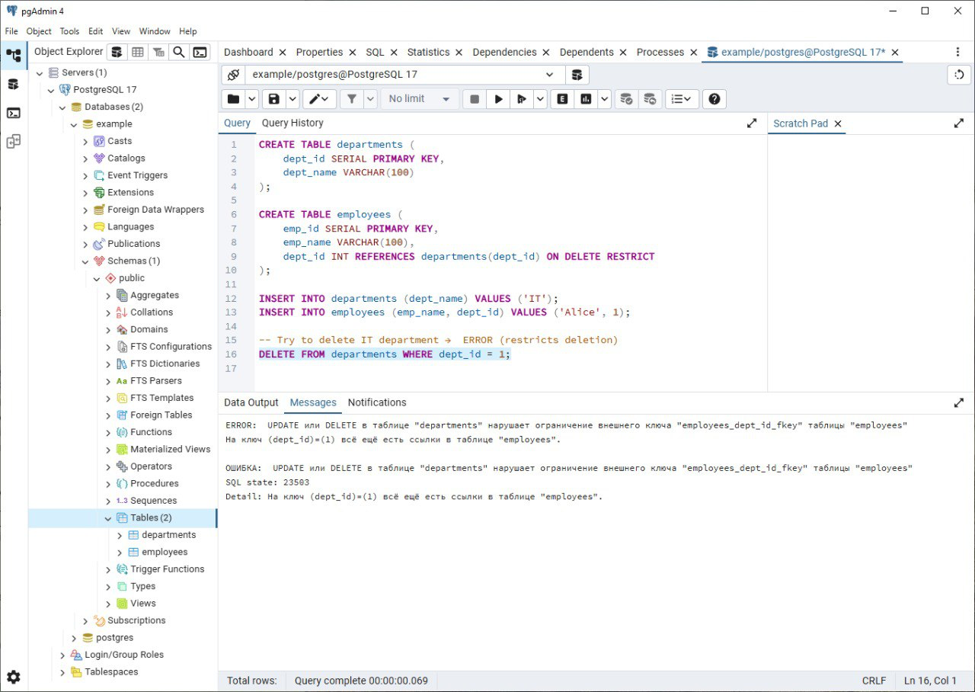
ON DELETE RESTRICT
Prevents deletion of parent row if related child rows exist.
Example:
- Department cannot be deleted if employees are still assigned.

Slide 4
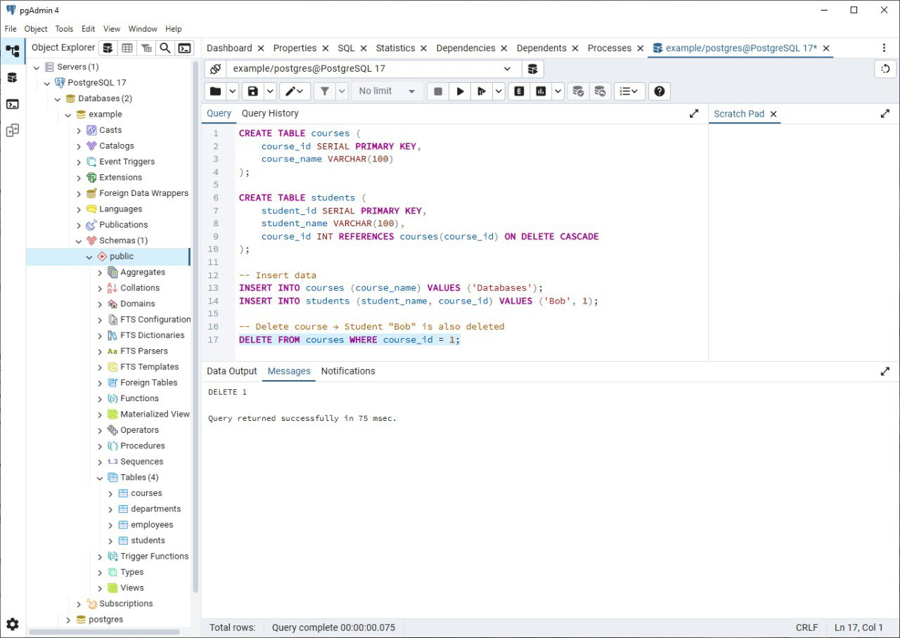
ON DELETE CASCADE
Automatically deletes child rows when parent row is deleted.
Example:
- Delete course → enrolled students are deleted too.

Slide 5
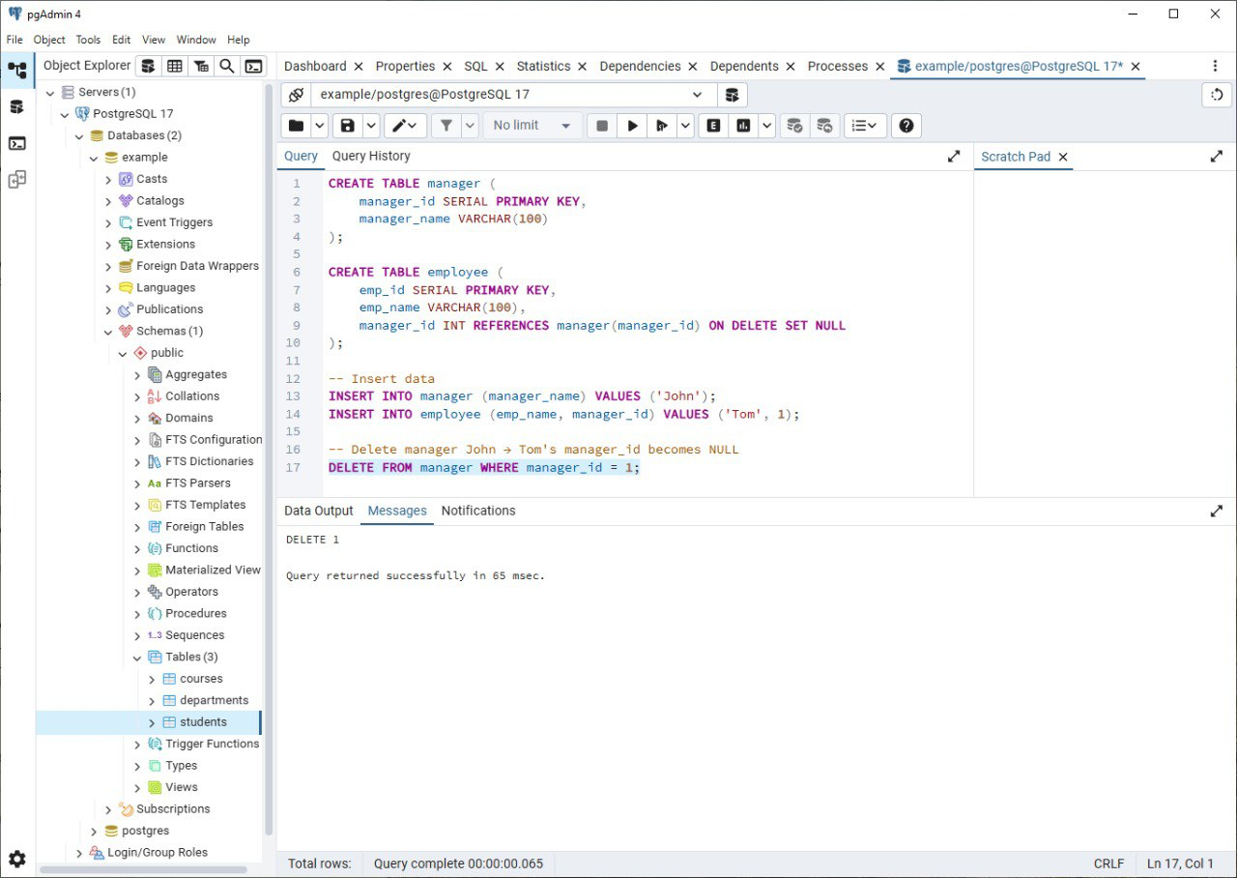
ON DELETE SET NULL
Sets the foreign key in child rows to NULL when parent row is deleted.
Example:
- Delete manager → employees' manager_id becomes NULL.

Slide 6
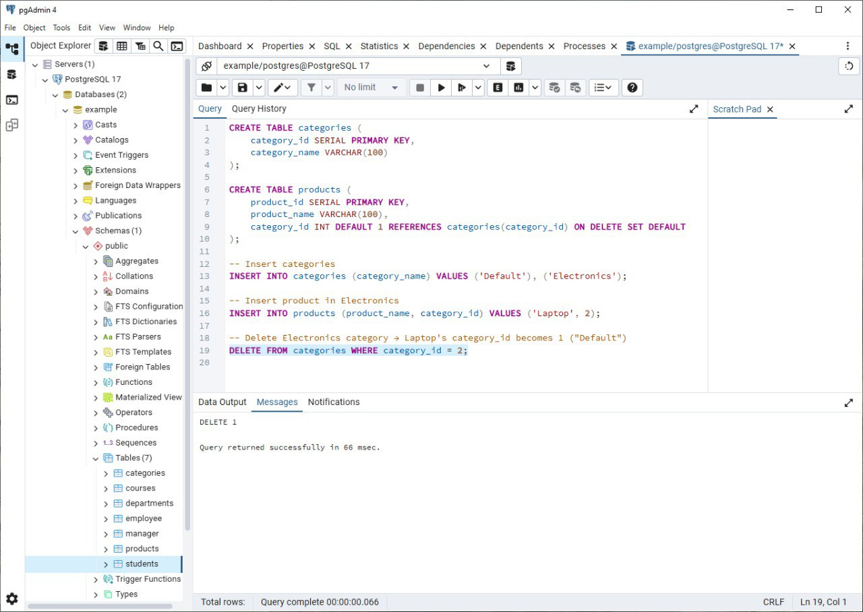
ON DELETE SET DEFAULT
Sets the foreign key in child rows to its DEFAULT value when parent row is deleted.
Example:
- Delete category → product moves to 'Default' category.

Slide 7
ON DELETE NO ACTION
Similar to RESTRICT, prevents deletion if child rows exist.
But check is deferred until the end of the transaction.

Slide 8
Comparison Table
RESTRICT → Block deletion
CASCADE → Delete children
SET NULL → Remove relation
SET DEFAULT → Assign default
NO ACTION → Same as RESTRICT but deferred

Slide 9
Conclusion
Choosing the right ON DELETE option is critical for maintaining data integrity.
It depends on business logic:
- RESTRICT: strict integrity
- CASCADE: automatic cleanup
- SET NULL/DEFAULT: keep records but adjust relations

