Slide 1
STUDENT NAME: AKTHAR HAJIRA S K
REGISTER NO AND NMID: 222402604
DEPARTMENT: DATA SCIENCE
COLLEGE: COLLEGE/ UNIVERSITY PRINCE SHRI VENKATESHWARA ARTS AND SCIENCE COLLEGE. MADRAS UNIVERSITY

Slide 2
PROJECT TITLE
DIGITAL JOURNEY
2

Slide 3
AGENDA
Problem Statement
Project Overview
End Users
Tools and Technologies
Portfolio design and Layout
Features and Functionality
Results and Screenshots
Conclusion
Github Link

Slide 4
PROBLEM STATEMENT
Overcoming Limitations of Traditional ResumesStudents and job seekers often rely solely on resumes to present their skills and achievements. Traditional resumes are static and lack interactivity or creative elements, making it difficult for recruiters to accurately gauge a candidate’s potential. A digital portfolio effectively bridges this gap by offering an engaging, interactive platform that highlights skills, projects, and personal strengths in a more dynamic way.

Slide 5
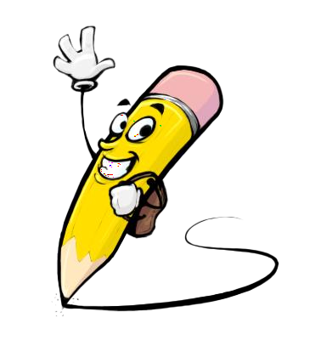
PROJECT OVERVIEW
Basic PortfolioThis project is a simple yet effective personal website designed to introduce myself in a structured and organized way. The portfolio contains core sections like About Me, Education, Hobbies, Skills, and Contact, each accompanied by my profile image to personalize the experience. The main goal of this portfolio is to provide a clear overview of my academic journey, enabling visitors to quickly understand my background, qualifications, and skill set. The minimalistic design ensures that attention remains on my personal and educational details without distractions, making it easy for anyone, including teachers, peers, or recruiters, to get a concise introduction to who I am.
5

Slide 6
WHO ARE THE END USERS?
Recruiters and Hiring ManagersThe primary users of my digital portfolio are recruiters and hiring managers. They can easily view my profile, skills, and achievements in a structured manner, which helps them assess my suitability for internships and job opportunities. Unlike traditional resumes, my portfolio provides a clear and interactive overview, saving recruiters time and effort in evaluating my potential.

Slide 7

TOOLS AND TECHNIQUES
HTML → Used to create the structure of the portfolio (headings, paragraphs, sections).
CSS → Used to add design, colors, and styling.
GitHub Pages → Used to host the portfolio online and share it easily.
7

Slide 8
POTFOLIO DESIGN AND LAYOUT
Home → A welcome message with my name and profile image.
About Me → A short paragraph about myself.
Skills → A simple bullet or numbered list of my skills.
Education → Details in table format or plain text (School, College, Year).
Hobbies → A simple list of hobbies.
Contact → My phone number, email, and address in plain text.
Responsive → On mobile, everything stacks in a single column.

Slide 9
FEATURES AND FUNCTIONALITY
Navigation bar with smooth scrolling – helps to move across sections easily.
Project showcase with details – highlights my academic and personal works.
Interactive hover effects – makes the portfolio engaging to explore.
Responsive design – adjusts neatly on all devices.
Organized layout – keeps sections clear and simple.

Slide 10
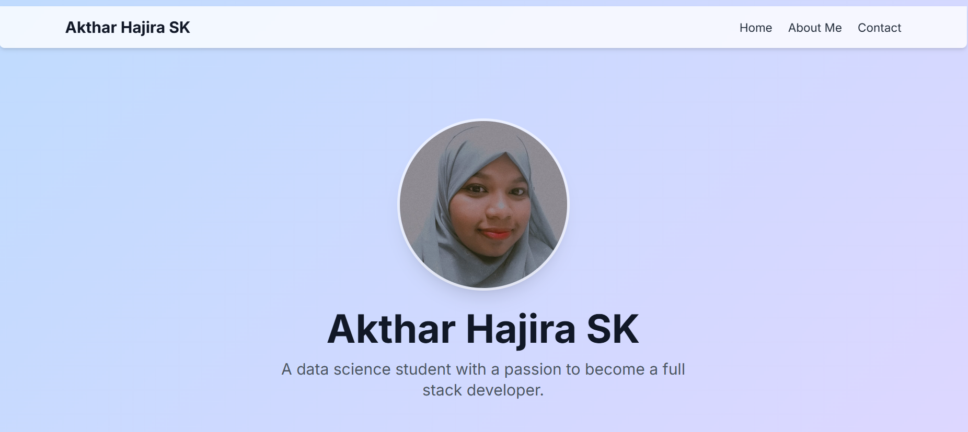
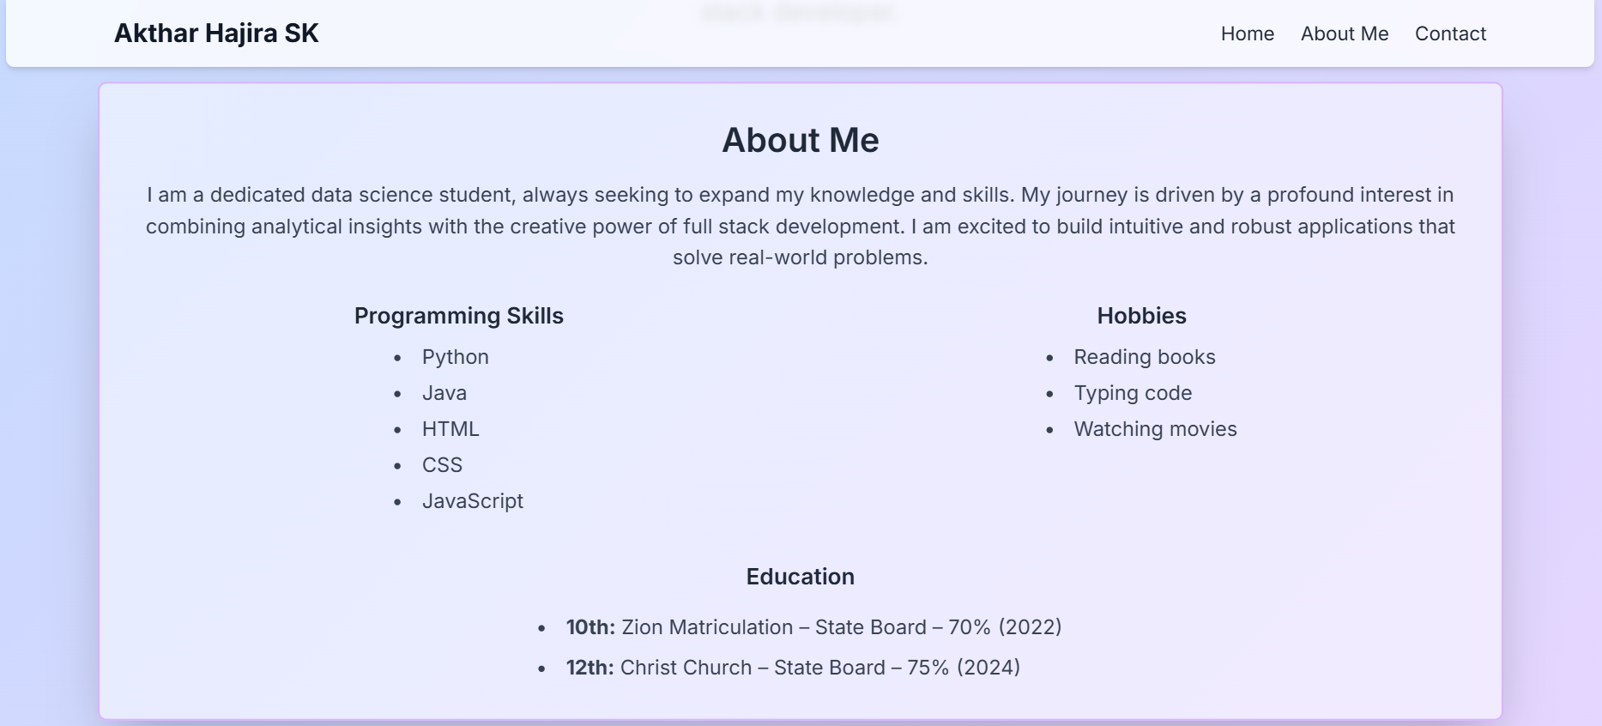

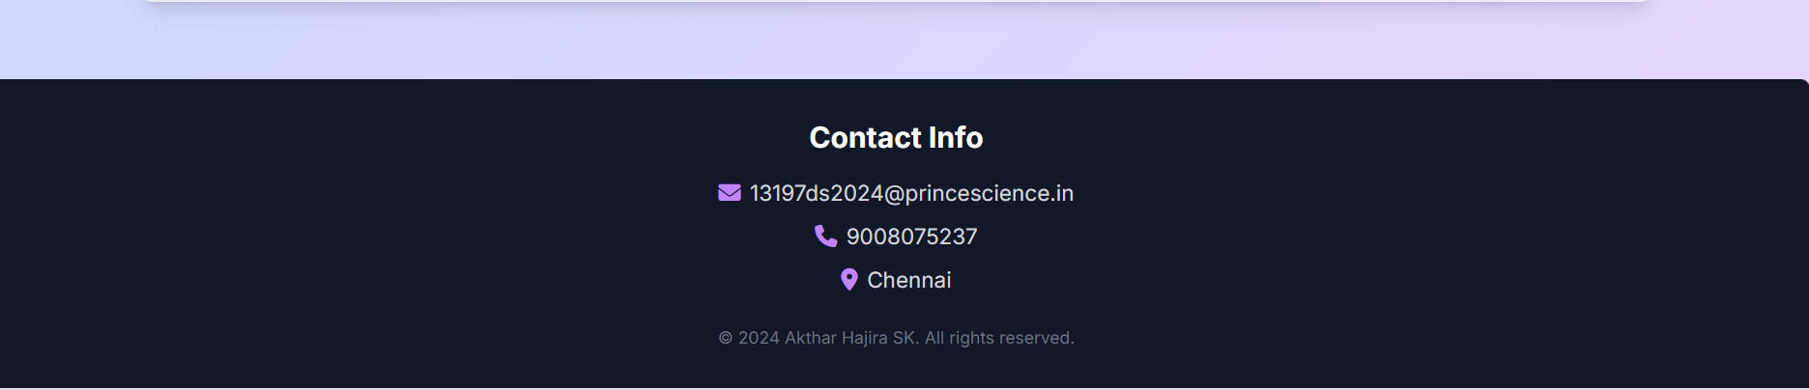
RESULTS AND SCREENSHOTS
Add your portfolio screenshot
10

Slide 11
CONCLUSION
My portfolio is a simple way to showcase myself.It includes my education, skills, hobbies, and profile.The design is neat and easy to understand.It works on all devices with a responsive layout.This portfolio reflects my learning and growth.
GITHUB: https://aktharhajira197.github.io/TNSDC-FWD-DP/
11

