Slide 1
Dashboard Project

Slide 2
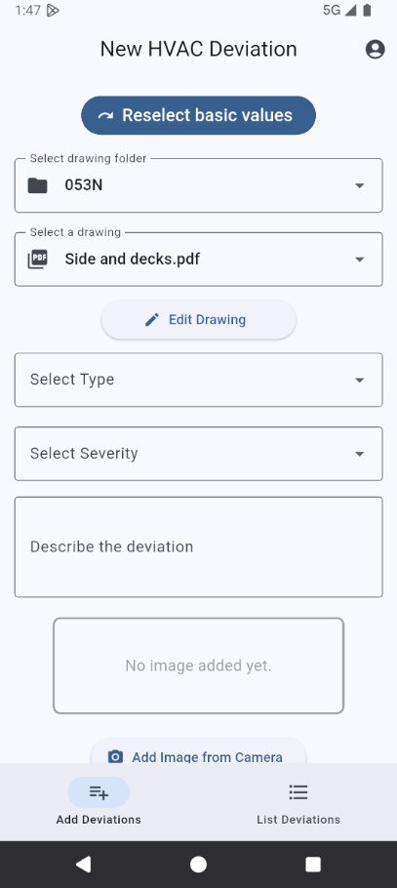
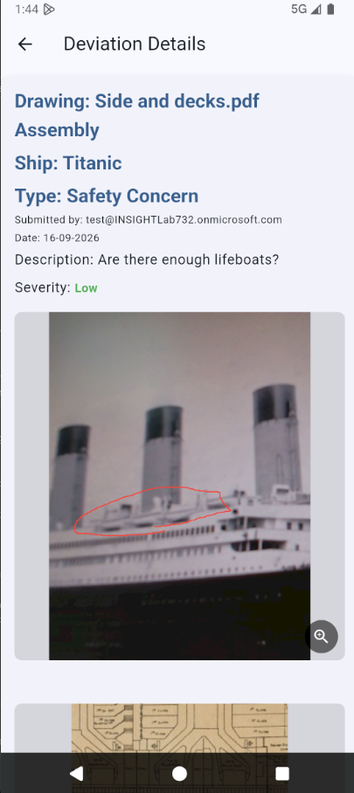
Deviation Tracker
Tool for collecting deviations/issues in construction.
Stores json and images
Built with Flutter
Works in SharePoint

Slide 3
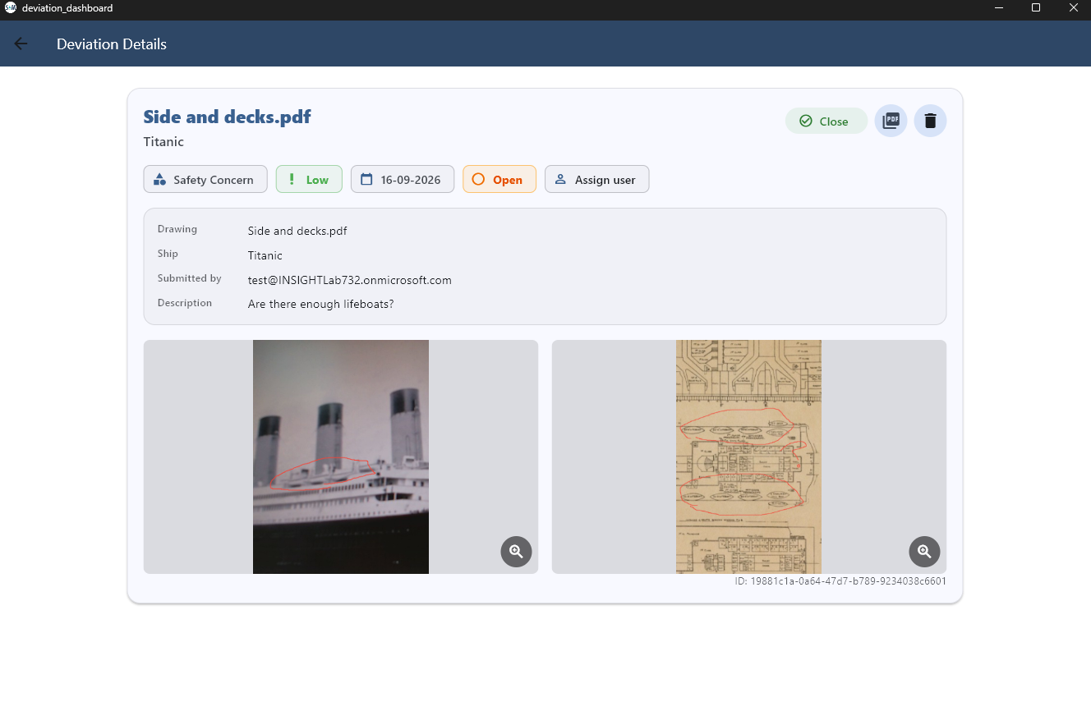
The Dashboard
Desktop application (Windows)
Use Flutter for cross combability
“GitHub” for construction
Currently: displays data, allows to close / open deviations & assign users to them.

Slide 4
Requirements
Authentication
Assign users to deviations and display them on the frontpage for the user
Deviation status: Open / In Progress / Closed
Deadline (alert for closing deadline?)
Add comments / discussion under deviation
Database (MongoDB / PostgreSQL
Backend (E.g. Python with Flask. Please no JavaScript)
Analytics: E.g. Types of deviations, open vs closed

