Slide 1


EVERYTHING APPRAISALS

Slide 2
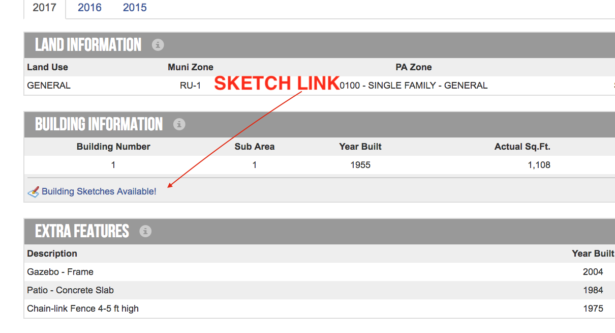

KNOW YOUR SUBJECT!!!
Start with www.MiamiDade.gov/pa Search and make note of age, size and location and any other key features
This typically shows “permitted work”
Check Sketch if Available

Slide 3
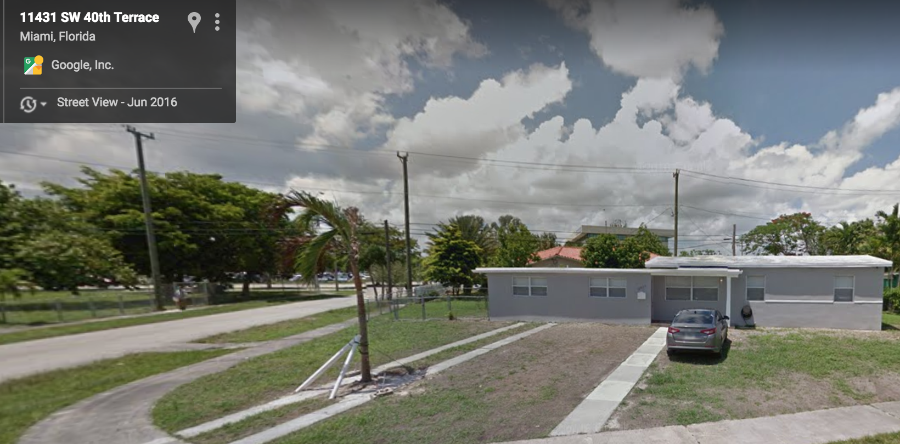
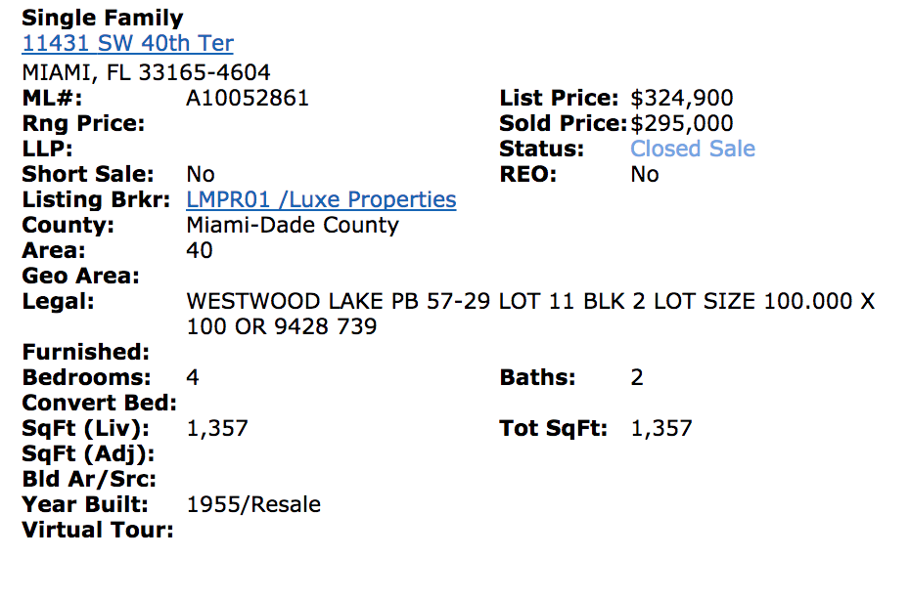
USE RESOURCES TO DISCOVER MORE
Check MLS History to see interior pictures of info differing from tax record
Drive by and Check Google Earth for Understand Neighborhood
Street by Street can change values

Slide 4
FINDING RELEVANT COMPS
Must Be MLS Sales
Select Comps First & Price After – DON’T try to find comps to support a price.
Relevant Comps
Size of Home and Lot
Condition, Age and Quality
Location
Timeframe of Sale

Slide 5
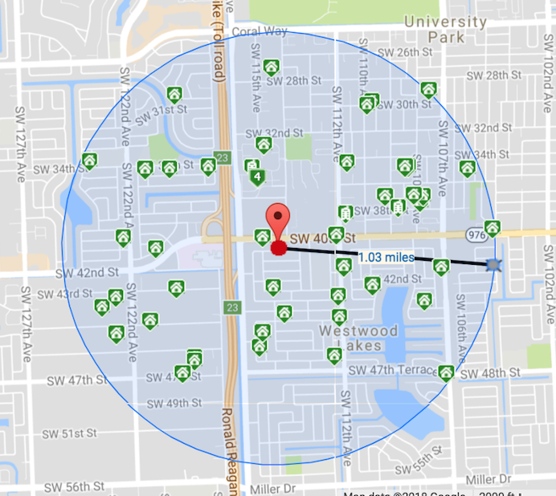
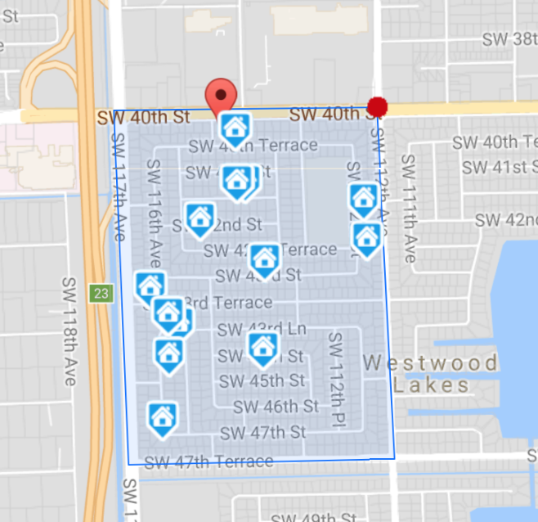
FINDING COMPS BY LOCATION
Same Subdivision is always best
Street by Street can change values
You cannot only use “within a mile” as different kinds of homes can reside within a mile
NO
YES

Slide 6
SIZE OF HOME
Always Make Sure You are using Living Area Vs Living Area of comparable homes. Not Adjusted Vs Living Area
Lot Size is just as important
Beds and Baths not as important the more you have
Can you fit a Pool?
Can the lot be subdivided?

Slide 7
CONDITION / AGE / QUALITY OF CONSTRUCTION
Is the home upgraded or original?
Condition is rate C1 t C6
You cannot compare a new home to a resale home under any circumstances
Does the home have superior construction? Ex - Higher Ceilings
Smart Home? Impact Windows?

Slide 8
LOCATION
Ideally you should look in subdivision first
Unless certain instances such as largest home, waterfront property, new home in old area
If Planned Development or Condo one sale must be from within at least
The Closer to the property the better
TIMEFRAME OF SALE
Should be within the past year
Most recent sales will always be used
If absolutely no sales a paired sales analysis will be used
Adjustments can be made for timeframe of sale

