Slide 1


SPHERE AND FARMING FOR LUXURY

Slide 2

Introduction to Luxury Recap

Slide 3
Session 1 Recap
Did you do your market research?
Any Surprises?
Did you dispel any myths?
Did you find any strong markets?
Did you find an accountability partner?

Slide 4
Sphere of Influence
Marketing

Slide 5
Why Nurture Your Sphere
Mets vs Haven't Met – Get "The Millionaire Real Estate Agent" by Gary Keller
You can TARGET your sphere as you grow it
People work with people they know, like and trust
Working your sphere is FAR less costly, lead than unmets
Repeat and referral business

Slide 6
Stats on Sphere
a bird in hand is worth two in the bush
50-75% of business is from sphere
For 33 touch system you will get 1 sale from 6 people in sphere
64% of all sellers worked with their previous agent or found their agent through referral
Only 9% of buyers find their agent online

Slide 7
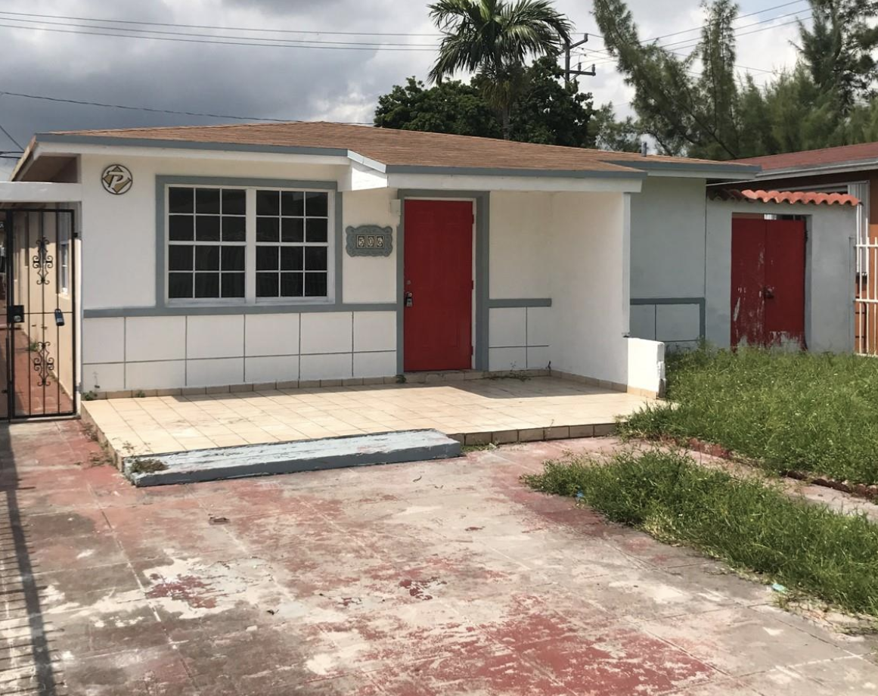
Who is Your Sphere
These are the people you know
Past Clients
Past Leads
Friends and Family
Groups and Organizations
Clubs, sports, etc.
Attorneys, insurance, professionals
Other real estate agents (referrals)

Slide 8
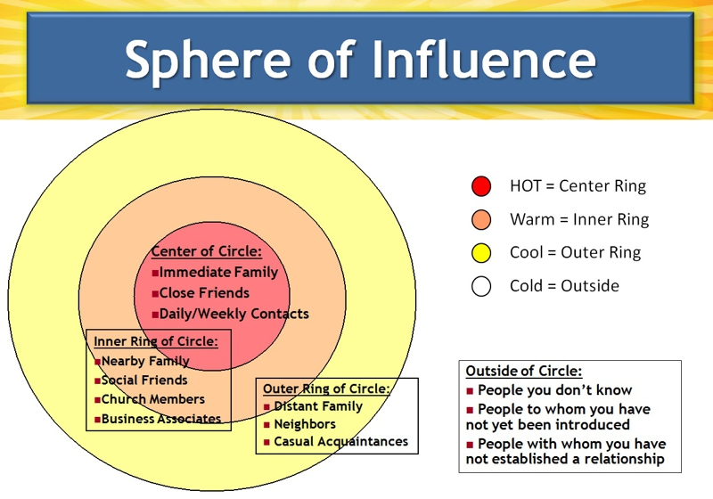
Know Your “Buckets”
Outer ring- Anyone you have contact info for
Middle Ring – Top 300
Inner Ring- Trophy (20-30 TOPS)

Slide 9
Who to Add to Your Sphere
Local influencers
Out of area agents
Leads and prospects
Anyone you meet
Affiliated business
Wealth managers
Financial advisors
Attorneys
Yacht brokers
Car dealers
Community VIPS
Niche influences
Local area business people
Press and Media

Slide 10
“Millionaire RE Agent”
1 out of every 6 you "work" will produce a good lead annually
33 Touch System
Break them up into groups
Trophy (20-30)
Main (max 300)
Everyone else
Sub Groups (brokers, OOT, Investors, etc.)

Slide 11
33 Touch System
Emails (Mail Chimp, Significant Sales, Market Reports, News etc.)
Calls
Gifts for Top 20 or Main
Birthday and Holiday
See in Person
Direct Mail ( Just Listed, Just Sold, Market Report, Etc.)
Social Media (Linkedin, FB, IG, Pinterest)
Offer to do an Annual CMA
Find out where else they own or are interested- Connect all theirs assets
Market Updates

Slide 12
Where to Start
Gather and Organize
Systematize
Synch w/phone
Processing new contacts
Have a contact action plan
Plan 1-2 Months for Existing
10/day plan

Slide 13
Farming & Luxury
Turning your area of choice into “Mets”

Slide 14
Why Farm?
Mets vs Haven't Met – Get "The Millionaire Real Estate Agent" by Gary Keller (the Red Book)
You can TARGET your sphere as you grow it
You can Niche yourself
You can connect your passions
with your profession
YOU ARE IN CONTROL

Slide 15
Concentrated Effort in
an Area Can Dominate

Slide 16
More Pros
Efficiency in marketing dollars & Time
More likely to be able to pair buyers and sellers (resulting in 2 sides)
Gain and retain "Top of Mind Awareness"
More repeat and word of mouth business
Push out the competition
Reduce objections
Become the expert
Residual effects, easier over time

Slide 17
Types of Farm Areas
Condos
Penthouses
Waterfront
Boating
Island
Equestrian
Sports and Entertainment
Out of town owners/buyers
Aging clients
Historic
Golf
BnBs and Inns
Military clients
Art Lovers
City Living
Boutique hotels
Vacation rentals
Distressed
Green or eco friendly communities
Special architectural styles (brownstones, Victorian, Spanish eclectic, etc.)
Walkability
Architecturally Significant
International Clients
Around philanthropic/community groups

Slide 18
Swarm
Dedicated website
Direct Mail
Targeted email from target list
Facebook page and/or Group
Blog
Networking
Community involvement
Open Houses
Local print advertising
Walk the walk, talk the talk (Social Media)
Market Reports
Videos
Nextdoor App if you live there
Online Market Valuation Offers

Slide 19
Swarm #2
Guest Blogging
Google PPC
Facebook Ads, Promoted Posts
Special Events
Press connections
Real Estate Market Updates, etc.
Promote other local businesses
SEO
Expireds
Waze Ads
Top Sales , Listing, etc. Lists
Cold/Circular/Warm Calls

Slide 20
Research Your Farm
Select your farm based on research
-Inventory?
-DOM?
-Average Sale Price?
-Dominated already?
Weak Link? What is your value
proposition
Direct mail areas? (EDDM, Access to Lists, etc.)
Specialty Websites (ie Horse, Historic, Commercial, etc.)

