Slide 1


HOW TO KNOW IF A CONDO CAN BE FINANCED BY FHA/VA

Slide 2

YES, WITH LIMITATIONS
There are only two cases in which financing with FHA is available:
If it is on an FHA approved list
If it is a Lot/Block Townhouse

Slide 3
FHA/VA APPROVED CONDOS
A list of FHA/VA Approved Condominiums are available on this website: https://entp.hud.gov/idapp/html/condlook.cfm
Please keep in mind that the building MUST be state approved and NOT be expired

Slide 4
LOT/BLOCK TOWNHOUSES
Regarding Lot Block Townhouses, property MUST have Lot/Block in their legal description AND have a homeowners association
Please refer to the example on the following slide:

Slide 5
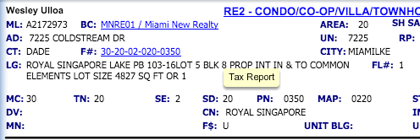
LOT/BLOCK TOWNHOUSES

Slide 6

Tips for Searching on MLS
Filter results by adding field “legal description” + “does not contain” Condo, Undiv
Disregard the terms considered

