Slide 1


FORECLOSURES & SHORT SALES EXPLAINED

Slide 2

IT ALL BEGINS WITH…
What Happens When Someone Stops Paying Their Mortgage?

Slide 3
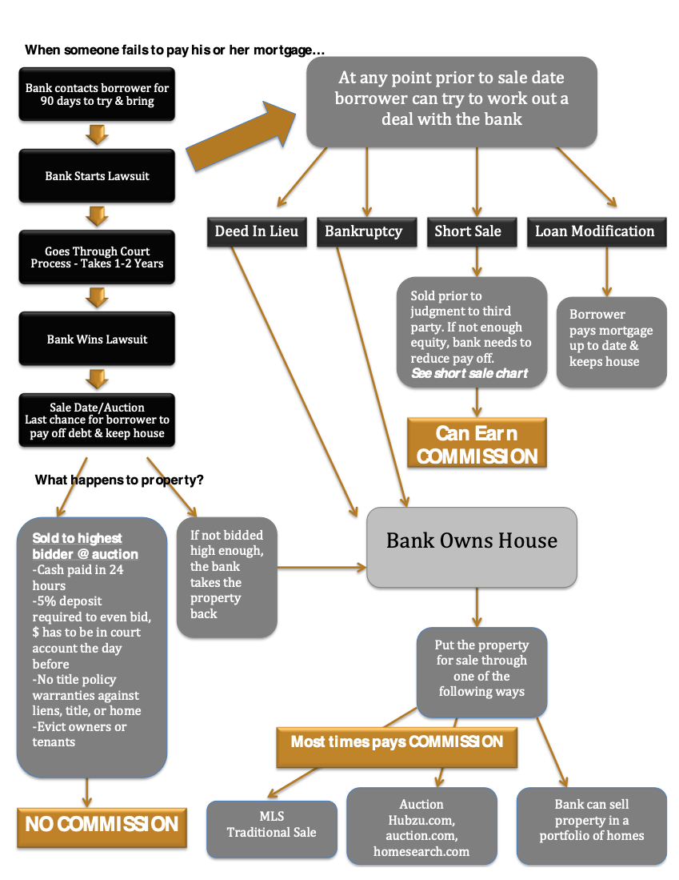

Slide 4
Short Sales – An Overview
A short pay off to the lender typically due to financial hardship
File is assigned to Loss Mitigation Department”
The seller must cooperate with lenders request for docs, access
Short sales can delay but not stop foreclosure proceedings
Can be as quick as 45 days or up to YEARS
Remember - Bank is not a party to contract
Your commission can be reduced by the lender
Cannot be sold to someone you “Know”

Slide 5
Prequalifying Short Sales
Check current status of foreclosure
Find out if the property has more than one mortgage
Check for any secondary liens or violations
Refer to an attorney to file a notice of appearance to delay proceedings
Find Out what type of loan the borrower has to know process. Example – FHA vs Conventional
Make sure buyers are serious

Slide 6
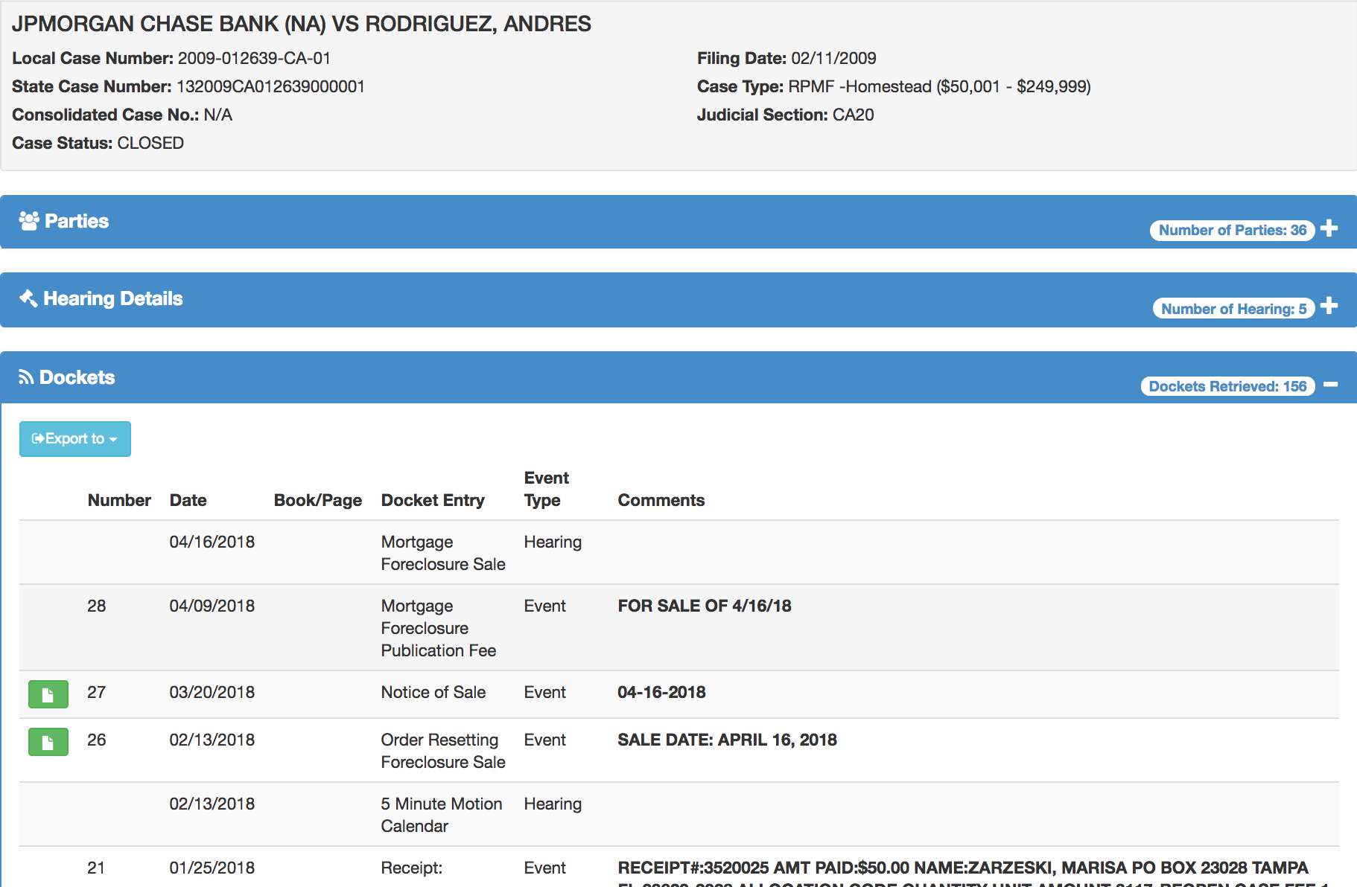
Docket Search Example

Slide 7
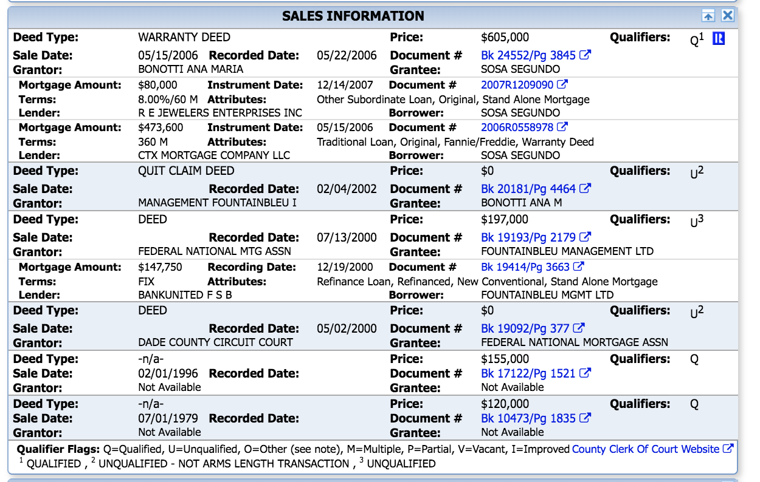
IMAPP Search For Mortgages

Slide 8
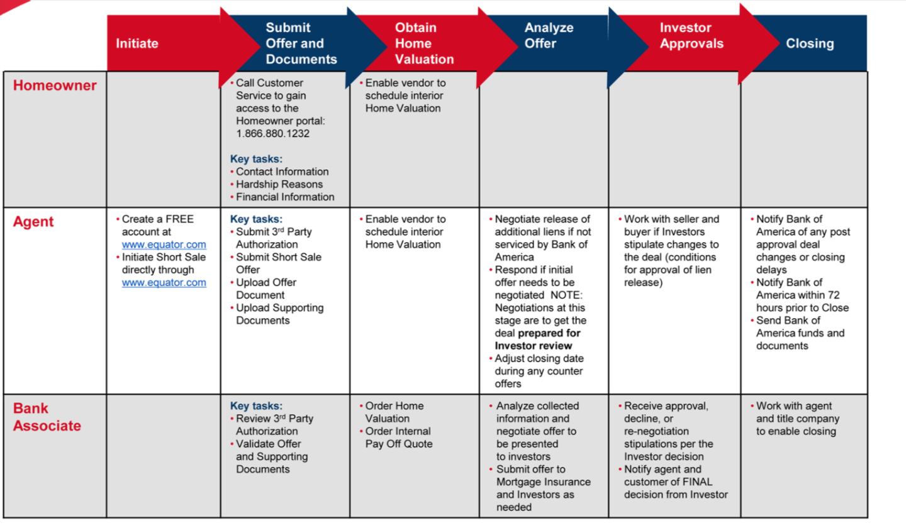
How to Process Short Sales
Bank orders BPO upon receipt to verify that the offer is in line with market value
Seller may not be fully released from Liability

Slide 9
List of Documents for Short Sale
*Please note these documents vary from lender to lender*
Uniform Borrower Assistance Form / Form 710
4506T
Proof of income (seller is wage earner: last 60 days of pay stubs, seller is self employed: profit & loss statement- year to date, seller receives unemployment: unemployment award letter, seller is retired: social security award letter)
All pages of 2 most recent bank statements for all accounts (checking, savings, IRA etc)
Last 2 years tax return signed/dated w/ all schedules & w2s, 1099s
Proof of occupancy: utility bill or copy of the lease agreement if the property is rented
Hardship letter: signed and dated
Current HOA statement w/ balance, Secondary, third lien information
Preliminary HUD showing bank net proceeds

Slide 10


Pros & Cons to Short Sales
Pros
Cons
Seller has control of moving
Not as bad as a foreclosure on their credit
Can get financial incentive to move
Typically released from liability from lender
Can have tax liability with IRS
Bank does not have to agree
Time consuming to negotiate
Commission can be reduced
Sometimes it is better for a bank to foreclosure

Slide 11
Court House Auctions - An Overview
Must have 5% of bid price in account with county prior to bidding
Cash Only Purchase
No warranties as to title
Typically no viewings or inspections prior to auction
You may have to evict occupants
Owners can contest and tie up property even after auction date
Can be purchasing HOA or 2nd mortgage lien

Slide 12
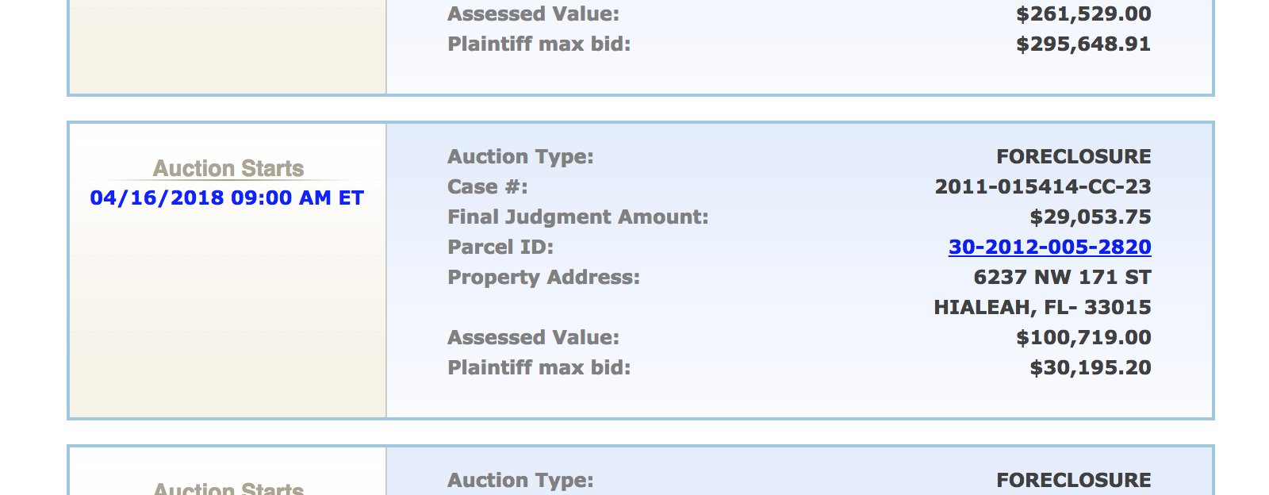
Real Foreclosure Website for Court Auctions

Slide 13
Foreclosures – An Overview
Foreclosure is any property already owned by the bank on their “books”
Also known as REO – Real Estate Owned
The property does not have to be listed – for example can be sold in a pool
Typically “AS-IS” condition with no warranties
Can be financed if property is in good condition
Beware of CU’s in Unincorporated Dade County
Typically Contingent Upon Clear Title
Some banks have different processes – HUD properties

Slide 14
Getting your REO offer accepted
Follow Instructions!
Make a strong offer in inspection, financing, closing
Don’t waste time trying to get agent on the phone
If you do try to find out of waste of time or get them on your side

Slide 15
How to Become REO Listing Agent
Get REO certified
Go to conferences
Fill out applications for all lenders who have REO department
Be prepared to have a good amount of working capital, team
Partner up with someone who has experience

Slide 16
Hubzu, Home Search, and Auction.com
Not the same as court house auctions
Can be financed in certain cases
Already “REOs”
House bidders fees
Contingent on clear title in most cases
Sometimes they sell them occupied

Slide 17
How to Find REOs, Short Sales, and Pre Foreclosures
IMAPP for pre foreclosures
Search fields REO & short sale on MLS
Abandoned Houses
Attorneys

