Slide 1


EVERYTHING YOU NEED TO KNOW ABOUT PERMIT, CONSTRUCTION, AND VIOLATIONS

Slide 2

BUILDING A NEW PROPERTY
Zoning of the property identifies what can be built on a specific site.
The higher the zoning/density the more valuable the property.
Rezoning and Variances are possible but vary city to city.
Some cities control look and design of the property including paint colors
Deal Structure is important. Financing for land is almost impossible. Construction loans depend on experience

Slide 3
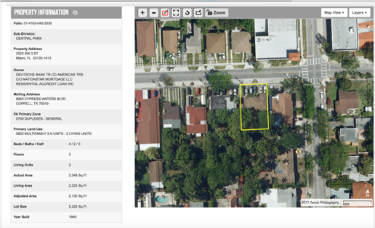
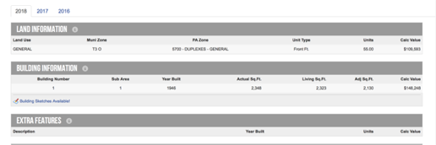
Understanding Zoning

Slide 4
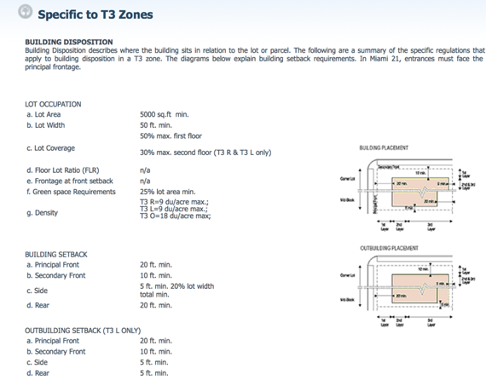
Understanding Zoning Continued

Slide 5
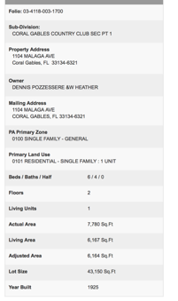
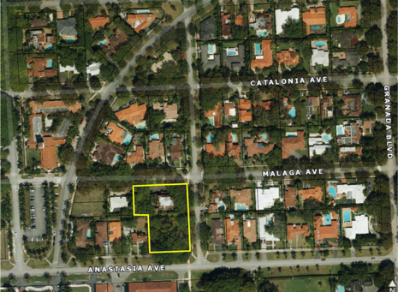
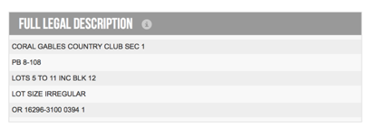
When a lot can be subdivided

Slide 6
Rule of Thumbs for Pricing / Time
Price PSF depends on finishes and experience of builder. Can be $80-$200 PSF
Demolition rough estimate is about $20,000 to tear down a 2,000 square foot home
Average timeframe for construction of a home is about 9-12 months.

Slide 7
Parties Involved in Building
General Contractor - Typically works for about 15% profit
Sub-Contractors - Specialists in a certain trade
Foreman - Site/Crew Manager
Architect
Engineer
City Building Department

Slide 8
Plan Approval Process
Design Plans with Architect
Mechanical, Electrical, Plumbing Engineering plans drafted
Structural Engineer for any changes to windows, additions or main structure.
Submit to City and Apply for Permit
City will review MEP and Structural and Architectural and will make comments and request revisions. Must go through each trade
Can be multiple rounds of revisions prior to approval

Slide 9
Construction Process - Shell
Demo if already constructed
Soil Boring Test - Check if solid ground
Utilities Prep if needed
Slab / Foundation / Main Plumbing
Structural Columns and Walls
Trusses and Roof
Windows and Doors
Stucco

Slide 10
What is a Permit?
A permit is when a contractor asks the city/county for permission to make changes to a property.
The contractor must perform work according to building code for specific change.
When a permit is required?
Depends on the city but a good guide can be found here:
- http://www.miamidade.gov/permits/

Slide 11
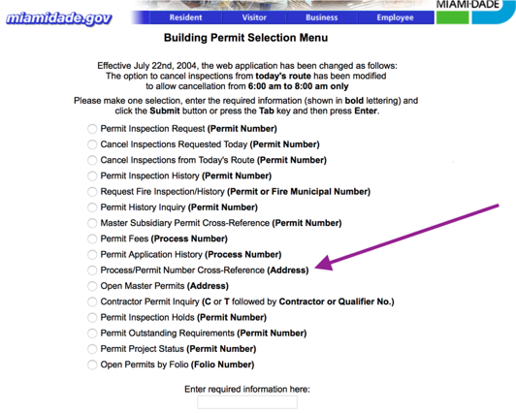
Permit Research For Property

Slide 12
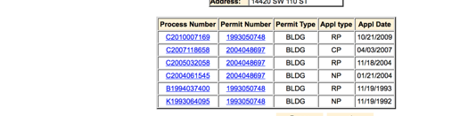
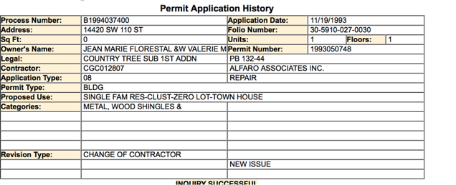
Permit Research For Property

Slide 13
Renovating an Older Home
Can sometimes be more difficult and costly then building from scratch
Good Rule of Thumb is $25 PSF for substantial remodel
Changes to more than 50% require bringing everything up to code.
Same planning and approval process and new construction
Many unforeseen issues

Slide 14
Differences
 | Title Issue
Liens | ✔ | ✔
Violations | ✔ | ✔
Open Permits | In some cases |  | ✔
Nonconforming Uses |  |  | In some cases

Slide 15
What are Open Permits?
Open permits are building or repair permits that a contractor started work and never finalized
Although not a title issue that can stop a closing, the buyer can sometimes be forced to close on a property with open permits
Ex: Electrical plumbing
Sometimes to close out old open permits, a contractor must bring the property up to current county code
Open permits that are never closed out can turn into a violation

Slide 16
What is a Nonconforming Use?
Nonconforming use is work done without a permit or not up to code which the city or county is not aware of.
Ex: A garage conversion done without permits or a single family house turned into a duplex without permits.
Can turn into a violation if the city becomes aware of the work done without a permit.
There is no such thing as “grandfathered in” when it comes to work without permits.
Disclosure is Key!!!

Slide 17
What is a Violation?
The easiest way to understand violations is to consider the equivalent of a traffic ticket
The violations are issued because the condition of the property violate some county building code
In order to pay the violation, the condition of the property must be brought up to current code
When there is a violation in place, financing is not possible
Many times in order to bring property up to code, seller must hire a contractor to do work with permits

Slide 18
What is a Violations | Continued
These violations, if not brought up to code can become a lien upon the property
They can accrue on a daily basis until brought into compliance sometimes reaching hundreds of thousands of dollars
Examples include:
- Unsafe structure
Turning single family into duplex
Work without permit
Commercial vehicle park in residential zone
Grass overgrown

Slide 19
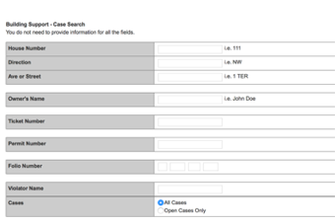
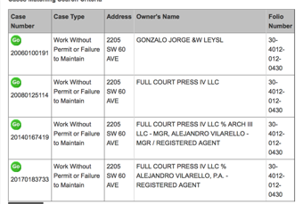
Violation Look Up - Miami Dade County

Slide 20
What is a lien?
Debt secured against the property’s title and can be against owner as well
Property liens; Examples: Mortgages, unpaid taxes, unpaid HOA dues, unresolved violations
Owner liens; Examples: Judgments from unpaid debts or IRS liens due to failure to pay income tax
All liens typically are paid at closing unless the property does not have enough equity to cover total lien amount. Then seller needs to negotiate with lien holder to lower liens

Slide 21
What is a Certificate of Use (CU)?
A certificate of Use is a engineering report issued on ALL foreclosures in unincorporated Dade county (Tip: check municipal code 30)
This report will show all open permits, non conforming uses and violations
Any issues requiring attention will turn into a violation within 90 days from Certificate of Use being issued
It is typically found as an attachment on the MLS or ask the listing agent

Slide 22
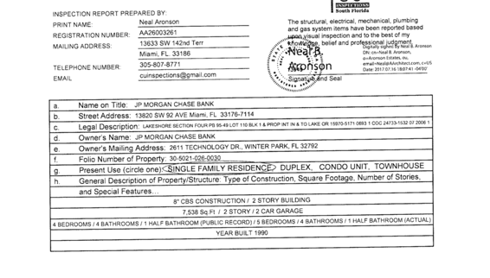
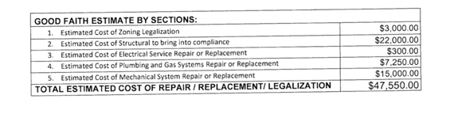
Example of CU

