Slide 1

Digital Mental Health and Psychological Support System for Students in Higher Education
DTIE Project
GROUP - 2
Presented by:
K.Greeshma - 2620040163
GLB. Ananya - 2620040168
T. Divya - 2620040079
A. Akshara - 2620030502
Gayatri - 2620040006
Under the Guidance of:
Sudhakar Gudlnarva

Slide 2



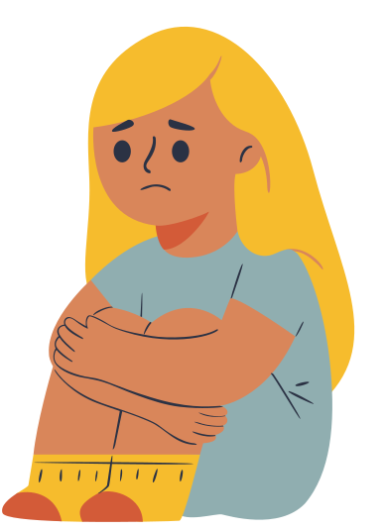

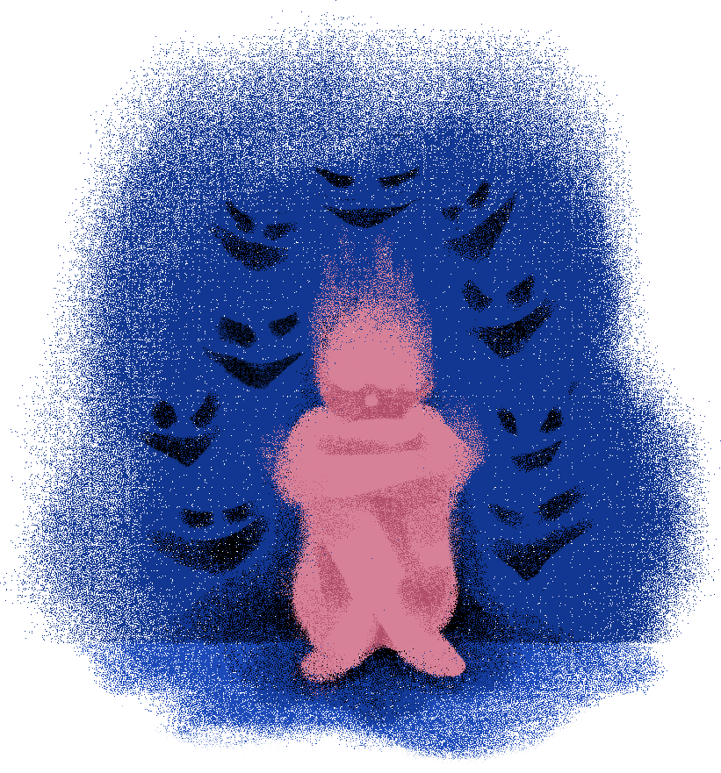
The Problem
What Problem Are We Addressing?
Students in higher education face multiple pressures that can negatively affect their mental well-being, academic performance, and daily life.
Major Challenges Faced by Students
Academic Pressure
Assignments, examinnations, deadlines, and performance expectations.
Stress & Anxiety
Constant worry, pressure, and difficulty managing emotions.
Loneliness & Isolation
Difficulty making connections or adjusting to a new environment.
Burnout
Physical and emotional exhaustion caused by prolonged stress.
Stigma Around Mental Health
Fear of judgement may prevent students from asking help.
Limited Access to Support
Students may not know where to seek help or may find counselling inconvenient

Slide 3
Problem statement
Students face stress, anxiety, loneliness and academic burnout, but often hesitate to seek help due to stigma, lack of awareness and limited accessibility.
Who is affected?
college & university students
→ Academic pressure
→ social isolation
→ difficulty adjusting
→ emotional stress
How might we...?
how might we provide students with a private, accessible and easy way to find the right psychological support
Goal
Recognize → support → connect

Slide 4
empathy: Understanding the users
Target Users:
College & University Students
What We Learned:
  Students often hide their struggles due to fear of judgement
  Many prefer private and convenient ways to seek help.
  Students may be unsure about when to seek professional support.
  They want quick, reliable and easy-to-understand resources.
  A supportive first step can make seeking help feel less intimidatng.
key insight
methods used:
“I want help, but I need a safe and simple way to ask for it.”
Student Survey, Interviews, Empathy Mapping

Slide 5
empathy map
💬 SAYS 💭 THINKS
“I’m just stressed.” “Will people judge me?”
“I can handle it myself.” “Do I actually need help?”
“I don't know who to talk to.” “I wish support was easier to access.”
👤 DOES ❤️ FEELS
Avoids asking for help Overwhelmed
Keeps problems to themselves Anxious
Searches online for solutions Lonely
Talks to friends instead Uncertain
Key Insight
Students want support, but privacy, convenience and fear of judgement influence how they seek it.

Slide 6
define: user persona
meet our user - aditi
19 years-old | 1st-Year College STUDENT
Situation: Struggling to balance academics, social life and personal well-being
Pain Points
  📚 Academic workload
  😰 Stress and overthinking
  👥 Difficulty opening up
  🤐 Fear of being judged
  🕐 Counselling feels inconvenient
Needs
  Privacy
  Easy access to support
  Reliable resources
  Non-judgmental guidance
Goal
To manage stress and get support without feeling exposed or judged.

Slide 7
define: core problem
what Does the student really need?
problem:
Students need a private and accessible way to recognize their emotional needs and find appropriate support without feeling judged or overwhelmed.
Our Design Requirements
🔒 Private — Protect student confidentiality
⚡ Accessible — Support available anytime
🧭 Guided — Help students find the right resource
🤝 Supportive — Encourage connection with people who can help
Design Goal
Create a simple digital bridge between students and psychological support.
MindBridge
Recognize → Guide → Connect → Support

Slide 8
idea generation
brainstorming possible solutions
we explored multiple ways to address students’ mental-health needs:
  📱 Mental Health App
  🧠 Daily Mood Check-in
  💬 Anonymous Support Chat
  👩‍⚕️ Online Counselling Booking
  🧘 Self-Help & Wellness Tools
  👥 Peer Support Network
  🚨 Emergency Support Access
  📊 Well-being Progress Tracking
From Ideas to One Solution
Combine the most useful features into one accessible platform — MindBridge.
Check-in → Self-help → Support → Professional Help

Slide 9
major modules of the proposed system
IDEA | IMPACT | PRIVACY | FEASIBILITY | ACCESSIBILITY | TOTAL
Meditation App | 3 | 5 | 5 | 5 | 18
Peer Support | 4 | 3 | 4 | 4 | 15
Counselling Booking | 5 | 4 | 4 | 4 | 17
MindBridge | 5 | 5 | 4 | 5 | 19
MINDBRIDGE - an integrated digital mental-health support platform for students

Slide 10
rapid estimation & solution concept
RAPID ESTIMATION:
REQUIREMENT
👥 Development Team
⏱️ Development Time
🧪 Testing
🏫 Initial Deployment
💰 Estimated MVP Cost
ESTIMATE
4–5 members
6–8 weeks
30–50 students
One college
₹30,000–₹40,000
SOLUTION CONCEPT - MINDBRIDGE
A student-friendly digital platform that provides:
Check-in → Self-Help → Peer Support → Counselling → Emergency Resources
Core Goal
Make mental-health support easier to access, understand and navigate.

Slide 11
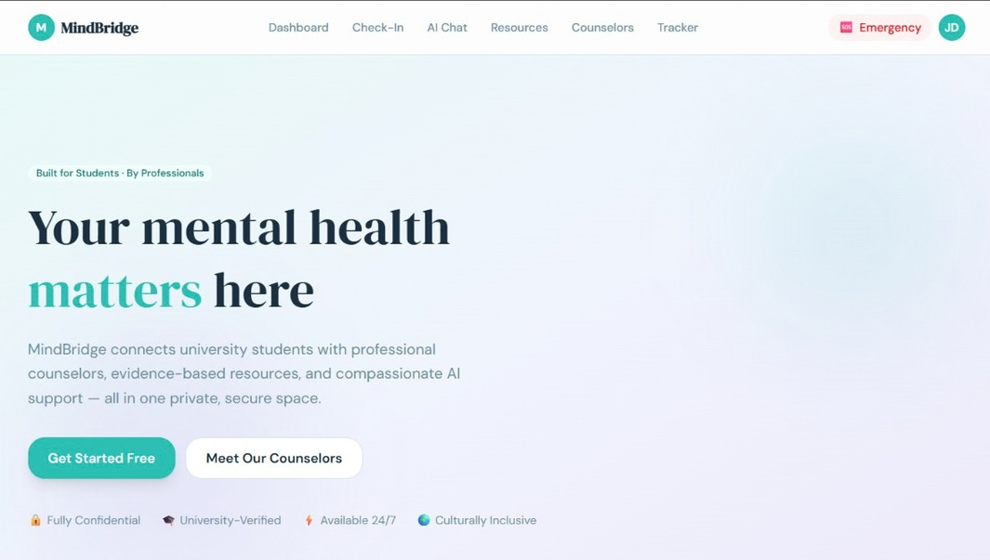
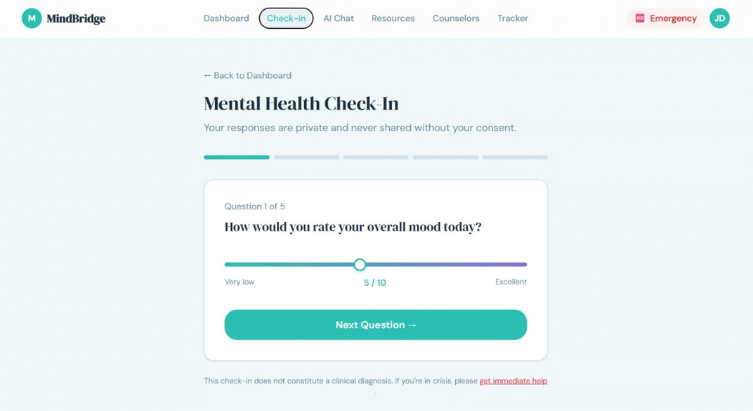
rough prototype
Home Page
Check-in

Slide 12
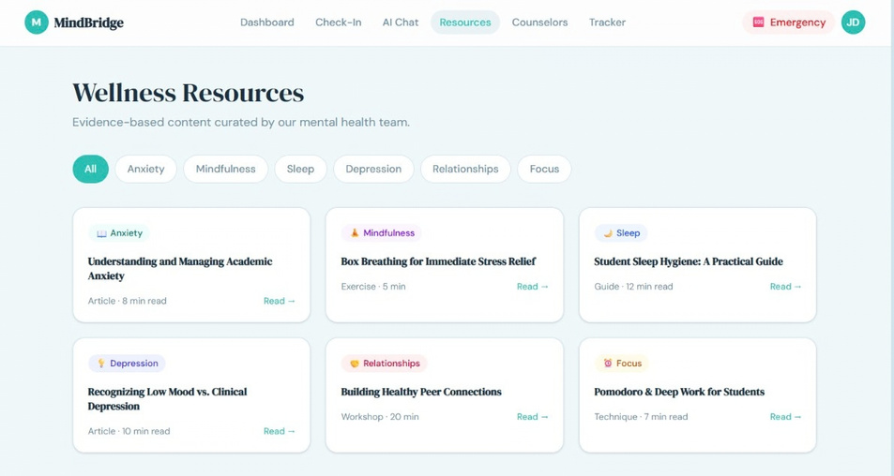
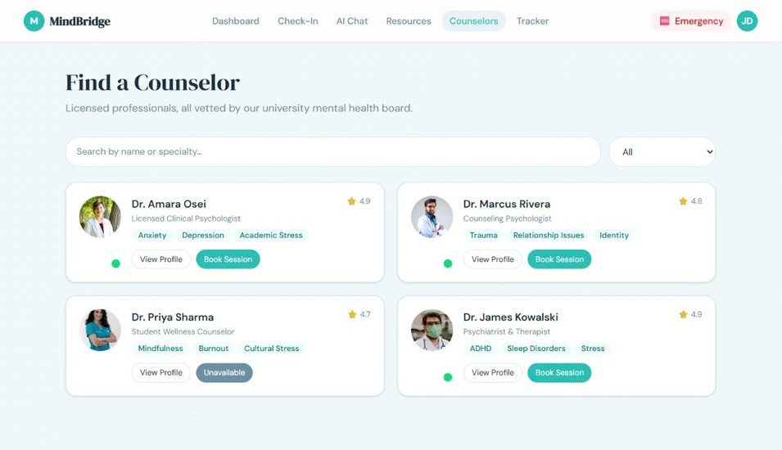
RESOURCES
COUNSELLING/PROFESSIONAL SUPPORT

Slide 13
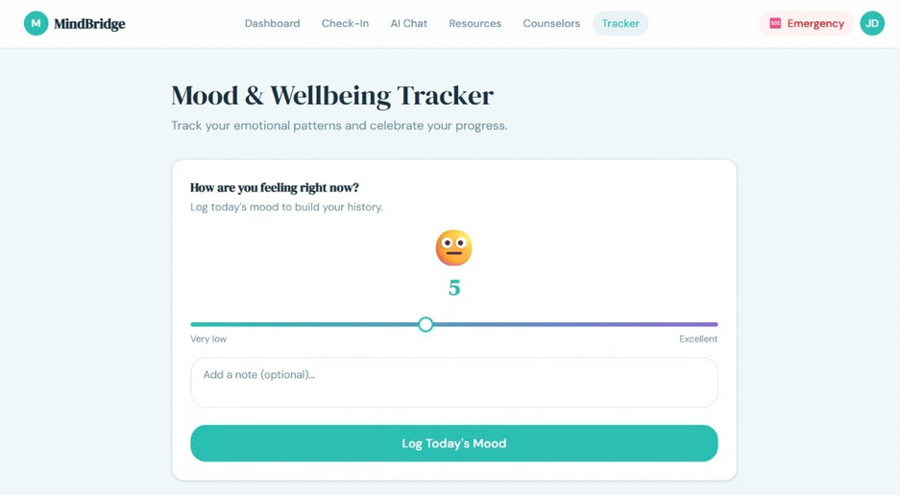
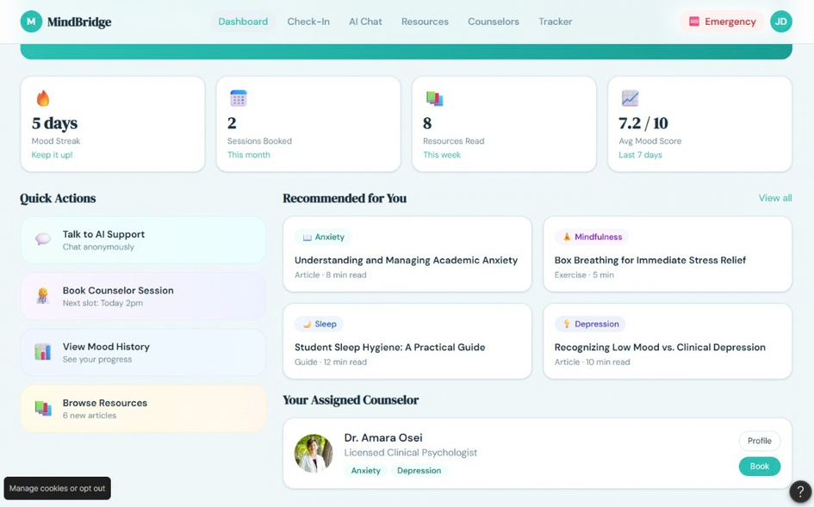
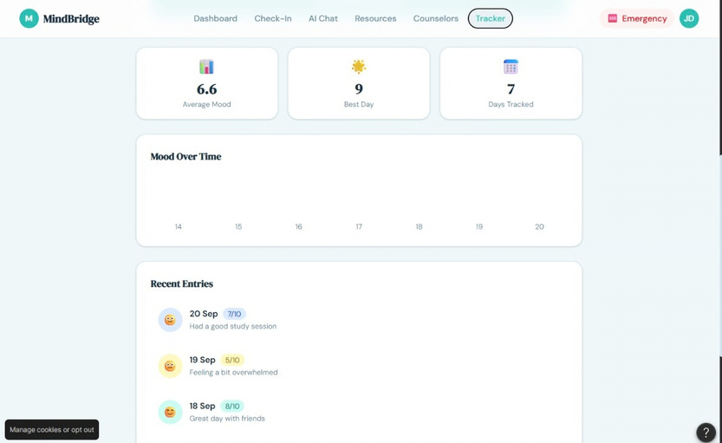
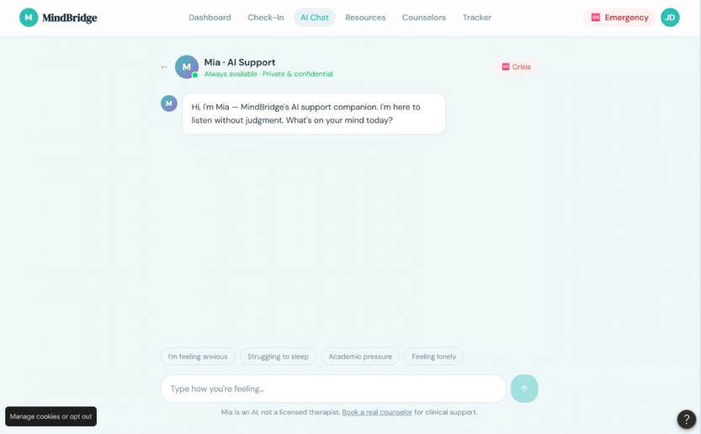
MOOD AND WELL-BEING TRACKER
ADDITIONAL FEATURES AND AI CHAT-BOT

Slide 14
website prototype
https://www.figma.com/make/k8dSRPvF2LEexiFYt7oYoU/MindBridge-Mental-Health-Website?t=aQ2kyXUN8BastSGw-1

Slide 15
expected impact
Expected Impact of MindBridge
🧠 Early Awareness
Helps students recognize their emotional and mental-health needs.
🔒 Greater Privacy
Provides a comfortable first step for students hesitant to seek help.
⚡ Easy Access
Makes support and resources easier to find in one place.
🤝 Better Connection
Links students with peer and professional support.
📚 Improved Well-being
Can help students manage stress and maintain healthier academic routines.
Overall Impact
A simpler path from “I’m struggling” to “I know where to get help.”

Slide 16
conclusion
  Mental health is an important part of student success and well-being
  students need support that is accessible, private and easy to navigate.
  mindbridge brings check-ins, self-help resources and support connections into one platform.
  the system encourages students to recognize their needs and seek appropriate help early
our vision
“No student should feel alone when seeking support.”

Slide 17
Thank you very much!

