Slide 1


SIGNAL CONDITIONING AND FREQUENCY COMPONENT EXTRACTION USING ACTIVE FILTERS AND FFT ANALYSIS
Akula Manasa Reddy
Veligatla Pardhu Sai Harsha

Slide 2
PROBLEM STATEMENT
The input signal is obtained from a black box system.
The signal contains multiple frequency components and noise.
Our objective is to extract a clean 6 kHz signal.
This requires signal conditioning and filtering.

Slide 3
AGENDA OVERVIEW
01
05
OBJECTIVE
CIRCUIT DIAGRAM
02
06
PROPOSED SOLUTION
SIMULATION RESULTS
03
07
SYSTEM BLOCK DIAGRAM
FFT ANALYSIS
04
08
HPF, BPF, LPF STAGES
BONUS

Slide 4
OBJECTIVE
• To design and implement a multi-stage active signal conditioning system using High-Pass, Band-Pass, and Low-Pass filters to extract the desired 6 kHz frequency component from a composite signal obtained from a black-box system, while suppressing low-frequency drift, high-frequency interference, and unwanted noise, and to verify the extracted signal using FFT analysis.

Slide 5
PROPOSED SOLUTION
The proposed system uses a combination of Sallen-Key active filters and passive signal conditioning circuits to progressively remove unwanted frequency components.
• A High Pass Filter (HPF) with cutoff frequency 2 kHz removes DC offset and low-frequency drift.
• Two Band Pass Filters (BPF) centered around 6 kHz provide selective amplification of the desired frequency band and suppress out-of-band noise.
• Two Low Pass Filters (LPF) with cutoff frequencies 10 kHz and 8 kHz reduce high-frequency interference and harmonics.
• An RC smoothing circuit is used to remove residual ripple and spikes in the signal.
• A voltage divider is implemented to scale the output amplitude to a suitable level.
• Finally, FFT analysis is performed to verify that the dominant frequency component around 6 kHz is successfully extracted.

Slide 6
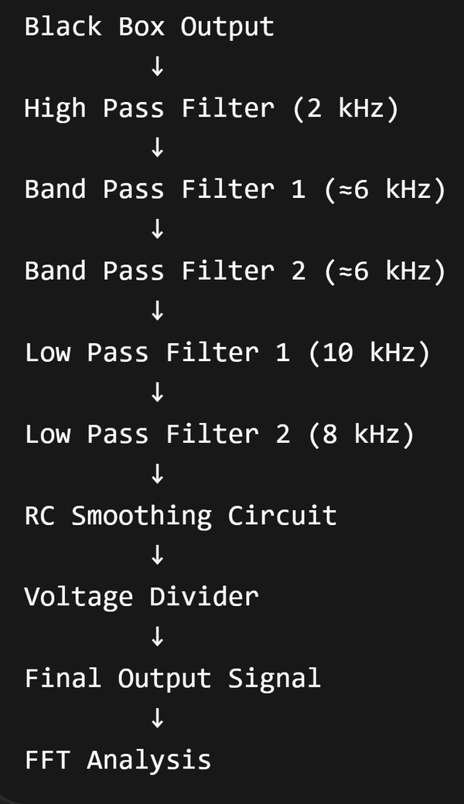
BLOCK DIAGRAM

Slide 7
HPF, BPF, LPF STAGES
High Pass Filter (HPF)
• Cutoff Frequency: 2 kHz
• Removes DC offset and low-frequency drift
• Allows frequencies greater than 2 kHz to pass.
Band Pass Filter (BPF)
• Center Frequency: ≈ 6 kHz
• Used to select the desired frequency band
• Two BPF stages are used to improve frequency selectivity and noise rejection.
Low Pass Filter (LPF)
• Cutoff Frequencies: 10 kHz and 8 kHz
• Suppresses high-frequency interference and unwanted harmonics
• Two LPF stages provide stronger attenuation of noise.

Slide 8
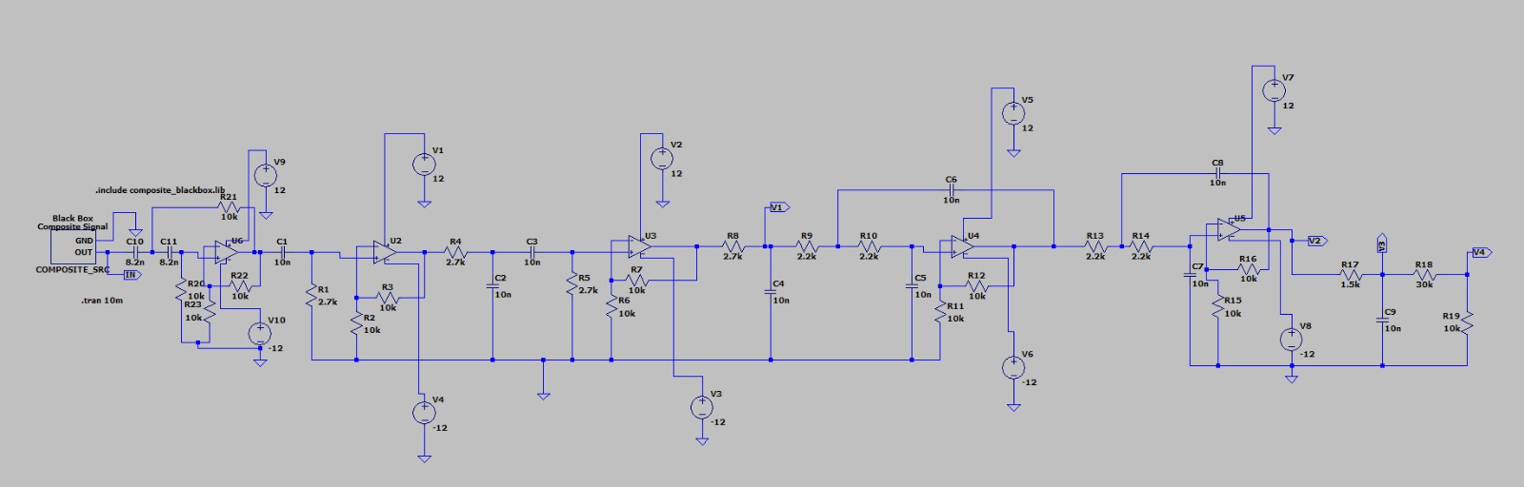
CIRCUIT DIAGRAM

Slide 9
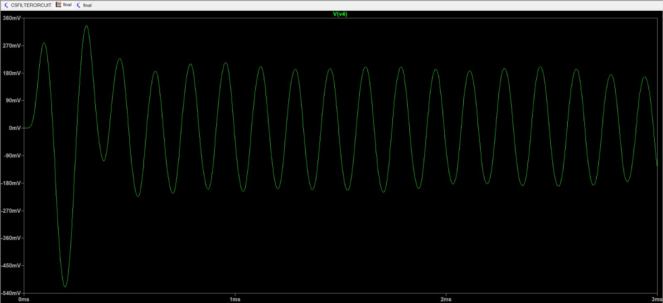
SIMULATION RESULTS

Slide 10
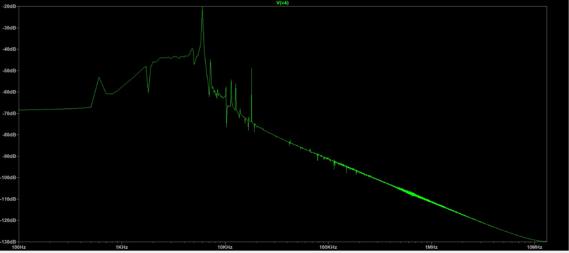
FFT ANALYSIS

Slide 11
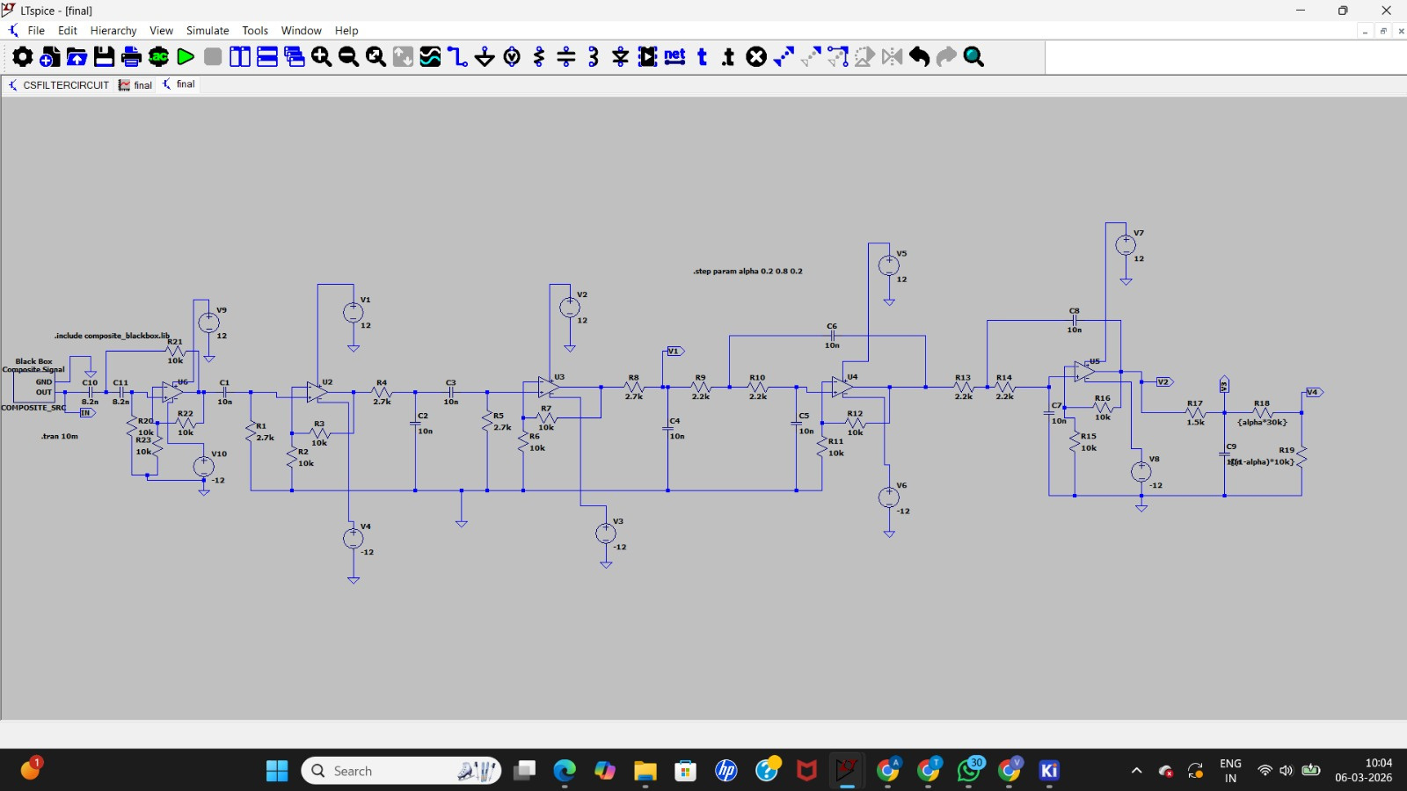
CIRCUIT WITH POTENTIOMETER

Slide 12
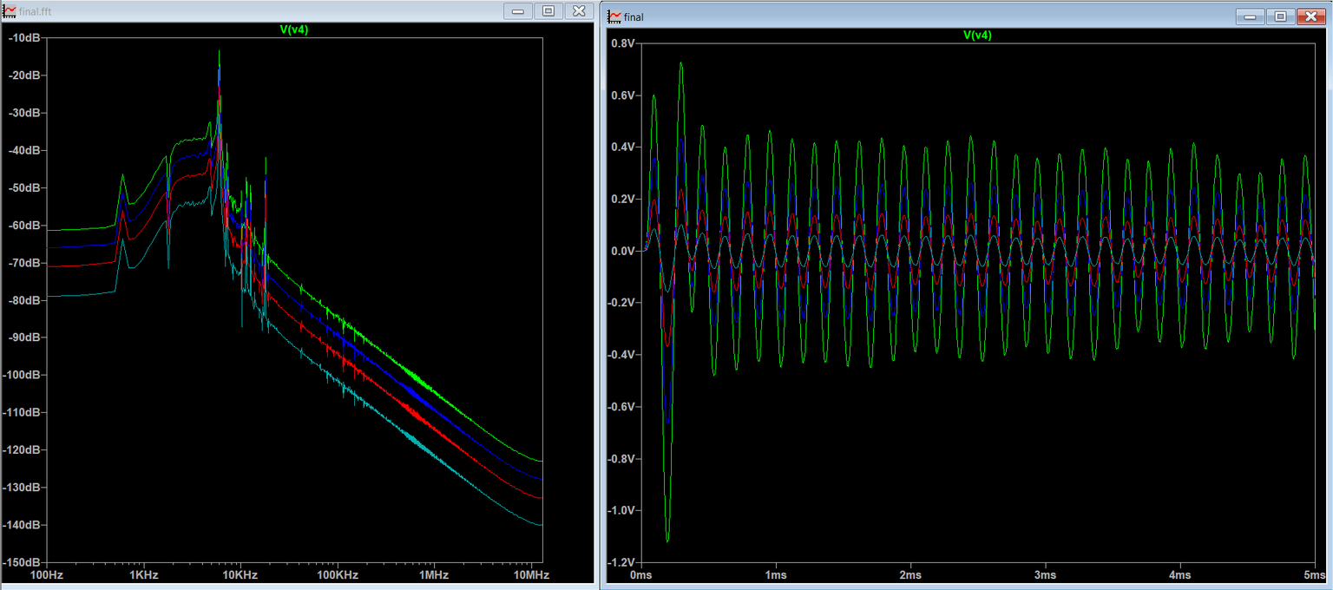
OUTPUT WAVEFORM IN BOTH TIME AND FREUENCY DOMAIN
THE SIMULATION RESULTS DEMONSTRATE THAT THE VARIABLE RESISTOR ACTS AS A GAIN AND SELECTIVITY CONTROL ELEMENT IN THE ACTIVE FILTER CIRCUIT. WHILE THE CENTER FREQUENCY REMAINS AROUND 6 KHZ DUE TO FIXED RC VALUES, THE MAGNITUDE AND SHARPNESS OF THE FREQUENCY PEAK VARY WITH THE RESISTOR VALUE, WHICH IS CLEARLY VISIBLE IN BOTH THE FFT SPECTRUM AND TIME-DOMAIN WAVEFORM.

Slide 13
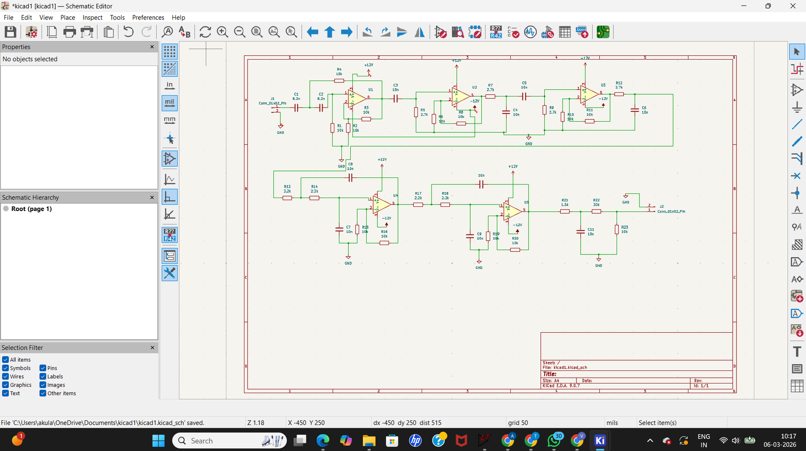
BONUS
BUILDED THE CIRCUIT KICAD

Slide 14
OBSERVATION
During simulation and implementation of the multi-stage filtering system, the following observations were made:
• The High Pass Filter (2 kHz) successfully removed DC components and low-frequency drift from the input signal.
• The Band Pass Filters selectively allowed frequencies around the desired 6 kHz region, improving frequency selectivity.
• The Low Pass Filters (10 kHz and 8 kHz) significantly reduced high-frequency noise and interference.
• Cascading multiple filter stages improved signal-to-noise ratio (SNR) and enhanced the clarity of the output signal.
• FFT analysis showed that unwanted frequency components were attenuated, and the desired frequency component became more prominent.

Slide 15
CONCLUSION
A multi-stage active filtering system was designed and implemented to extract the desired signal from a composite black-box input.
The combination of High Pass, Band Pass, and Low Pass filters effectively removed low-frequency drift, high-frequency interference, and unwanted noise components.
The use of multiple filter stages improved frequency selectivity and signal quality.
FFT analysis confirmed that the filtering system successfully enhanced the desired frequency component around 6 kHz.
This approach demonstrates an effective method for signal conditioning and frequency component extraction in electronic systems.

Slide 16
THANK YOU

