Slide 1

Project Title - Seasonal Agriculture Performance Analysis
Student Name – Ramya Krishna Akula
College Name- Bhoj Reddy Engineering College for Women
AICTE STU ID : STU625ba2aa3a4d71650172586

Slide 2

PROBLEM STATEMENT
Agricultural activities are influenced by seasonal variations in environmental conditions, farming practices, resource availability and market conditions. As a result, agricultural performance may differ from one season to another.
The problem is to analyze the given agricultural dataset and investigate seasonal differences in agricultural performance by identifying meaningful patterns, trends, relationships and variations within the available data.

Slide 3
Project Description
Analyzes 4,000 agricultural records across different seasons.
Compares crops, irrigation methods, states and districts.
Studies key metrics such as yield, production, revenue, cost and profit.
Examines rainfall, soil, temperature and water usage.
Uses Python for data cleaning, analysis and visualization.
Identifies key patterns, relationships and data-driven insights.

Slide 4

WHO ARE THE END USERS?
Farmers – To understand crop performance, profitability and irrigation efficiency.
Agricultural Organizations – To analyze farming patterns and improve resource planning.
Irrigation & Resource Managers – To understand water usage and efficiency.
Agricultural Analysts – To study seasonal, crop and regional performance.
Government & Policy Makers – To support data-driven agricultural planning and decisions.

Slide 5

Technology Used
Python – Data analysis and processing
Pandas – Data cleaning and manipulation
NumPy – Numerical analysis
Matplotlib – Data visualization
Seaborn – Statistical visualization
Jupyter Notebook – Project development and analysis

Slide 6
Seasonal Analysis

Slide 7
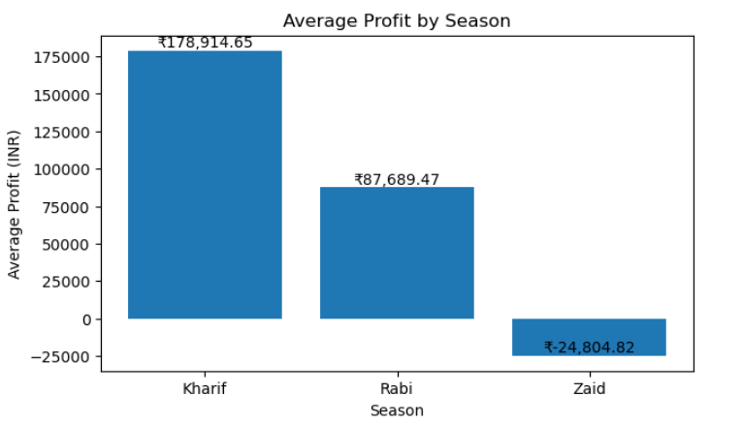
RESULTS
Kharif was the most profitable season, with an average profit of approximately ₹1.79 lakh, while Zaid recorded an average loss of ₹24,805.

Slide 8
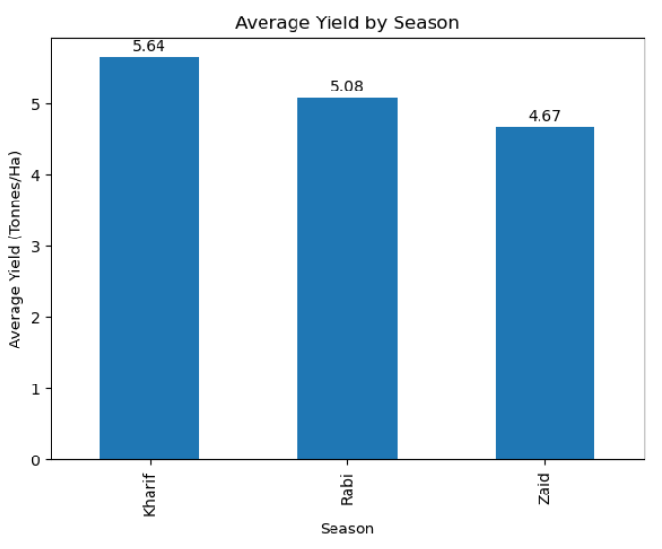
RESULTS
Kharif has the highest average yield: 5.63 tonnes/ha.
Rabi: 5.04 tonnes/ha.
Zaid has the lowest: 4.64 tonnes/ha.So, in this dataset, Kharif shows the highest average crop yield.

Slide 9
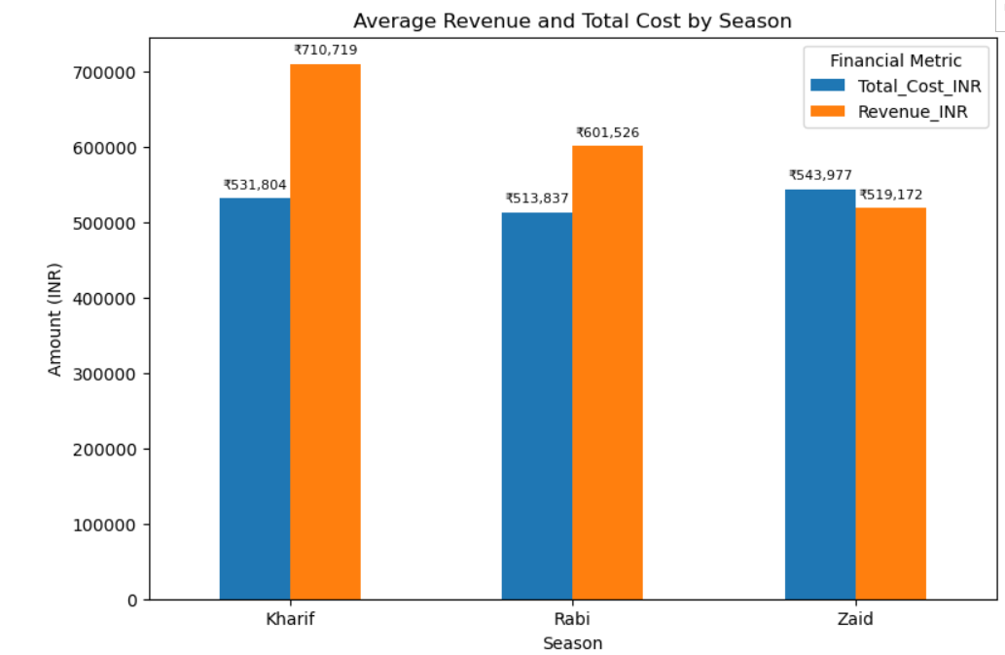
RESULTS

Slide 10
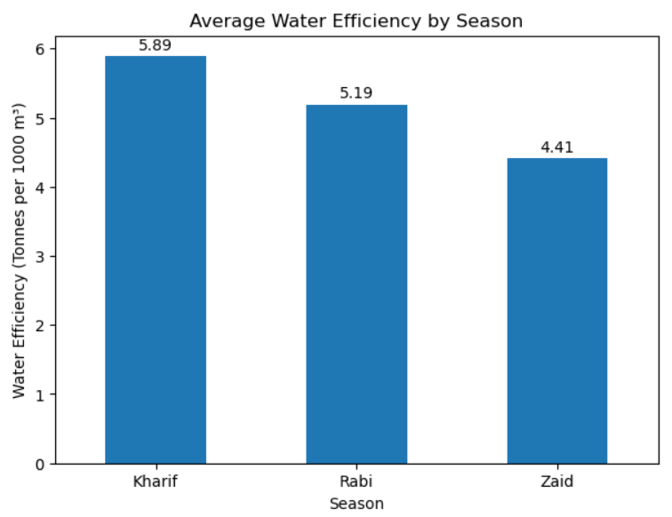
RESULTS
Kharif showed the highest average water efficiency at 5.89 tonnes per 1,000 m3, while Zaid had the lowest at 4.41 tonnes per 1,000 m3.

Slide 11
Crop Analysis

Slide 12
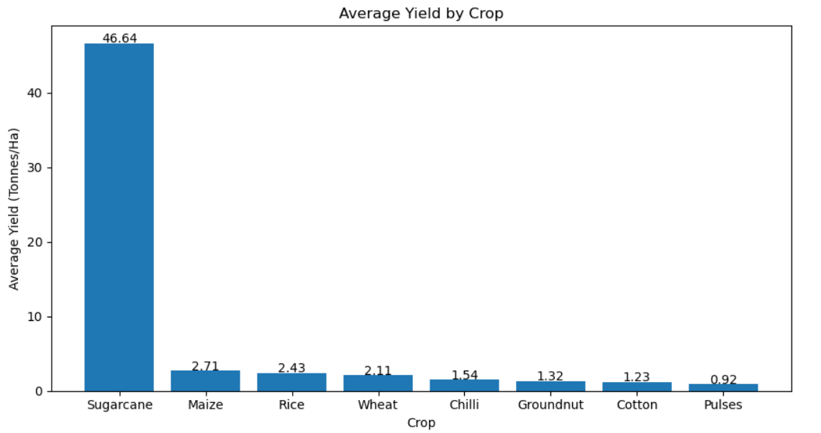
RESULTS
Sugarcane recorded the highest average yield at 46.64 tonnes per hectare, while Pulses recorded the lowest at 0.92 tonnes per hectare. Among the remaining crops, Maize had the highest average yield at 2.71 tonnes per hectare.

Slide 13
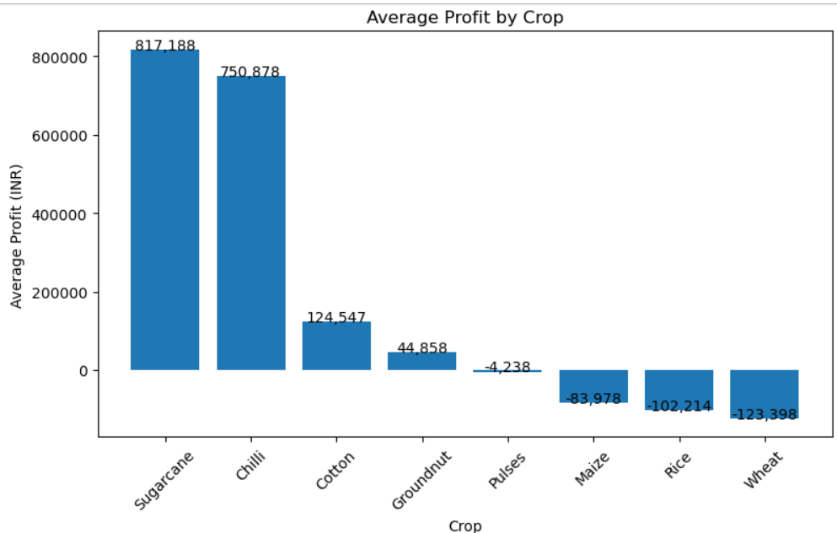
RESULTS
[Add screen shots of your code ]

Slide 14
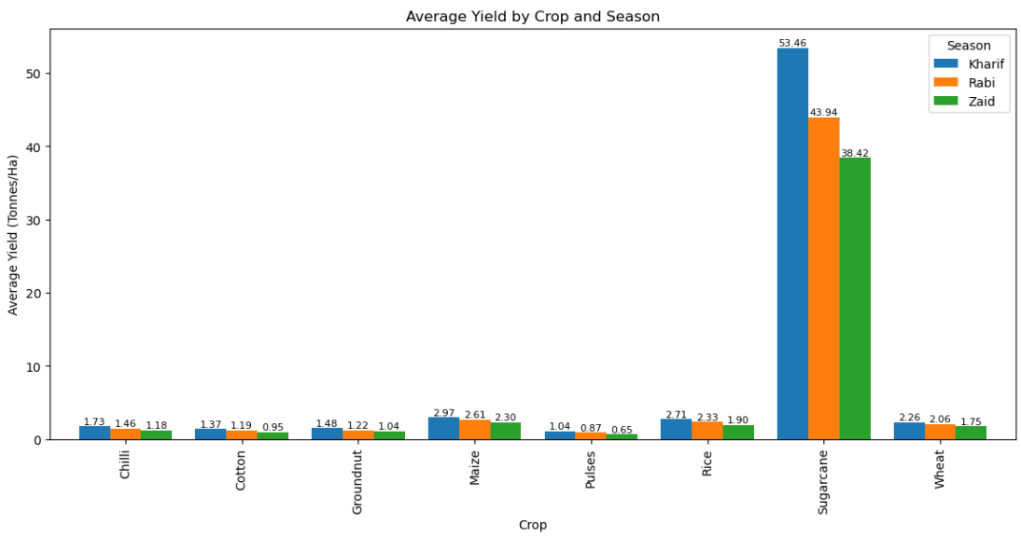
RESULTS
Kharif had the highest yield for most crops, while Zaid had the lowest. Sugarcane had the highest yield, and Pulses had the lowest across the seasons.

Slide 15
Irrigation Analysis

Slide 16
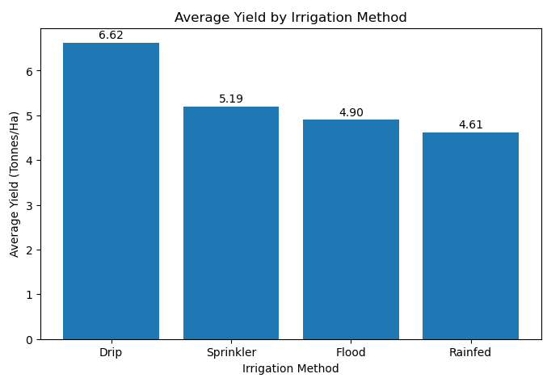
RESULTS
Drip irrigation has the highest average yield (6.58 tonnes/ha).
Rainfed has the lowest (4.60 tonnes/ha).
Drip irrigation appears to be the most effective method for yield.

Slide 17
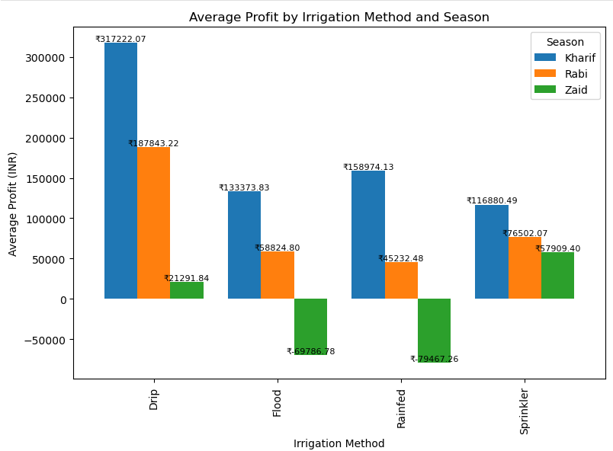
RESULTS
Drip irrigation recorded the highest average profit in Kharif and Rabi, while Sprinkler recorded the highest average profit in Zaid. Profitability generally decreased from Kharif to Zaid, with Flood and Rainfed showing losses during Zaid.

Slide 18
State & District Analysis

Slide 19
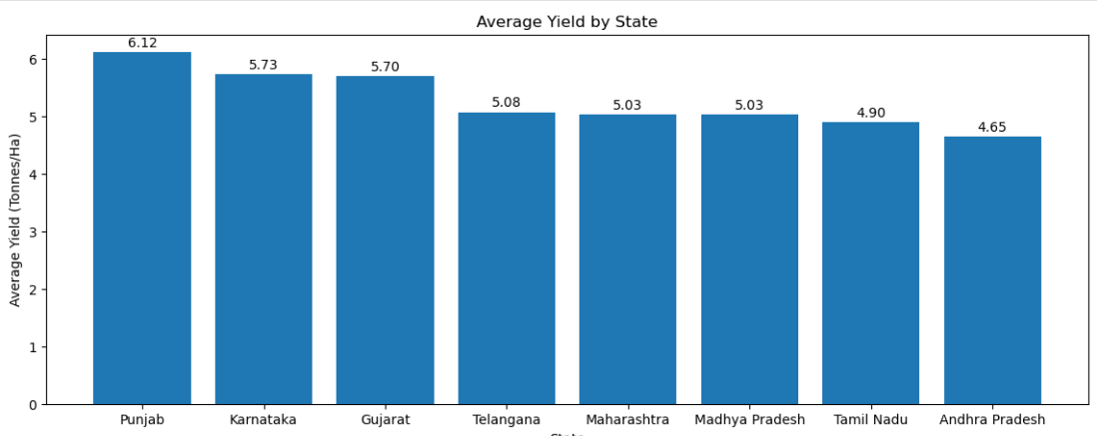
RESULTS
Punjab recorded the highest average yield at 6.12 tonnes per hectare, while Andhra Pradesh recorded the lowest at 4.63 tonnes per hectare. Karnataka and Gujarat also showed relatively high average yields.

Slide 20
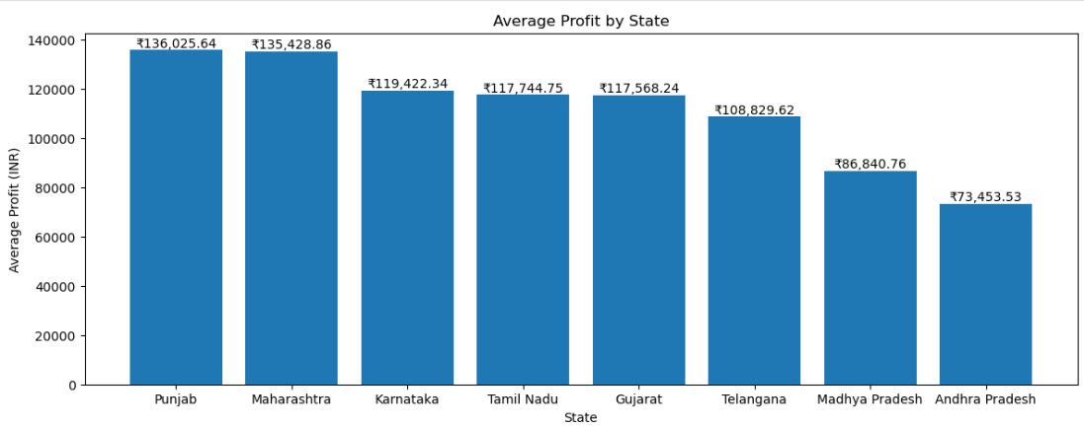
RESULTS
Punjab recorded the highest average profit of approximately ₹1.36 lakh, while Andhra Pradesh recorded the lowest at approximately ₹73,454. Maharashtra also showed a high average profit, closely following Punjab.

Slide 21
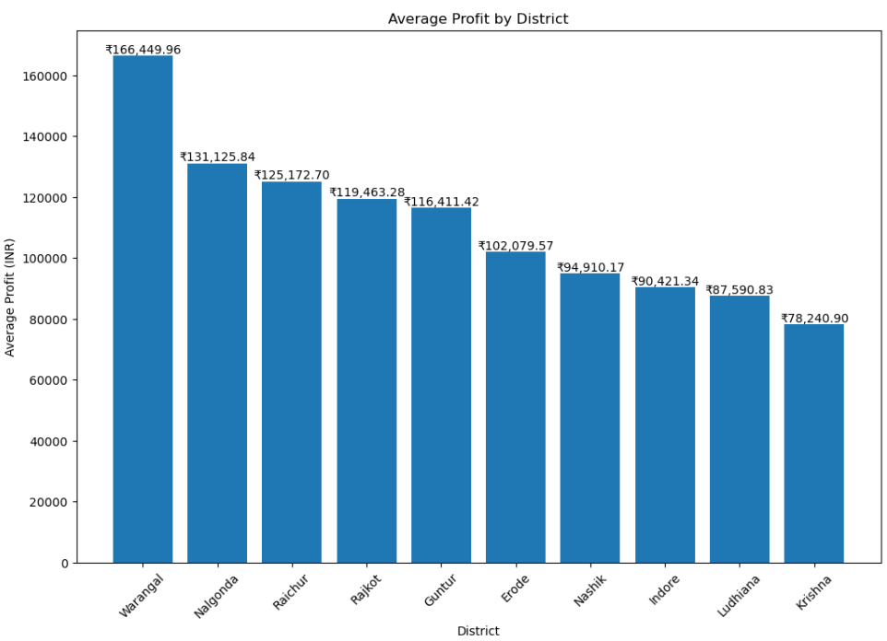
RESULTS
Warangal recorded the highest average profit at approximately ₹1.66 lakh, while Krishna recorded the lowest at approximately ₹78,241. Nalgonda and Raichur also showed relatively high average profitability.

Slide 22
Relationship Analysis

Slide 23
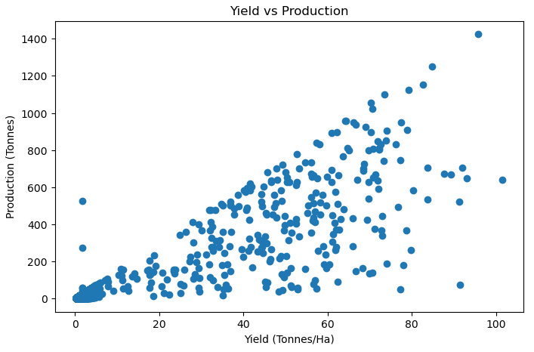
RESULTS
[Add screen shots of your code ]

Slide 24
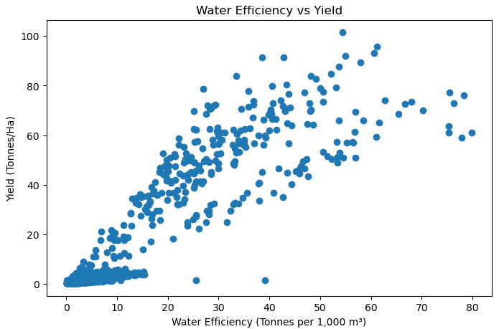
RESULTS

Slide 25
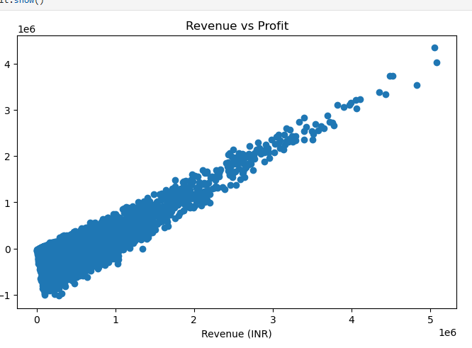
RESULTS
[Add screen shots of your code ]

Slide 26
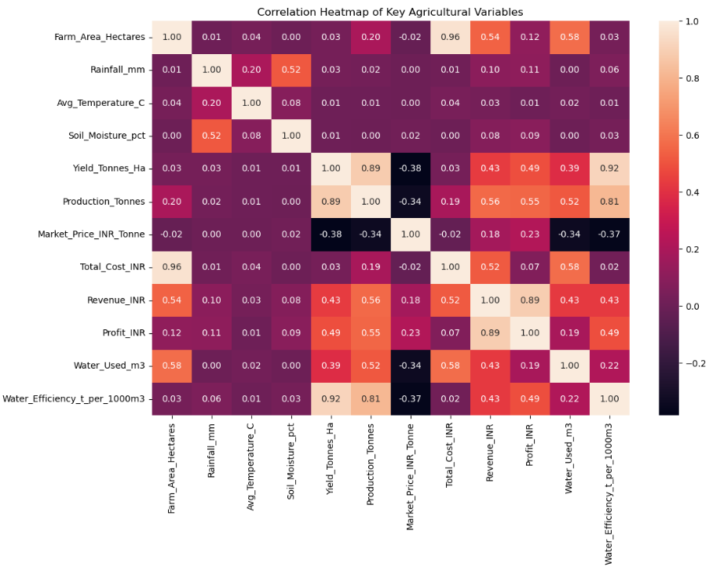
RESULTS

Slide 27
Future scope
This project can be extended in the future by using more detailed and real-time agricultural data. Weather forecasts, soil conditions, market prices and crop-related information can be included to improve the analysis.
The future scope of this project includes:
Using real-time weather and rainfall data for better seasonal analysis.
Adding more years of agricultural data to identify long-term trends.
Including real-time crop market prices to improve profit analysis.
Using machine learning to predict crop yield and profitability.
Developing an interactive dashboard for farmers and agricultural decision-makers.
Analyzing future water requirements and improving irrigation planning.
Adding more districts and crops for a broader analysis.
These improvements can help make the analysis more useful for crop planning, resource management and agricultural decision-making.

Slide 28
GitHub Link
https://github.com/AkulaRamyaKrishna/Seasonal-Agriculture-Performance-Analysis

Slide 29

VOIS Course completion certificate -
Course name- Data Visualization

Slide 30
Thank you
Seasonal Agriculture Performance Analysis
Data-driven insights for better agricultural decision-making
Name: Ramya Krishna Akula
STU ID : STU625ba2aa3a4d71650172586
.
.

