Slide 1

WIPRO NGA Program
Capstone Project Presentation – 05 August 2024
Project Title – Automating candymapper.com with Python and Selenium
Presented by – A Akhil
www.rpsconsulting.in

Slide 2

Introduction
Background:
CandyMapper is a web site which is a funny demos site for testing.
This site is based on Halloween party theme where we can host and attend party.
This site consist of 5 modules namely Home, Join Us, Halloween Party, Launch Candy Mapper and more.
We have opted for web automation testing as it help us to save time and extract data for report more efficiently as compared to manual testing.
Problem Statement:
Need to automated testing to ensure the functionality of candymapper.com
Challenges in manual testing and data extraction.
Objective:
Develop automated test script to verify the functionality of the key feature on candymapper.com
Implementing data extraction for analysis or reporting purposes.
2024 - RPS Consulting all rights reserved

Slide 3
Project overview
Project Scope:
Login functionality has been automated.
Account creation functionality has been automated.
Logout functionality has been automated.
Join us page has been automated.
Tools and Technology:
Python: Programming language used.
Selenium: Tool for web automation.
WebDriver: Chrome WebDriver.
Jira: For testing board.
2024 - RPS Consulting all rights reserved

Slide 4
Methodology
Approach:
SetUp: We have installed the following things to setup our testing environment
Created jira board and created test cases in zephyr scale.
Installed PyCharm for Python user interface.
Installed Selenium for web automation.
Installed Html Reporter for generating test execution report
We have installed chrome web driver as a WebDriver.
Scripts:
We have followed page object model to create scripts.
There is 5 test scripts
For closing pop-up: It closes the popup.
For logging into account: It consist of all necessary action required for log-in into account
For Log out: It consist of all necessary action required for logging out of account
For Joins us: It contains script to create new account.
For Creating account: It contains script for creating a new account.
Names of the test script starts with test_ (e.g.: test_login.py)
2024 - RPS Consulting all rights reserved

Slide 5
Methodology(Contd..)
Testing Process
Test Cases:
To close pop-up which appear as soon we open the web site, if not close then we can not access other elements
To authenticate sign with correct credentials so that login is authenticate.
To sing-in with invalid credential to verify the login page functionality.
To verify email is sent with credential while creating account to user.
To verify if user is new to page then able to create account by click join us.
Automation Flow:
Locators
(Object)
TeTest case1
(Native test case)
Sign-in page
(Page object)
Selenium function class
AUT
TeTest case 2
(Native test case)
2024 - RPS Consulting all rights reserved

Slide 6
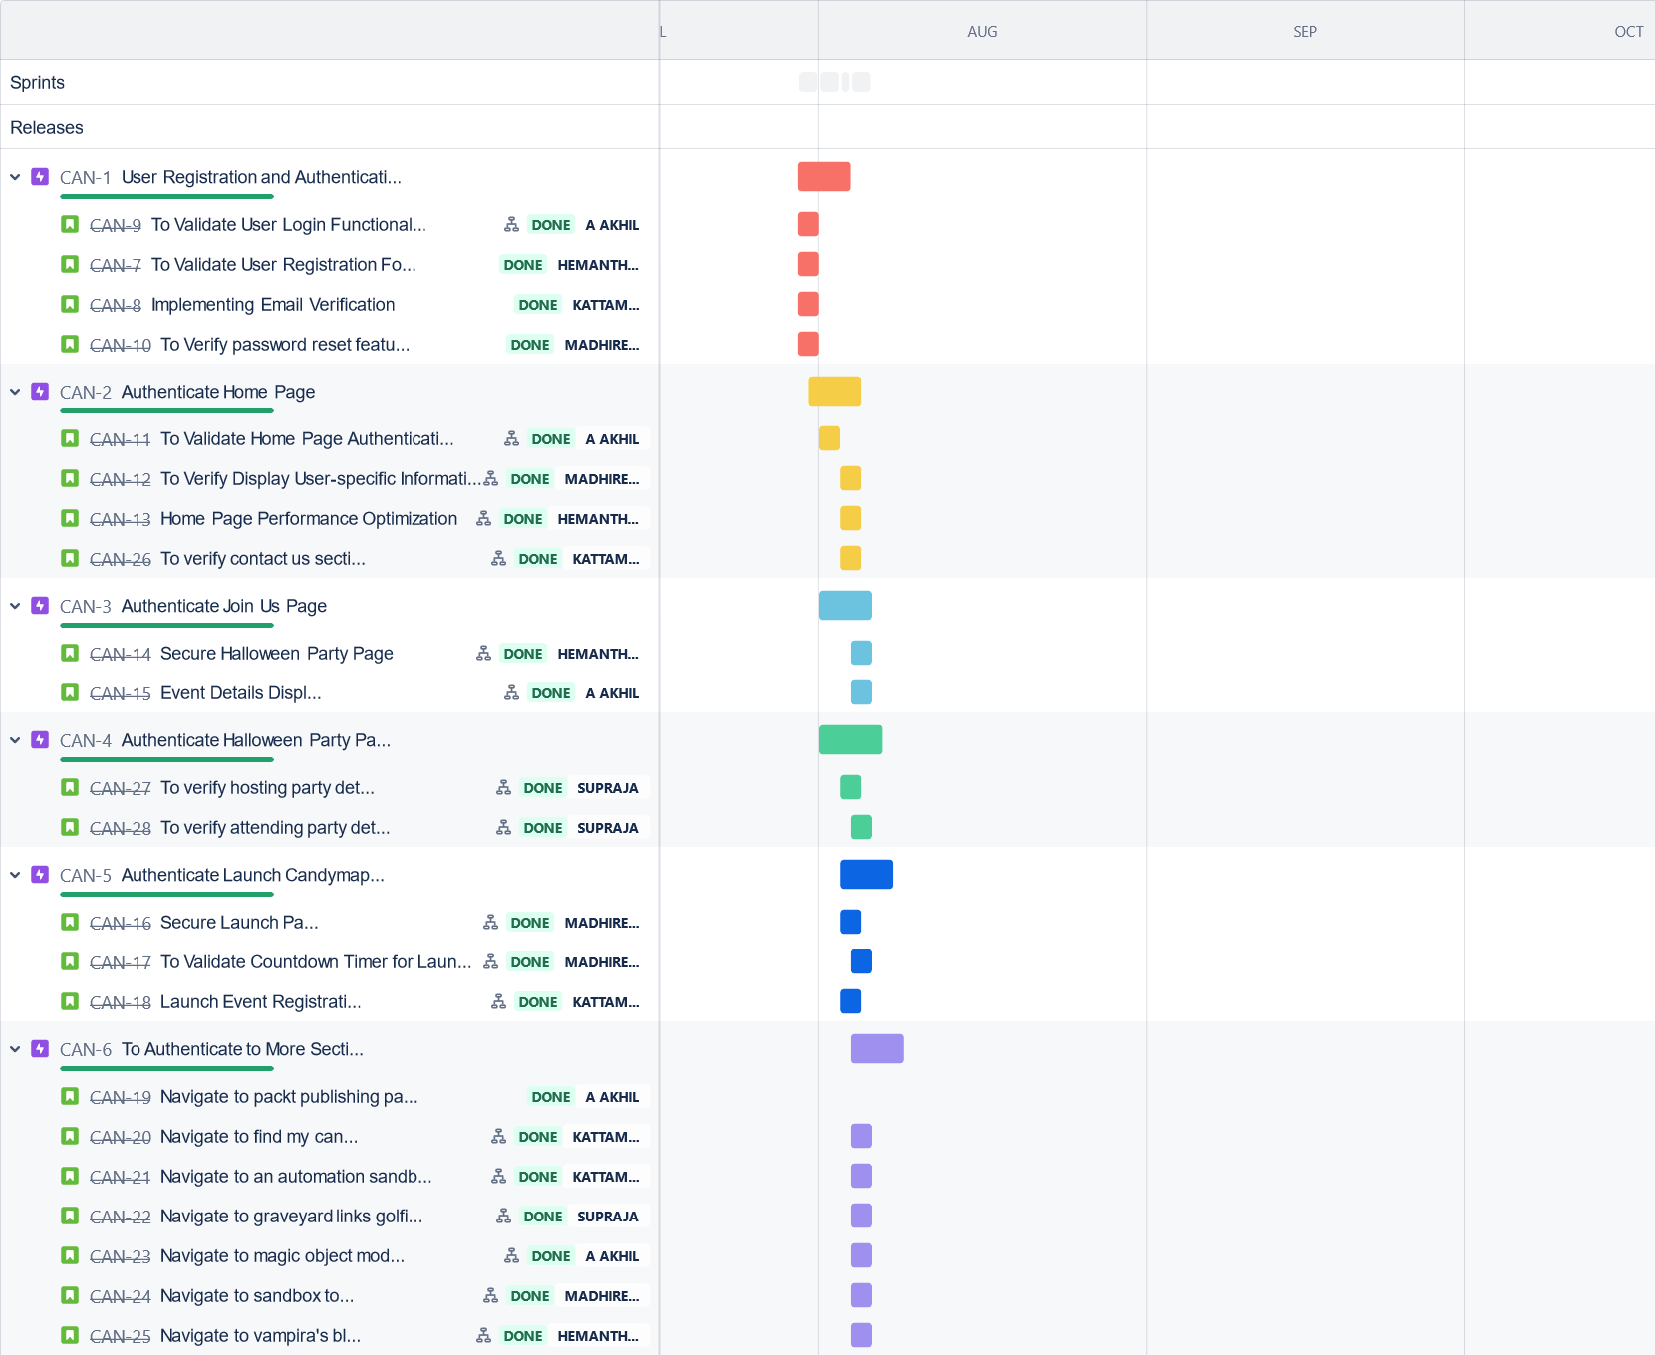
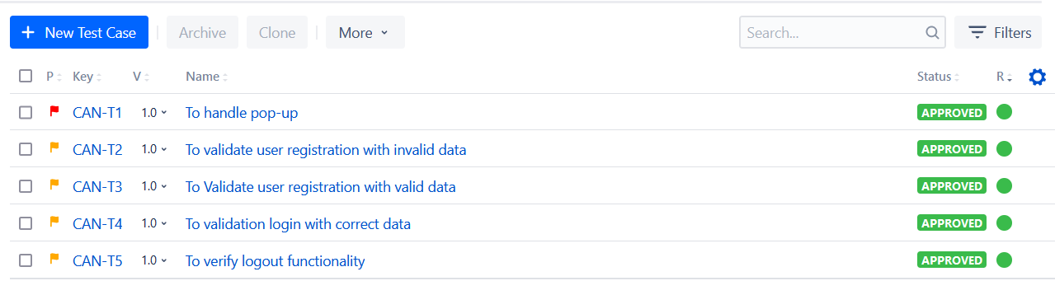
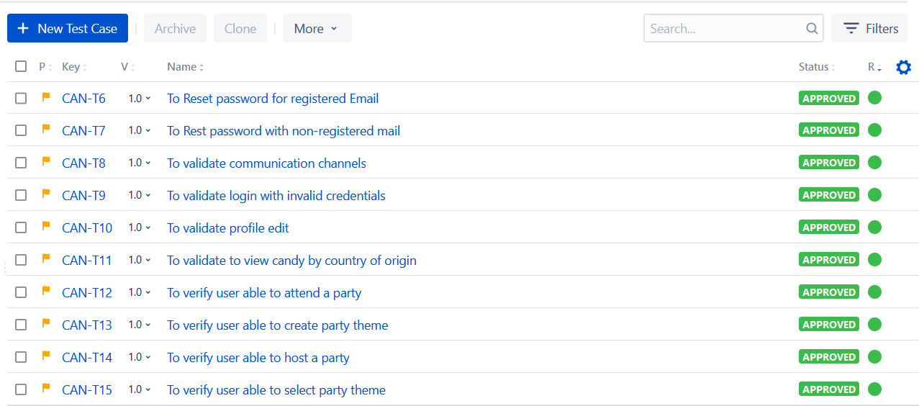
Scrum Board
Jira testing board.
Jira Timeline
2024 - RPS Consulting all rights reserved

Slide 7
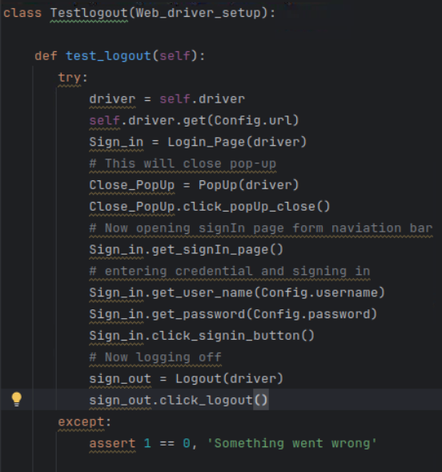
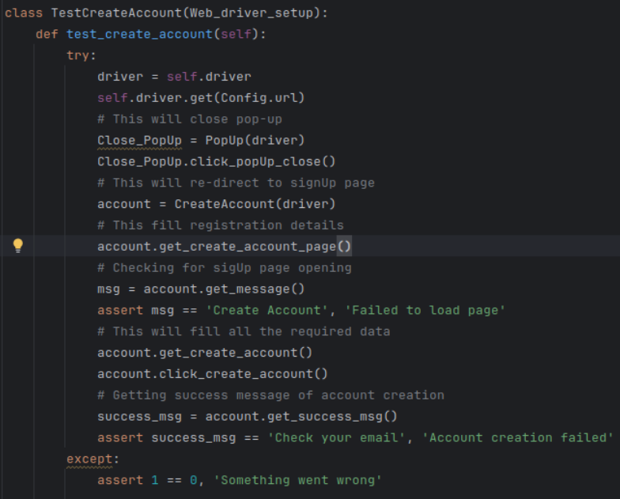
Implementation Details
Close pop-up, Login, Logout Automation
Create Account Automation.
2024 - RPS Consulting all rights reserved

Slide 8
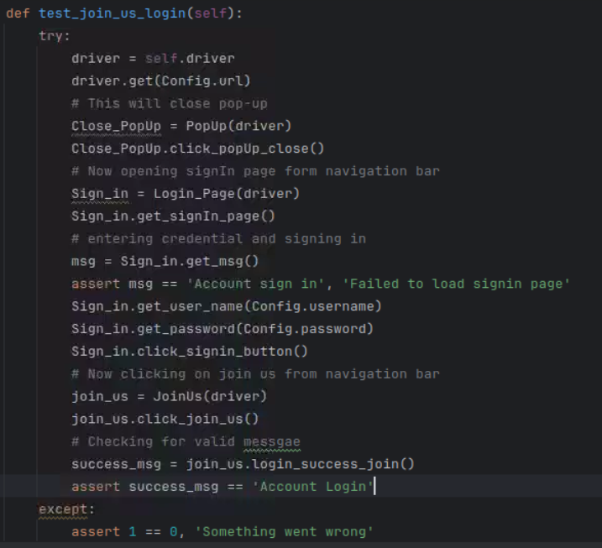
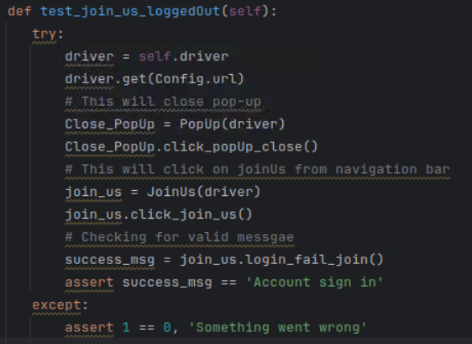
Implementation Details(Contd..)
Automating Join Us after log-in
Automating Join Us without login
2024 - RPS Consulting all rights reserved

Slide 9
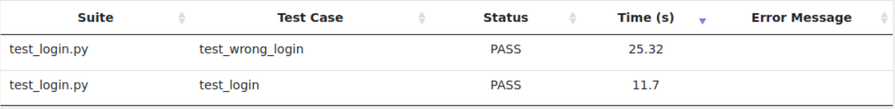
Results
Close Popup
Account Login
Account Logout
2024 - RPS Consulting all rights reserved

Slide 10
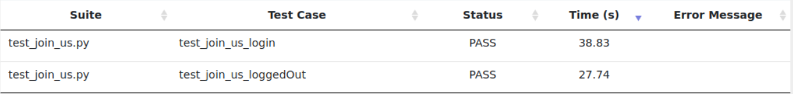
Results(Contd..)
Create Account Page
Join Us Page
2024 - RPS Consulting all rights reserved

Slide 11
Discussion
Findings:
We have to give proper mail id for login and account creation.
We have to handle popup to continue with automation testing.
Challenges:
Finding locators, Specially dynamic locators
Setting up of page object model.
Benefits:
Automation testing helps us to save time.
Automation testing is more accurate than manual testing.
Report and screenshot can be generated automatically
2024 - RPS Consulting all rights reserved

Slide 12
Conclusion
Summary:
We have automated Candymapper.com for ensuring functionality.
We have seen the flow of automation testing followed.
We have seen execution reports and jira reports.
Contributions:
Made initial setup for testing environment.
Automated Sign page, Create account page, Join us page.
Generated report for the above automation.
Future work:
Validate email before creating account.
2024 - RPS Consulting all rights reserved

