Slide 1

WIPRO NGA Program – Embedded Testing
Capstone Project Presentation – 05 August 2024
Project Title – Basic LED Controller Simulation
Presented by – A Akhil
www.rpsconsulting.in

Slide 2

Introduction
Background:
This is a Basic LED Controller Simulation project is designed to simulate the functionality of an LED controller within a software environment.
This project allows for turning LEDs on and off and adjusting their brightness using pulse-width modulation (PWM).
The simulation is implemented in C and can be run entirely in a software environment using Visual Studio Code without actual hardware.
Problem Statement:
Simulating the functionality of an LED Controller.
Objective:
Simulate LED control: Implement software to simulate LEDs turning on and off.
Adjust LED brightness: Develop a method to simulate brightness adjustment of LEDs using PWM.
Software-only environment: Ensure all simulations run entirely in software, without the need for physical hardware.
2024 - RPS Consulting all rights reserved

Slide 3
Methodology
Approach:
SetUp: We have installed the following things
Visual code for running code.
GDB debugger for debugging the code
Project Structure
The project is organized into three main components:
Header File (led_controller.h): Defines the interface and data structures for the LED controller.
Source File (led_controller.c): Implements the functions declared in the header file.
Main File (main.c): Contains the main function to test and demonstrate the LED controller functionality.
2024 - RPS Consulting all rights reserved

Slide 4
Code Execution Process
Steps to Run the Program:
Set up the development environment: Install Visual Studio Code and configure it for C programming.
Compile the code: Use a C compiler to compile the project files.
Execute the main.c file: Run the main function to test the LED controller.
Verify output: Check the console output to verify the LED state and brightness levels.
GDB Debugging Steps:
Set breakpoints: Place breakpoints in key parts of the code (e.g., main.c, led_controller.c).
Start GDB: Launch GDB and load the compiled executable.
Run the program: Use the run command to start the program within GDB.
Step through the code: Use step and next commands to move through the code line by line.
Inspect variables: Use the print command to check the values of variables and program state.
Continue execution: Use the continue command to resume program execution or terminate the debugging session as needed.
2024 - RPS Consulting all rights reserved

Slide 5
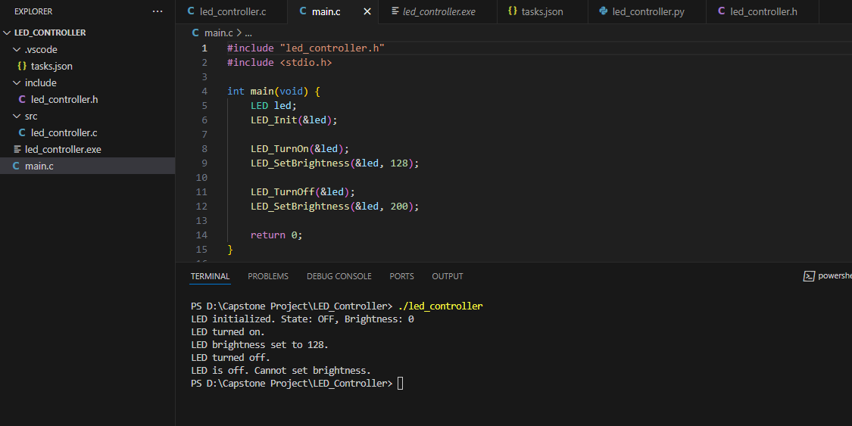
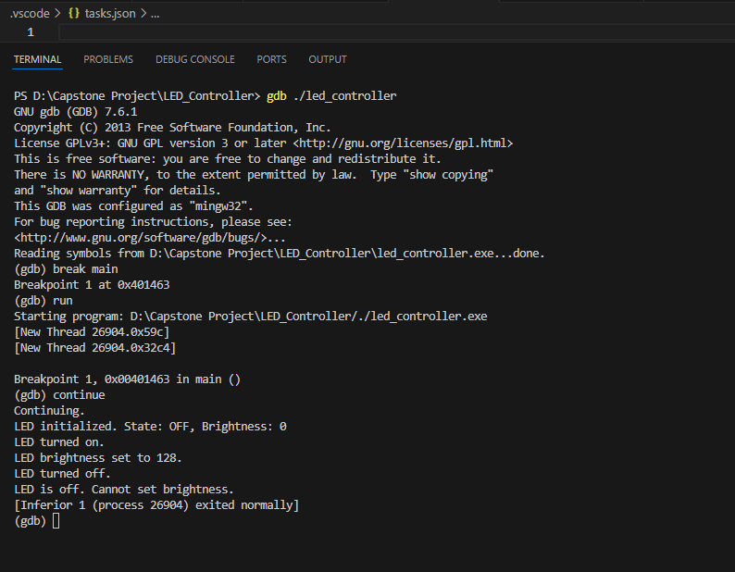
Outputs
Fig.1: Building and running code
Fig.2: Executing gdb debugging.
2024 - RPS Consulting all rights reserved

Slide 6
Conclusion
Summary:
We have runned and debugged a simple led controller simulation program with any hardware implementation
By following the described steps, one can successfully simulate LED control operations without the need for physical hardware
2024 - RPS Consulting all rights reserved

