Slide 1
FACE RECOGNITION ATTENDANCE SYSTEM
By: Akula Sindhu
B.Tech CSE

Slide 2
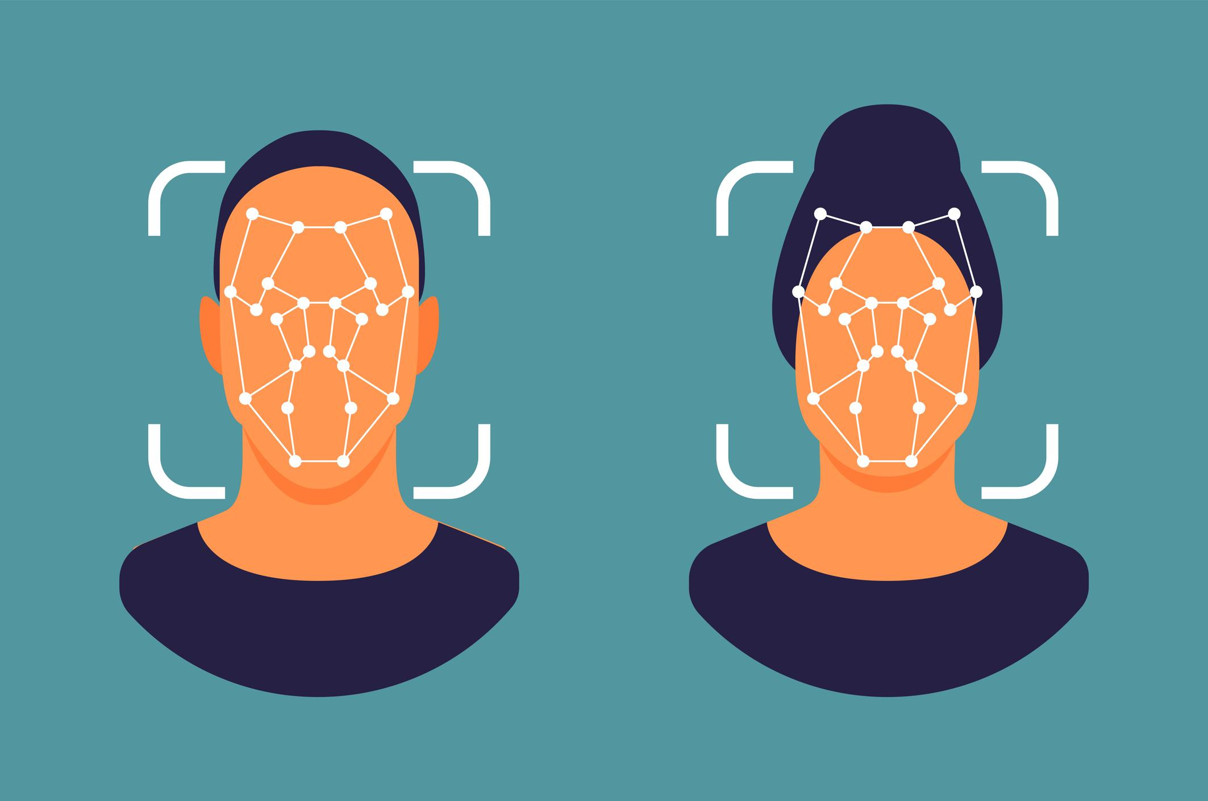

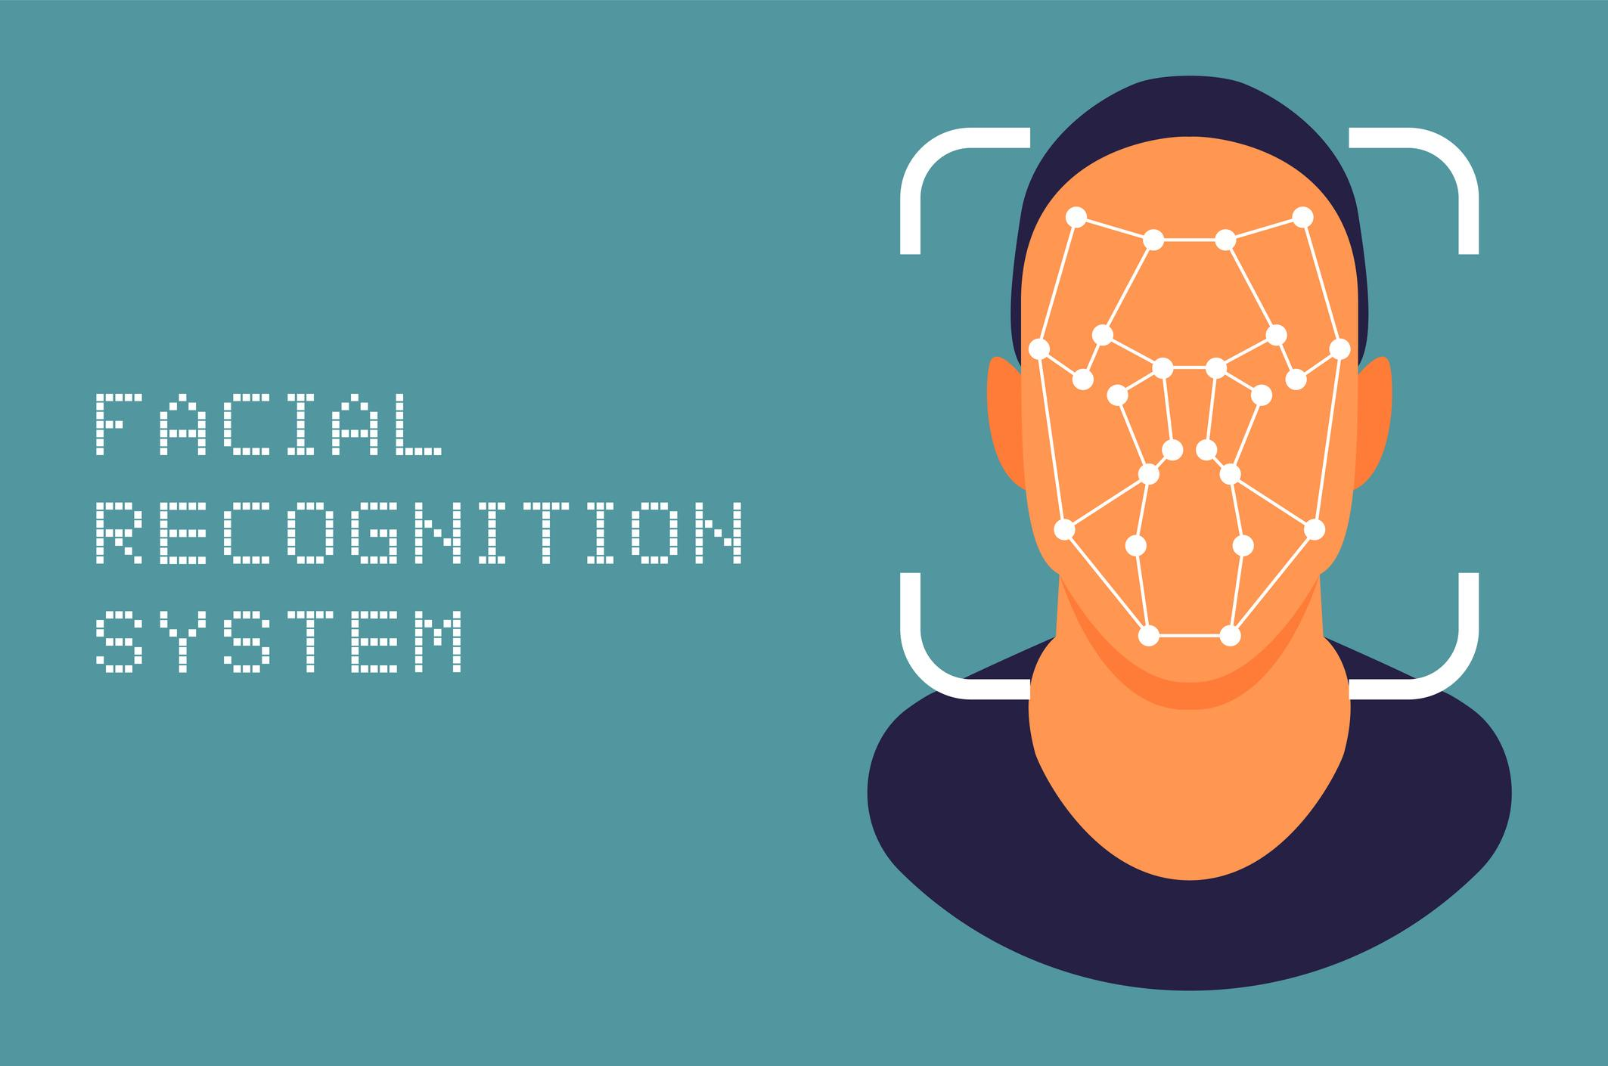
Introduction
Face Recognition Attendance System is an AI-based automation project that detects and recognizes human faces using a webcam and automatically records attendance in a CSV file.
It eliminates manual entry, improves accuracy, and provides contactless attendance.

Slide 3
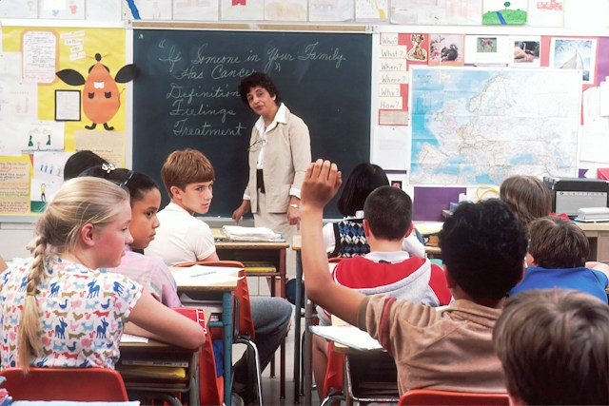
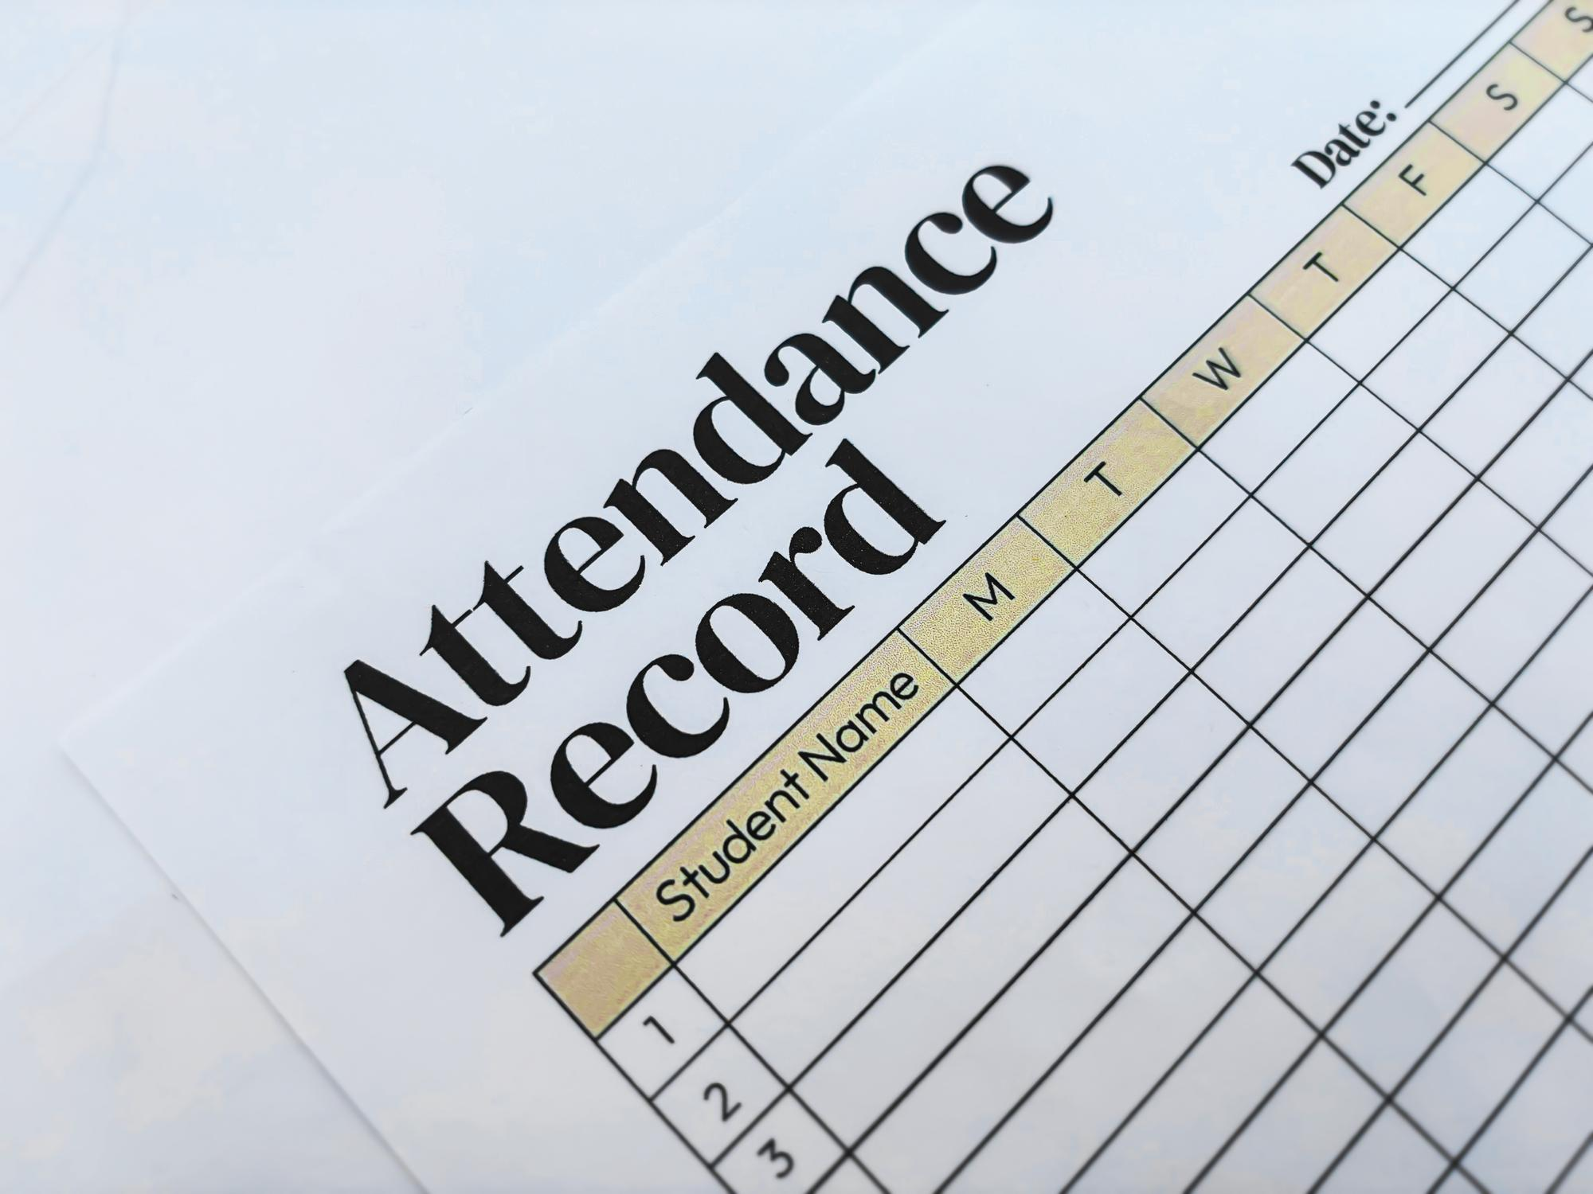
Problem statement
Traditional attendance systems have multiple issues:
Time-consuming manual process
High chances of proxy attendance
Requires physical signatures
Difficult to maintain accuracy
Not suitable for large groups

Slide 4
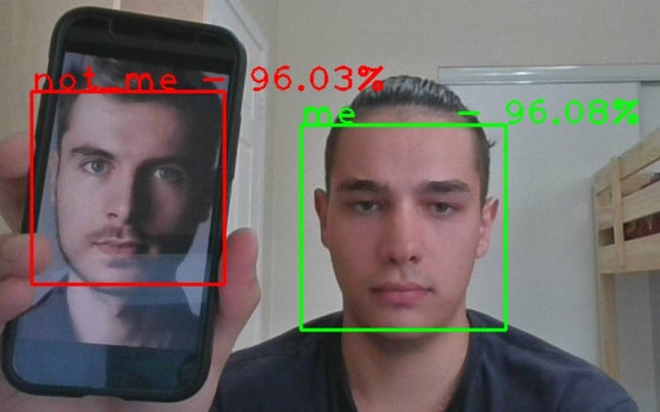
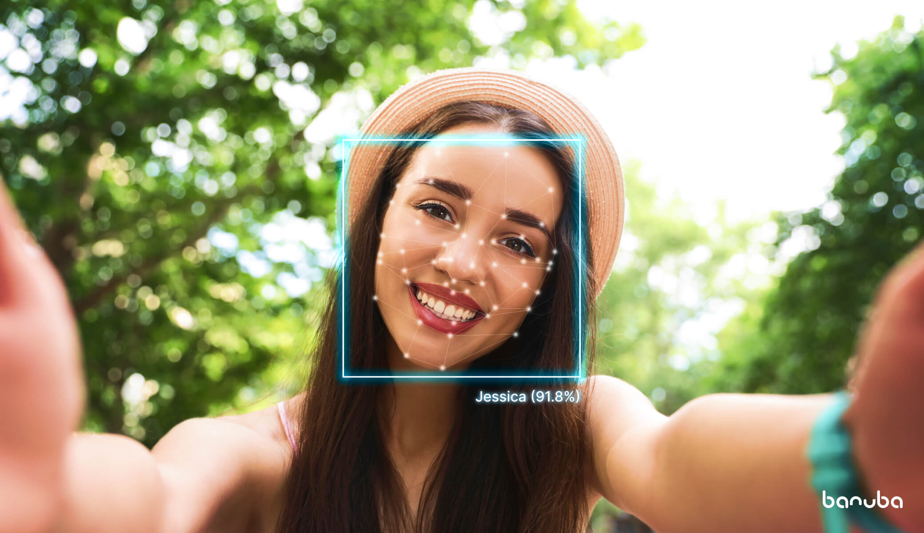
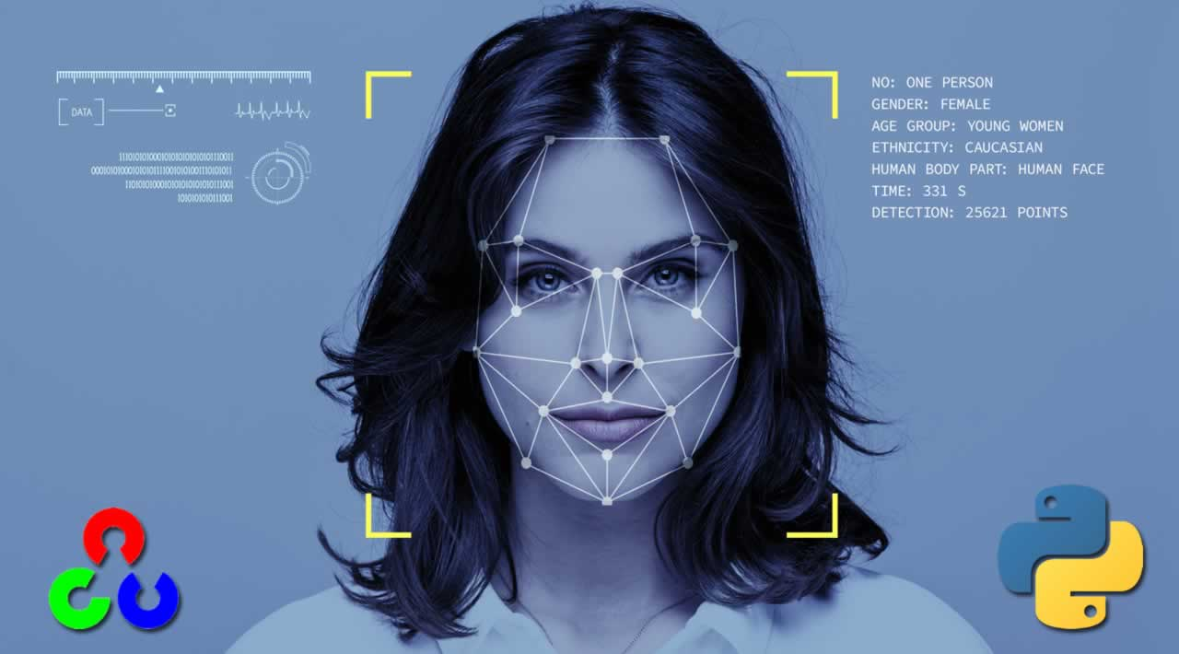
objectives
Detect faces in real-time
Recognize registered users
Automatically mark Name, Date & Time
Prevent duplicate entries
Provide an accurate and contactless system

Slide 5
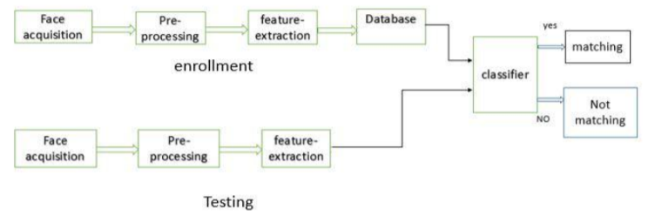

Technologies used
Python 3.12
OpenCV – image processing
NumPy – numerical operations
Pandas – storing attendance in CSV
Haar Cascade – face detection
LBPH – face recognition algorithm

Slide 6
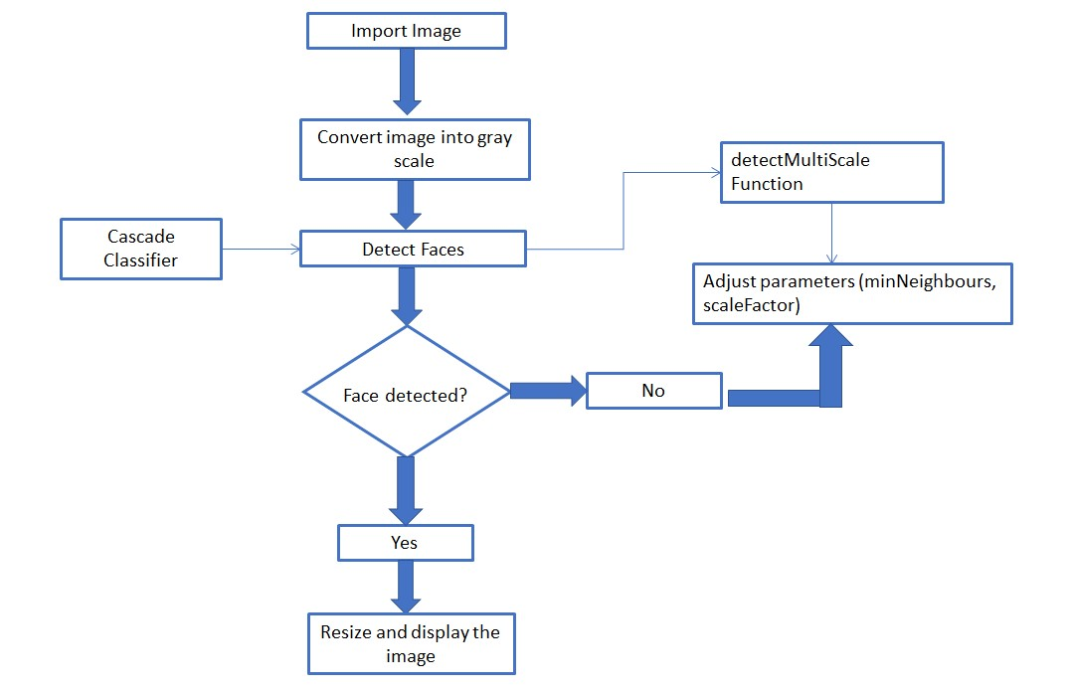
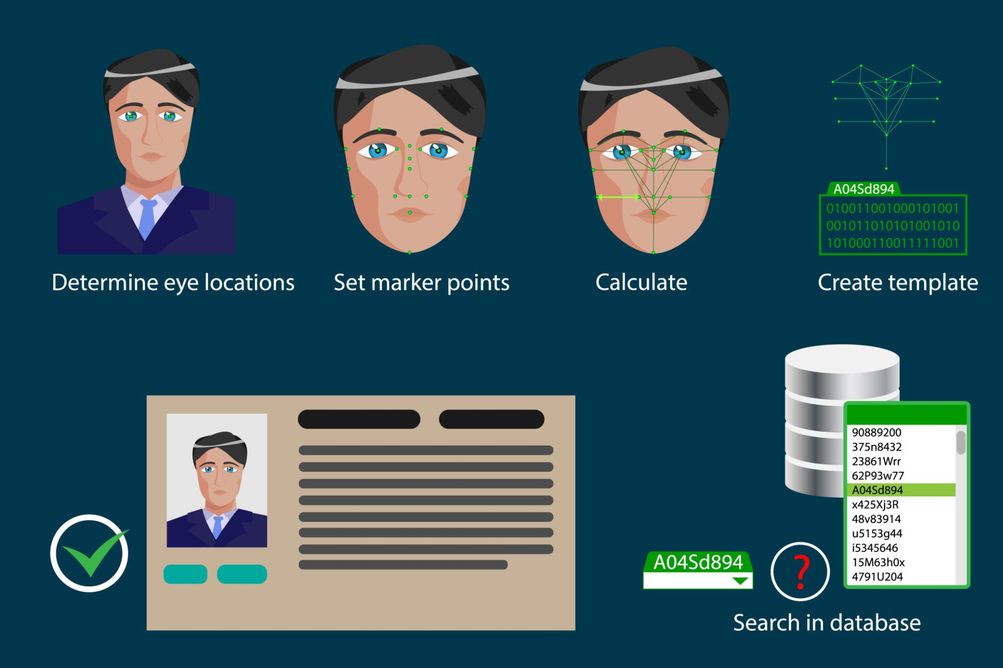
System workflow
Step-by-step process:
1️⃣ Camera captures live video
2️⃣ Haar Cascade detects the face
3️⃣ Face ROI is extracted & resized
4️⃣ LBPH model predicts the identity
5️⃣ Attendance saved into CSV

Slide 7

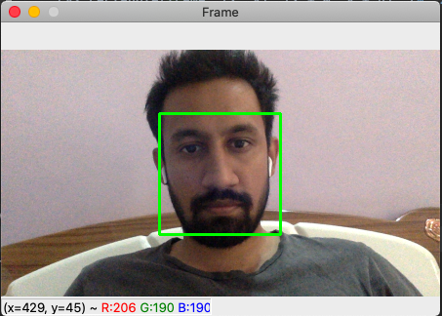
Dataset collection
Each user must provide 100–150 face images from different angles:
Front
Left
Right
Up
Down
This helps improve accuracy and makes recognition strong.

Slide 8
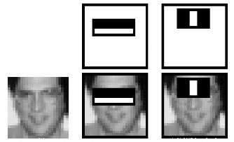
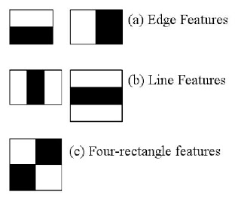
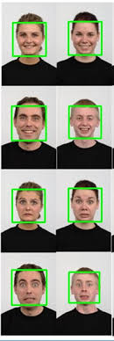
Face detection
Converts video frame → grayscale
Haar Cascade detects face boundaries
Draws a rectangle around detected faces
Extracts ROI (Region of Interest)

Slide 9
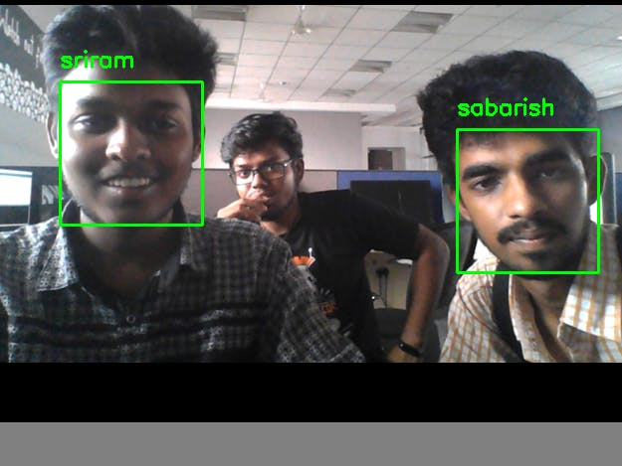
Model training process
The training program:
Reads face images from dataset folder
Extracts labels (names)
Trains LBPH recognizer
Saves model as:
✔ trained_model.yml
✔ labels.npy

Slide 10
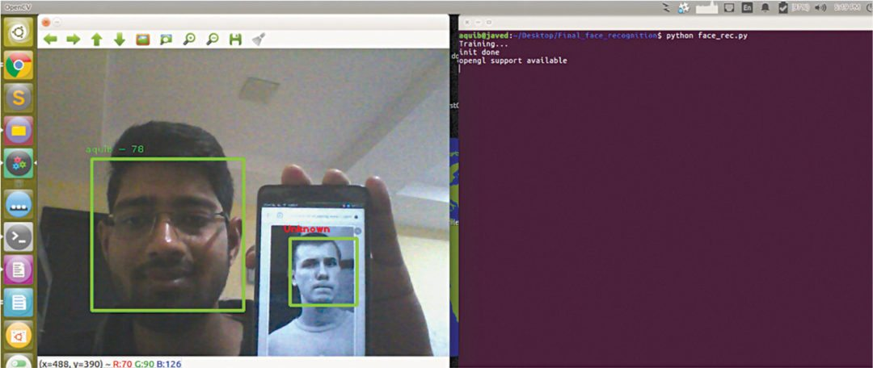
Real-time face recognition
When the model is run:
Camera opens
Detects face in frame
Predicts the user name
Displays name on video screen
Marks attendance automatically

Slide 11
Attendance system output
Attendance is stored in a CSV file with:
Name
Date
Time
Example CSV:

Slide 12
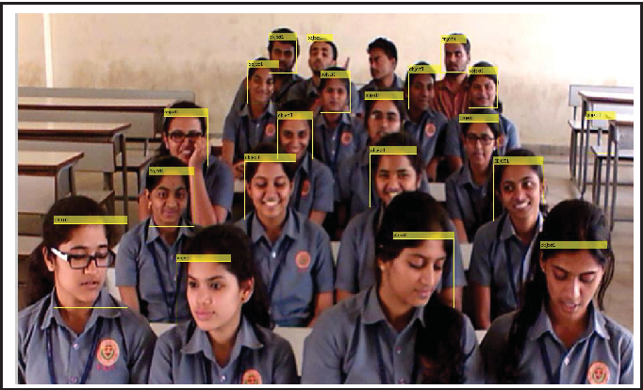
applications
Schools & Colleges
Offices & Workplaces
Laboratories
Hostels & PGs
Secure Access Control

Slide 13
Future enhancements
Deep Learning (FaceNet / Dlib CNN)
Anti-spoofing (detects photos/videos)
Cloud-based attendance database
Mobile app integration
Live dashboard for faculty

Slide 14
conclusion
The Face Recognition Attendance System is a fast, secure, and contactless AI system that improves efficiency and eliminates manual errors.
It is ideal for modern classrooms and offices.

