Slide 1
Python for reliable delivery of cross-platform developer products
@avidas

Slide 2

Speaker
Ananya (Avi) Das
Engineer at Braintree, a PayPal company
Developer experience, SDKs and platform infrastructure
Austin, Texas
Notes:
First time speaking at a conference
At various points switch between browser, live coding, and slides. Please shout out if fonts are too low.

Slide 3
Introduction
Cross platform: One use case can involve multiple devices, mobile/client-side web/server side
Does it work?
Where are the pain points?
Health of APIs and SDKs
Live, Sandbox and Stage environments

Slide 4

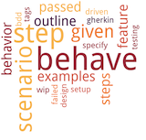



Overview
Build a minimum viable testing pipeline
Notes:
Use Python to automate iOS app via Appium
Use Behave, a Python BDD framework, as a way to describe tests for better communication
Storage of test data via ElasticSearch
Visualization of results on Kibana
Pycon is really great because there are people working in all these different fields, finance, healthcare, climate. My goal with this talk is that some of you may learn something useful in this talk that you can then go back and use in your work or hobby project

Slide 5
Product
One Touch reduces friction in payments by preserving identity across apps or sites
Fewer Screens, better conversion
Notes:
We are well known for serving a broad set of use cases across payments industry
The whole product depends on a multitude of distributed teams working on individual components
Your customers will log in just once per device and then instantly complete purchases across other apps or sites. They’ll see fewer screens, which could mean better conversion for you.

Slide 6
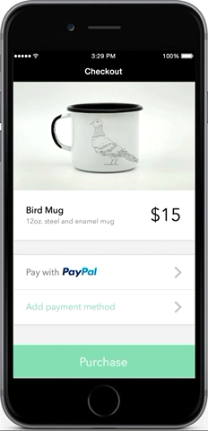
Notes:
In this Video, an user chooses to pay with PayPal in a merchant application, at which point it switches to browser, where user grants consent and it comes right back to the app. If you are selling on mobile, this is huge since there is no entering credentials, typing in credit card numbers. Less friction, more sales

Slide 7

Notes:
These are just some of our awesome partners who using this in production

Slide 8
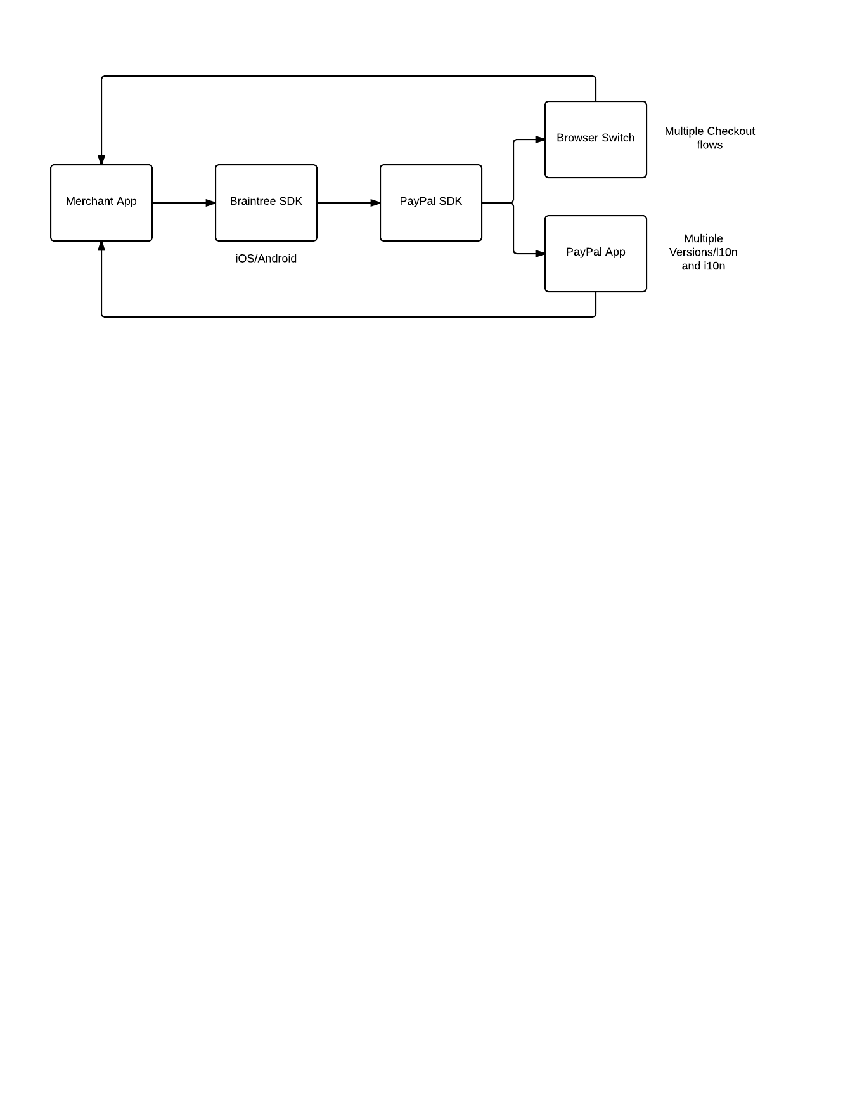
Client Side
Notes:
How does this work

Slide 9
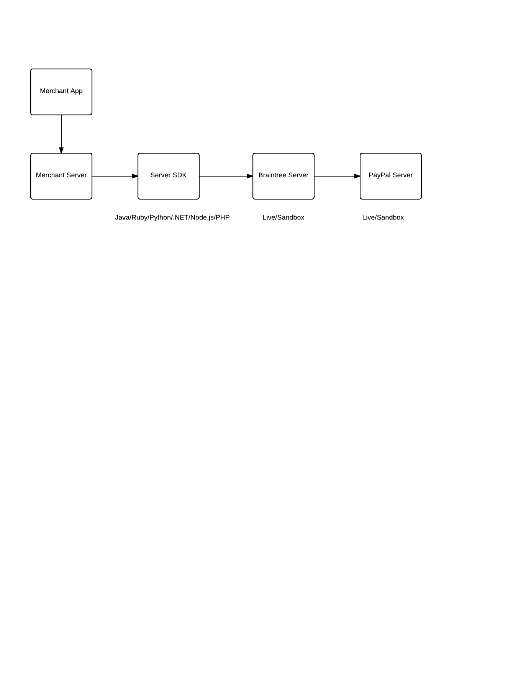
Server Side

Slide 10


Slide 11
requirements.txt
mobile/web automation
enable product/marketing to write tests describing expected behavior
communicate current health of the platform via dashboards/charts
Notes:
So let’s look at our requirements

Slide 12
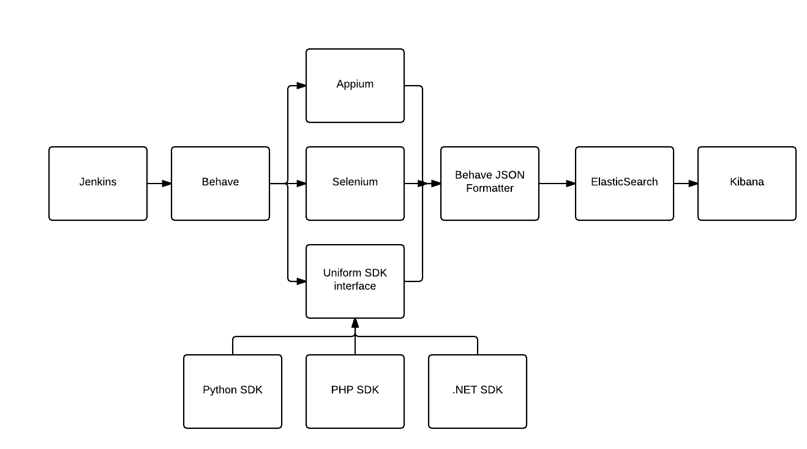
Architecture

Slide 13
Start
PHP
Became obvious that PHP was not general purpose enough for our requirements
Switch to Python and have worked very well for us
Notes:
This is not a gripe on the language, but just the ecosystem is focused most on web pages than anything else
Might be good language

Slide 14
Automation
Appium for iOS/Android automation
Follows the WebDriver API similar to Selenium
Can automate mobile native, mobile web and mobile hybrid apps
Notes:
Who here have used Appium?
The context under which you test will inform you of the specific choice of testing methodology and test tools to choose. The more options you are aware of, the better your context specific choice is going to be.

Slide 15
Code Example
http://bit.ly/1Hls0Hg
Check out v0.1.0 tag of repo
Tests an iOS app (needs Xcode)
Needs Appium running (needs Node.js)
Notes:
OSX only

Slide 16
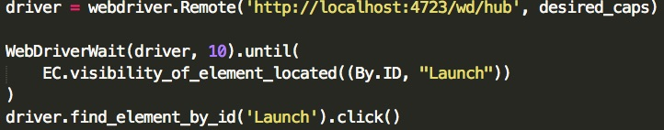

Slide 17
Behavior Driven Testing
Behave, a Python BDD framework
Terminology: Features, Scenarios and Steps, context
Custom formatters for output
Notes:
Allows us to communicate the tests across product, management, business stakeholders
`context` used to pass state across steps

Slide 18
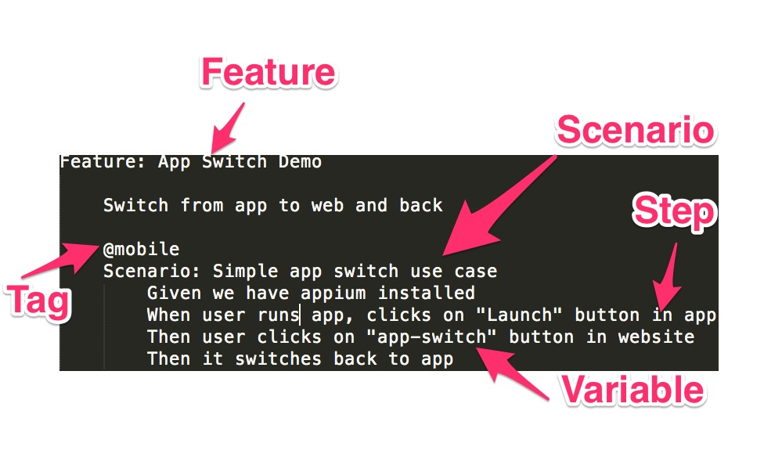
Example Behave Spec
Notes:
----- Meeting Notes (11/8/15 12:47) -----
Feature is

Slide 19
Code Example
Describe the previous Appium use case as a behave test
Check out v0.2.0 tag

Slide 20
Storage and Visualization
ElasticSearch and Kibana
JSON over HTTP interface
Index, Mapping type
Notes:
By default, Behave reports result as print out but we needed json formatting as it is a better cross platform data format. Extended Behave PrettyJSONFormatter
Based on the Lucene Search Index
This is not the most common use for ElasticSearch, most common use case is full-text search
Not just for full-text search
Supports authentication via add-ons such as Shield
Extensive documentation and support
E.g. A blogging platform may store data in a single index and within it different mappings for user, blog, comments

Slide 21
Install ElasticSearch (OSX)
brew install elasticsearch && brew info elasticsearch
launchctl load ~/Library/LaunchAgents/homebrew.mxcl.elasticsearch.plist

Slide 22
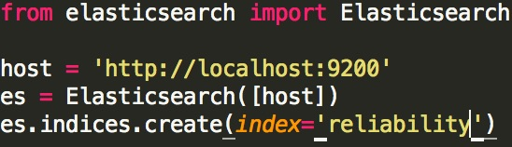
Create elasticsearch index

Slide 23
Create Elasticsearch Mapping
es.indices.put_mapping(doc_type='behave', body=mappingJson, index=['reliability'])

Slide 24
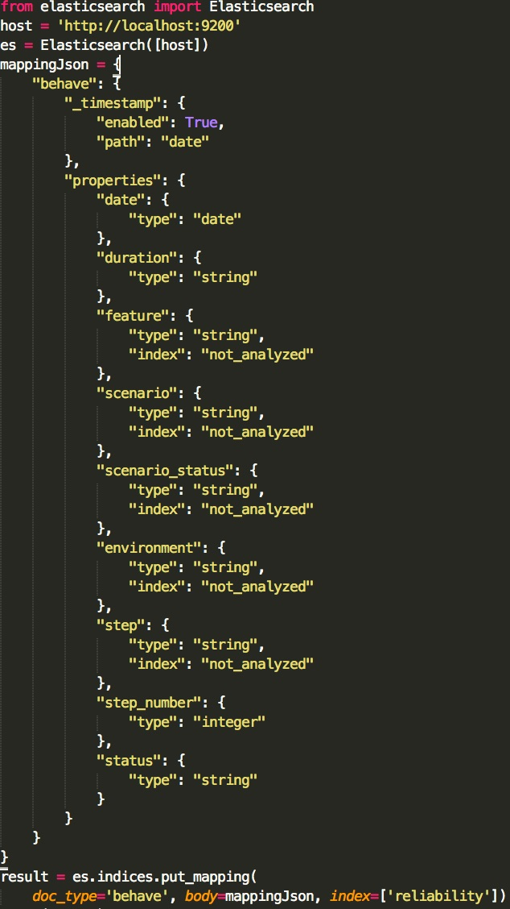

Slide 25
Submit to ElasticSearch

Slide 26
Code Example
Getting the behavior driven test data into ElasticSearch and display on Kibana
Check out v0.3.0 tag

Slide 27
Kibana
Open source data visualization platform
Wide variety of graphs and charts out of the box
Benefits from ElasticSearch’s extensive search and analytics abilities
Negatives: Sacrifices some configurability in the latest major 4.0 e.g. Modifying labels/colors is not possible yet

Slide 28
Install Kibana
brew install kibana && brew info kibana
launchctl load ~/Library/LaunchAgents/homebrew.mxcl.kibana.plist

Slide 29
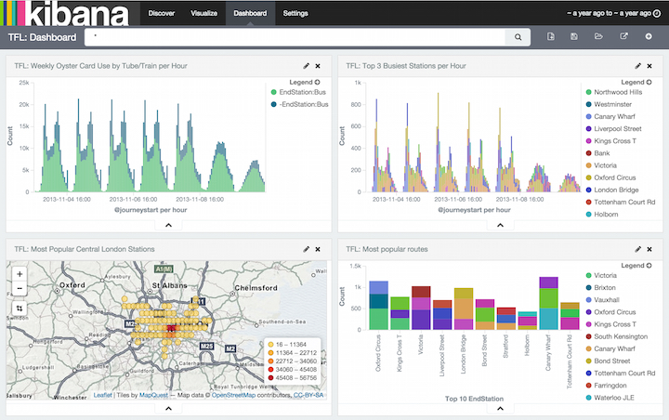

Slide 30
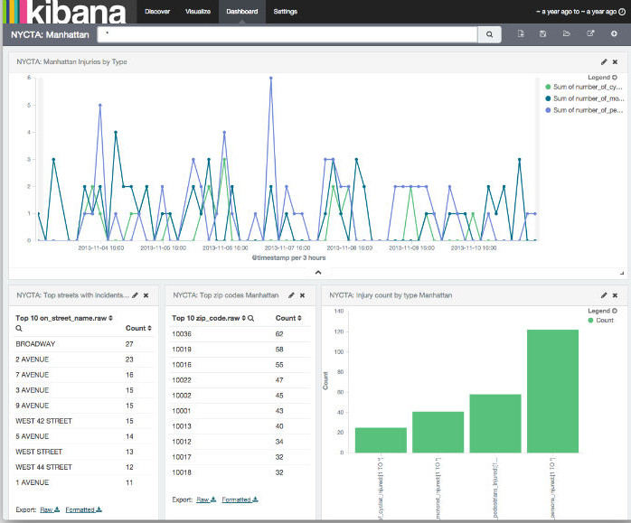

Slide 31
Continuous Integration(CI)
Jenkins gets latest copy of the code and runs the end to end test cases
Admin interface for configuring to run jobs at set cadence and monitor run history

Slide 32
Takeaways
Python’s ease of learning ensured team members adept in other technologies/platforms could contribute
Appium is a Node app, ElasticSearch written in Java, Behave in Python, Kibana in Node. All have officially supported Python bindings.
Get to production fast and iterate
Notes:
PRs from people who do not write Python on day to day basis.
Biggest win developers with core competencies in languages such as php, .net, java could get productive fast. Optimize for developer happiness.
Productivity, beauty and brevity.
Use plain language PHP or Java

Slide 33
Future work
Improve alerting e.g. send meaningful alerts via email/Slack
Release components to Open source community
Expand usage to other products
Notes:
we are discovering problems faster, and seeing where existing test framw integrate with good alerting
Such as Pay With Venmo
Test different versions of sdks, different versions of APIs

Slide 34
Contributors
Jason Ziaja (@jziaja)
Jay Patel (@jaypatel512)
Juwon Lee (@juwlee)
Matt Jacunski (@mattjacunski)
Avi Das (@avidas)

Slide 35
Thank you!
https://www.braintreepayments.com/features/one-touch
www.braintreepayments.com
Avi Das (@avidas)
Questions?
Notes:
The tools used here worked well in conjunction with the use cases we have
Doesn’t mean there aren’t better ways to do it
Open to feedback and improving the pipeline

