Slide 1

MINEGUARD: IoT Based Health and Gas Monitoring System for Miners
Electronic Design Workshop (ECP5005), SEM: V
Akanksha Warkad-02
Akul Kute-03
Ananya Botkawar-05
Arpita Singh-14
Ashutosh Keshpage-17
Prof. A. A. Jaiswal
Session 2025-26
Department of Electronics & Communication Engineering

Slide 2
Problem Statement/objectives
Detect harmful gases and monitor miner’s health in real time.
Problem Statement :
Mining environments expose workers to harmful gases, high temperatures, and oxygen deficiency, leading to serious health risks and potential fatalities.
Existing monitoring systems are either manual or lack real-time data transmission and early warning mechanisms, resulting in delayed responses during emergencies.
Project Objectives:
Detect harmful gases (CO, CO₂, NH₃, etc.) and monitor miner’s health in real time.
Transmit live data to monitoring authorities wirelessly.
Generate on-site alerts for immediate action to improve miner safety and reduce accident response time.

Slide 3
Existing Solutions/Literature Survey
Current mining safety solutions exhibit considerable gaps in functionality and coverage:​
Conventional gas detectors (e.g., Becker Wholesale Mine Supply) monitor gases like CH₄, CO, H₂S, O₂ and trigger alarms if dangerous thresholds are crossed, but often lack health monitoring and only provide localized alerts without comprehensive team communication.​
Remote gas monitoring devices (e.g., Eureka Patsnap, PK Safety) enable detection in hard-to-access areas, yet face issues such as limited mobility, absence of wireless communication, and high installation costs. Such systems rarely address miners’ physiological health, nor do they deliver alerts to all personnel.​

Slide 4
Existing Solutions/Literature Survey
IoT-based smart helmets (e.g., IoT Smart Mining Helmet, M.Tech Engineering Projects) introduce basic health metrics and hazardous gas detection, typically alerting only the individual wearer and lacking connectivity for group-wide notification. Reliance on simple buzzers or screens further limits emergency impact.​
LoRa- and ZigBee-enabled systems offer wireless sensor formats for environmental monitoring, but encounter reliability issues underground due to interference and signal obstruction. Battery drain, added bulk, and connectivity constraints are common limitations, and health monitoring is typically absent.​
Wireless sensor networks (WSN) and robots have demonstrated potential for continuous underground monitoring, yet often miss miner health data and face power or environmental interference issues.​

Slide 5
Existing Solutions/Literature Survey
Wearable health devices like ECG-based patient monitors address health concerns but do not overlap with hazardous gas detection or provide robust alerting mechanisms underground.​
ESP-NOW solutions for mine monitoring have been proposed, mostly focused on environmental sensors with short coverage and lacking integrated health metrics for miners.​

Slide 6
Proposed solution
Our innovation combines gas detection + health monitoring + intelligent communication in one compact system.
Efficient Wireless Communication: Sensor data from multiple miners is transmitted wirelessly using the ESP-NOW protocol within a bus topology, ensuring reliable, low-latency communication even in challenging underground conditions.​
Immediate On-Site Alerts: In case of hazardous conditions, the system generates instant audio-visual alerts (buzzer, LED indicator) to notify the affected miner on-site.
Collaborative Alert Escalation: The detected hazard is relayed to a repeater ESP board and transmitted to the control room, which further shares the alert across the team, enabling rapid awareness and coordinated response.
Continuous Vital Sign Transmission: Health readings from wearable sensors are continuously streamed to the control room, supporting real-time assessment and early intervention for miner well-being.

Slide 7
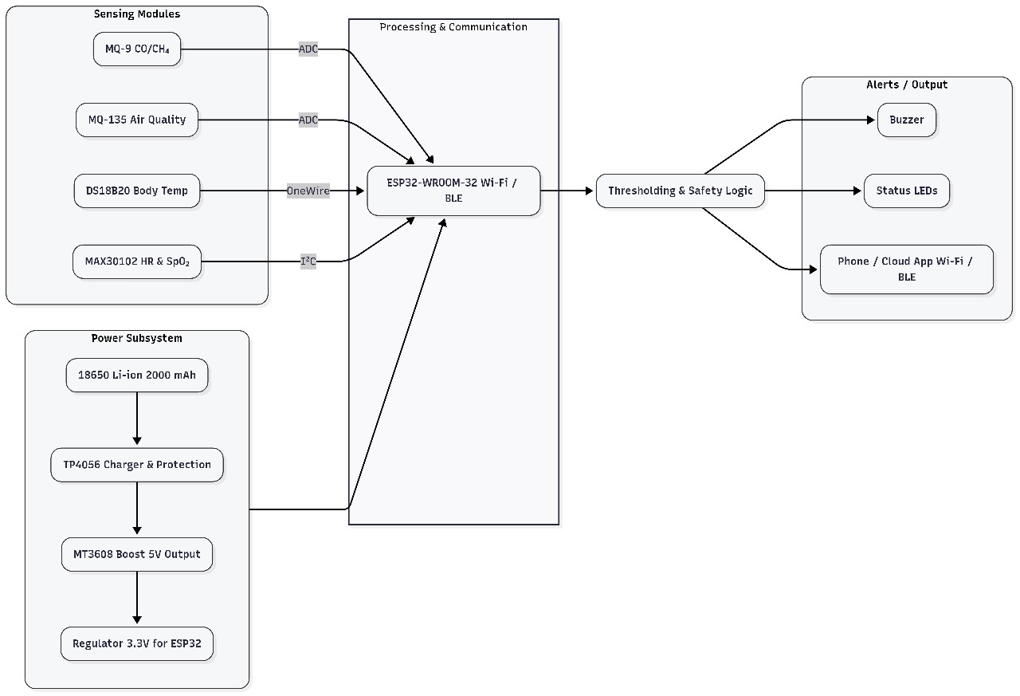
Block Diagram

Slide 8
Description of Block Diagram
The system consists of three main subsystems: sensing modules, processing and communication, and power management.
Sensing Modules
MQ-9 (CO/CH₄) and MQ-135 (Air Quality):
These Analog sensors continuously monitor levels of harmful gases like carbon monoxide, methane, and general air quality inside the mine.​
DS18B20 Body Temperature:
A digital sensor using the One-Wire protocol, measuring individual miner’s body temperature.
MAX30102 (HR & SpO₂):
An I²C-based wearable sensor tracking heart rate and blood oxygen saturation, enabling health monitoring of each miner.

Slide 9
Description of Block Diagram
2. Power Subsystem
Battery Power:
The system is powered by a rechargeable 18650 Li-ion battery (2000 mAh), making it portable and suitable for wearable use.
Charging & Regulation:
Includes a TP4056 module for battery charging and protection, MT3608 for boosting voltage to 5V, with a final step-down regulator providing a stable 3.3V supply for the ESP32 module.
3. Processing & Communication
ESP32-WROOM-32 (Wi-Fi/BLE):
This microcontroller serves as the brain of the system, reading data from sensors through ADC, OneWire, and I²C interfaces. It executes thresholding and safety logic to evaluate environmental and physiological data against critical safety margins.​

Slide 10
Description of Block Diagram
Wireless Data Transmission:
ESP-NOW protocol is used for fast, low-power, peer-to-peer communication between devices, allowing sensor readings and alerts to be reliably transmitted in real time to monitoring authorities and other miners.
4. Output & Alerting
Thresholding & Logic:
When any sensor data breaches set safety thresholds, the system triggers immediate alerts.
Local Alerts:
Buzzer and status LEDs provide on-site notification, warning the miner directly of hazardous situations.
Remote Alerts:
Wireless transmission of alert messages to repeaters and control room enables centralized, team-wide awareness. Data/alerts can also be broadcast to mobile/cloud apps using Wi-Fi/BLE.

Slide 11
Results
Successful real-time transmission of sensor data (Body Temperature, SPO₂, and Gas Concentrations) using ESP-NOW communication between miner nodes and control room ESP.
The bus topology ensured smooth data sharing among multiple ESP modules with minimal latency and reliable connectivity.
Alerts (buzzer and LED blinking) were successfully triggered whenever hazardous gas levels or abnormal health parameters were detected.
The Control Room Dashboard accurately displayed real-time readings and graphical data (line, pie, and bar charts) for each miner every 5 minutes.
Inter-ESP communication verified — alerts from one miner were received by the repeater ESP and forwarded to all miners and control ESP successfully.

Slide 12
Results
Hardware modules (wristband and back patch) operated efficiently on rechargeable batteries with low power consumption and stable performance.
The entire system demonstrated consistent data accuracy, robust wireless communication, and effective alert response in testing conditions.

Slide 13
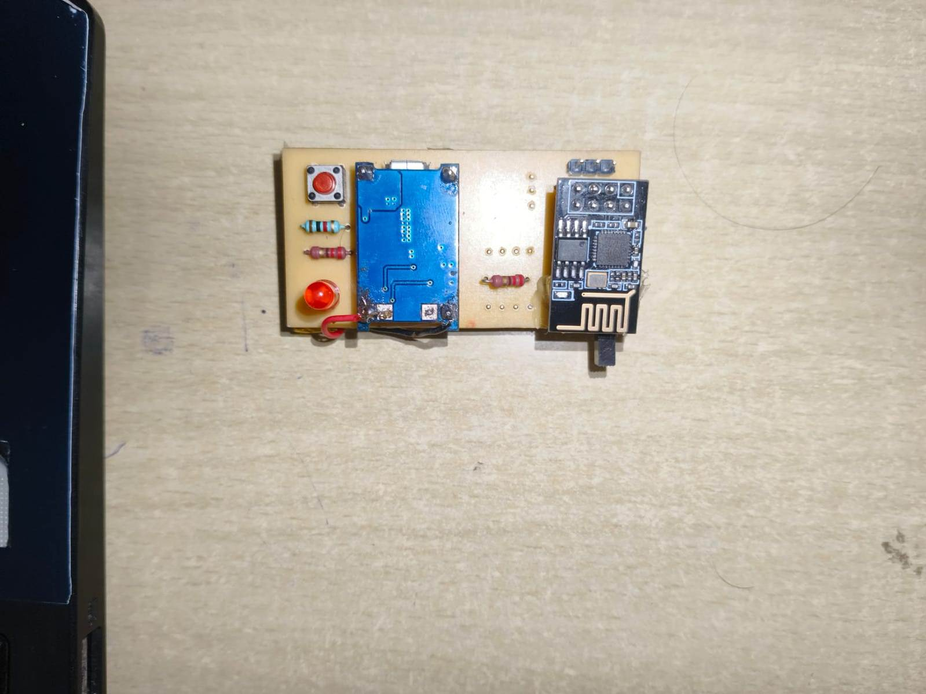
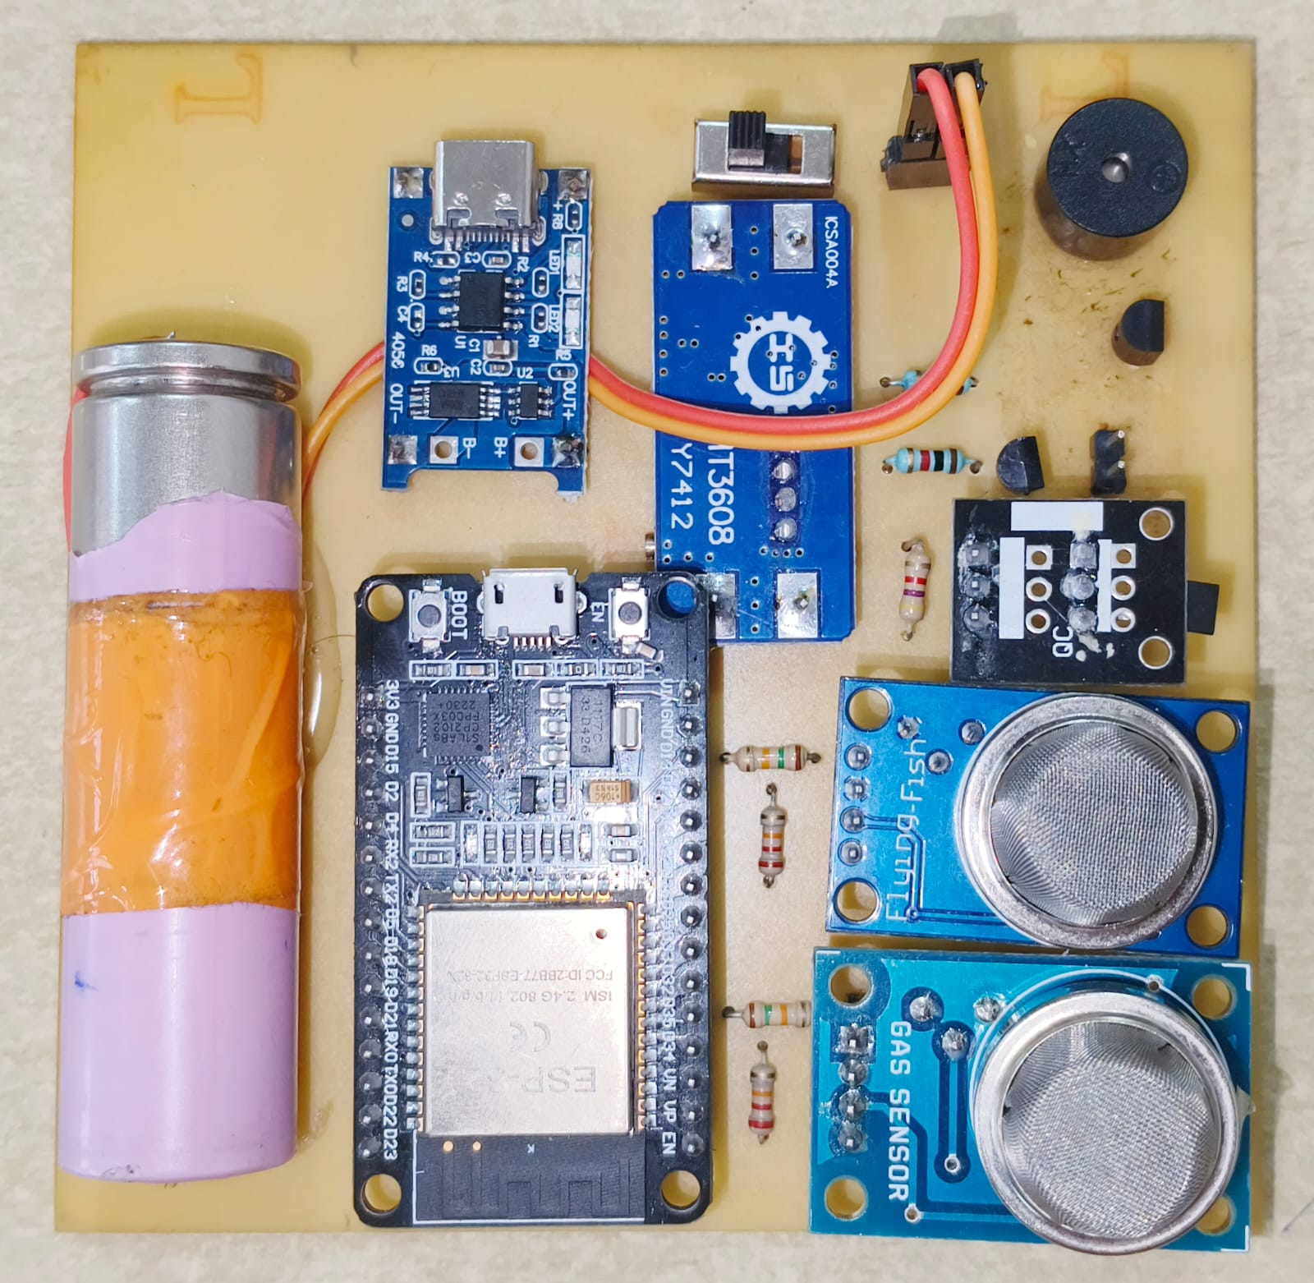
Results
Fig – Wrist-Band Hand PCB
Fig – Back-Patch PCB

Slide 14
Feasibility Analysis
Technical Feasibility:
Low-power design enables continuous operation on portable rechargeable batteries.
Uses readily available electronic components for quick prototyping.
Simple, portable design allows easy assembly and maintenance.
Reliable ESP-NOW communication protocol ensures real-time data transmission.
Control room dashboard displays real-time gas and health data for each miner.
2. Operational Feasibility:
System is user-friendly and safe for miners to wear during shifts.
Generates immediate alerts (buzzer and LED) for hazardous gas detection.
Continuous monitoring of body temperature and SPO2 via WristBand.
Dashboard allows higher authorities to track miners’ status easily and Updates every 5 minutes with graphical representation (pie chart, line graph, bar graph).

Slide 15
Feasibility Analysis
3. Economic Feasibility
Low-cost components make the system affordable for deployment in multiple miners.
Minimal power consumption reduces operational costs over time.
Portable design eliminates need for complex infrastructure.
Scalable for large mining teams without significantly increasing expenses.
Maintenance is cost-effective due to simple assembly and modular design.
4. Overall Feasibility Analysis
Technically viable due to simple, low-power, and reliable design.
Operationally practical for daily mining activities and emergency response.
Economically sustainable for deployment in mining operations.
Provides real-time monitoring, alerts, and centralized dashboard for effective safety management.

Slide 16
Innovation or Uniqueness of the solution
Mine Guard introduces a multi-node safety network using the ESP-NOW protocol with bus topology, ensuring fast and efficient data transmission among miners.
The system provides two-way alert communication — between miners and the control room — for instant hazard awareness.
Combines health monitoring and gas detection into a wearable, low-power, and cost-effective solution.
Features a real-time control dashboard that visually displays all miners’ health and safety data.

Slide 17
Impact or Usefulness of the solution
Ensures real-time safety of miners by continuously monitoring toxic gases and vital health parameters.
Provides instant alerts to both miners and control authorities, reducing accident response time.
Enhances situational awareness and coordination among miners during emergencies.
Promotes a safer and more efficient mining environment through automated and reliable IoT communication.

Slide 18
Summary
The Mine Guard system is an IoT-based safety and health monitoring solution designed for miners working in hazardous underground environments.
It integrates gas detection, vital health monitoring, and wireless data communication into a wearable and portable device.
Using the ESP-NOW protocol with bus topology, data from multiple miners is transmitted efficiently to the control room, where a real-time dashboard displays environmental and health parameters.
In case of danger, the system instantly alerts miners through buzzers and LEDs and notifies the control team, ensuring quick and coordinated action.

Slide 19
References
[1] Maithili Majag, Trupti Chavan, Tanvi Khandagale, Sanika Bandgar, Shailesh Bhise, “Coal Mine Safety And Health Monitoring System Using LoRa”, Vol. 12, Special Issue 1, March 2025
[2] 𝗫𝗶𝗟𝗶𝗥 𝗧𝗲𝗰𝗵𝗻𝗼𝗹𝗼𝗴𝗶𝗲𝘀, “Smart Helmet for Air Quality and Hazardous Event Detection for the Mining industry”, xilirprojects, 2012, Smart Helmet for Air Quality and Hazardous Event Detection for the Mining industry - M.Tech B.Tech Engineering Projects Thesis Research Help in New Delhi, INDIA
[3] Hafiz Zameer ul Hassan , Anyi Wang a, Ghulam Mohi-ud-din, “A wireless sensor network for coal mine safety powered by modified localization algorithm”, Volume 11, Issue 1e41262January 15, 2025

Slide 20
References
[4] Gosink, Luke J.; McNeil, Sean; Brandi-Lozano, Juan M.; Williams, Ryan; Bruce, Joseph R.; McCall, Jonathon D., “Wearable health monitoring device”, Patent: Wearable health monitoring device, 03 May 2022, OSTI ID:1892884
[5] S. B. Lenin*, R.Priyadharshni, S.Mohanram and S. Ashok Kumar , “Wireless Coal Mine Monitoring System based on ESP-NOW Protocol for Real-Time Data Acquisition and Analysis ”, Journal of Engineering Science and Technology Review 17 (2) (2024) 16 - 22
[6] Yufeng Jiang , Wei Chen , Xue Zhang , Xuejun Zhang , Guowei Yang , “Real-Time Monitoring of Underground Miners’ Status Based on Mine IoT System”, 2024 Jan 23;24(3):739. doi: 10.3390/s24030739

Slide 21
References
[7] Mark Morrison, John Usher, Chris Green, “Mine operation monitoring system”, 2010, Application US13/500,778 events US9234426B2 - Mine operation monitoring system - Google Patents
[8] B.Priyanka , S.K.Satyanarayana ,M.Anjali Sri Teja , CH.Srikanth, G.Sanjana, “Iot Based Smart Helmet for Mining”, Volume 10, Issue 7 July 2022 | ISSN: 2320-2882, IJCRT2207508.pdf
[9] Becker Wholesale Mine Supply, “Gas Leak Detector in Mining: Predictive Care”, beckerwmsusa, 2025, Becker Wholesale Mine Supply
[10] Eric Pedley, “Mining Gas Detectors: Gas Leak Detection Solutions for Miners”, February 20, 2025, Mining Gas Detectors: Gas Leak Detection Solutions for Miners | PK Safety

