Slide 1

Introduction to Computing
Using Java
Graphical User Interface

Slide 2
Overview
Human Computer Interface
Graphical User Interface
Basic Elements
Event Driven Model
Trigger and Callback

Slide 3
Human Computer Interface
Means of communication.
Bi-directional channels.
Multiple media.
Easy to control.
Easy to understand.

Slide 4
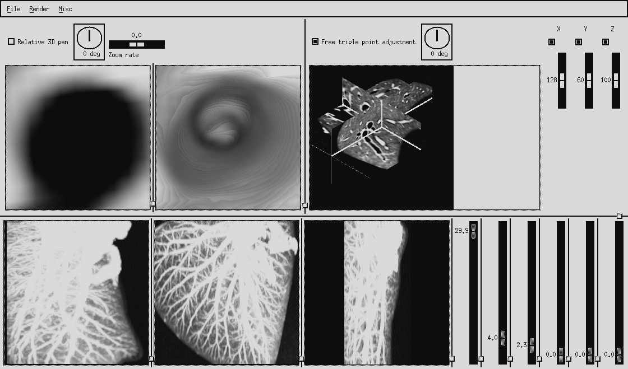
Examples

Slide 5
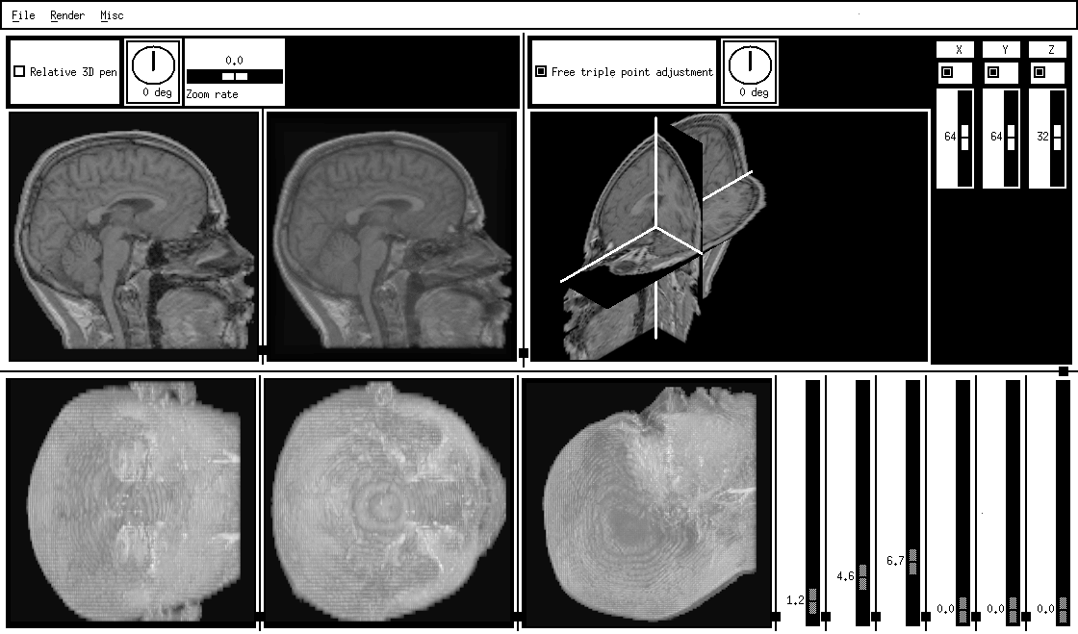
Examples

Slide 6
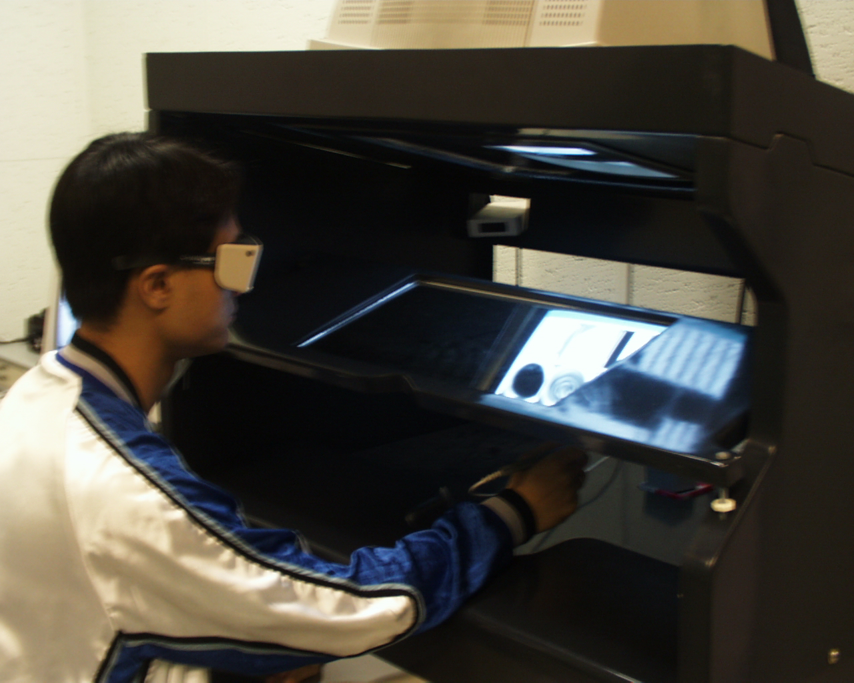
立體

Slide 7
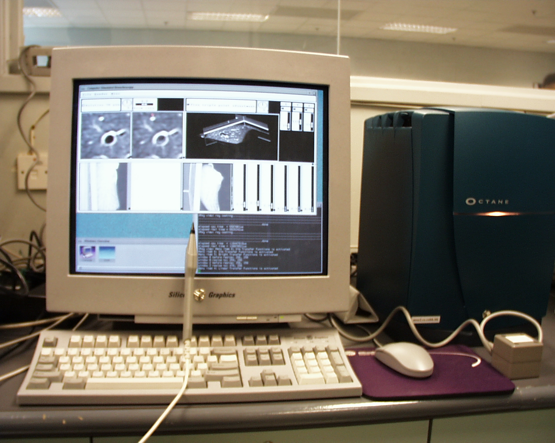

Slide 8

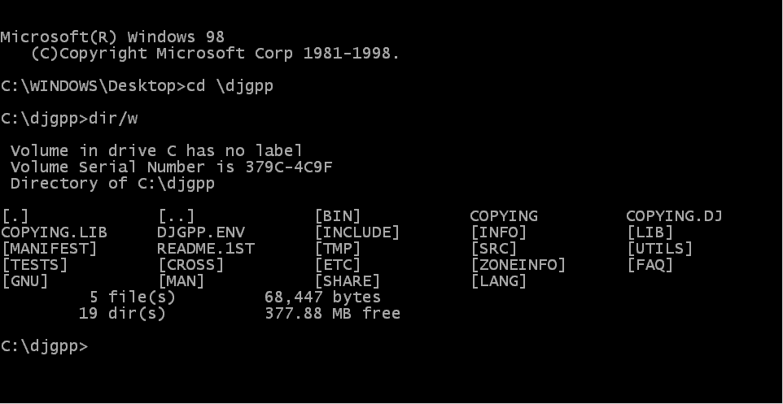
Command-line User Interface

Slide 9

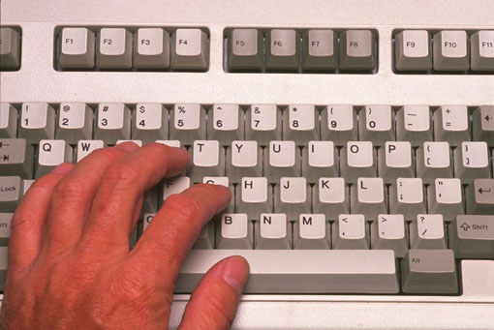
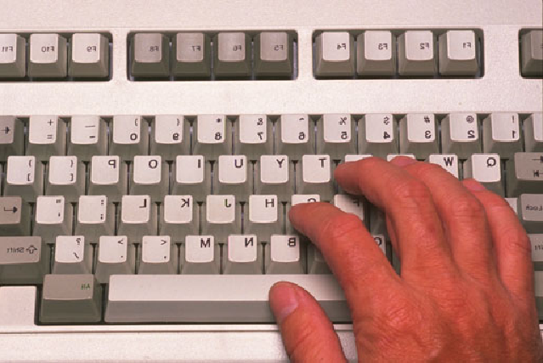
Keyboard Only? No Way!

Slide 10
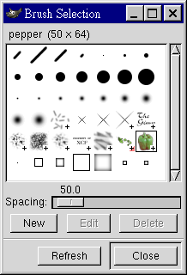
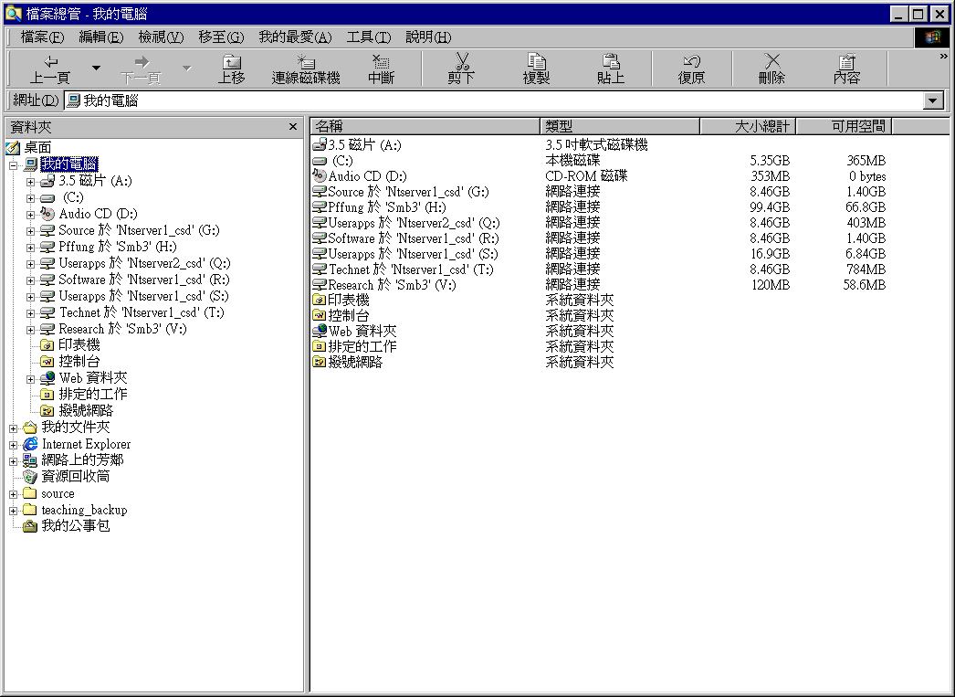
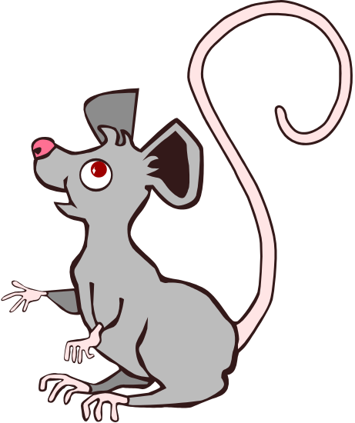
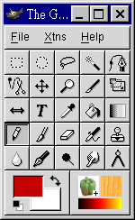
Graphical User Interface

Slide 11
GUI – Computer Display
Use of graphical representations
  Windows
  Icons
  Buttons
  …
To convey the underlying concepts
  An icon represents a file
  A button represents certain function

Slide 12
GUI – User Input
Use of various interactive input devices
  Keyboard
  Mouse
  Touch screen
  …
To gather command and control from user
  A mouse click opens a file
  A mouse drag moves a window
  Pressing <Enter> means “OK”

Slide 13

7-Minute Break

Slide 14
GUI and OOP
A window is an object.
A button is an object.
We create windows and buttons from classes.
Such objects
  store state of the component (field/property);
  perform certain function (method);
  generates events (event objects);
  respond to user actions (callback method);

Slide 15


1) Store State
Basic properties
  Colour
  Size
  Visibility
Dynamic states
  On/off state of a button
  Value of a text field

Slide 16
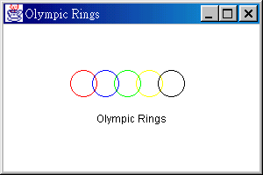
2) Perform Action
Paint the window
Draw circles
Display text

Slide 17
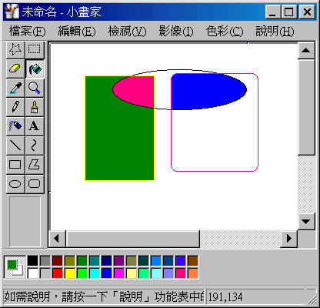
3) Generate Event
Detect if you dragged the scrollbar
Detect if you clicked a button
Detect if you dragged the mouse pointer

Slide 18
4) Handle Event
On clicking the buttons, moving the mouse, dragging the mouse, … over a component, events are generated.
On receiving an event, the corresponding callback method of a listener is invoked.
The method may update the screen, update the state, perform some function, etc.

Slide 19
How to Do it Using Java?
One of the provided packages java.awt (Abstract Windowing Toolkit) is readily used.
There are plenty of component classes well-defined in the package.
  Frame: basically a window
  Button: a push button with a label
  TextField…

Slide 20
Simple Example
import java.awt.*;
/* This is not the usual way we call up GUI
* Normally, we should subclass (extends) some
* GUI components in order to modify the behaviour
*/
class SimpleGUI {
public static void main(String[] args) {
Frame myWindow = new Frame();
myWindow.setTitle("Simple GUI");
myWindow.setSize(200, 100);
myWindow.setVisible(true);
}
}

Slide 21
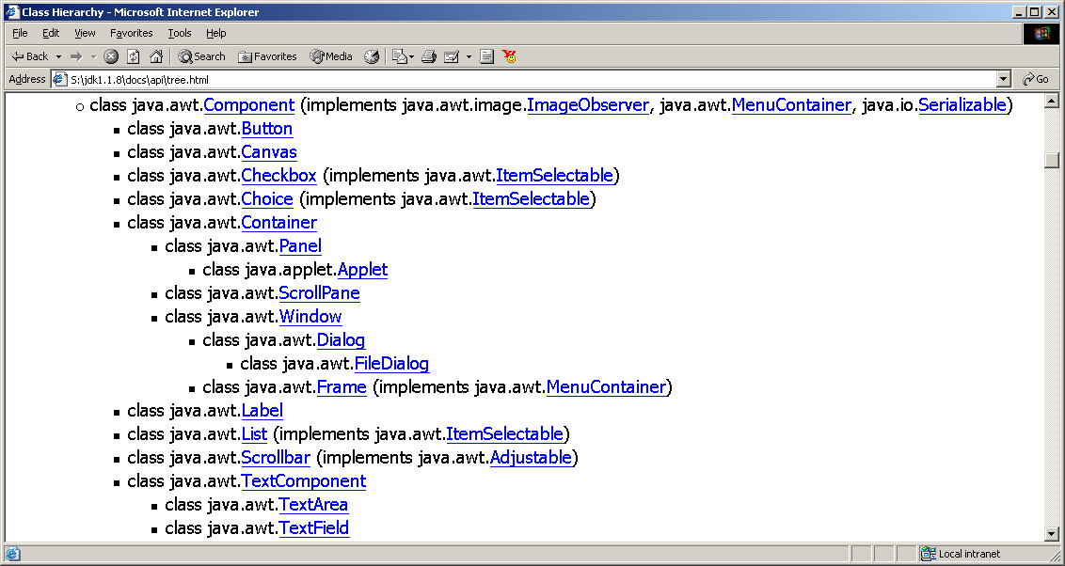
Components List - Classes

Slide 22
How to Use the Components?
Read the API Manual and Books!
Check for the components you need
Create (new) the components
Set their properties
  Basic properties and initial state
  Relationship between the components
  Action to be performed on event happening

Slide 23
Component - Basic Properties
Colour : setBackground(Color)
setForeground(Color)
Size : setSize(int, int)
Position : setLocation(int, int)
State : setEnabled(boolean)
Font : setFont(Font)
Visibility : setVisible(boolean)
…

Slide 24
Component - Relationship
Sibling/sub-ordinary relationship
window.add(button1);
Relative position between the components
Button1 and Button2 are contained/embedded in the Frame
Button1 is on the left of Button2 on the same row

Slide 25
7-Minute Break

Slide 26
Component - Event Generation
Events are automatically generated during interaction with the user.
Events are normally happened in conjunction with certain component(s).
If the involved component(s) do not listen to (pay attention to) that event, normally nothing would happen.

Slide 27
Component - Event Listening
To listen to an event, we need a listener:
Frame myWindow = new Frame();
/* Adapter is a kind of Listener */
WindowAdapter adapter = new WindowAdapter();
myWindow.addWindowListener(adapter);
add*Listener() are methods of components.
We register a listener to listen to certain kind of events, say MouseEvent.
  e.g. MouseListener may be MouseAdapter objects.

Slide 28
Event Handling
Button1
Generates

MouseEvent
User action
MouseListener
MouseAdapter
mouseClicked
Event Handler may:
- Update the appearance of the button
- Modify the state of the button
- Perform programmer-defined action
such as “Say Hello”
mouseEntered
Event
Dispatching
mousePressed
…

Slide 29
Listener Example
File ListenGUI.java
import java.awt.*;
import java.awt.event.*;
class ListenGUI {
public static void main(String[] args) {
Frame myWindow = new Frame();
myWindow.setTitle("Simple GUI");
myWindow.setSize(200, 100);
myWindow.setVisible(true);
myWindow.addWindowListener(new MyWindowAdapter());
}
}
class MyWindowAdapter extends WindowAdapter {
public void windowClosing(WindowEvent e) {
System.out.println(“Terminating the program!”);
System.exit(1); // a message to ask the System to exit
// ... OR you may open other windows!!!
}
}

Slide 30
Handler (Callback) Method
An adapter in fact normally listens to a set of related events.
For each kind of event, a corresponding handler method is defined.
On receiving a MouseEvent which indicates mouse button pressed, the mousePressed() method of the MouseAdapter object will be invoked.

Slide 31
Customizing the Handling
Without customizing (overriding) the default handler methods provided in the adapter, nothing would happen.
That’s why we extends the WindowAdapter, MouseAdapter… classes.
By re-defining (overriding) their methods, we can achieve desired behaviour in event handling.

Slide 32
Examples
NormalMouseAdapter
NormalWindowAdapter
NormalGUI
ListenGUI
ListenGUI2

Slide 33
What Kinds of Events?
Examples:
  WindowEvent needs WindowListener.
  WindowAdapter is a kind of WindowListener.
  MouseEvent needs MouseListener.
  MouseAdapter is a kind of MouseListener.
The events themselves are generated by some components under user interaction.

Slide 34
After-Life of main()
When and how does a GUI program end?
main() is the first method to be invoked.
Normally, after main() finishes, the program ends.
But this is not the case for GUI programs...
Why? The underlying event dispatching loop of the system takes over the control.

Slide 35
Advanced Topics
Using Swing/ AWT with NetBeans
  Setting properties and layout
  Creating call-back methods
Inner Classes

Slide 36
End Note
Readings and References
  Sections 3.9, 3.10: Components
  Sections 4.6, 4.7, 4.8: GUI, Buttons
  Section 5.10: Events
  Section 6.10: GUI Design
  Sections 7.9, 7.10: More events
  Section 8.6: Component Class Hierarchy
  Section 8.7: Extending Adapter Classes

