Slide 1

CBRE AI‑Powered Sprint Analytics Dashboard AI‑Powered Sprint Analytics Dashboard transforms Agile data into real‑time actionable intelligence—reducing management overhead improving delivery predictability cutting operational costs.
Presenter Name – Team (Tech Sorcerers)
( Abhishek , Anil, Ankur, Manoj, Sudheer , Varun )

Slide 2
Problem statement -
Enterprise agile teams at CBRE lack a unified, real‑time platform, resulting in manual sprint reporting, fragmented data, and missed risks across roles.
This AI‑powered Sprint Analytics Dashboard centralizes Azure DevOps data in Snowflake to proactively surface blockers, capacity risks, and role‑based insights.
Solution –
We built an AI‑powered Sprint Analytics Dashboard on Snowflake that delivers real‑time, role‑based visibility across agile teams.
With embedded AI via Cortex Analyst, it proactively identifies delivery risks and enables natural‑language sprint insights—driving faster, data‑driven decisions.

Slide 3
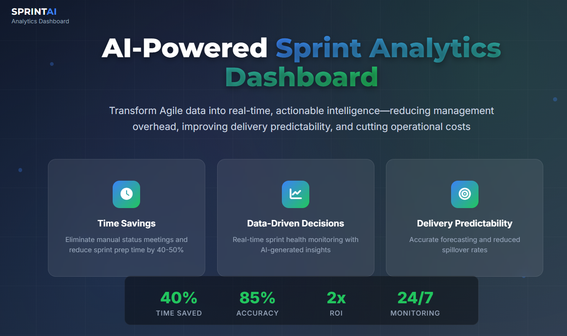

Slide 4
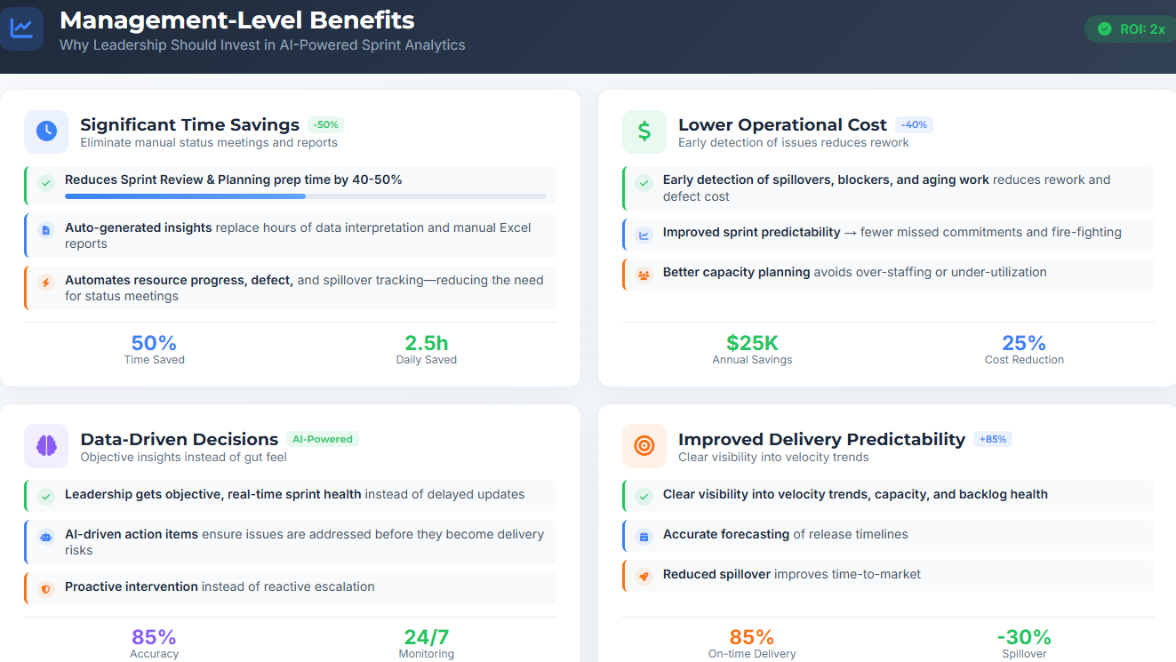

Slide 5
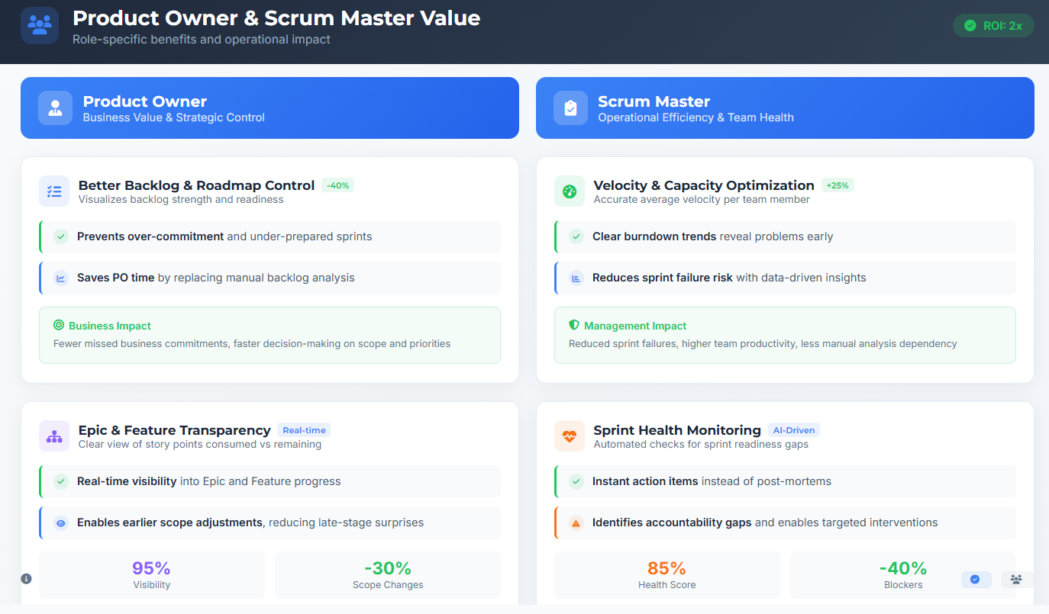

Slide 6
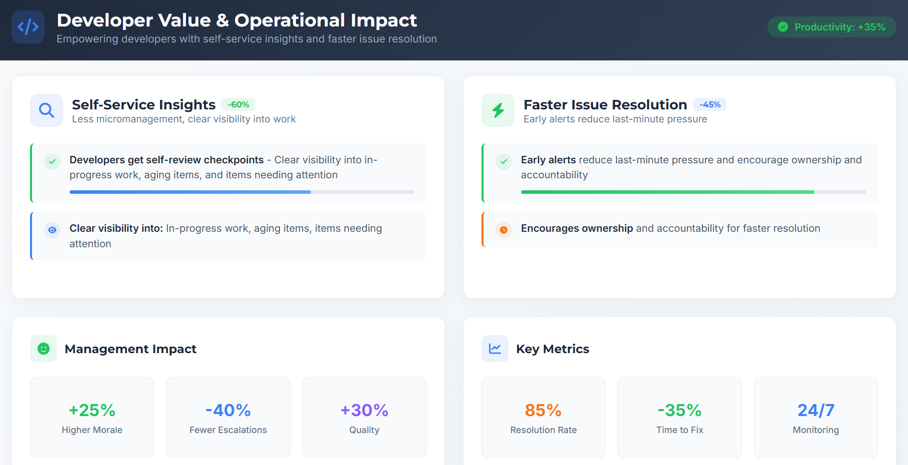

Slide 7
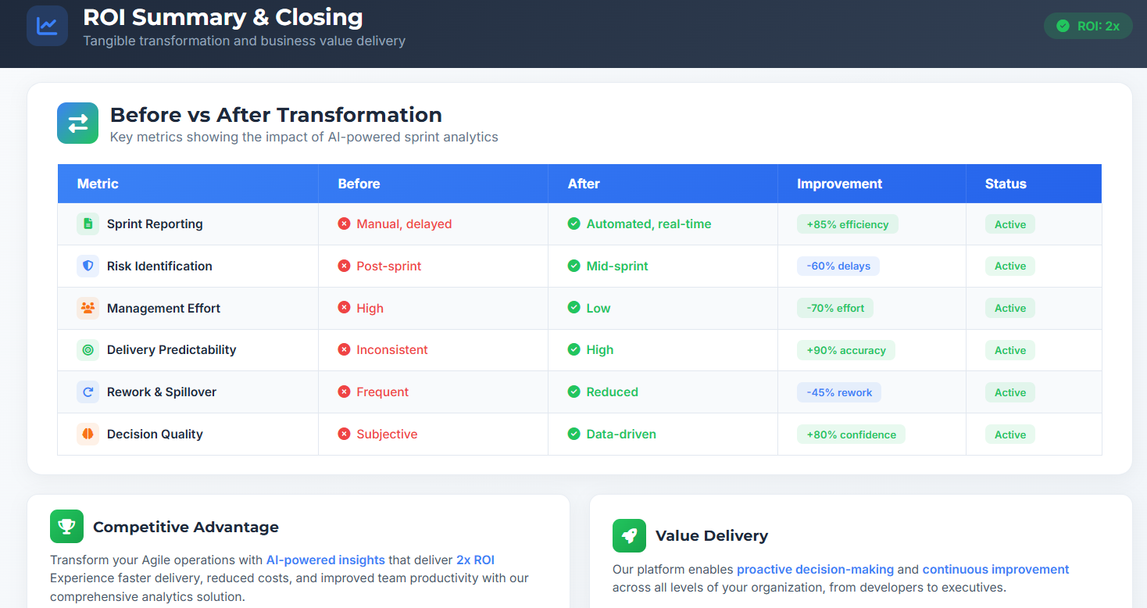

Slide 8
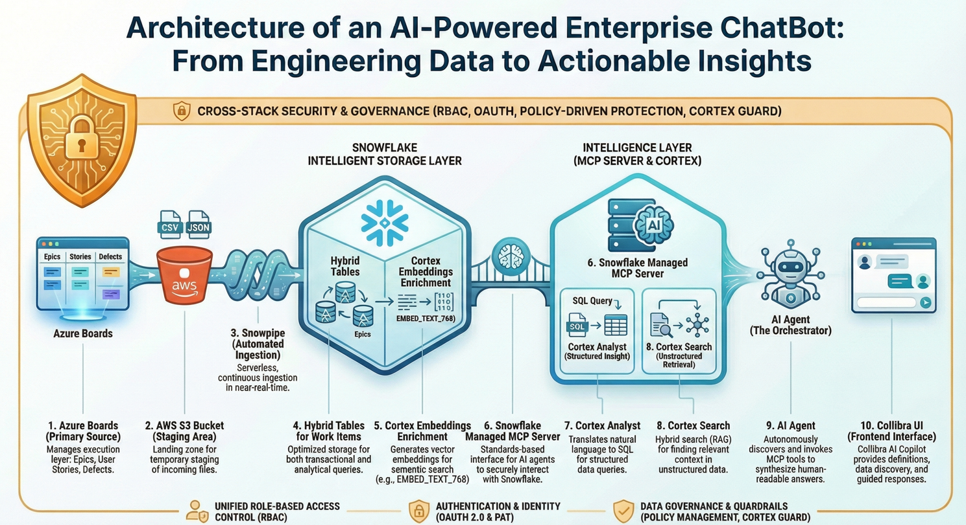

Slide 9
Innovate 2026 - Documents - Tech_Sorcerers - All Documents

Slide 10

Q&A
Panel discussion session

