Slide 1
Variant Calling Workflow Pipeline
Team_Nyoka_Tengeza
Careen Naitore
Festus Nyasimi
Charles Kamonde
Michael Landi

Slide 2
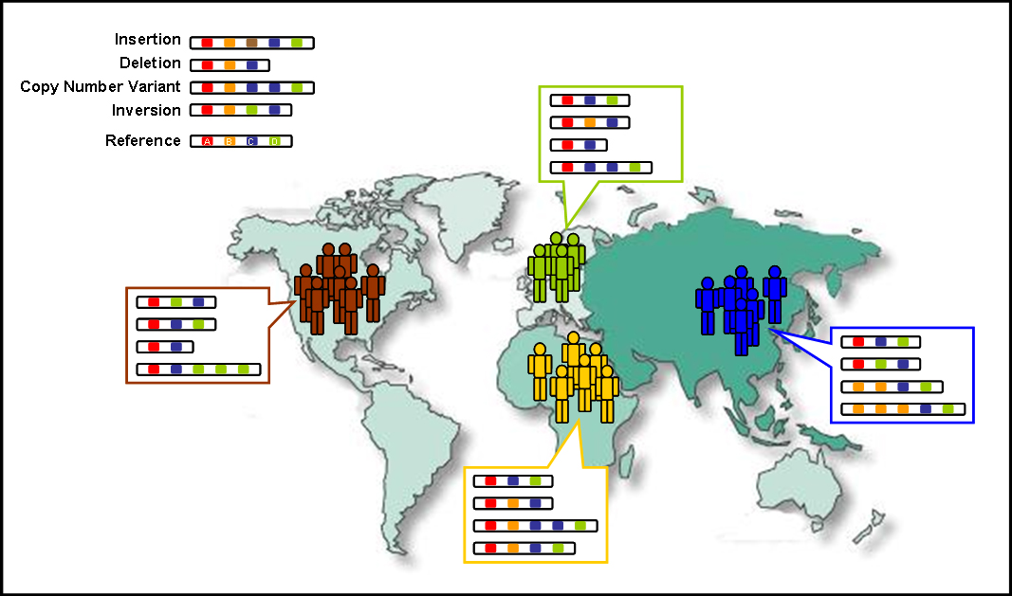
Introduction
Genetic diversity within and between population
Notes:
-Shows genetic variantion
-Why is it important to study genetic variation

Slide 3
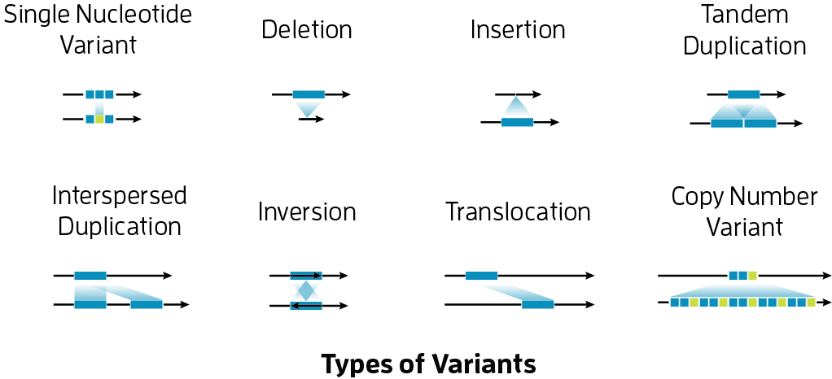
Types of Variants
Notes:
-Explain different types of variants in details

Slide 4
How….?

Slide 5
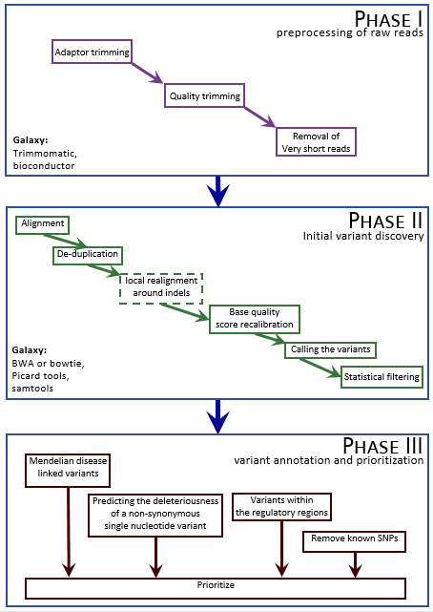

Slide 6



Slide 7
Objective
To create a variant calling pipeline
To convert the pipeline to a portable and reproducible snakemake workflow

Slide 8
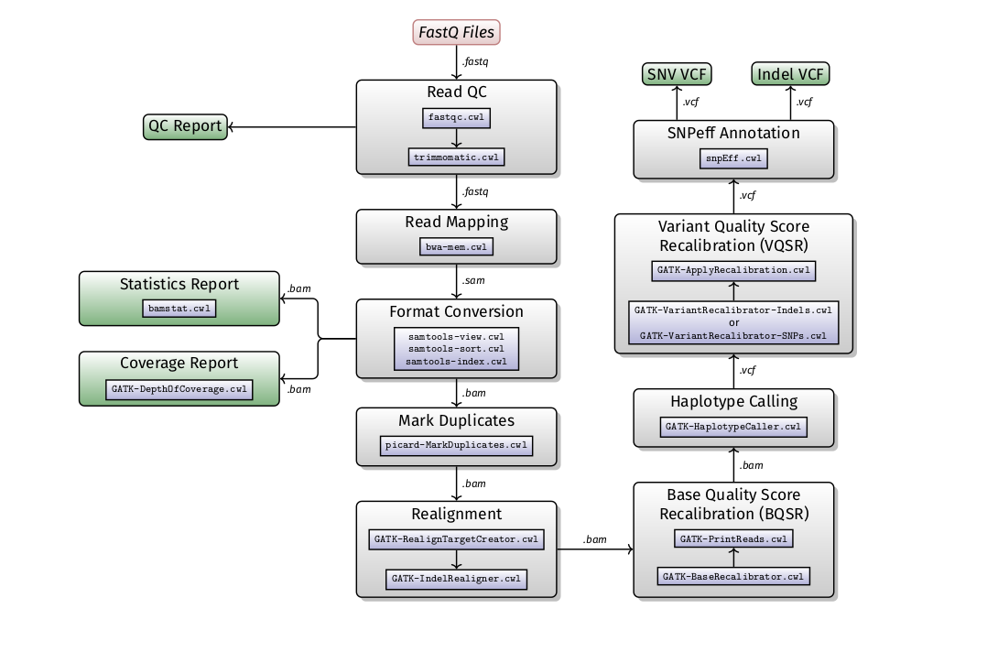
Methodology

Slide 9
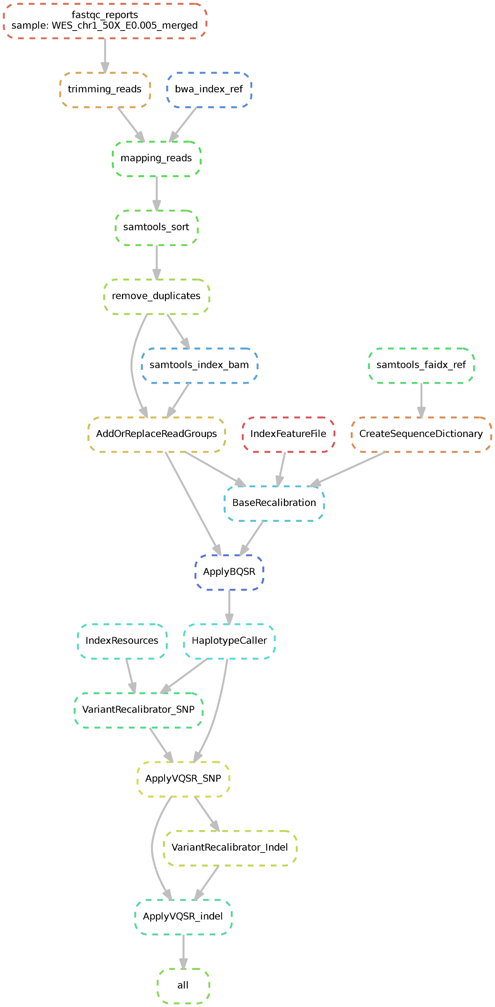
Results

Slide 10
Portability of Snakemake Workflow
Create and environment with all the packages needed
$conda env create –n variant-calling -f variant-calling.yaml (exported env)
Folder organization
Do a dry run snakemake
$snakemake –np
Run Snakemake
$snakemake -j 4(optional)

Slide 11
Limitations and Challenges
The project focused on only SNPs and Indels
It has a steep learning curve

Slide 12
Conclusion
Our snakemake workflow was able to generate an annotated vcf file
Our snakemake workflow combined the pipeline effect of most programming languages such as bash and the portability
The workflow comprehensively generated results in terms of vcf files.

Slide 13


Acknowledgement

