Slide 1
PREDICTIVE MODELING: Group-3
Group Assignment
Group members
Akshay Arora
Naman Khurana
Vineet Singla
Praveen Moon
Nitish Gupta

Slide 2
Dataset – PM_GA_Dataset.xlsx
We are given Customer churn dataset of a telecommunications company.
The dataset has the following variables:-
Churn - 1 if customer cancelled service, 0 if not
AccountWeeks - number of weeks customer has had active account
ContractRenewal - 1 if customer recently renewed contract, 0 if not
DataPlan - 1 if customer has data plan, 0 if not
DataUsage - gigabytes of monthly data usage
CustServCalls - number of calls into customer service
DayMins - average daytime minutes per month
DayCalls - average number of daytime calls
MonthlyCharge - average monthly bill
OverageFee - largest overage fee in last 12 months
RoamMins - average number of roaming minutes
Target Variable – Churn will be the categorical target/dependent variable with 2 levels : 0 or 1.
Independent Variables – All other variables will be the independent variables.

Slide 3
OBJECTIVE
We are required to build a logistic regression model on the data set and interpret the results.
Logistic Regression model will be able to regress the dependent variables with the independent variables, thereby predicting whether the customer will churn or not, basis the set of independent variables chosen to arrive at the model.
PROCEDURE
Exploratory Data Analysis:- Structure and data summary
Partition the data set by allocating 70% -for training data and 30% -for validating the results.
Logistic Regression Model:- Arriving at best predictors on basis of Variable inflation factor(VIF) and p values of independent variables.
Using Rank Ordering to capture Maximum Customer Churn Rate.
Optimising the efficiency of model using ROC curve.
Interpreting the results.

Slide 4
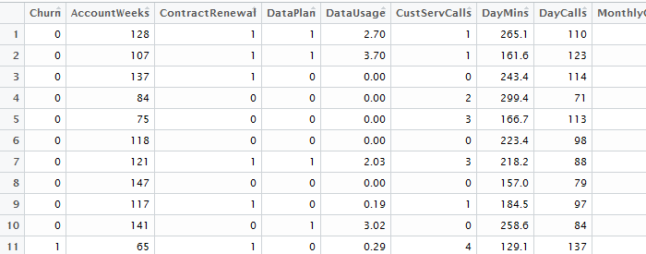
IMPORTING DATASET
The output of which will be like the table below.

Slide 5
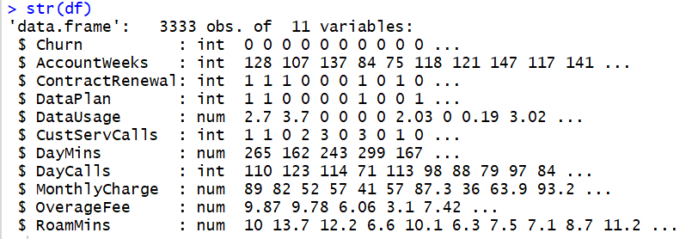
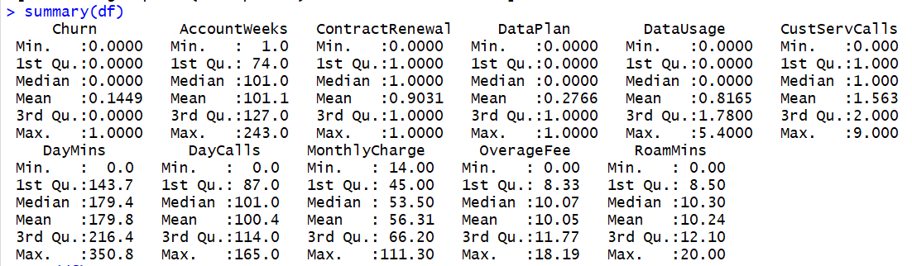
Data Summary
Structure of the data can be viewed using the below command:-

Slide 6
Data Summary
Total Churn rate = 14.49%
403 out of 483 customers who churn does not have any data plan while 80 of them has it.
137 out of 323 customers who do not recently renewed contract churns.

Slide 7
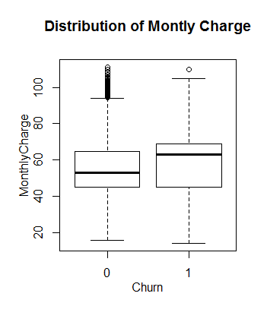
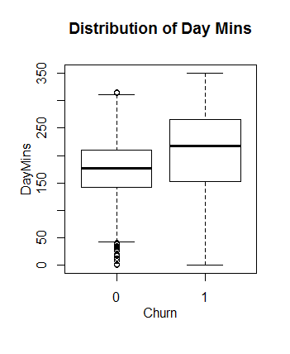
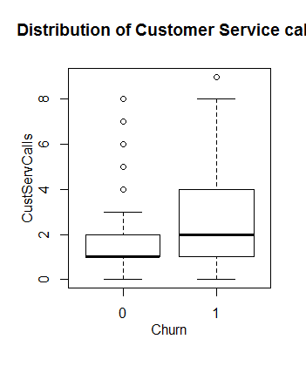
Bi-variate Analysis

Slide 8
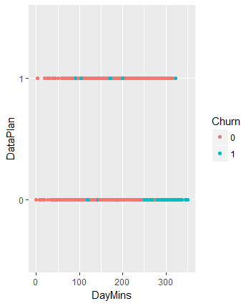
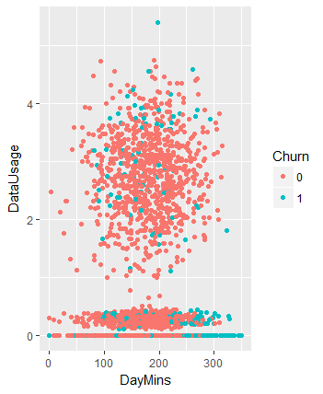
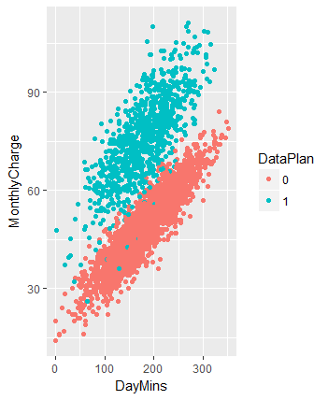
Multi-Variate Analysis

Slide 9
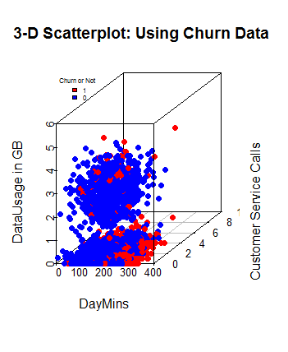
3d Plots

Slide 10
Data Split- Stratified Sampling
Splitting the data into train(70%) and validation set (30%)
Training data Churn rate = 14.32%
Validation Data Churn rate = 14.8%

Slide 11
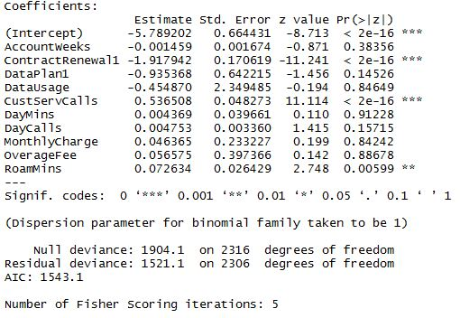
Model Building- Logit
Initially Model was built using :
Target Variable: Churn
Independent Variables: All
All Variable Model Output:-

Slide 12

Fine Tuning the Model
VIF Output:-
Monthly charges (as it is caused by Other variables like Data usage, DayMins etc) and Data Plan variables are dropped.
Next, AccountWeeks and DayCalls are also dropped as they are not coming significant in the final model.

Slide 13
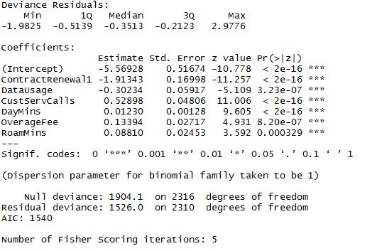
Final Model
After 4 iteration, a final Customer Churn prediction model was built which has the following output:-

Slide 14
Interpreting the Output
As we can see, P values of all the variables which are used in the final model are significant.
AIC value of final model is also smaller than the final model with all the variables.

Slide 15
Model Evaluation
Rank Ordering:
deciles | cnt | cnt_resp | cnt_non_resp | cum_resp | rrate | cum_non_resp | cum_perct_resp | cum_perct_non_resp | ks
10 | 102 | 49 | 53 | 49 | 48.04 | 53 | 32.45 | 6.13 | 26.3
9 | 102 | 39 | 63 | 88 | 38.24 | 116 | 58.28 | 13.41 | 44.9
8 | 101 | 23 | 78 | 111 | 22.77 | 194 | 73.51 | 22.43 | 51.1
7 | 102 | 16 | 86 | 127 | 15.69 | 280 | 84.11 | 32.37 | 51.7
6 | 101 | 10 | 91 | 137 | 9.9 | 371 | 90.73 | 42.89 | 47.8
5 | 102 | 3 | 99 | 140 | 2.94 | 470 | 92.72 | 54.34 | 38.4
4 | 101 | 3 | 98 | 143 | 2.97 | 568 | 94.7 | 65.66 | 29
3 | 102 | 5 | 97 | 148 | 4.9 | 665 | 98.01 | 76.88 | 21.1
2 | 101 | 3 | 98 | 151 | 2.97 | 763 | 100 | 88.21 | 11.8
1 | 102 | 0 | 102 | 151 | 0 | 865 | 100 | 100 | 0

Slide 16
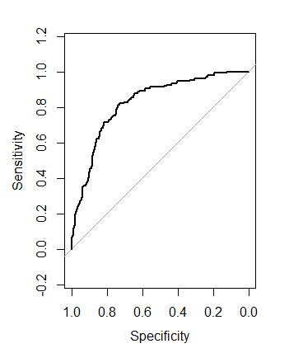
ROC Curve
AUC value = 83%

Slide 17
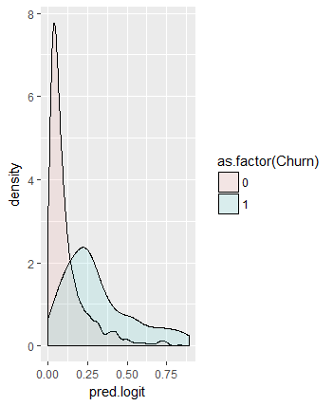
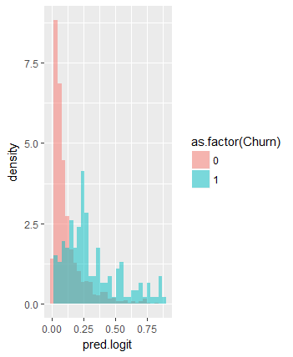
Distribution of Predicted Probabilities
Using this we can set the threshold for our classifier.
Based on our Business requirement: to capture Customer Churn, we will set it to 0.22 while maintaining a trade-off between Precision and Recall.

Slide 18
Confusion Matrix
Based on the threshold, we set in previous slide as 0.22, Confusion Matrix for the final model is:-
Accuracy = 82.1 %
Percent of the Churn cases did we catch (Recall) = 63%
Percent of Churn predictions were correct(Precision) = 44%
 |  | Observed
 |  | Not Churn (0) | Churn (1)
Predicted | Not Churn (0) | 741 | 57
 | Churn (1) | 124 | 94

Slide 19
Appendix(Code)
setwd( "E:\\Akxay\\GLIM\\Predictive Analytics")
tele_data<-read.csv(file.choose(), header=T)
View(tele_data)
str(tele_data)
library(caret)
library(car)
library(psych)
library(e1071)
library(plyr)
colnames(tele_data)
## Target Rate
sum(tele_data$Churn)/nrow(tele_data) # 14% churn rate
tele_data$Churn = as.factor(tele_data$Churn)

Slide 20
EDA
tele_data$ContractRenewal = as.factor(tele_data$ContractRenewal)
tele_data$DataPlan = as.factor(tele_data$DataPlan)
table(tele_data$Churn,tele_data$DataPlan)
# 403 out of 483 churn goes not have any data plan and 80 of them has
table(tele_data$Churn,tele_data$ContractRenewal)
# 137 out of 323 who do not renew contract churns
# impact of DataPlan and MonthlyCharge on customer churn
boxplot(tele_data$MonthlyCharge ~ tele_data$Churn)
title(xlab="Churn", ylab="MonthlyCharge",main="Distribution of Montly Charge", line=2,cex.lab=1)
boxplot(tele_data$DayMins ~ tele_data$Churn)
title(xlab="Churn", ylab="DayMins",main="Distribution of Day Mins", line=2,cex.lab=1)

Slide 21
EDA Cont.
boxplot(tele_data$CustServCalls ~ tele_data$Churn)
title(xlab="Churn", ylab="CustServCalls",main="Distribution of Customer Service calls", line=2,cex.lab=1)
qplot(DayMins, MonthlyCharge , colour = DataPlan, data=tele_data)
qplot(DayMins, DataPlan, colour = Churn,data=tele_data)
qplot(DayMins, DataUsage, colour = Churn,data=tele_data)
# but among those who dont use data plan but still charged high are churning
# create 3D point color
library(scatterplot3d)
#Binary Classification Plots: tele_data vs No tele_data
tele_data$pcolor[tele_data$Churn==1] <- "red"
tele_data$pcolor[tele_data$Churn==0] <- "blue"

Slide 22
3d plots
with(tele_data, {
s3d <- scatterplot3d(DayMins, CustServCalls, DataUsage, # x y and z axis
color=pcolor, pch=19, # circle color indicates tele_data or not
main="3-D Scatterplot: Using Churn Data ",
xlab="DayMins",
ylab="Customer Service Calls",
zlab=" DataUsage in GB")
s3d.coords <- s3d$xyz.convert(DayMins, CustServCalls, DataUsage)
# add the legend
legend("topleft", inset=.05, # location and inset
bty="n", cex=.5, # suppress legend box, shrink text 50%
title="Churn or Not",
c("1","0"), fill=c("red", "blue"))
})

Slide 23
Data Splitting and Model Building
set.seed(1111)
pd<-sample(2,nrow(tele_data),replace=TRUE, prob=c(0.7,0.3))
train<-tele_data[pd==1,]
val<-tele_data[pd==2,]
summary(train$Churn)
summary(val$Churn)
library(SDMTools)
library(pROC)
library(Hmisc)
Logit<-Churn~AccountWeeks+ContractRenewal+DataPlan+DataUsage+CustServCalls+DayMins+DayCalls+MonthlyCharge+OverageFee+RoamMins
#All Variables
Logit.1 <- glm(Logit , train, family = binomial)
summary(Logit.1)
vif(Logit.1)

Slide 24
Final Model and Predictions
Logit.new<-Churn~AccountWeeks+ContractRenewal+DataPlan+DataUsage+CustServCalls+DayMins+DayCalls+OverageFee+RoamMins
Logit.2 <- glm(Logit.new , train, family = binomial)
summary(Logit.2)
vif(Logit.2)
Logit.3<-Churn~AccountWeeks+ContractRenewal+DataUsage+CustServCalls+DayMins+DayCalls+OverageFee+RoamMins
Logit.3 <- glm(Logit.3 , train, family = binomial)
summary(Logit.3)
vif(Logit.3)
Logit.4<-Churn ~ ContractRenewal+DataUsage+CustServCalls+DayMins+OverageFee+RoamMins
Logit.4 <- glm(Logit.4 , train, family = binomial)
summary(Logit.4)
vif(Logit.4)
pred.logit <- predict.glm(Logit.4, newdata=val, type="response")

Slide 25
Rank Ordering
## deciling code
decile <- function(x){
deciles <- vector(length=10)
for (i in seq(0.1,1,.1)){
deciles[i*10] <- quantile(x, i, na.rm=T)
}
return (
ifelse(x<deciles[1], 1,
ifelse(x<deciles[2], 2,
ifelse(x<deciles[3], 3,
ifelse(x<deciles[4], 4,
ifelse(x<deciles[5], 5,
ifelse(x<deciles[6], 6,
ifelse(x<deciles[7], 7,
ifelse(x<deciles[8], 8,
ifelse(x<deciles[9], 9, 10
))))))))))
}
## deciling
val$deciles <- decile(pred.logit)

Slide 26
Rank Ordering Cont.
library(data.table)
val$Churn = as.numeric(as.character(val$Churn))
tmp_DT = data.table(val)
rank <- tmp_DT[, list(
cnt = length(Churn),
cnt_resp = sum(Churn),
cnt_non_resp = sum(Churn == 0)) ,
by=deciles][order(-deciles)]
rank$rrate <- round(rank$cnt_resp * 100 / rank$cnt,2);
rank$cum_resp <- cumsum(rank$cnt_resp)
rank$cum_non_resp <- cumsum(rank$cnt_non_resp)
rank$cum_perct_resp <- round(rank$cum_resp * 100 / sum(rank$cnt_resp),2);
rank$cum_perct_non_resp <- round(rank$cum_non_resp * 100 / sum(rank$cnt_non_resp),2);
rank$ks <- abs(rank$cum_perct_resp - rank$cum_perct_non_resp);
View(rank)

Slide 27
Predicted Probabilities Distribution
x = cbind(val,pred.logit)
churn = (subset(x, x$Churn==1))
summary(churn$pred.logit)
not_churn = (subset(x, x$Churn==0))
summary(not_churn$pred.logit)
df=x[,c(14,1)]
# Churn vs not churn predicted probablities
ggplot(df, aes(pred.logit, fill = as.factor(Churn))) + geom_histogram(alpha = 0.5, aes(y = ..density..), position = 'identity')
ggplot(df, aes(pred.logit, fill = as.factor(Churn))) + geom_density(alpha = 0.1)

Slide 28
ROC and Confusion Matrix
## The distribution of the estimated probabilities
quantile(churn$pred.logit, c(0,1,5,10,25,30,35,50,80,86,90,95,100)/100)
tab.logit<-confusion.matrix(val$Churn,pred.logit,threshold = 0.22)
tab.logit
roc.logit<-roc(val$Churn,pred.logit )
roc.logit
plot(roc.logit)
#Recall- percent of the Churn cases did we catch?
# 94/151 = 63%
#Precision = percent of Churn predictions were correct?
# 94/218 = 44%

Slide 29
THANK YOU

