Slide 1
Machine Learning Framework
Surrogate Modeling for Piezoelectric Morphing Wings

Slide 2
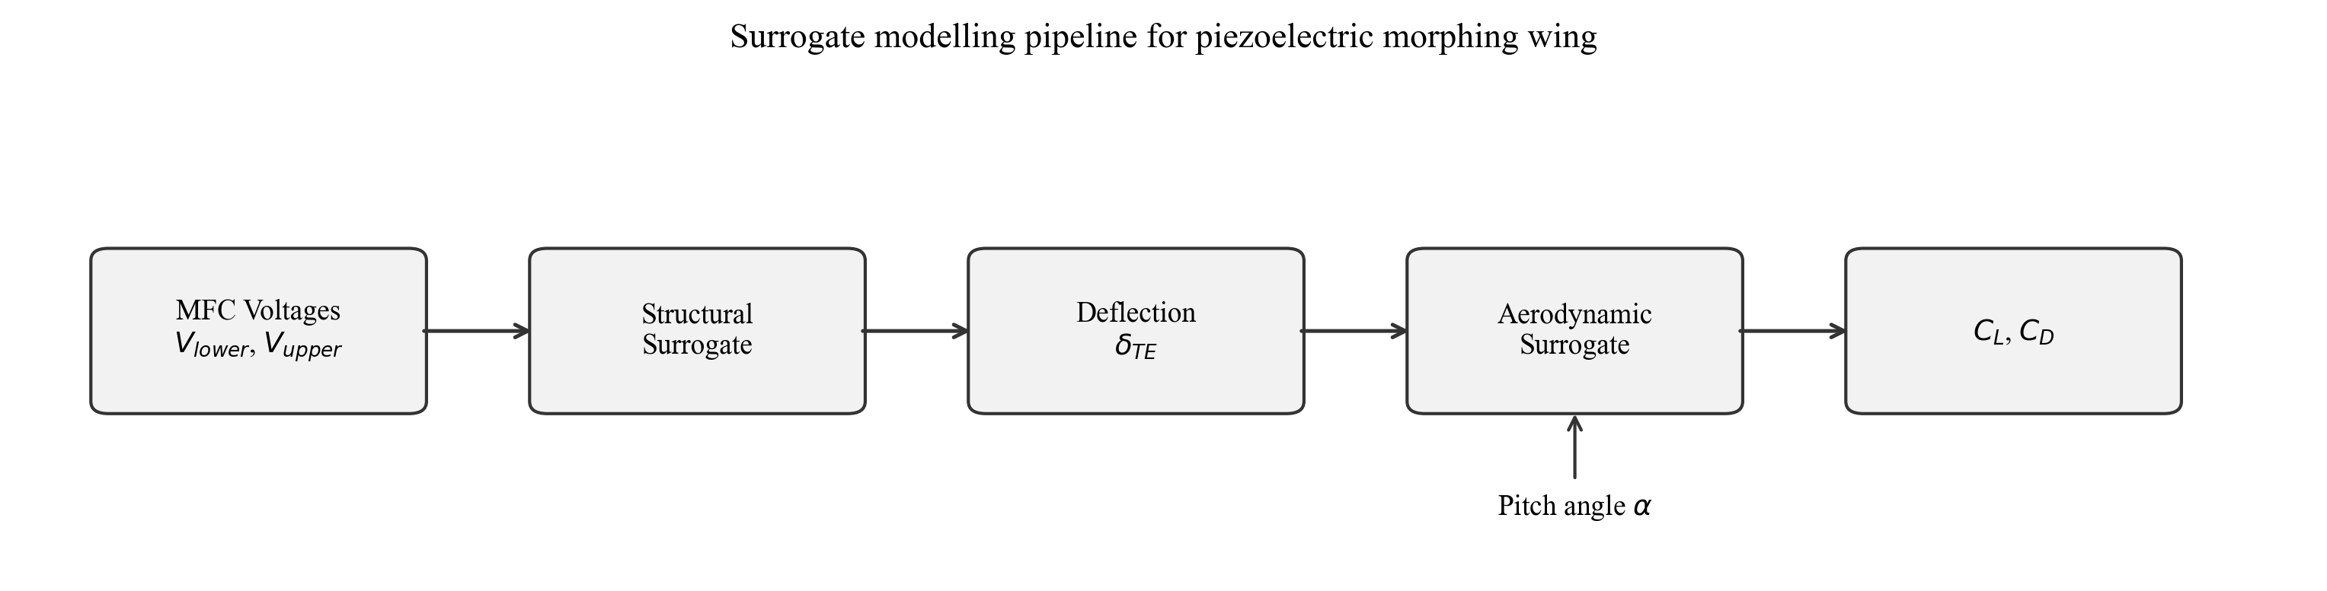
ML Problem and Goal
Input: Lower MFC voltage, Upper MFC voltage, Pitch angle
Output: Trailing-edge deflection, Lift coefficient (C_L), Drag coefficient (C_D)
Challenge: Replace expensive CFD and structural simulations
Solution: Build fast, accurate surrogate models using ML

Slide 3
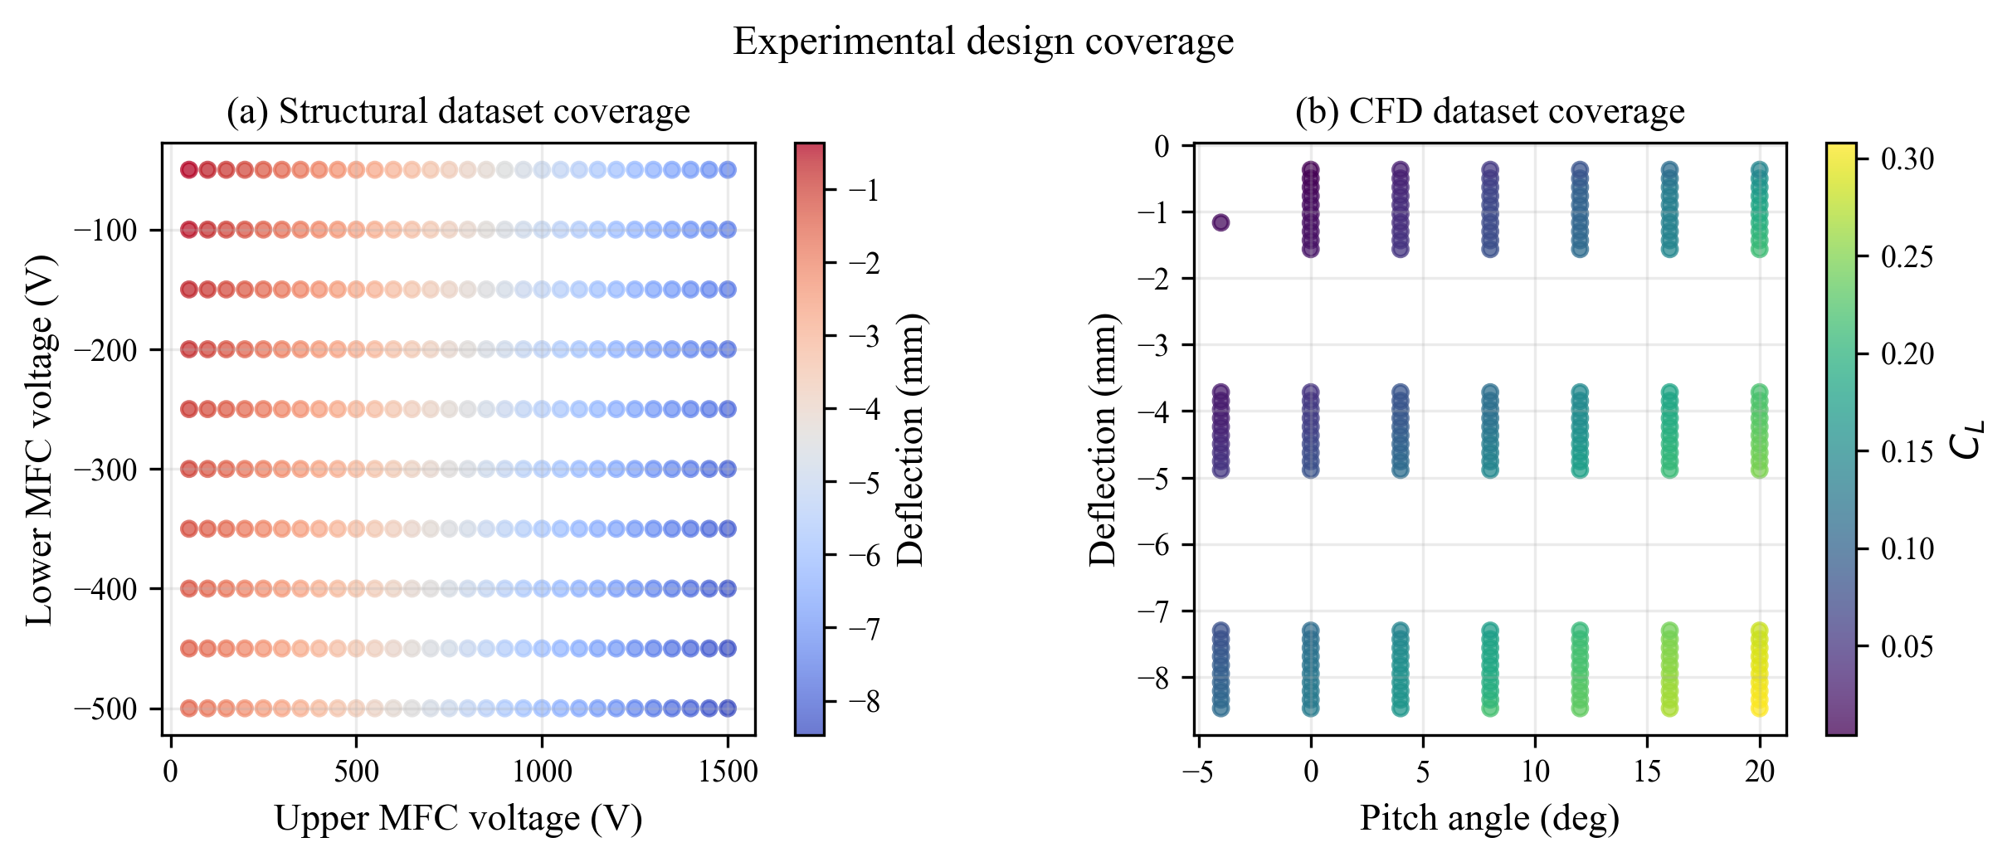
Data and Training Space
Structural dataset: 300 ANSYS coupled-field simulations
Aerodynamic dataset: 201 CFD samples
Sparse coverage: Limited voltage combinations and pitch angles
Solution: Physics-consistent synthetic data augmentation

Slide 4
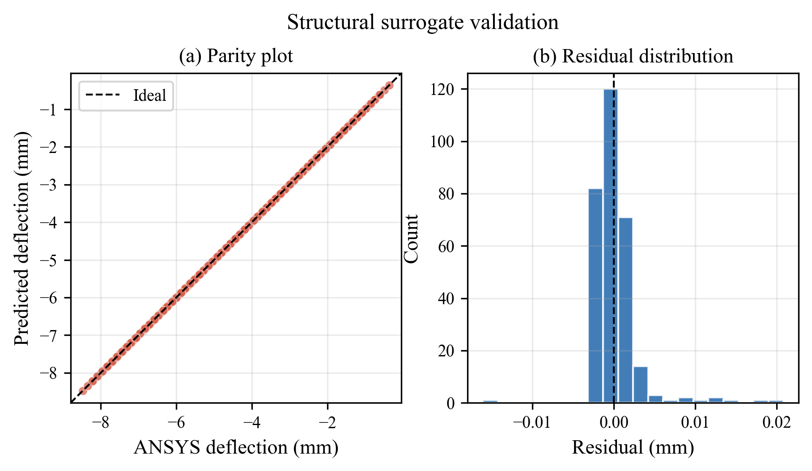
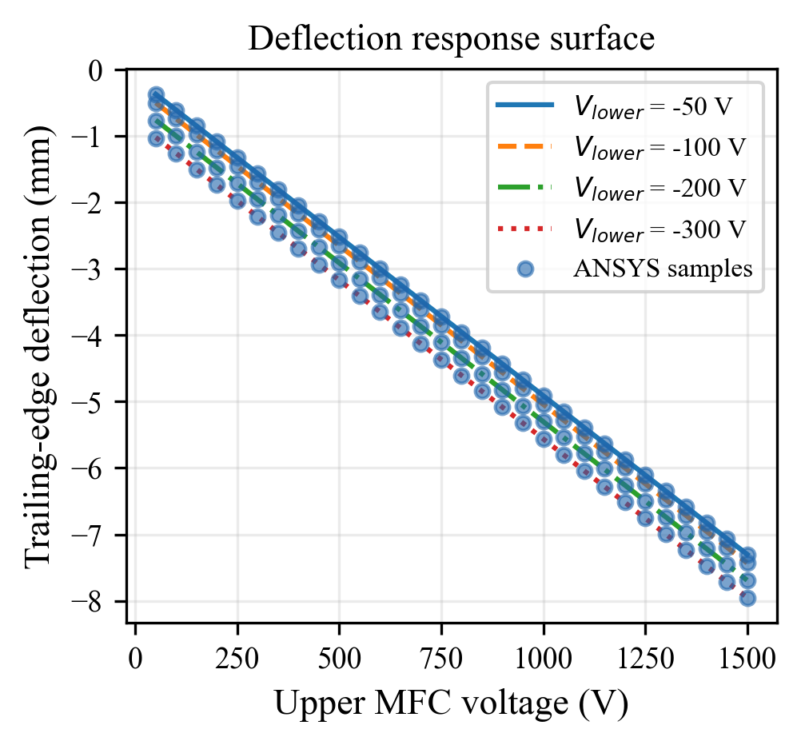
Structural Surrogate: Voltages → Deflection
Task: Predict trailing-edge deflection from MFC voltages
Best model: Linear regression
Accuracy: R² = 0.9999, MAE = 0.0016 mm
Validation: Parity plot (left), Response curves (right)

Slide 5
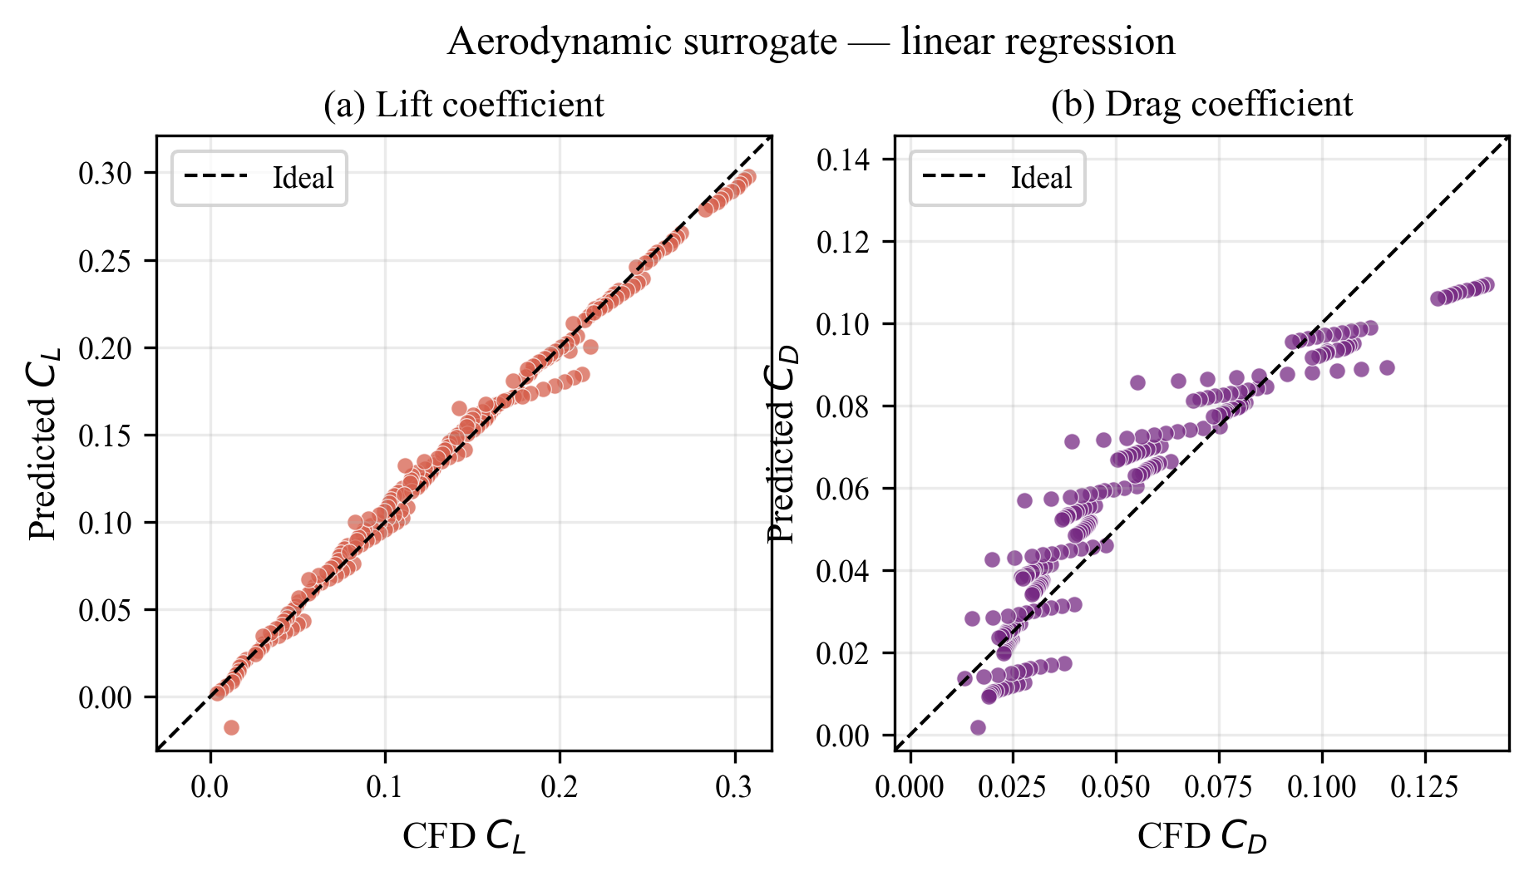
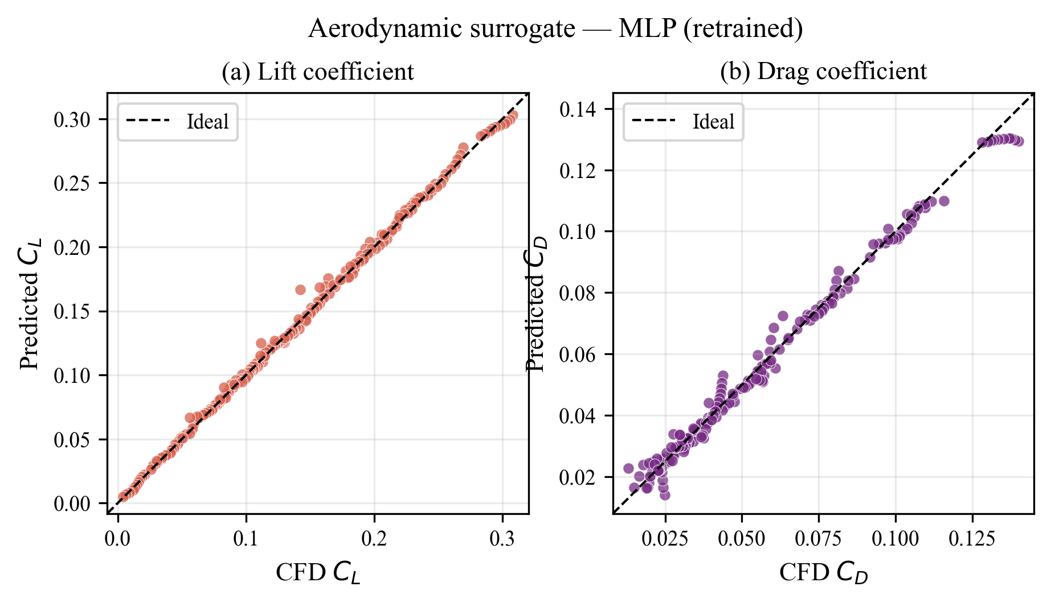
Aerodynamic Surrogate: Deflection + Pitch → C_L, C_D
Task: Predict lift and drag from deflection and pitch angle
Baseline: Linear regression (R² = 0.98 for C_L, 0.83 for C_D)
Improved: MLP regressor after augmentation
Results: C_L MAE = 0.0022, C_D MAE = 0.0021 (both R² > 0.99)

Slide 6
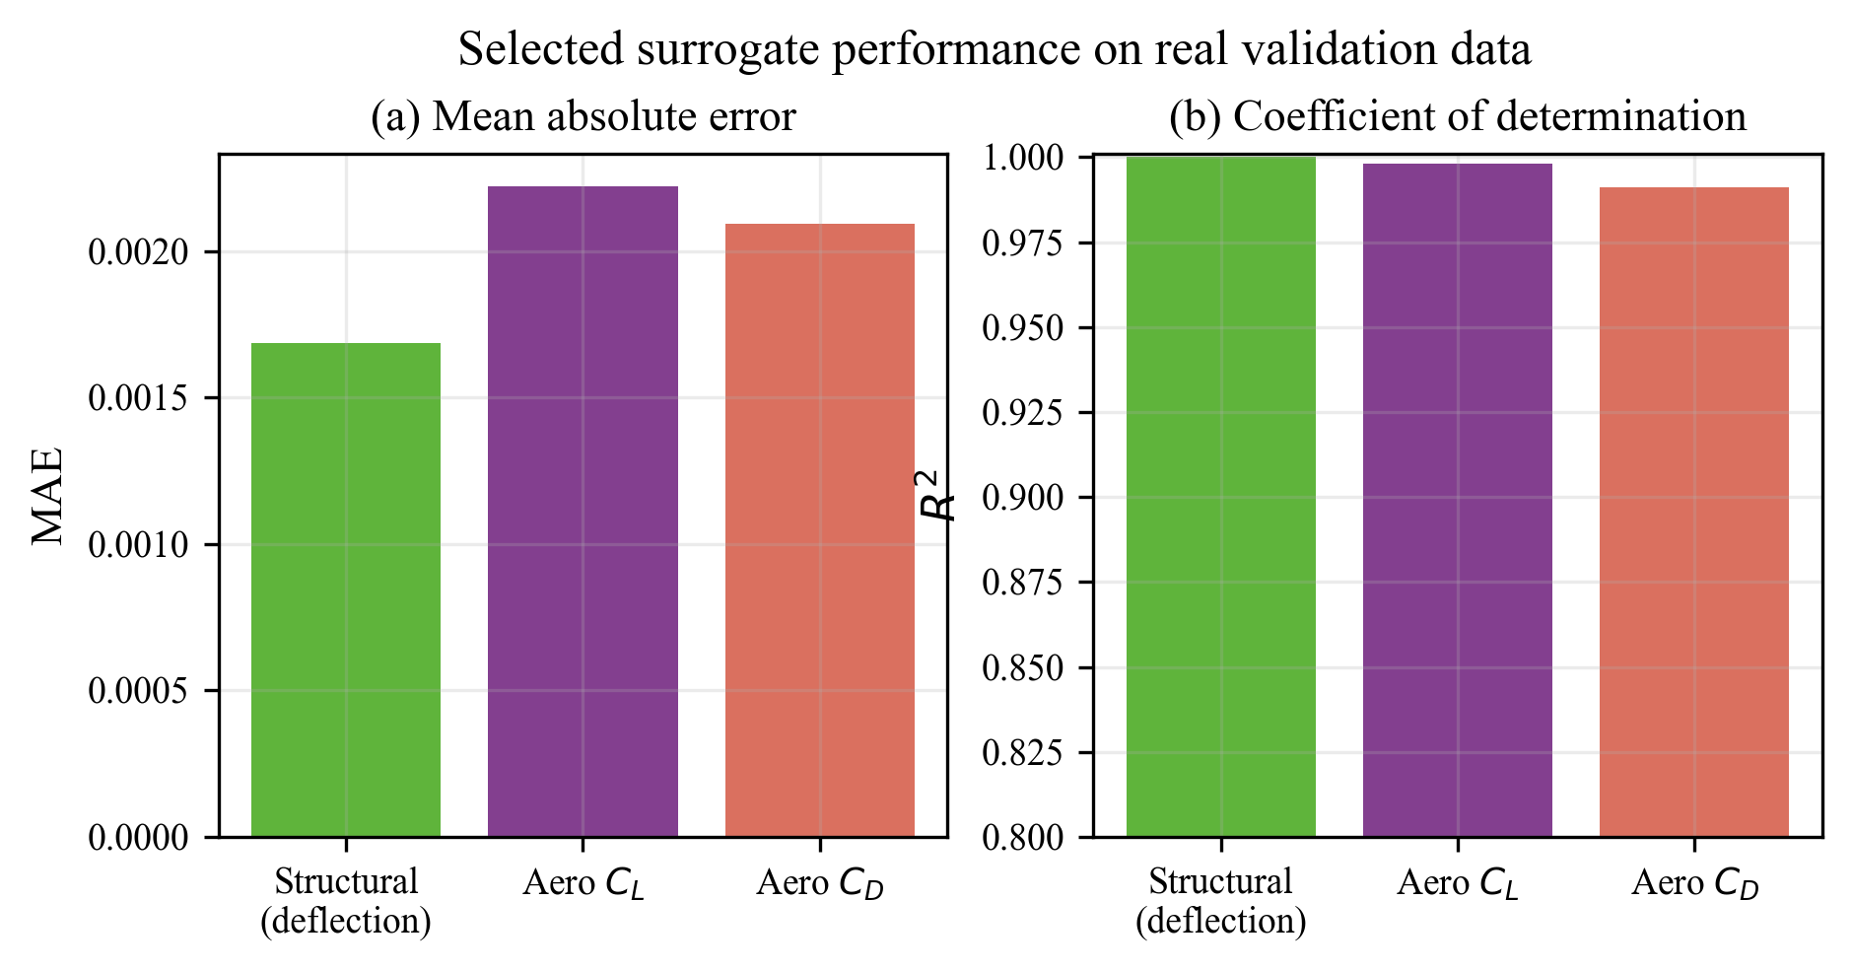
Data Augmentation and Performance Gain
Generated 7,797 synthetic rows using physics-consistent interpolation
Strict and noisy variants tested for robustness
MLP benefits more from augmentation than linear models
C_D improvement: 20× reduction in error after augmentation

Slide 7
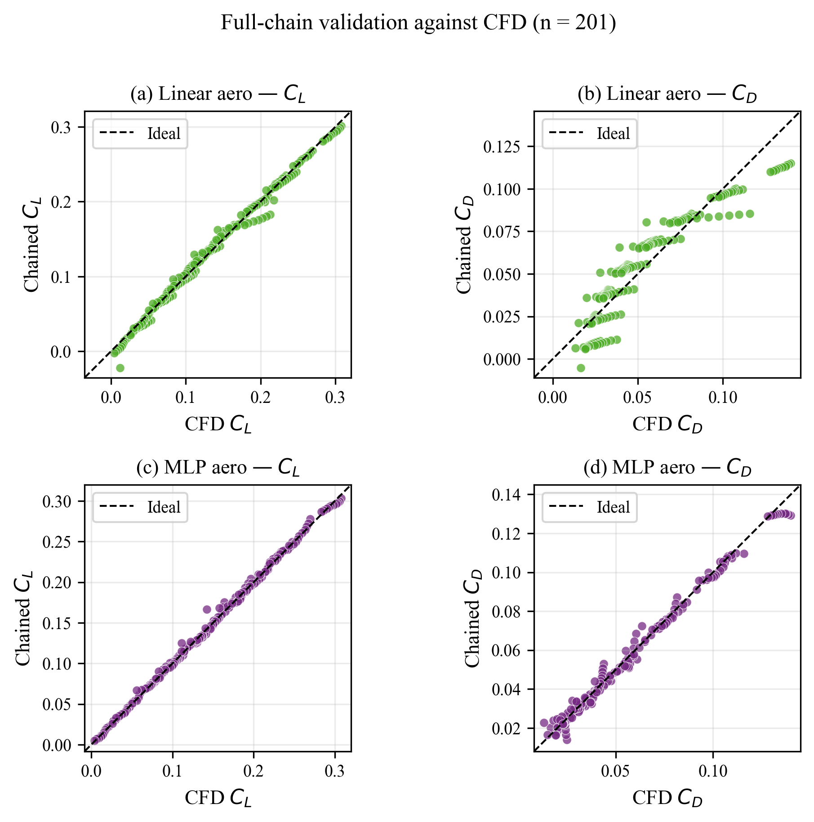
Full Chained ML Pipeline: Voltages → C_L, C_D
End-to-end: Structural model → Aerodynamic model
Tested on 201 real CFD validation points
Linear chain: C_L MAE = 0.0050, C_D MAE = 0.0093
MLP chain (selected): C_L MAE = 0.0022, C_D MAE = 0.0021

Slide 8
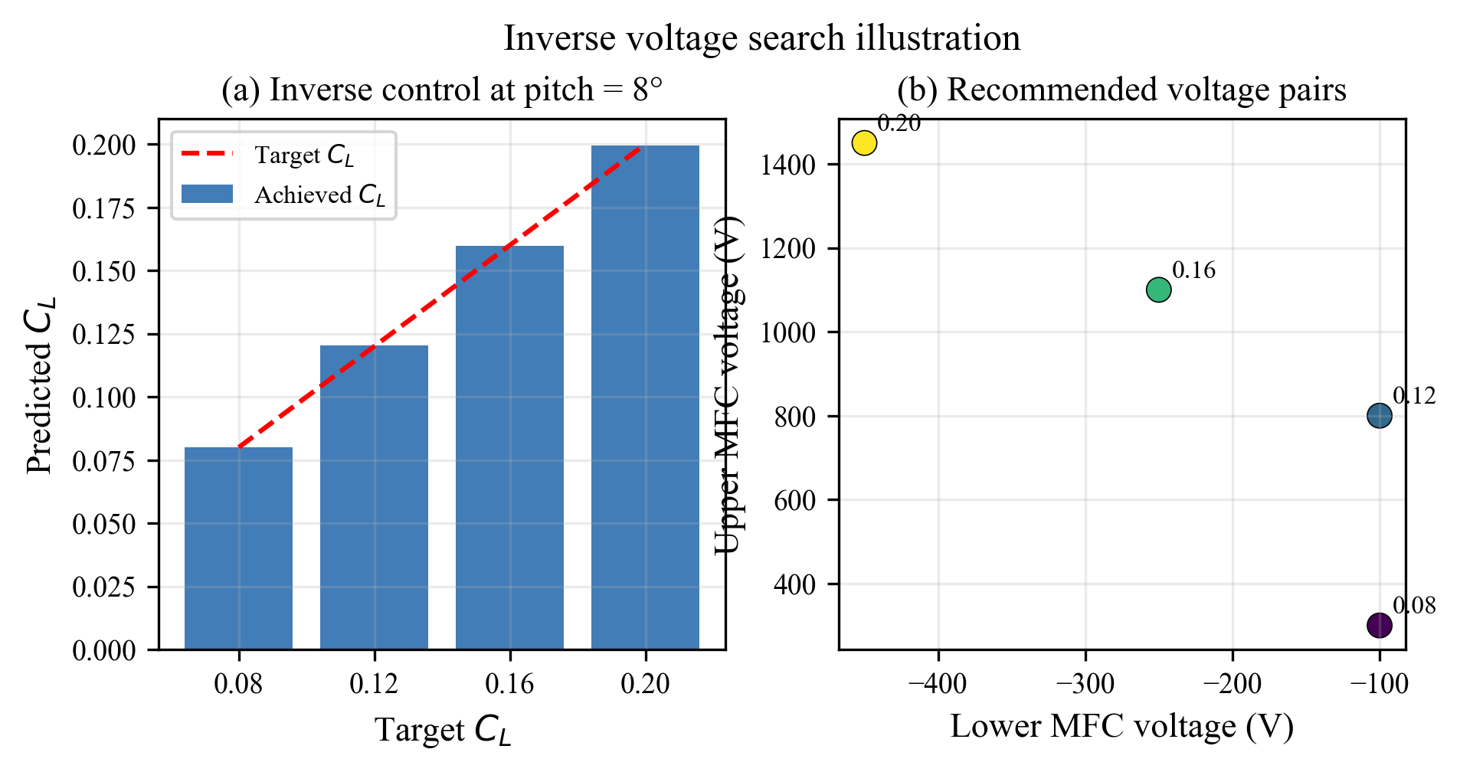
Inverse Voltage Recommendation
Input: Target C_L and pitch angle (with optional C_D constraint)
Method: Grid search (50 V step) + L-BFGS-B continuous refinement
Output: Ranked voltage pairs with predicted aerodynamic coefficients
Use case: Control system for achieving desired lift at any pitch

Slide 9
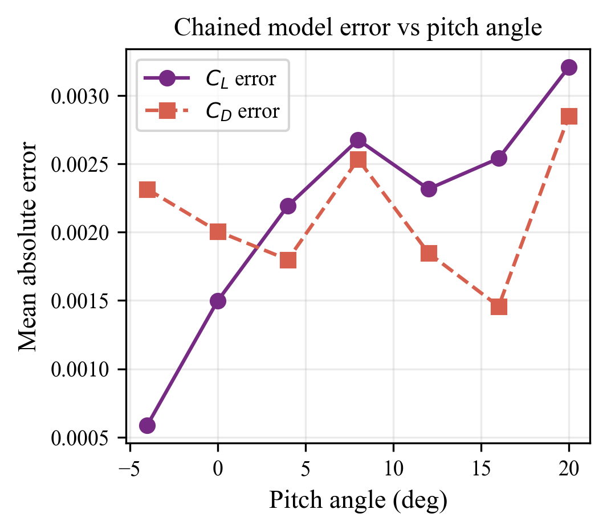
Error Analysis: Model Limitations
Chained model accuracy varies with pitch angle
C_L error: Consistent across pitch range
C_D error: Increases slightly at extreme angles
Recommendation: Use model in −4° to +20° pitch range for best accuracy

Slide 10
Conclusion: Key Results and Impact
✓ Structural surrogate: Near-perfect accuracy (R² ≈ 0.9999)
✓ Aerodynamic MLP: Significant improvement with augmented training
✓ Full chain: Fast (<60 ms), accurate replacement for simulation
✓ Inverse control: Enables real-time voltage recommendations for target lift

