Slide 1
Statistics
Name
Student ID | Total | 03.03 | 03.05 | 03.10 | 03.12
20xx-xxxxx | 20/20
20xx-xxxxx | 11/20
20xx-xxxxx | 17/20
20xx-xxxxx | 20/20
20xx-xxxxx | 20/20
20xx-xxxxx | 17/20
20xx-xxxxx | 20/20
20xx-xxxxx | 19/20
20xx-xxxxx | 20/20
20xx-xxxxx | 20/20
20xx-xxxxx | 13/20
20xx-xxxxx | 20/20
20xx-xxxxx | 20/20
20xx-xxxxx | 20/20
20xx-xxxxx | 20/20
20xx-xxxxx | 20/20
20xx-xxxxx | 20/20
20xx-xxxxx | 20/20
Course
CourseID
Statistics

Slide 2
Course
Name
04.12
+
Course
CourseID
04.10
Manage
04.05
04.03
Statistics

Slide 3
Course
Name
04.12
Course
CourseID
04.10
04.05
04.03
`
Statistics

Slide 4
attendance check page
Name
+
-
Course
CourseID
Date
(04/01)
tag
picture

Slide 5
Main
Name
course search
recent picture list
course name / date
picture
course name / date
picture

Slide 6
sign up page
name
password
password
confirm
school
major
student
number
sign up

Slide 7
Create Course
Course
Course ID
Create

Slide 8
main page
course search
recent picture list
course name / date
picture

Slide 9
Name
side bar
Course
CourseID
Course
Manage
Course ID
Create

Slide 10
name
attendance check page
course
name
+
-
tag
picture

Slide 11
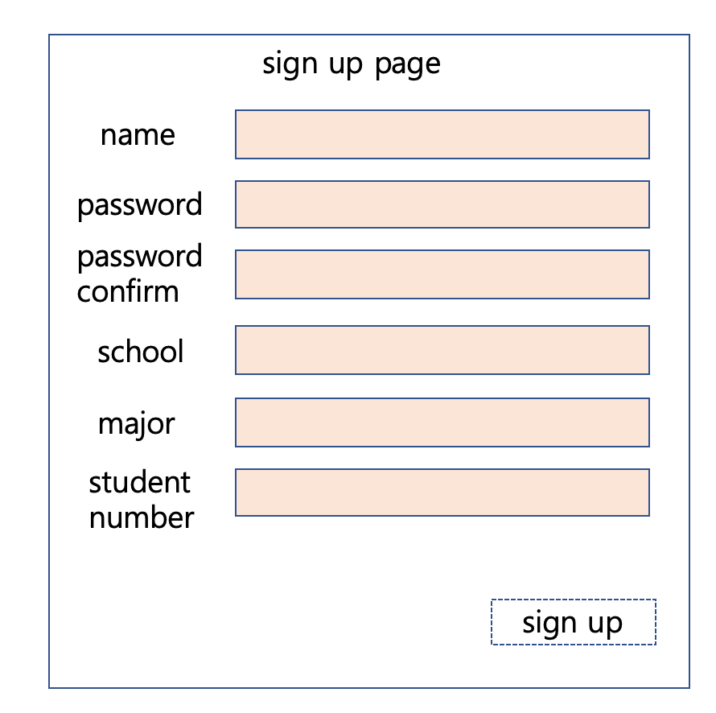
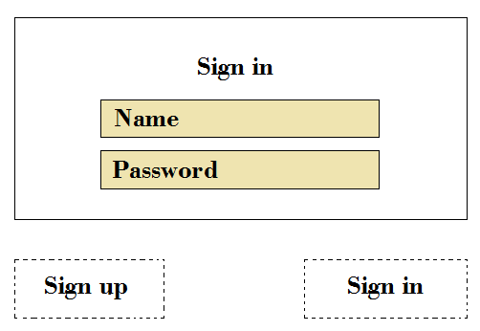
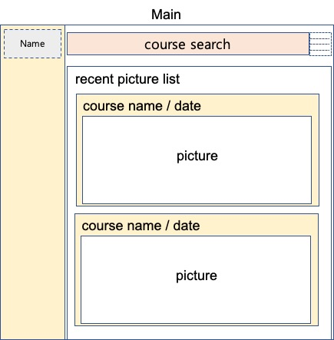
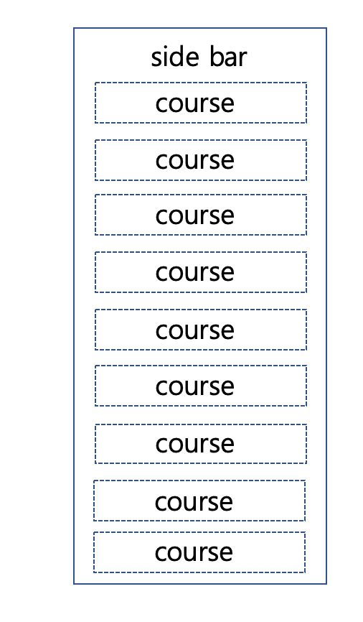
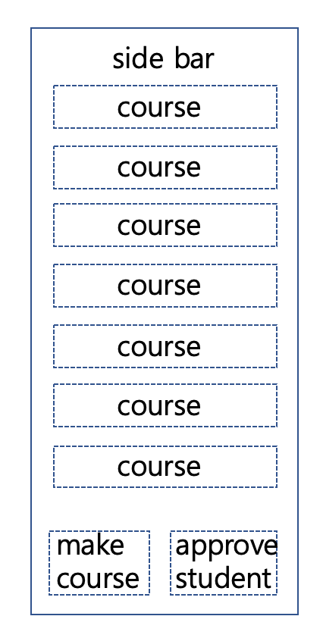
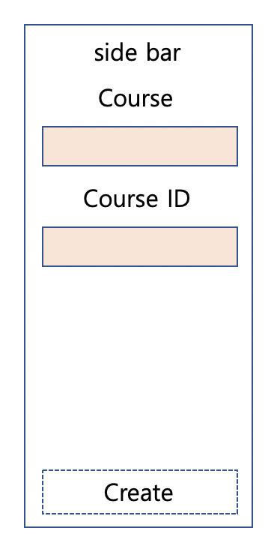

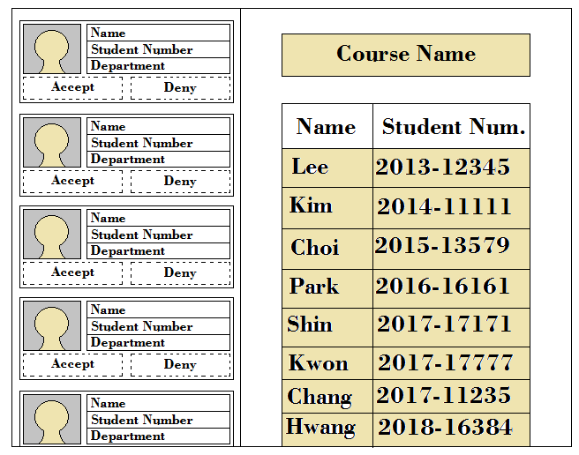
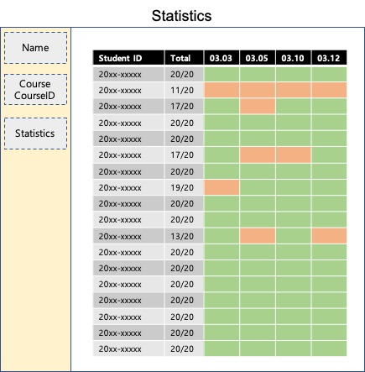
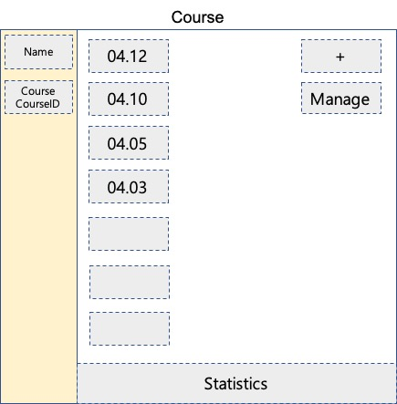
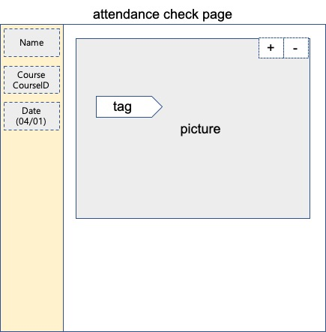
stud.
prof.
professor
only
professor
only

