Slide 1
Project Name: NGO Platform Management
Team Members
1. Al-Amin Hridoy (2243081166)
2. Abidul Islam Khan (2243081179)
3. Fahim Forkan (2243081169)
4. Tanvir Ahmed (2243081177)
5. Taspriya Sultana (2243081046)

Slide 2
Admin Class
Purpose : Authentication for Admins Login.
Variables : username, password. //Private variabe
TotalRequiredMoney , TotalCollectedMoney // Public variable
Constructor : Admin()
Methods : get set Method,
Login() , AdminMenu () // Void Method
Control Flow : By using Conditional Statements inside while Loop.

Slide 3
Interface
display--
    Virtual Method : Display()
donate --
    Virtual Method : Donate()
Abstract Class
  Class Name: BaseCategory
  Inheritence: Inherit from multiple class of interface
  Features : String type field as Name,
  Constructor // BaseCategory(),
Abstract method // SpecialFeature().
  Operation : Interface methods.

Slide 4
FundCategory Class
Objective : To get Donating option.
Inheritence : Inherit from BaseCategory class.
Features : Constructor // by Passing new Name as parameter
Sum operators (+) // for adding two categories at the same time.
override Method //SpecialFeatures
CategoryMenu() Method. // to use Loop
Control Flow : Conditional statements inside while Loop.
Example- if (Choice==“1”)
{ 1. Donate }
else if (Choice==“0”)
{ 2. Back }

Slide 5
Static Class
Class Name : Donation class.
Objective : To use Donating information in every categories.
Methods : Static Method // MakeDonation()
Features : User inputs for Donating information
      Name,
      Email Id,
      Country,
      ID Type : 1. Passport
      2. NID // Using Conditional Statements
      Payment Method
      Donation Amount

Slide 6
FundGroup Class
Properties : String type Group Name, 5 Referenced Topic from FundCategory.
Purpose : To Use as Base Class for Subcategories class.
Constructor : public FundGroup()
Methods : LoadDefaultCategories() // Virtual Method
Void Menu()
Objects : Topic1 – Topic5 // inside Virtual Method
Control Flow : Inside Loop by using Conditional Statements
Example- if (Choice==“1”)
{ Topic1.CategoryMenu(); }
else if
{ …………….. }

Slide 7
Natural Disaster Relief Fund Class
Objective : To Make a sub categories class.
Inheritence : Inherit from FundGroup class.
Constructor : DisasterReliefFund() : base (“Natural Disaster Relief Fund”)
Methods : LoadDefaultCategories() // Override Method
Objects : Topic1 -- Topic5
Subcategories : 1.”Emergency Help”
2.”Medical Help”
3.”Shelter Help”
4.”Homeless Families Support”
5.” Safety Support”.

Slide 8
WarzoneReliefFund
Similar to Disaster Relief Fund Class.
Sub Categories: 1.”Emergency Help”
2.”Medical Help”
3.”Shelter Help”
4.”Refugee Families Support”
5.” Safety Support”.
AnimalShelterFund
Similar to Disaster Relief Fund class.
Sub Categories: 1. “Food & Items”
2. “Animal Treatment”
3. “Shelter Support”
4. “Adoption Help“
5. "Rescue Work"

Slide 9
Health Care support Fund Class
Objective : To Make a sub categories class.
Inheritence : Inherit from FundGroup class.
Constructor : HealthCareSupportFund() : base (“HealthCare Support Fund”)
Methods : LoadDefaultCategories() // Override Method
Objects : Topic1 -- Topic5
Subcategories : 1.” Vaccines”
2.”Hospital Tools”
3.”Free Checkup Camps”
4.”Health Awareness”
5.” Patient Help”.

Slide 10
EducationSupport Fund
Objective : To Make a sub categories class.
Inheritence : Inherit from FundGroup class.
Constructor : EducationSupportFund() : base (“Education Support Fund”)
Methods : LoadDefaultCategories() // Override Method
Objects : Topic1 -- Topic5
Subcategories : 1. ” School Items”
2. ”Study Scholarships”
3. “Teacher Trainings”
4. ”Library Support”
5. ”Student Help”.

Slide 11
Main Class
Purpose : To Control the entire Code flows.
Objects : Admin, Disaster, Warzone, Animal, Health, Edu.
Fund Options : Showing Output of Fund options(1 -5).
User Input : Choice (String Type)
Control Flow : Inside While Loop using Conditional statements.
Example: if (choice==1)
{ Disaster.Menu(); }
else if ……………….
else if (Choice == 6 )
{ inside nested conditions (admin.AdminMenu()) will be called )
else
{ “ Invalid Choice. “ }

Slide 12
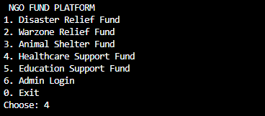
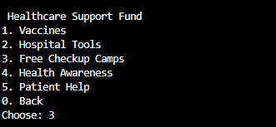
Output Demo
Choosing 4h option as Fund Option
Choosing 3rd option as Sub Category

Slide 13
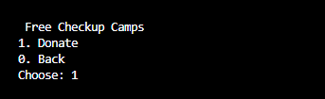
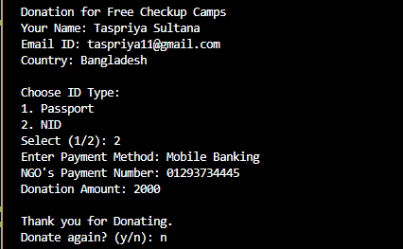
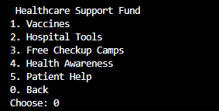
Choosing 1 to Donate
Giving Donating Information by giving n leaving donate option.
By choosing Back coming back to Main Home Page.

Slide 14
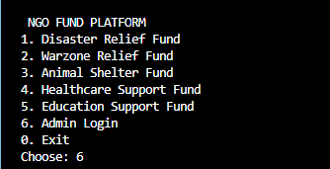

Admin’s Option
Choosing 6th For admins Options.
Giving Admins Informations and login in for any updates or changes.

Slide 15
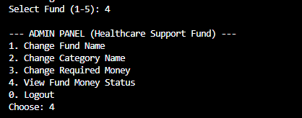

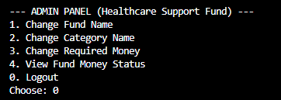
Choosing 4 to see fund money status and can watch funds money status.
Can choose any other options too for more upadates in site. By choosing Logout option can comeback to home page .

Slide 16
Conclusion
The project demonstrates the application of Object-Oriented Programming principles through interfaces, abstraction, inheritance, and polymorphism
The system organizes various donation types using a hierarchical class structure, ensuring clean separation of responsibilities.
THANK YOU

