Slide 1
Temperature and Precipitation Forecasting using LSTM
A Comparative Study of LSTM Variants for Single-Step and Multi-Step Forecasting

Slide 2
Introduction
Objective: Develop LSTM models to predict temperature (°C) and precipitation.
Experimented with three LSTM variants:
Vanilla LSTM
Stacked LSTM
Bidirectional LSTM
Focus on single-step (1-hour) and multi-step (24-hour) forecasting.

Slide 3
Methodology
Data Preparation: Time-series data scaled (Min-Max) and split into sequences (24-hour lookback).
Model Variants:
Vanilla LSTM: Single LSTM layer.
Stacked LSTM: Multiple LSTM layers for deeper learning.
Bidirectional LSTM: Processes data in both directions for context.
Evaluation Metrics: MAE (Mean Absolute Error), RMSE (Root Mean Squared Error) and R2.

Slide 4
False Nearest Neighbors (FNN) Analysis
Objective:
Identify optimal time delay (τ) and embedding dimension (m) for time series forecasting.
Use FNN analysis for phase space reconstruction

Slide 5
FNN Analysis – Temperature
τ = 24 (1 day): Based on daily seasonality.
Embedding Dimension (m) | Raw FNN Count | Total Points | FNN (%) Relative to m=1
1 | 18,699 | 19,976 | 100.00%
2 | 5,538 | 19,952 | 29.62%
3 | 1,479 | 19,928 | 7.91%
4 | 905 | 19,904 | 4.84%
5 | 675 | 19,880 | 3.61%
6 | 626 | 19,856 | 3.35%
7 | 567 | 19,832 | 3.03%
8 | 527 | 19,808 | 2.82%
9 | 488 | 19,784 | 2.61%
10 | 448 | 19,760 | 2.40%
Interpretation:
FNN drops <8% at m = 3 → optimal embedding.
Temperature dynamics are smooth and predictable.

Slide 6
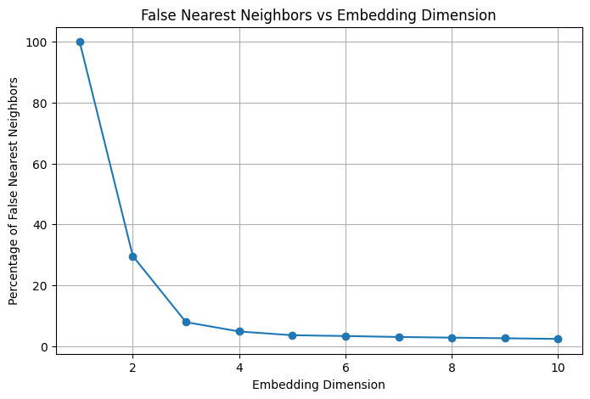

Slide 7
FNN Analysis – Temperature
τ = 1
Dimension (d) | FNN Count (Raw) | FNN Percentage
1 | 17,804 / 19,999 | 100.00%
2 | 5,978 / 19,998 | 33.58%
3 | 1,935 / 19,997 | 10.87%
4 | 1,213 / 19,996 | 6.81%
5 | 856 / 19,995 | 4.81%
6 | 543 / 19,994 | 3.05%
7 | 337 / 19,993 | 1.89%
8 | 270 / 19,992 | 1.52%
9 | 222 / 19,991 | 1.25%
10 | 190 / 19,990 | 1.07%
Interpretation:
FNN drops <8% at m = 3 → optimal embedding.
Temperature dynamics are smooth and predictable.

Slide 8
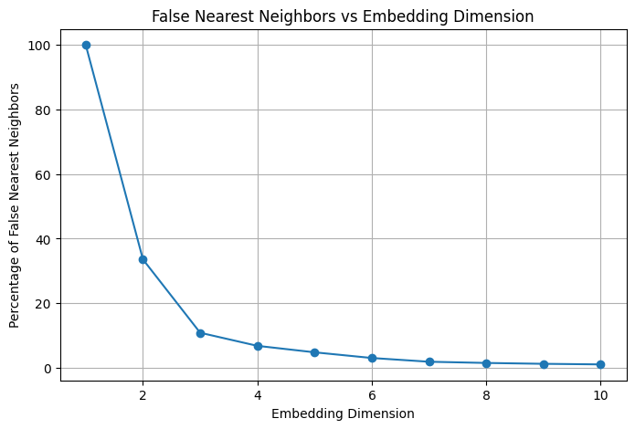

Slide 9
FNN Analysis – Precipitation
τ = 1
Dimension (d) | FNN Count (Raw) | FNN Percentage
1 | 19,969 / 19,999 | 100.00%
2 | 18,625 / 19,998 | 93.27%
3 | 16,233 / 19,997 | 81.29%
4 | 15,028 / 19,996 | 75.26%
5 | 14,499 / 19,995 | 72.61%
6 | 14,161 / 19,994 | 70.91%
7 | 13,917 / 19,993 | 69.69%
8 | 13,733 / 19,992 | 68.77%
9 | 13,578 / 19,991 | 68.00%
10 | 13,443 / 19,990 | 67.32%
High FNN across all dimensions
Indicates poor deterministic structure in hourly data

Slide 10
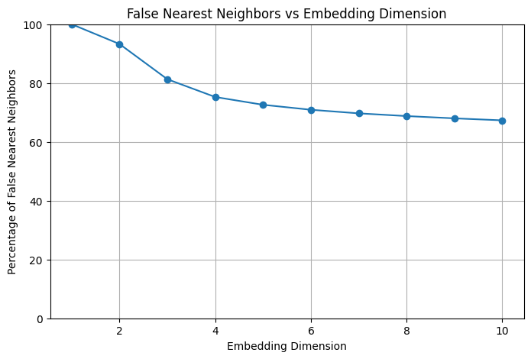

Slide 11
Temperature Forecasting Results
Single-Step Performance:
Model | MAE (°C) | RMSE (°C) | R² Score
Bidirectional LSTM | 0.0159 | 0.0422 | 0.9994
Vanilla LSTM | 0.0172 | 0.0428 | 0.9994
Stacked LSTM | 0.0229 | 0.0456 | 0.9993
Key Insight:
Bidirectional LSTM shows the best performance across all metrics (lowest MAE/RMSE, highest R²)

Slide 12
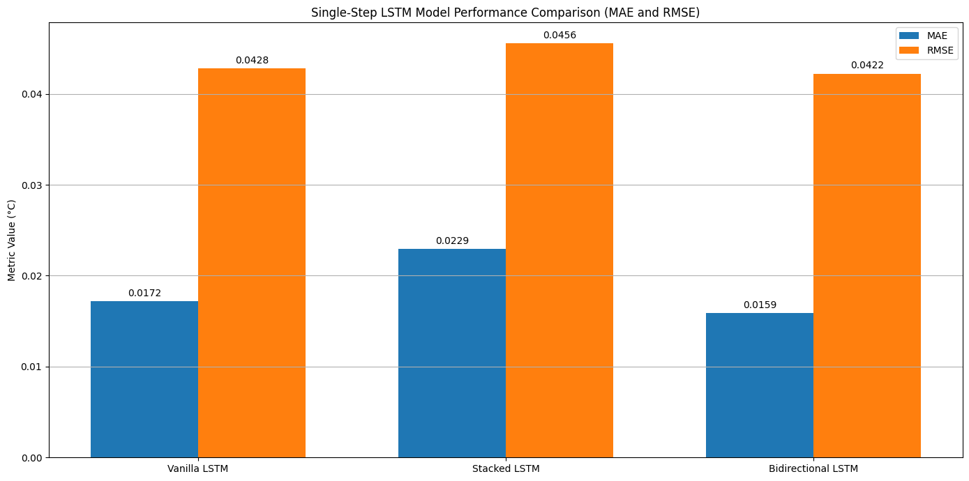

Slide 13
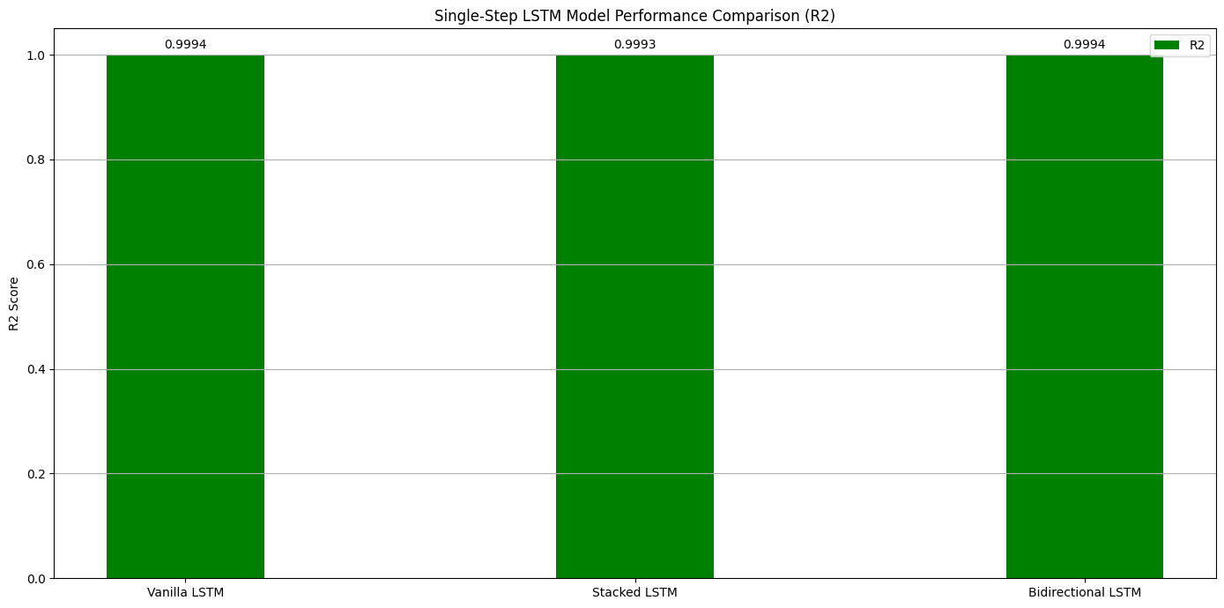

Slide 14
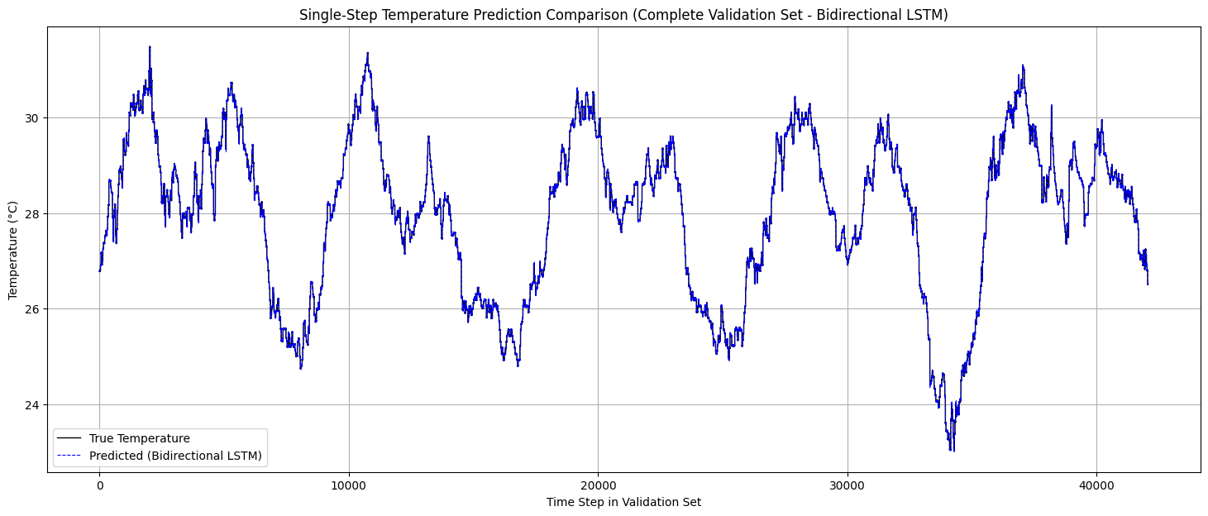
Single-Step Prediction Visualization

Slide 15
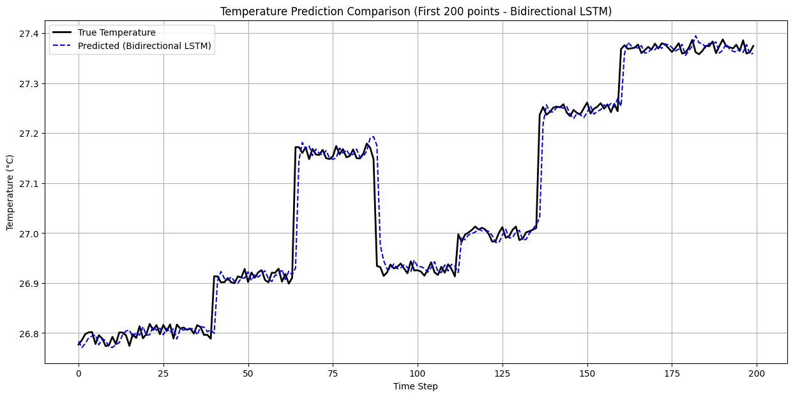
Single-Step Prediction Visualization

Slide 16
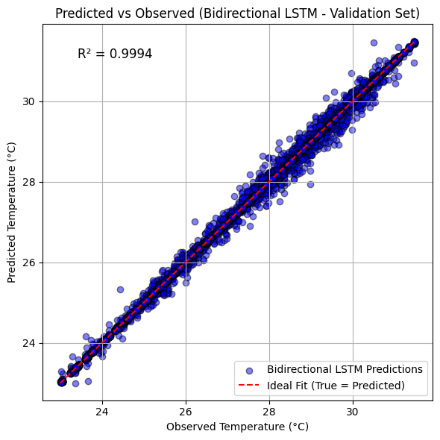
Temperature Forecasting Accuracy
Observation: Predictions align almost perfectly with observed temperatures (clustered along ideal line).

Slide 17
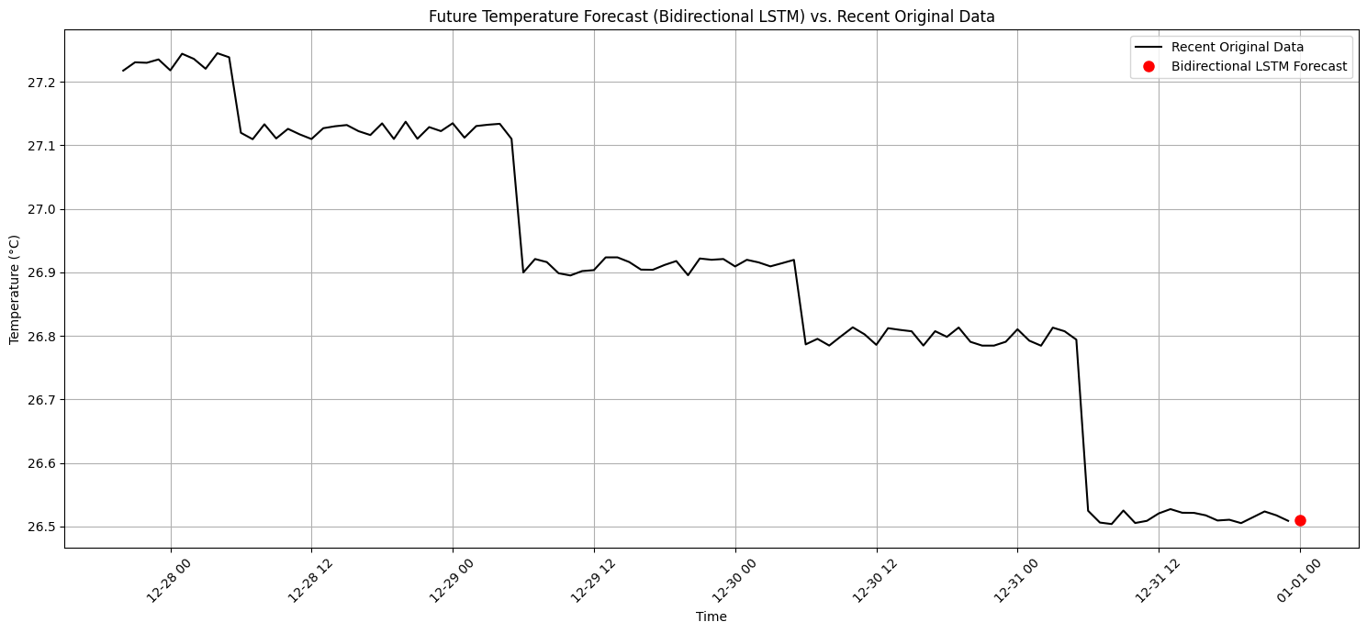
Forecasted Value for 2020-01-01 00:00:00:
Bidirectional LSTM Forecast for 2020-01-01 00:00:00: 26.5098°C

Slide 18
Temperature Forecasting Results
Multi-Step Performance (24-hour):
Model | Overall MAE (°C) | Overall RMSE (°C) | Overall R²
Vanilla LSTM | 0.0869 | 0.1433 | 0.9927
Stacked LSTM | 0.0872 | 0.1435 | 0.9927
Bidirectional LSTM | 0.1044 | 0.1545 | 0.9916
Key Insight: Vanilla LSTM shows best overall performance (lowest MAE/RMSE)

Slide 19
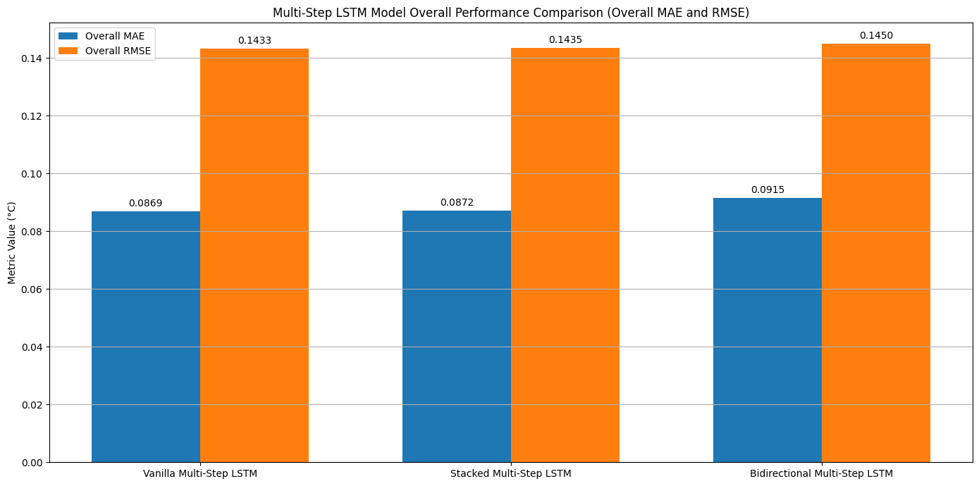

Slide 20
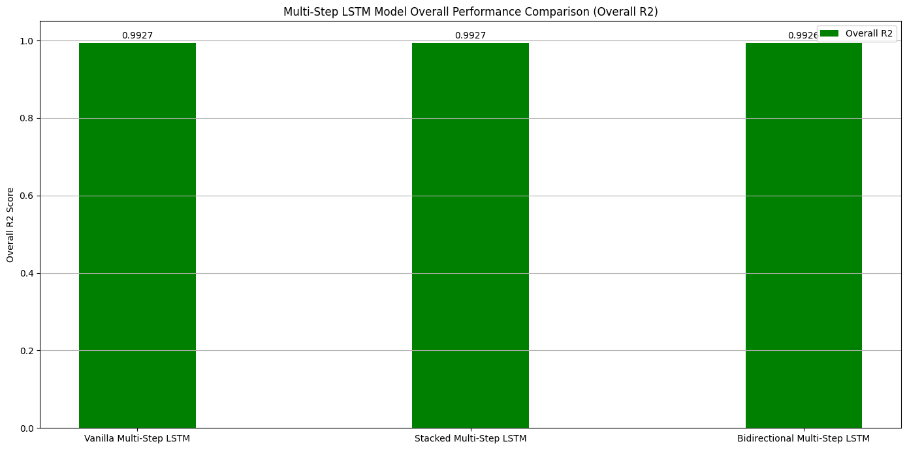

Slide 21
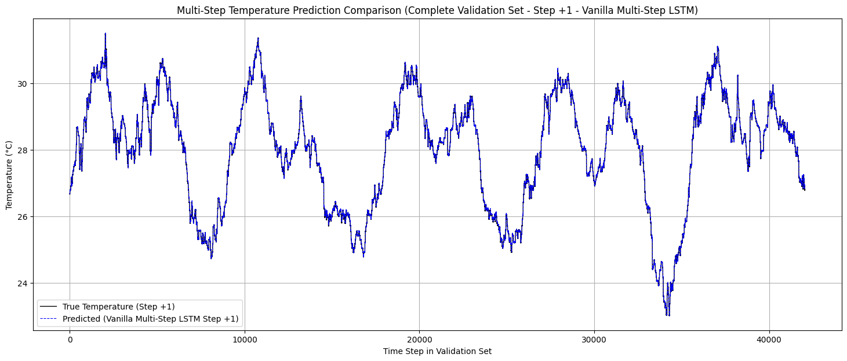
Multi-Step Prediction Visualization

Slide 22
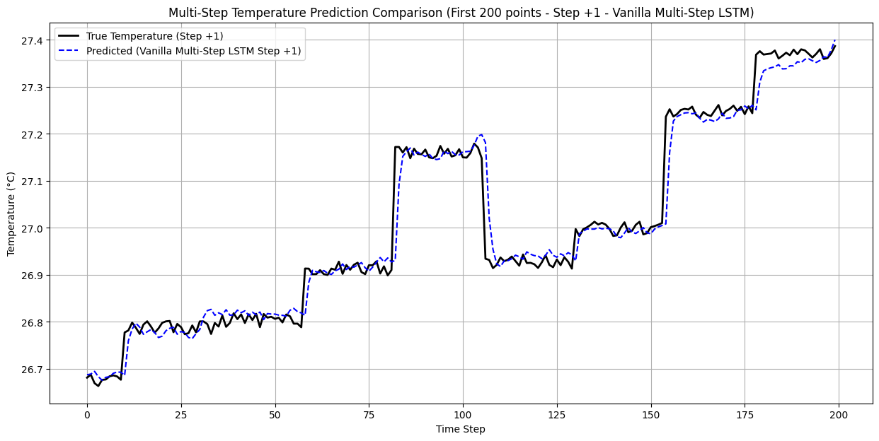
Multi-Step Prediction Visualization

Slide 23
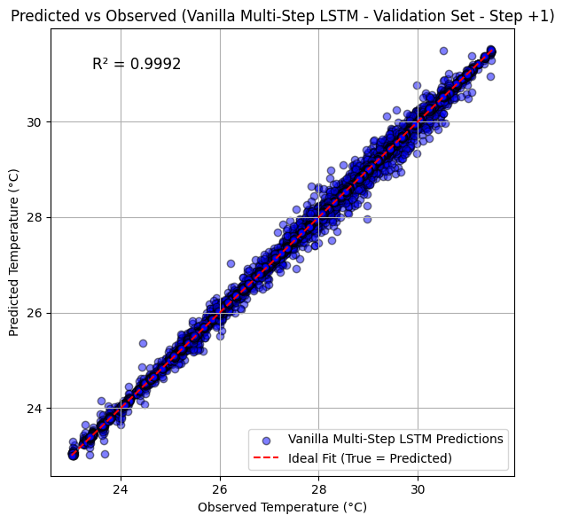
Temperature Forecasting Accuracy
Observation: Error growth remains controlled even at 24-hour horizon (MAE < 0.1°C)

Slide 24
Multi-Step Forecast Predictions
24-Hour Temperature Forecast for 2020-01-01 (00:00 to 23:00):
Hour | Vanilla LSTM
00:00 | 26.5543°C
01:00 | 26.5588°C
02:00 | 26.5462°C
03:00 | 26.5398°C
04:00 | 26.5235°C
05:00 | 26.5366°C
... | ...
22:00 | 26.5639°C
23:00 | 26.5662°C

Slide 25
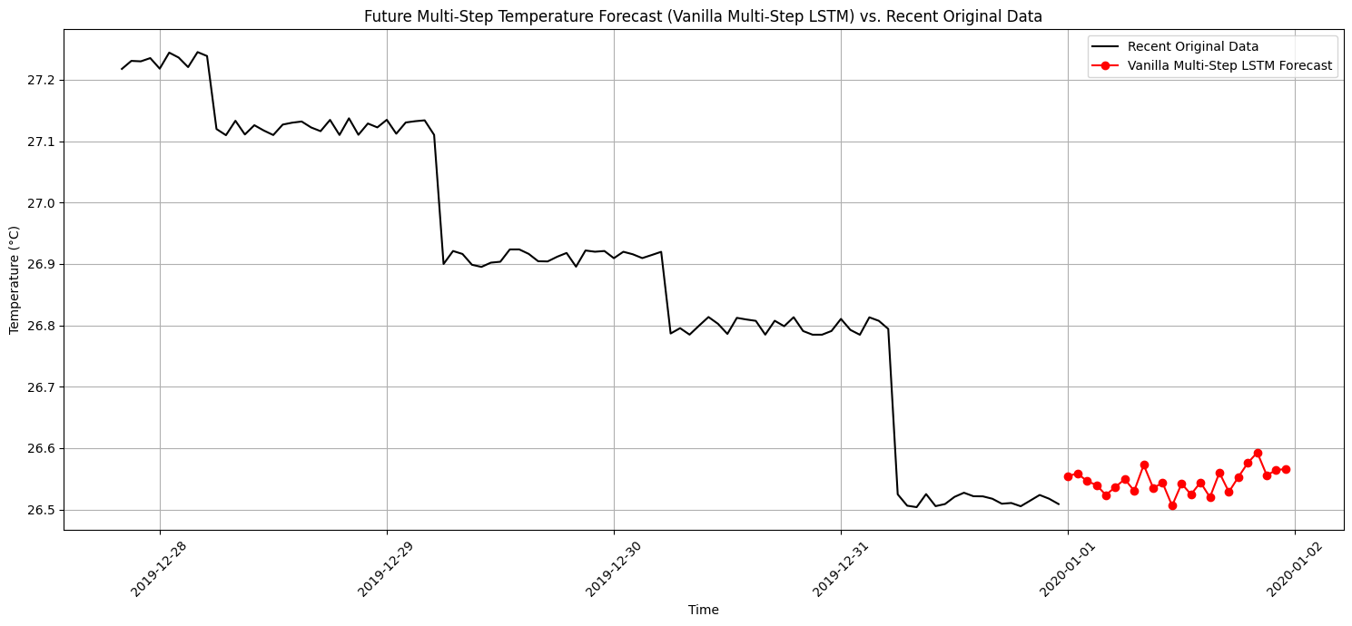

Slide 26
Precipitation Forecasting Results
Single-Step Performance:
Model | MAE | RMSE | R² Score
Stacked LSTM | 0.0949 | 0.5075 | 0.6774
Bidirectional LSTM | 0.0988 | 0.5257 | 0.6539
Vanilla LSTM | 0.2422 | 0.5432 | 0.6304
Key Insight: Stacked LSTM excels for precipitation forecasting, while Bidirectional is competitive.

Slide 27
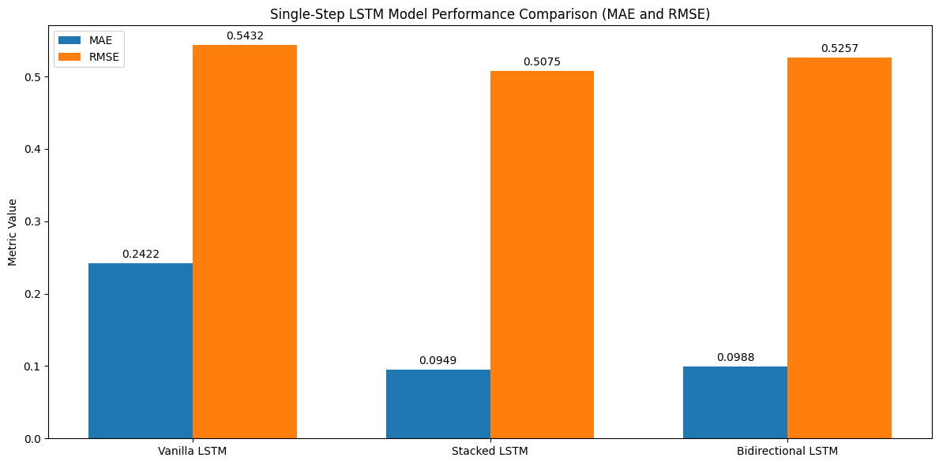

Slide 28
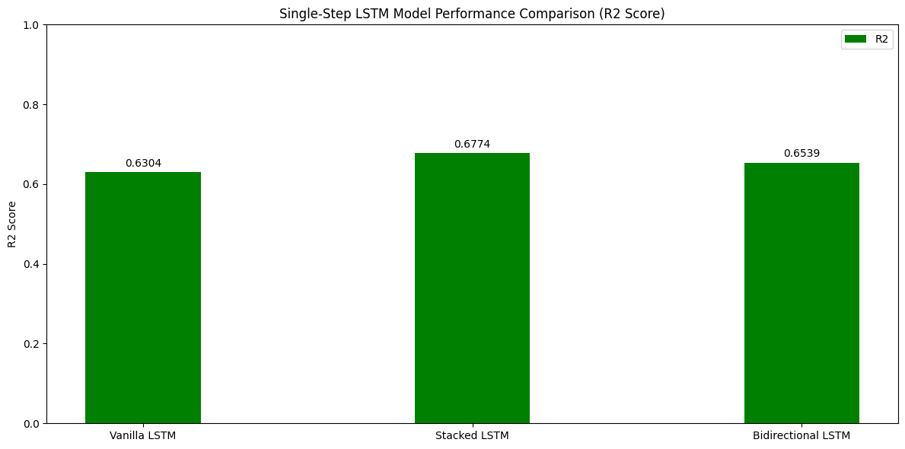

Slide 29
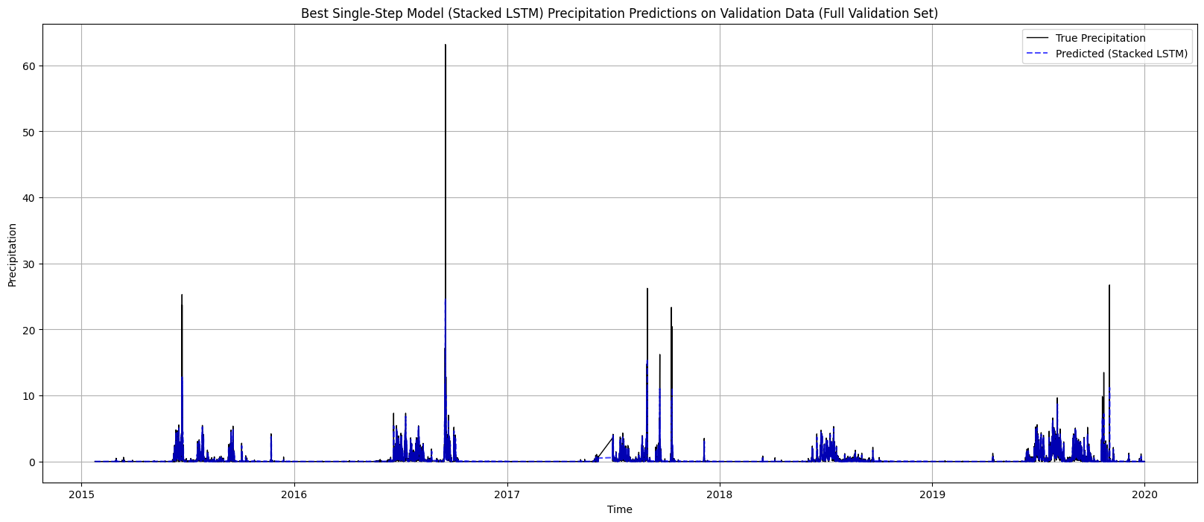
Single-Step Prediction Visualization

Slide 30
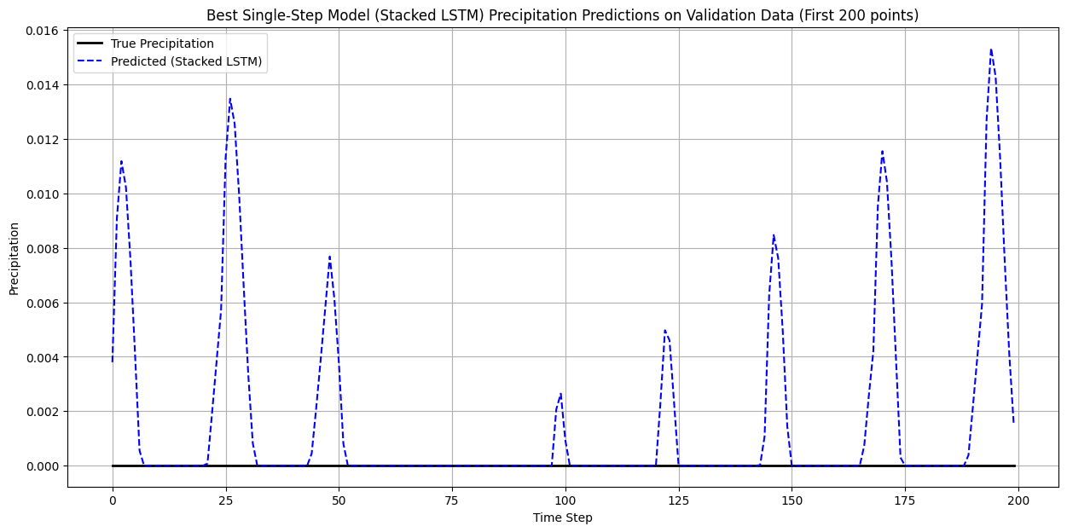
Single-Step Prediction Visualization

Slide 31
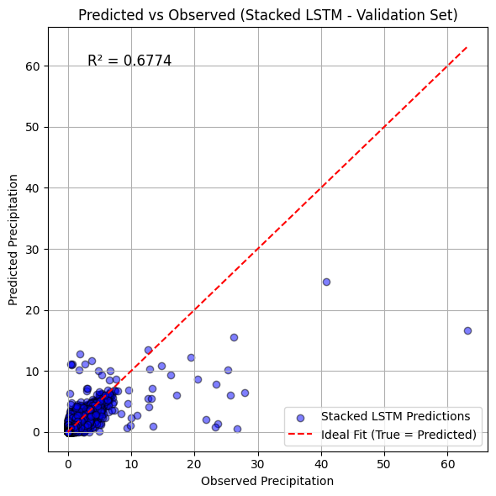
Precipitation Forecasting Accuracy
Observation: Model captures key precipitation events despite data sparsity.

Slide 32
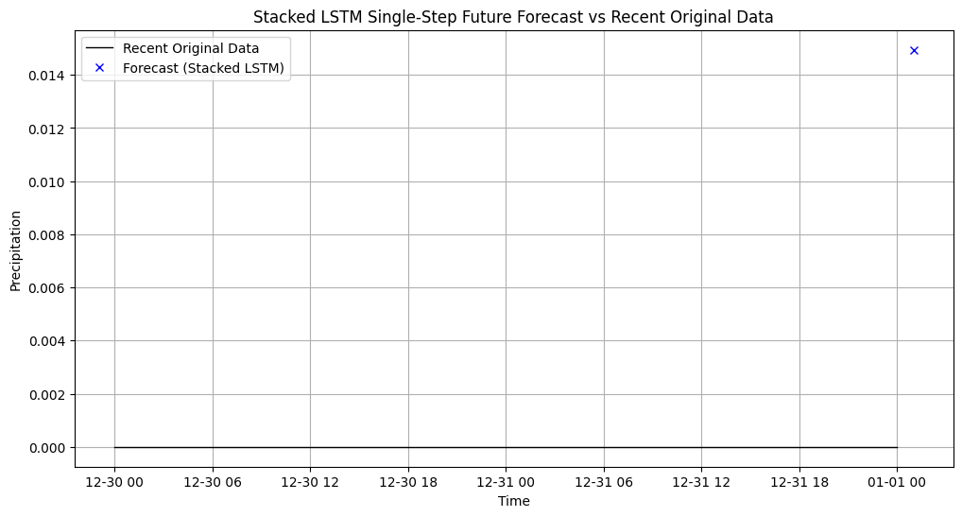
Forecasted Values for 2020-01-01 00:00:00:
Stacked LSTM Model Forecast for 2020-01-01 01:00:00: 0.0149

Slide 33
Precipitation Forecasting Results
Multi-Step Performance (24-hour):
Model | Overall MAE | Overall RMSE | Overall R²
Stacked LSTM | 0.1634 | 0.7085 | 0.3714
Vanilla LSTM | 0.1841 | 0.7097 | 0.3692
Bidirectional LSTM | 0.1788 | 0.7087 | 0.3710
Key Insight: Stacked LSTM excels for precipitation forecasting, while Bidirectional is competitive.

Slide 34
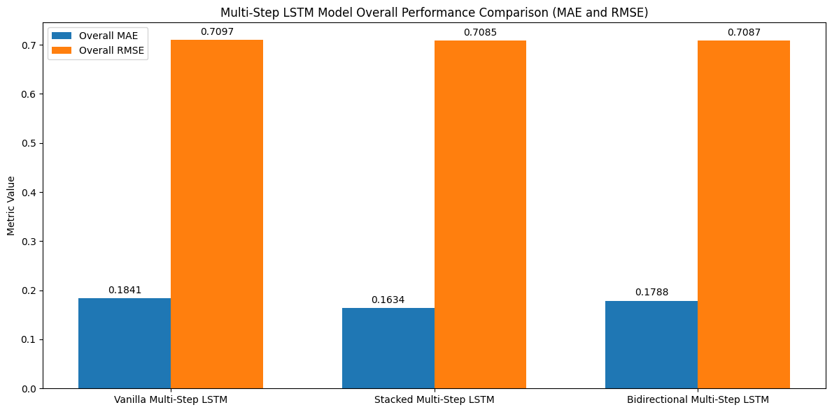

Slide 35
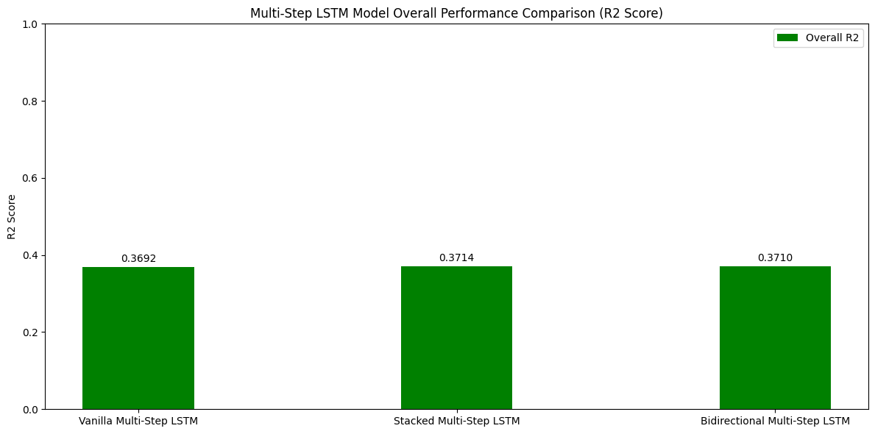

Slide 36
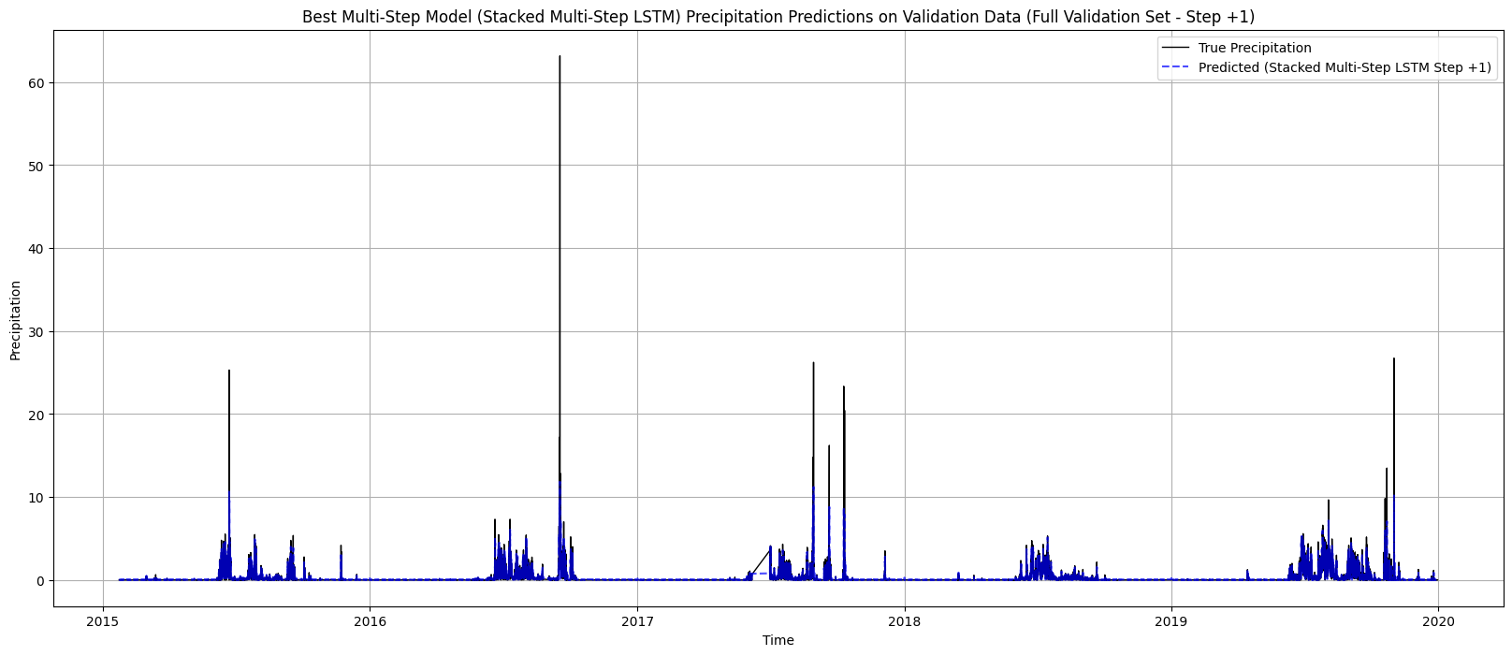
Multi-Step Prediction Visualization

Slide 37
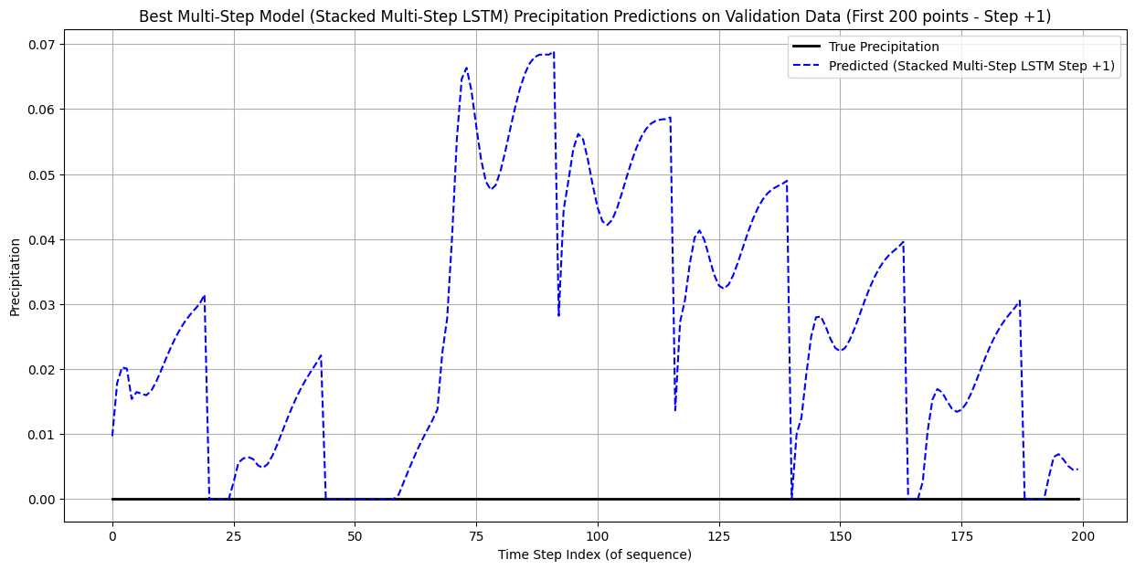
Multi-Step Prediction Visualization

Slide 38

Precipitation Forecasting Accuracy
Observation: Model captures key precipitation events despite data sparsity. Good agreement for moderate precipitation

Slide 39
Multi-Step Forecast Predictions
24-Hour Forecast Values (2020-01-01 to 2020-01-02)
Time | Stacked LSTM Forecast
2020-01-01 01:00:00 | 0.1343
2020-01-01 02:00:00 | 0.0874
2020-01-01 03:00:00 | 0.0212
2020-01-01 04:00:00 | 0.0000
2020-01-01 05:00:00 | 0.0000
2020-01-01 06:00:00 | 0.0000
2020-01-01 07:00:00 | 0.0011
2020-01-01 08:00:00 | 0.0000
2020-01-01 09:00:00 | 0.0091
2020-01-01 21:00:00 | 0.0000
2020-01-01 22:00:00 | 0.0105
2020-01-01 23:00:00 | 0.0022
2020-01-02 00:00:00 | 0.0371

Slide 40
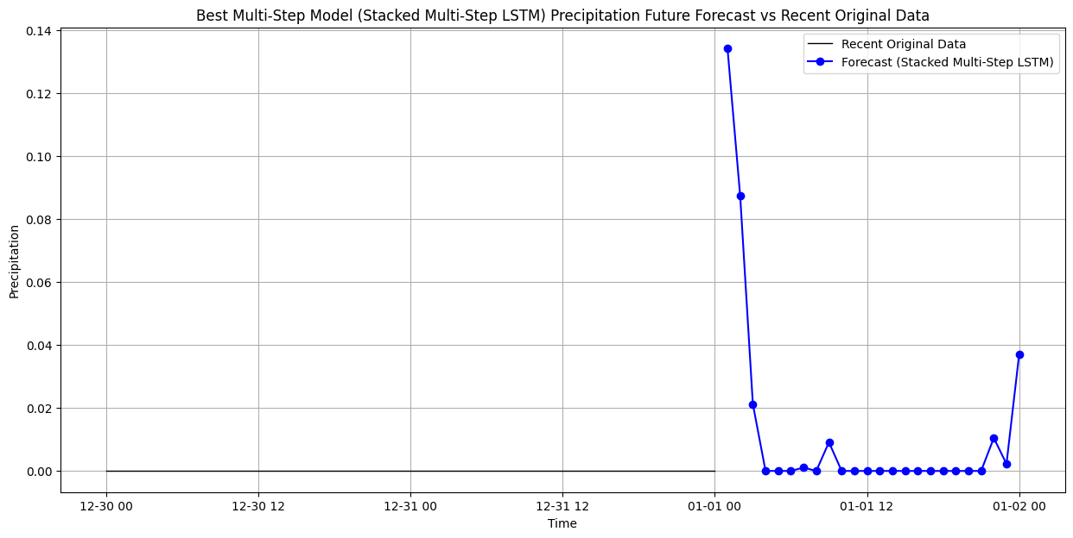

Slide 41
Why the Difference?
Temperature: Bidirectional excels due to smooth temporal patterns.
Precipitation: Stacked handles sporadic events better (e.g., zero rainfall).

Slide 42
Conclusion
Temperature Forecasting:
Bidirectional LSTM performed best for single-step prediction.
Vanilla LSTM outperformed others for multi-step forecasting.
Successfully captured smooth temporal dependencies in temperature data.
Precipitation Forecasting:
Stacked LSTM gave the most stable performance in both single-step and multi-step tasks.
All models showed signs of overfitting due to rainfall's sporadic nature.
Key Takeaway:
Model choice depends on variable type:
Bidirectional for smooth, continuous variables like temperature.
Stacked for irregular, sparse variables like precipitation.

Slide 43
References
https://colah.github.io/posts/2015-08-Understanding-LSTMs
https://www.cse.iitk.ac.in/users/sigml/lec/Slides/LSTM.pdf
Fang, W., Sun, Q., Ye, J., & Wang, X. (2021). Predicting flood susceptibility using LSTM neural networks with geospatial data. International Journal of Environmental Research and Public Health, 18(5), 2617.
Garg, S., Agnihotri, P. G., & Choudhury, A. (2023). Multivariate, multi-step LSTM-based flood runoff forecasting for the Godavari River Basin. Journal of Hydrology, 620, 129506.
Hochreiter, S., & Schmidhuber, J. (1997). Long short-term memory. Neural Computation, 9(8), 1735–1780. Jhong, W., Chang, F. J., & Chen, H. (2024). Enhancing LSTM-based flash flood forecasting using genetic algorithms for hyperparameter optimization. Journal of Hydrologic Engineering, 29(1), 04023072.
Kratzert, F., Klotz, D., Brenner, C., Schulz, K., & Herrnegger, M. (2018). Rainfall–runoff modelling using long short-term memory (LSTM) networks. Hydrology and Earth System Sciences, 22(11), 6005–6022.
Liu, J., Tan, W., Chen, C., Xu, H., & Zhu, Q. (2023). LSTM-based short-term flood forecasting model for the Xiangjiang River, China. Water, 15(1), 20.
Moon, J., Yoon, B., & Moon, H. (2023). Urban flood forecasting using a hybrid modeling approach based on a deep learning technique. Sustainability, 15(10), 8053.

