Slide 1
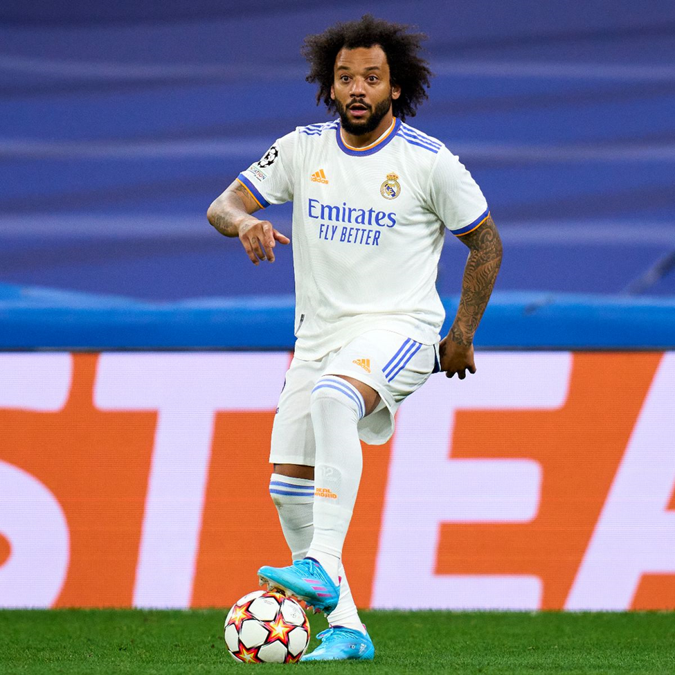
SOCCER PERFORMANCE ANALYSIS USING ML & CV
Author: Mohammad Al-Hakawati
Supervisor: Dr.Rami Ibrahim

Slide 2
TABLE OF CONTENTS
1 - Purpose Statement
2- Research Questions & Objectives
3- Data Sources & Data Collection Methods
4- Data Analysis Tools Used
5- Findings and Results
6- Recommendations
7- Action Plan

Slide 3
PURPOSE STATEMENT
Utilize ML & CV to analyze soccer players' movements, positions, gestures, statistics, physiological data, and biomechanics in depth. In order to identify players' strengths, weaknesses, and areas for advancement, provide coaches with insights for strategic adjustments, estimate their future match performance, predict the possibility of a player obtaining a penalty card or an injury.

Slide 4
RESEARCH QUESTIONS
Can we provide accurate insights of players based on their performance?
Can we forecast a soccer player's future match performance based on historical data?
Can we predict if a player would face any injuries or penalty cards?

Slide 5
RESEARCH OBJECTIVES
Employ ML & CV techniques to analyze soccer player movements, positions, gestures, and biomechanics during matches.
Provide actionable insights to coaches by integrating ML findings into team strategy recommendations.
Develop predictive models leveraging player specifications to forecast individual performance and susceptibility to injuries.
Design a predictive model capable of assessing the likelihood of a soccer player receiving penalty cards during matches, utilizing historical data and contextual game situations.

Slide 6
DATA SOURCES & DATA COLLECTION METHODS
Primary data collection method:
Interviews with soccer coaches
Secondary data collection method:
literature review of 7 recent related research papers

Slide 7
DATA ANALYSIS TOOLS USED
This research applies thematic analysis. Thematic analysis provides an organized and methodical way for analyzing data, making it easier to find and understand themes or patterns in the data. Thematic analysis provides a solid framework for identifying important themes connected to player assessment methods, metrics, and information resources, as well as the relationship between previous data and future performance.

Slide 8
FINDINGS AND RESULTS
Effective player participation during games is a top priority by coaches, who highlight the value of getting to know their players on a deeper level than just their statistics.
The fact that coaches employ many metrics and data sources shows how important it is to monitor all aspects of on-field performance.
Coaches depend on past statistics to develop their proactive management of penalty cards and injuries
Coaches and players might benefit from advanced technology like CV & ML, which can recognize relationships and analyze real-time data effectively.

Slide 9
RECOMMENDATIONS
Integrate advanced Analytics Tools
Proactive Injury Prevention tactics
Employ Predictive Models in Penalty Management
Gather more historical data of players

Slide 10
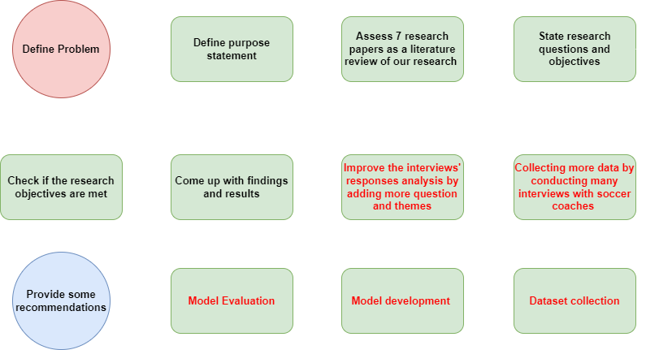
ACTION PLAN

