Slide 1
Unit 1 What is Machine Learning?
EE-UY4563/ EL-GY6143: Introduction to machine learning
Prof. Sundeep rangan

Slide 2
Learning Objectives
Identify data-driven learning vs. expert or domain knowledge-based approaches
Provide examples of machine learning used today
Given a new problem, qualitatively describe how machine learning can be used
Formulate a potential machine learning task
Identify the data needed for the task
Identify objectives
Classify a machine learning task:
Supervised vs. unsupervised, regression vs. classification
For supervised learning, identify the predictors and target variables

Slide 3
Outline
What is Machine Learning?
Types of machine learning algorithms
Classification
Regression
Unsupervised learning
Why the hype today?
Some slides from:
A. Zisserman, “Machine Learning Introduction”
Alpaydin, “Introduction to Machine Learning”

Slide 4
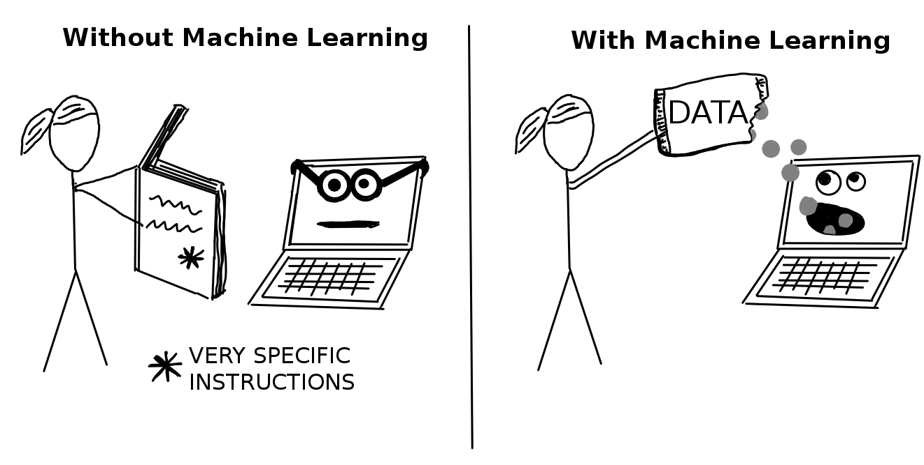
What is Machine Learning?
Learn to improve algorithms from data.
Why?
Human expertise does not exist (ex: complex medical processes we don’t fully understand)
Humans are unable to explain their expertise (speech recognition)
Solution change or adapt in time (routing on a computer network)
Image from Christoph Molnar, https://christophm.github.io/interpretable-ml-book
Traditional approach
Domain or expert knowledge
Machine Learning Data-driven

Slide 5
Example 1: Digit Recognition
Problem: Recognize a digit from the image
MNIST dataset challenge
Dataset developed in 1990s to spur AI research on a challenging problem for the time
Data taken from census forms
Became a classic benchmark for machine vision problems
We will see this dataset extensively in this class

Slide 6
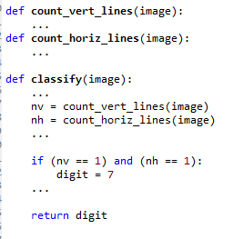
Classical “Expert” Approach
Idea: Use your knowledge about digits
You are an “expert” since you can do the task
Construct simple rules and code them
Expert rule example: “Image is a digit 7 if…”:
There is a single horizontal line, and
There is a single vertical line
Rule seems simple and reasonable
But,…

Slide 7

Problems with Expert Rules
Simple expert rule breaks down in practice
Hard to define a “line” precisely
Orientation, length, thickness, …
May be multiple lines…
General problem: We cannot easily code our knowledge
We can do the task
But it is hard to translate to simple mathematical formula

Slide 8
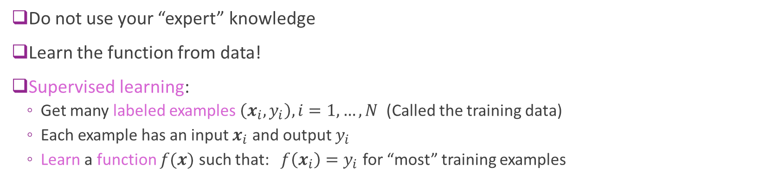
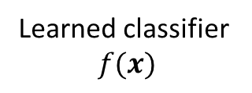
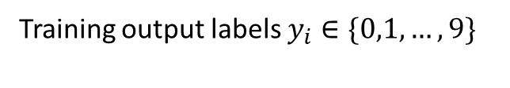

ML Approach: Learn from Data
Training inputs images $x_{i}$ (ex. 5000 ex per class)
?
Training output labels $y_{i}∈\{0,1,…,9\}$
Learned classifier $$f(x)$$
Do not use your “expert” knowledge
Learn the function from data!
Supervised learning:
Get many labeled examples $\left(x_{i},y_{i}\right), i=1,…,N$ (Called the training data)
Each example has an input $x_{i}$ and output $y_{i}$
Learn a function $f(x)$ such that: $f\left(x_{i}\right)=y_{i}$ for “most” training examples

Slide 9
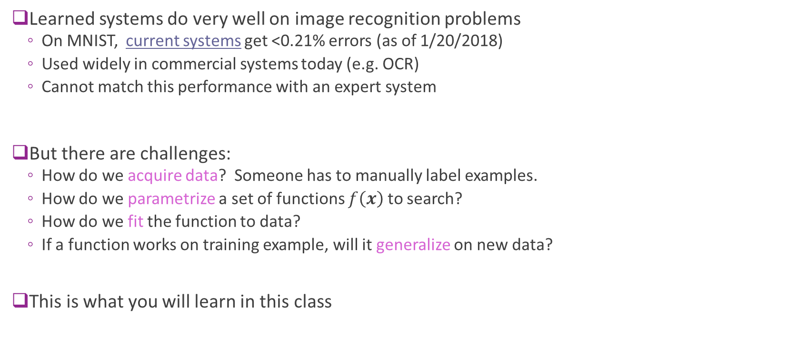
ML Approach Benefits and Challenges
Learned systems do very well on image recognition problems
On MNIST, current systems get <0.21% errors (as of 1/20/2018)
Used widely in commercial systems today (e.g. OCR)
Cannot match this performance with an expert system
But there are challenges:
How do we acquire data? Someone has to manually label examples.
How do we parametrize a set of functions $f\left(x\right)$ to search?
How do we fit the function to data?
If a function works on training example, will it generalize on new data?
This is what you will learn in this class

Slide 10
Example 2: Face Detection
Problem: For each image region, determine if face or non-face
More challenging than digit recognition
Even harder to describe a face via “rules” in a robust way

Slide 11
Supervised Learning Approach
Data: Get large number of face and non-face examples
Typical early dataset
5000 faces (all near frontal, vary age, race, gender, lighting)
10^8 non faces
Faces are normalized (scale, translation)
Learn a classifier from a class of functions
Each function maps image to binary value “face” or “non-face”
Select function that works well on training data
For good performance, functions may be complex
Many parameters
Many more datasets are available now:
See http://www.face-rec.org/databases/
You can use this for your project!
Rowley, Baluja and Kanade, 1998

Slide 12
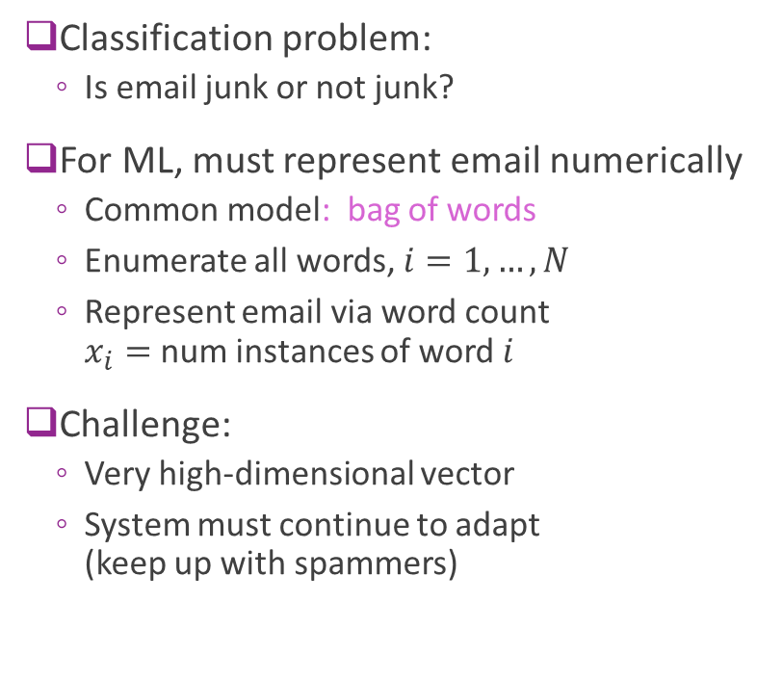
Example 3: Spam Detection
Classification problem:
Is email junk or not junk?
For ML, must represent email numerically
Common model: bag of words
Enumerate all words, $i=1,…,N$
Represent email via word count $x_{i}=$ num instances of word $i$
Challenge:
Very high-dimensional vector
System must continue to adapt (keep up with spammers)

Slide 13
Example 4: Stock Price Prediction
Can you predict the price of a stock?
What variables would you use?
What is a non-machine learning approach?

Slide 14
Machine Learning in Many Fields
Retail: Market basket analysis, Customer relationship management (CRM)
Finance: Credit scoring, fraud detection
Manufacturing: Control, robotics, troubleshooting
Medicine: Medical diagnosis
Telecommunications: Spam filters, intrusion detection
Bioinformatics: Motifs, alignment
Web mining: Search engines
...

Slide 15
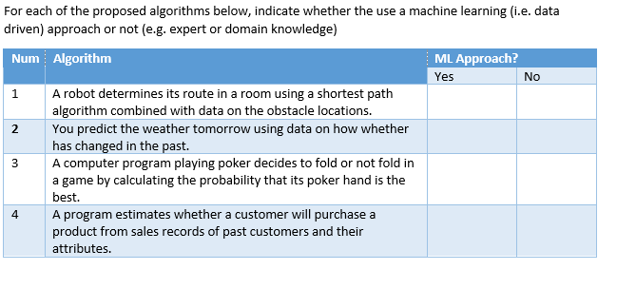
In-Class Exercise 1

Slide 16
Outline
What is Machine Learning?
Types of machine learning algorithms
Classification
Regression
Unsupervised learning
Reinforcement learning
Why the hype today?
Some slides from:
A. Zisserman, “Machine Learning Introduction”
Alpaydin, “Introduction to Machine Learning”

Slide 17
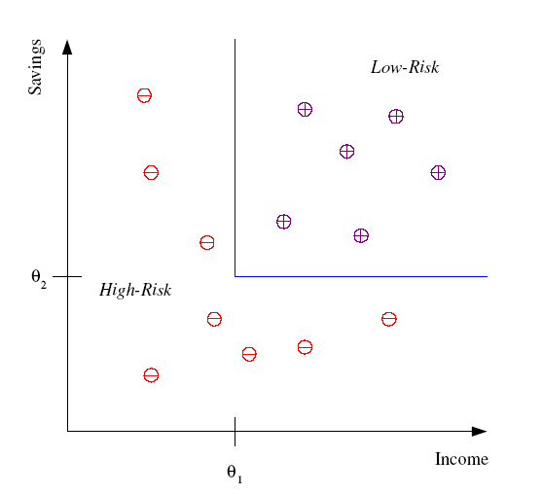
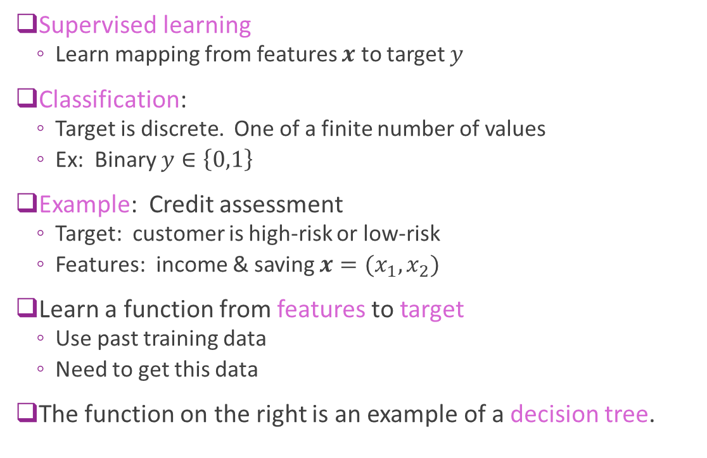


Classification
Supervised learning
Learn mapping from features $x$ to target $y$
Classification:
Target is discrete. One of a finite number of values
Ex: Binary $y∈\left\{0,1\right\}$
Example: Credit assessment
Target: customer is high-risk or low-risk
Features: income & saving $x=(x_{1},x_{2})$
Learn a function from features to target
Use past training data
Need to get this data
The function on the right is an example of a decision tree.
Savings
Low risk
$$x_{2}$$
High risk
$$x_{1}$$
Income

Slide 18
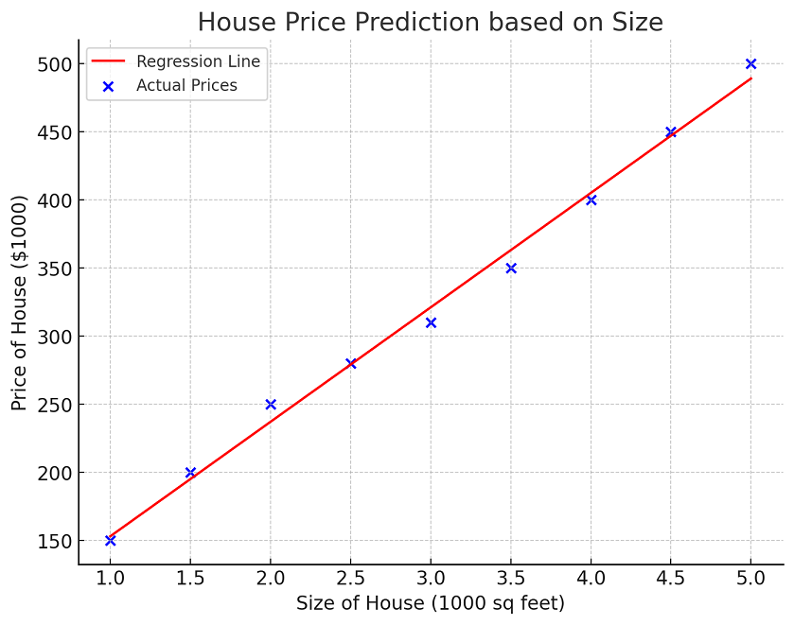
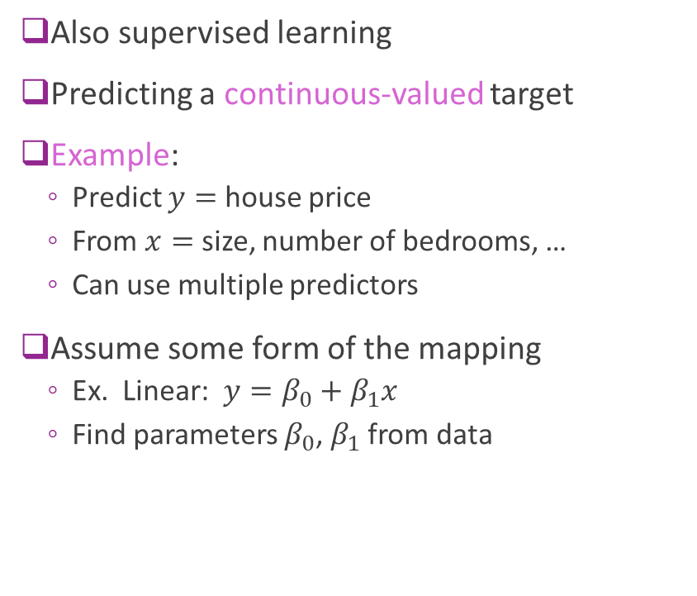
Regression
Also supervised learning
Predicting a continuous-valued target
Example:
Predict $y=$ house price
From $x=$ size, number of bedrooms, …
Can use multiple predictors
Assume some form of the mapping
Ex. Linear: $y=β_{0}+β_{1}x$
Find parameters $β_{0}$, $β_{1}$ from data
Price
Size
https://www.scribbr.com/statistics/simple-linear-regression/

Slide 19
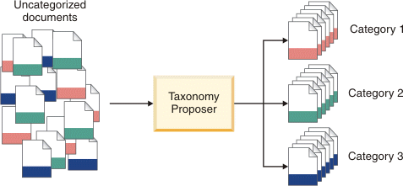

Unsupervised Learning
Learning “what normally happens”
No output
Just values $x$. No target $y$
Clustering: Grouping similar instances
Example applications
Customer segmentation
Image compression: Color quantization
Bioinformatics: Learning motifs
Example: Document classification
http://www.ibm.com/support/knowledgecenter /SSBRAM_8.7.0/com.ibm.classify.ccenter.doc/ c_WBG_Taxonomy_Proposer.htm

Slide 20

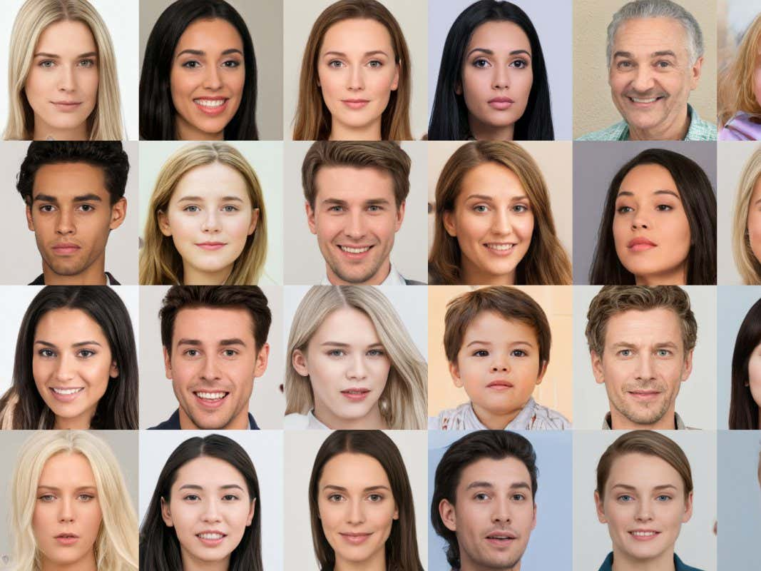
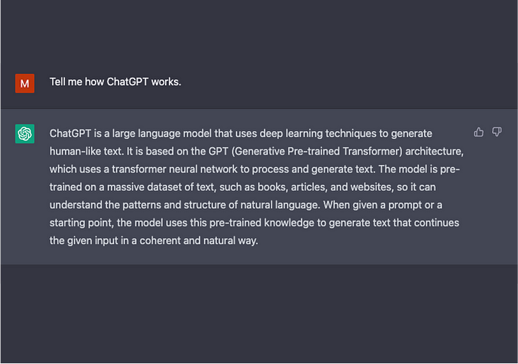

Generative AI
Type of unsupervised learning
Given data $\{x_{1},…,x_{N}\}$ generate a similar sample $x$
Many examples today
Synthetic faces generated by a GAN

Slide 21
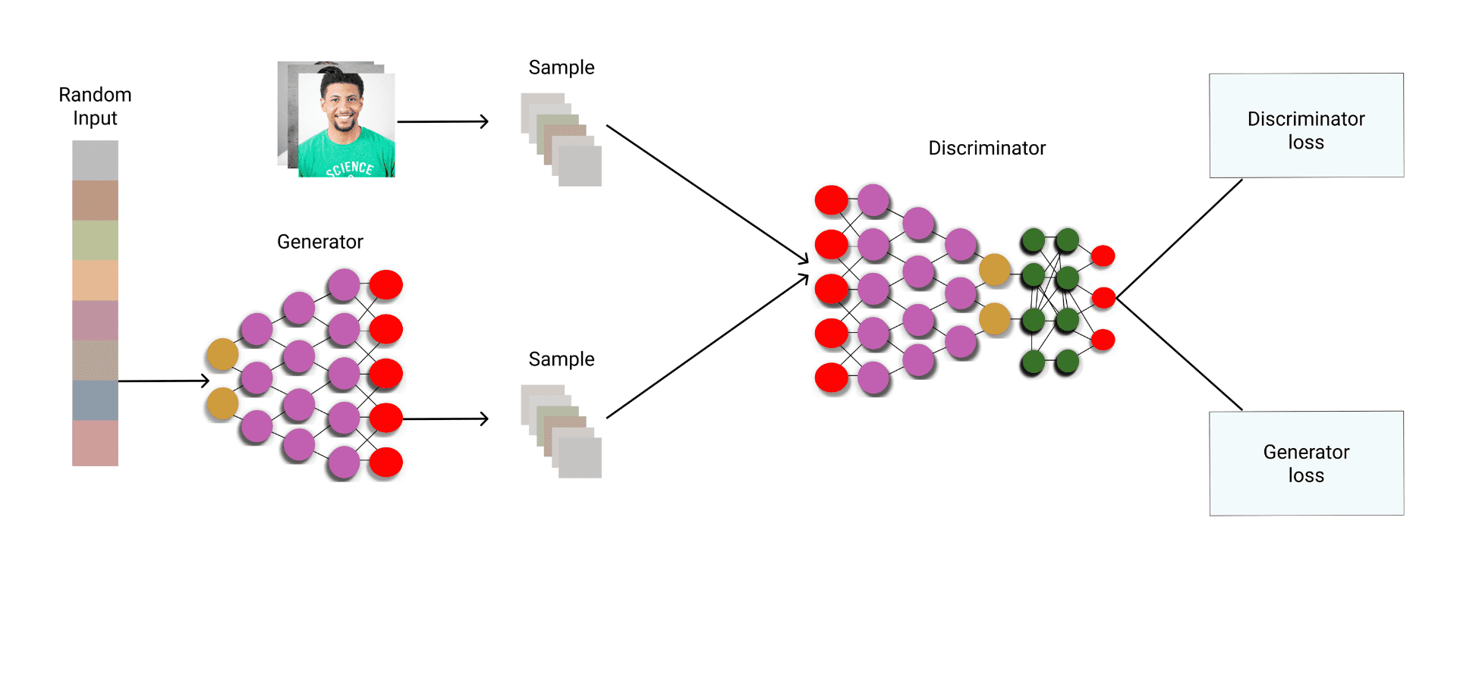
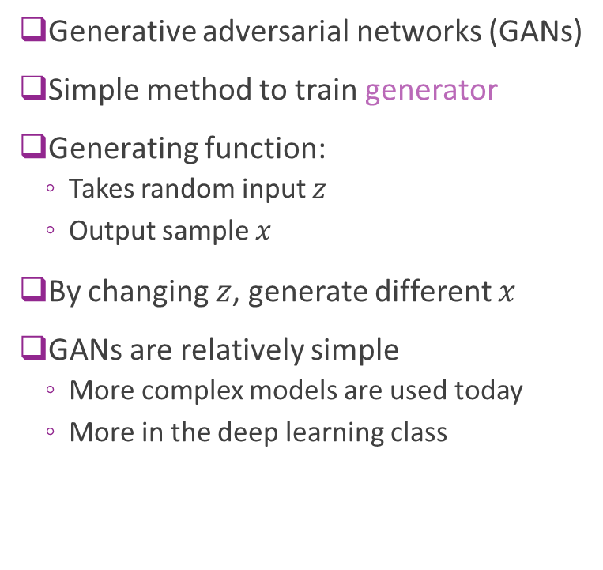



Simple GAN
Generative adversarial networks (GANs)
Simple method to train generator
Generating function:
Takes random input $z$
Output sample $x$
By changing $z$, generate different $x$
GANs are relatively simple
More complex models are used today
More in the deep learning class
$$z$$
$$x$$
Random
Generated sample
$$x=g(z)$$
Generator

Slide 22
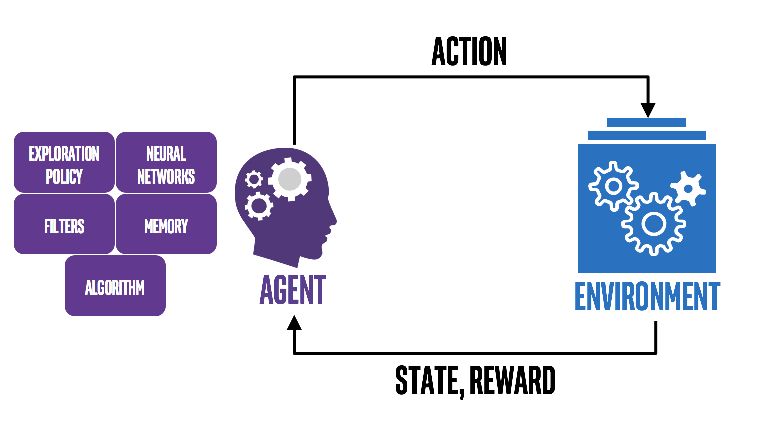
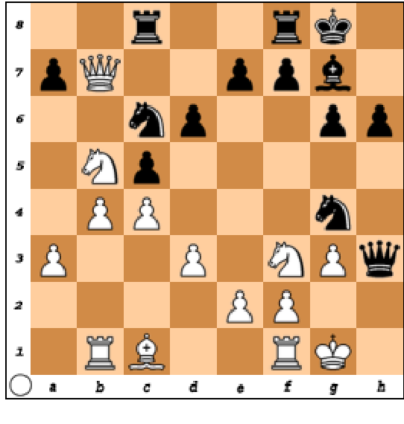
Reinforcement Learning
Move: …Bd4
State: Current position
Reward: Win or Lose
Agent learns to make actions that interact with an environment to maximize a reward
Agent typically acts in a closed loop system
Key tradeoffs:
Exploitation (Learn from past actions) vs. exploration (try new choices)
Credit assignment: Which actions in the past led to the current reward?

Slide 23
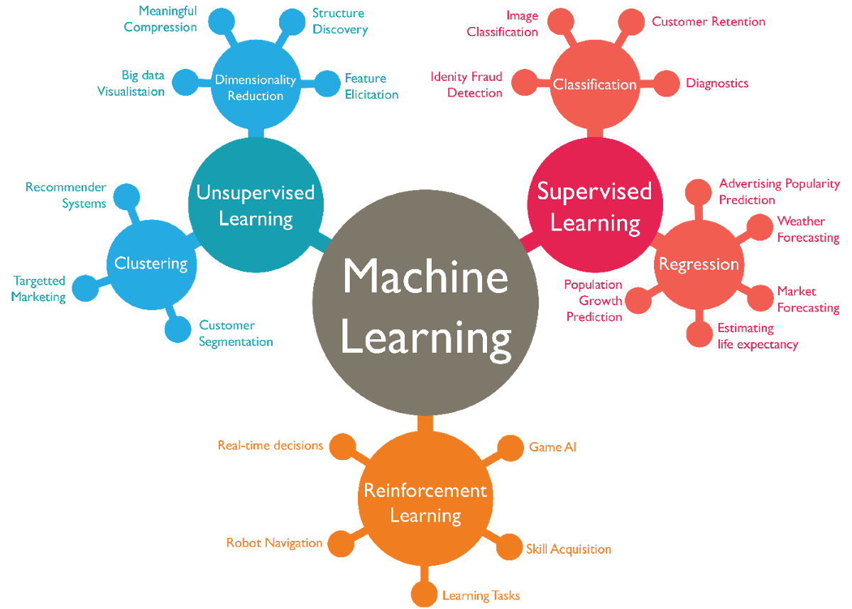
Types of Machine Learning
https://www.7wdata.be/visualization/types-of-machine-learning-algorithms-2/

Slide 24
In-Class Exercise 2
For each of the problems below:
Determine type of ML problem (regression, classification, unsupervised, RL)
What data would be needed?
What attributes could you use?
Problem 1: Estimate sales from attributes of an advertising campaign
Problem 2: Predict if a tissue is cancerous or not from an image
Problem 3: Train a computer to steer a car from camera data.
3A: For training, assume you have recorded human steering along with video of what the human saw
3B: For training, assume you no labeled data. The training must learn long-term consequence
Problem 4: Write a song in the style of a given artist

Slide 25
Outline
What is Machine Learning?
Types of machine learning algorithms
Classification
Regression
Unsupervised learning
Why the hype today?
Some slides from:
A. Zisserman, “Machine Learning Introduction”
Alpaydin, “Introduction to Machine Learning”

Slide 26
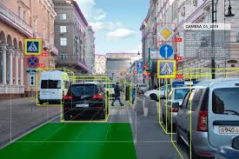
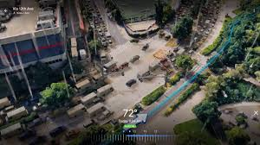
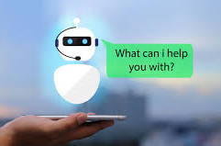
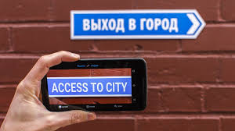
What ML is Doing Today?
Navigation and map building
Complex scene understanding
Chat bots, natural language processing
Machine translation
Virtually every product can benefit from AI

Slide 27
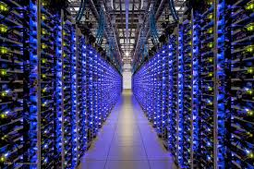
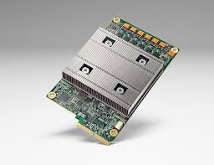
Why Now?
Machine learning is an old field
Much of the pioneering statistical work dates to the 1950s
So what is new now?
Big Data:
Massive storage. Large data centers
Massive connectivity
Sources of data from Internet and elsewhere
Computational advances
Distributed machines, clusters
GPUs and hardware
Google Tensor Processing Unit (TPU)

Slide 28
Exercise
Break into small groups
Take a field that interests you:
Ex. Driving a car, social networks, recommend a movie to watch, …
Identify a specific task that can be done with machine learning
What is the objective of the task?
What is the data you need?
What type of ML problem is this? Classification, regression, …
How would your approach compare to an expert-driven method?

