Slide 1
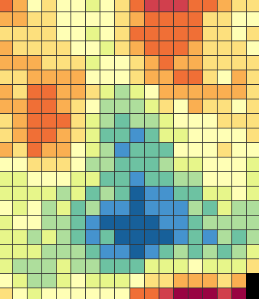
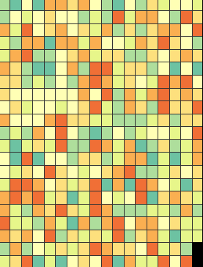
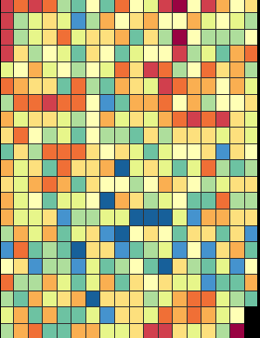
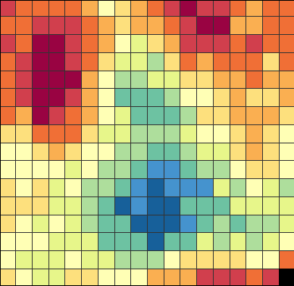
SPATIAL SCOPE
ADDITIVITY AND LINEARITY
COVARIANCE
Additive
(linear)
Outcomes
Local mapping
+
Non-additive
(non-linear)
Brain-wide
modeling
✕
Modeling covariance:
across brain regions
INTERMEDIATE LAYERS
INDIVIDUAL OR POPULATION
across outcomes
Two-layer model
Idiographic model
Multi-layer model
Population model

Slide 2

Neuroimaging-based biomarker validation system
Multi-study validation process of neuroimaging-based biomarkers
Figure 5
a
b
Optimize:
Identify neuroimaging marker
Biomarker can substitute
the target measure
Prospective
validation
Biomarker discovery
OPTIMIZE
Identify neuroimaging marker
Probable biomarker
Known biomarker
PROSPECTIVE
VALIDATION
Generalize:
across individuals, labs, scanners, populations
Application
GENERALIZE
across individuals, labs, scanners, populations
Characterize:
properties across test conditions, boundary conditions
EVIDENCE
APPLICATION
CHARACTERIZE
properties across test conditions, boundary conditions
DEMONSTRATION
CHARACTERIZATION
EXPLORATION
SURROGACY
UTILITY
Figure 5. To be a useful neuroimaging marker, it needs to demonstrate increasing levels of supporting evidence and generalizability through multiple stages. Therefore, establishing neuroimaging markers requires a long development and validation process supported by multi-study and multi-site efforts (Reproduced from [35]).

Slide 3
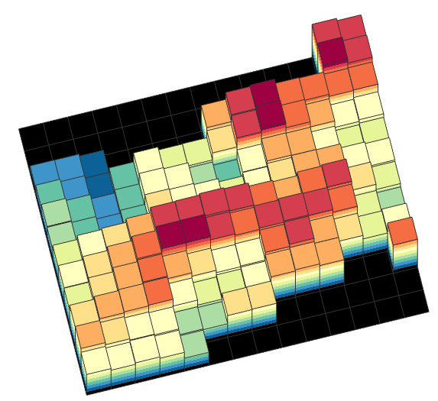
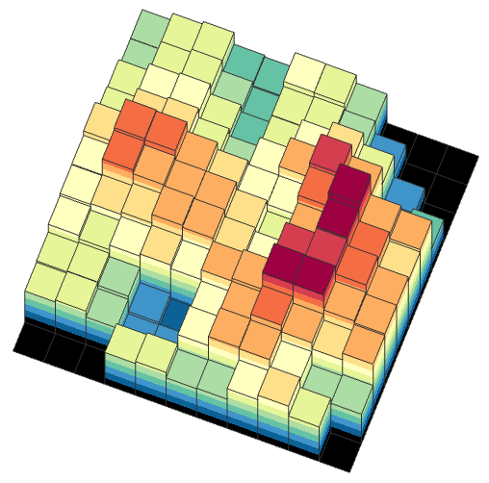
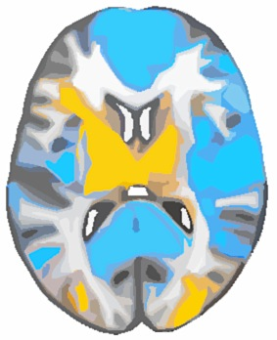

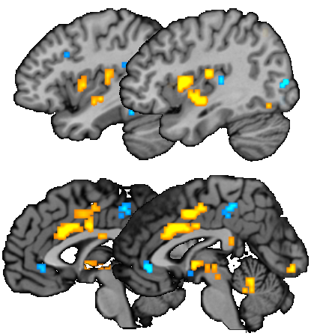
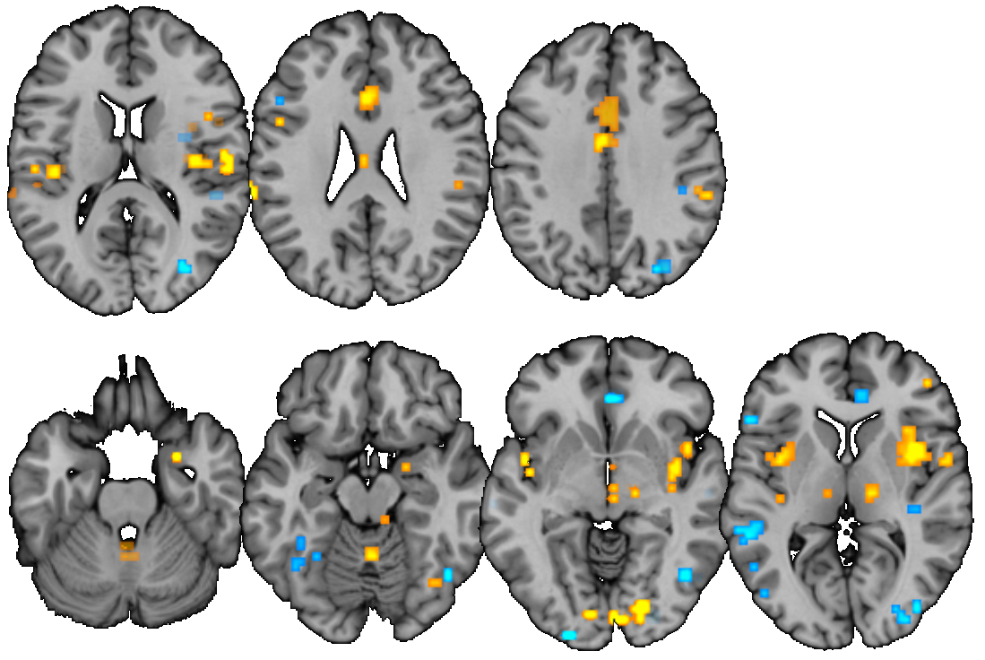
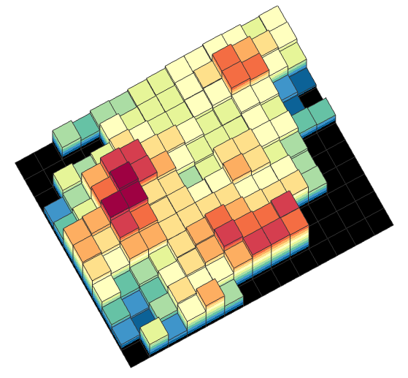
Figure 7
A
dACC
dpINS/S2
B
Activation map
from new individual
+
predictive
weights
−
Signature
response
INS
x = 0
4
z = 16
26
37
Y
Predict
Pain
x = -38
41
-25
-15
-4
6
Figure 7. The Neurologic Pain Signature (NPS). The NPS is defined by brain-wide, meso-scale patterns of fMRI activity across multiple pain-related regions, and can be prospectively tested on new individuals and datasets. The brain map shown here is the thresholded pattern map (q < 0.05, false discovery rate [FDR]) for display only. All voxels within NPS should be used to predict pain in new individuals. Some examples of unthresholded patterns are presented in the insets; each 3-d bar represents one voxel. dACC, dorsal anterior cingulate cortex; INS, insula; dpINS, dorsal posterior insula; S2, secondary somatosensory cortex. Reproduced with permission from [20].

Slide 4
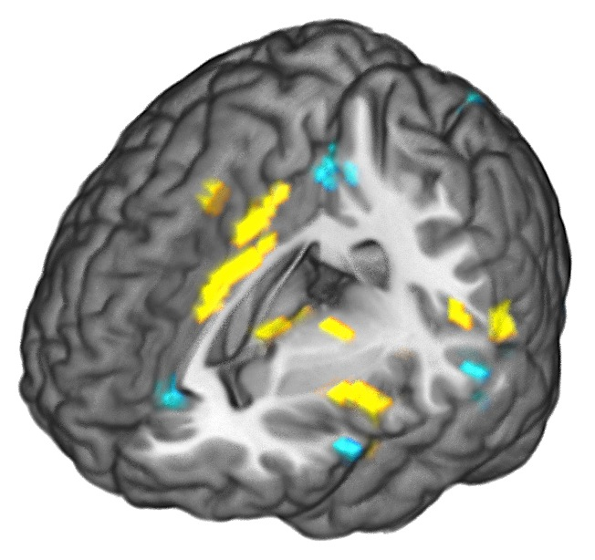


Figure 8
Prospective testing
Neurologic pain signature
(NPS; Wager et al., 2013)
Krishnan, in revision
Lopez-sola, under review
Validation questions:
Does the NPS respond to vicarious pain, negative emotions? (Krishnan et al., in revision; Chang et al., 2015)
Does the NPS respond to different types of acute, experimental pain (Krishnan et al., in revision)?
Basic research questions:
Does cognitive reappraisal regulate pain through the nociceptive pain system? (Woo et al., 2015)
Clinical research questions:
Does the NPS respond to allodynia, hyperalgesia, spontaneous pain in clinical pain conditions? (Lopez-sola, under review)
Figure 8. Deployability of the NPS. The NPS has been applied and tested on datasets from different laboratories around the world to answer different types of research questions.

Slide 5
Table. Desirable characteristics of neuroimaging biomarkers

